Slide 1

If the score is between 100 and 200, the player gets 50 bonus points.
If the total ordering is above $100.00, shipping costs is $5.00.
…

Slide 2

Let me test it! I do “off-by-one” mistakes all the time!

Slide 3
Let me test it! I do “off-by-one” mistakes all the time!
Boundary analysis

Slide 4
X >= 100
OUT-points
IN-points
OFF-
point
ON-
point
…
99
100
101

Slide 5
X > 100
OUT-points
IN-points
ON-
point
OFF-
point
…
99
100
101

Slide 6
score >= 100
On point: Exactly on boundary
In point: Makes the condition true
Out point: Makes the condition false
Off point:
Flips the outcome for on point and
Is as close to boundary as possible
On is 100; In is e.g. 200; Out is e.g. 50; Off is 99.

Slide 7
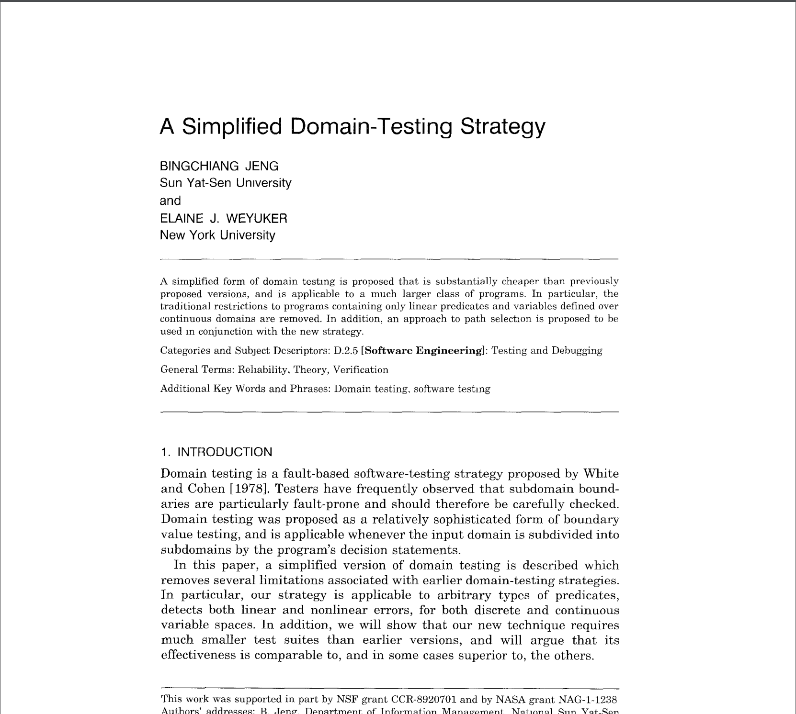
Multiple boundaries?

Slide 8
Simplified domain-testing strategy
Handle boundaries independently
For each boundary, pick on and off point
While testing one boundary, use varying in points for the remaining boundaries.
Use domain matrix.

Slide 9
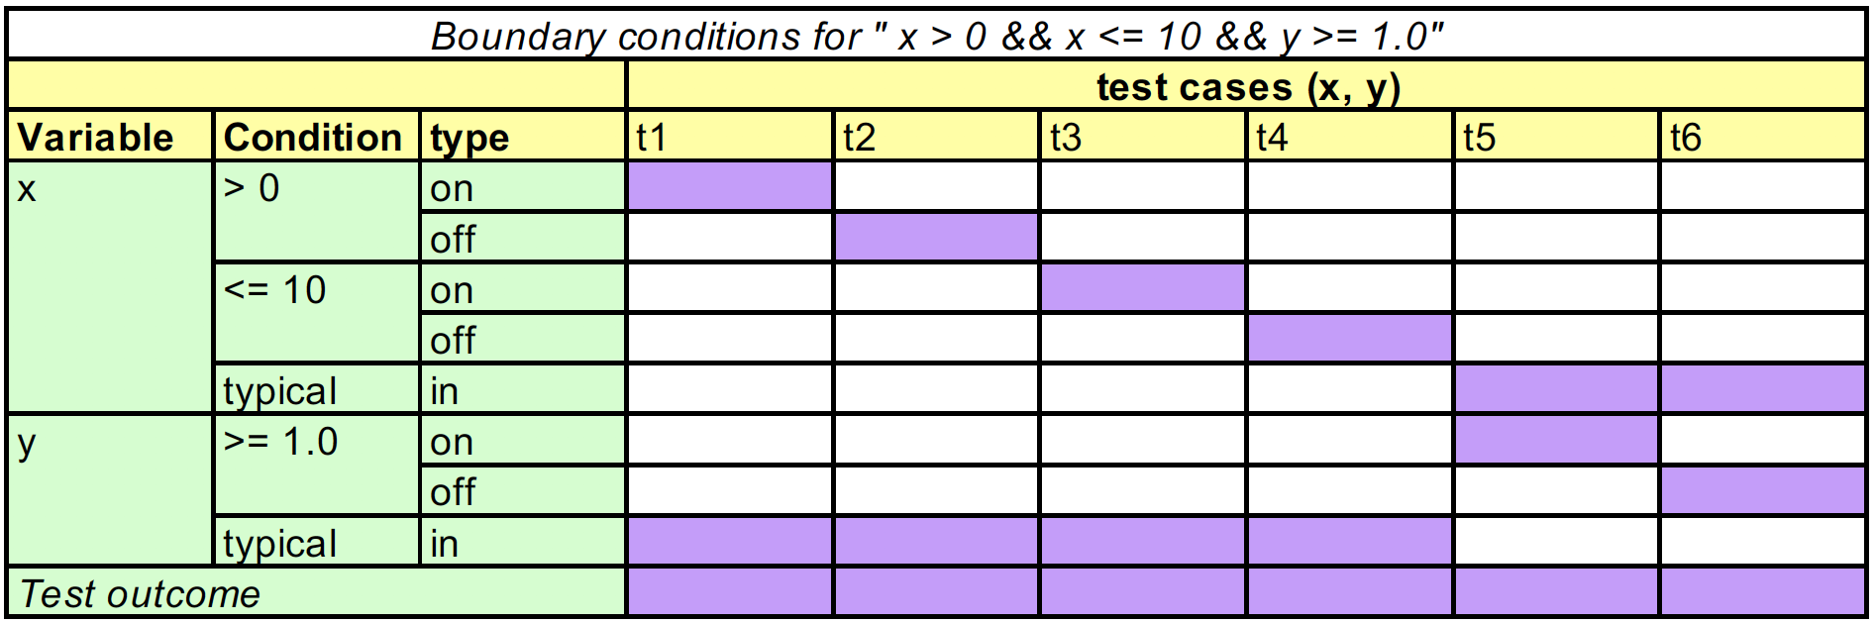

Slide 11
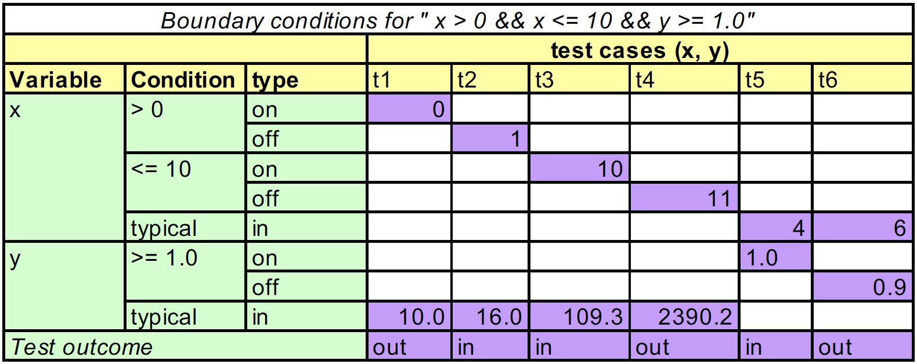

Slide 14
Simplified domain-testing strategy
Handle boundaries independently
For each boundary, pick on and off point
While testing one boundary, use varying in points for the remaining boundaries.
Use domain matrix.

