Slide 1
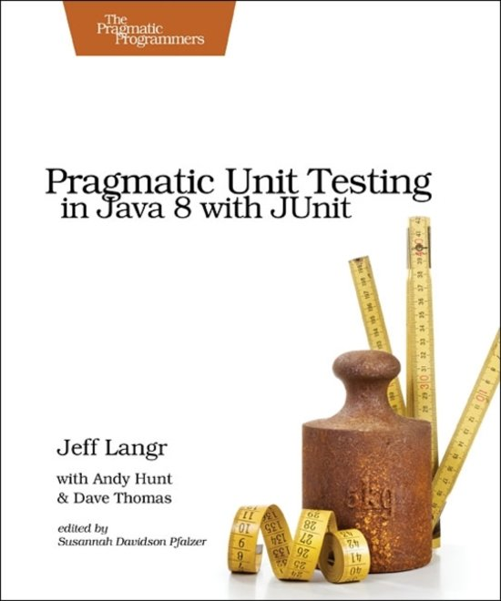
Chapter 7
Boundary conditions:
the Correct way

Slide 2
[C]ORRECT: Conformance
Many data elements must conform to a specific format.
Example: e-mail (always name@domain).
Test when your input is not in conformance with what is expected.

Slide 3
C[O]RRECT: Ordering
The order of the data might influence the output.
What happens if the list is ordered? Unordered?

Slide 4
CO[R]RECT: Range
Inputs should usually be within a certain range.
Example: Age should always be greater than 0 and smaller than 120.
In most programming languages, basic types give you more than you need.

Slide 5
COR[R]ECT: Reference
When testing a method, consider:
What it references
External dependencies
It depends on the object being in a certain state
Any other conditions that must exist

Slide 6
CORR[E]CT: Existence
Does something really exist? What if it doesn’t?

Slide 7
CORRE[C]T: Cardinality
Off-by-one errors
Loops:
Zero
One
Many

Slide 8
CORREC[T]: Time
Ordering in time
What happens if I forget to invoke a() before b()?
Timeouts
Date/Time operations
Should we use UTC? GMT?
Concurrency

