Slide 1

Test analysis & design

Slide 2

Test Execution

Slide 3
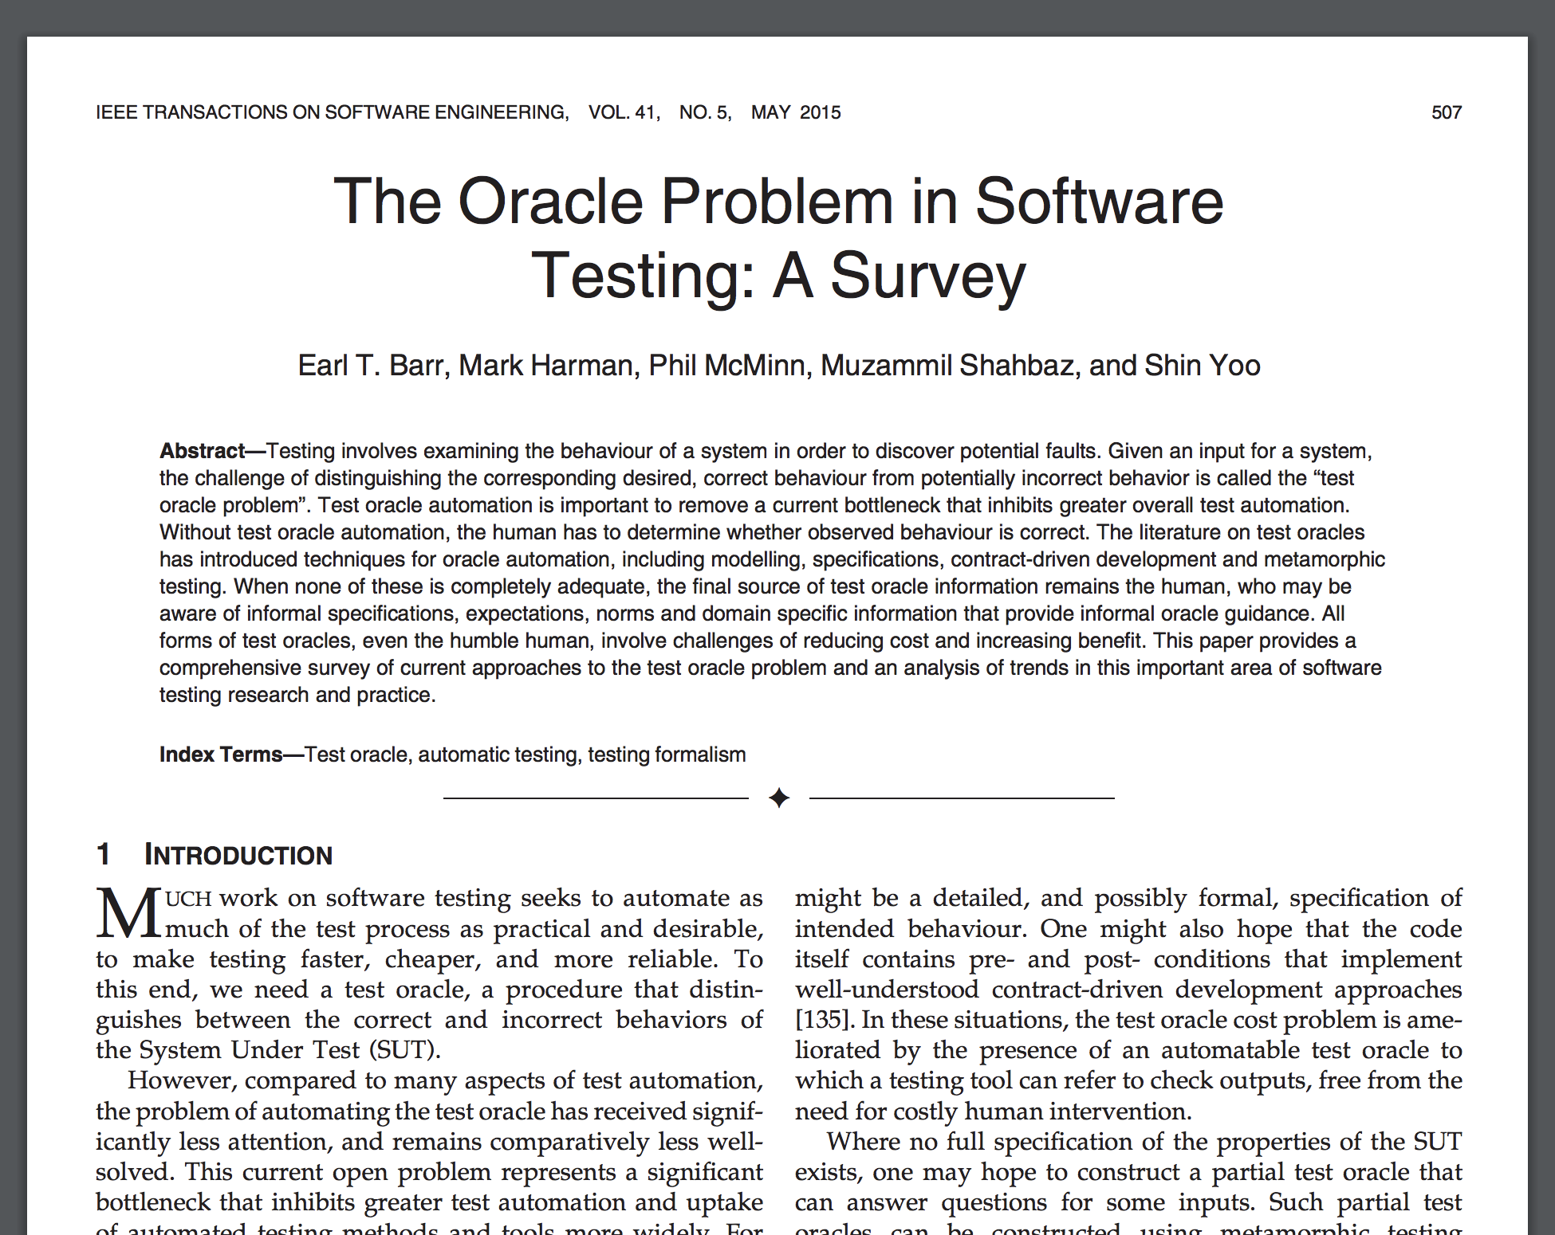
The literature on test oracles has introduced techniques for oracle automation, including modelling, specifications, contract-driven development and metamorphic testing. When none of these is completely adequate, the final source of test oracle information remains the human, who may be aware of informal specifications, expectations, norms and domain specific information that provide informal oracle guidance.

