Slide 1

Error, mistake, defect, bug, fault, failure…
Aren’t they all the same?

Slide 2
Failure
A component or system behaves in a way that it is not expected.

Slide 3
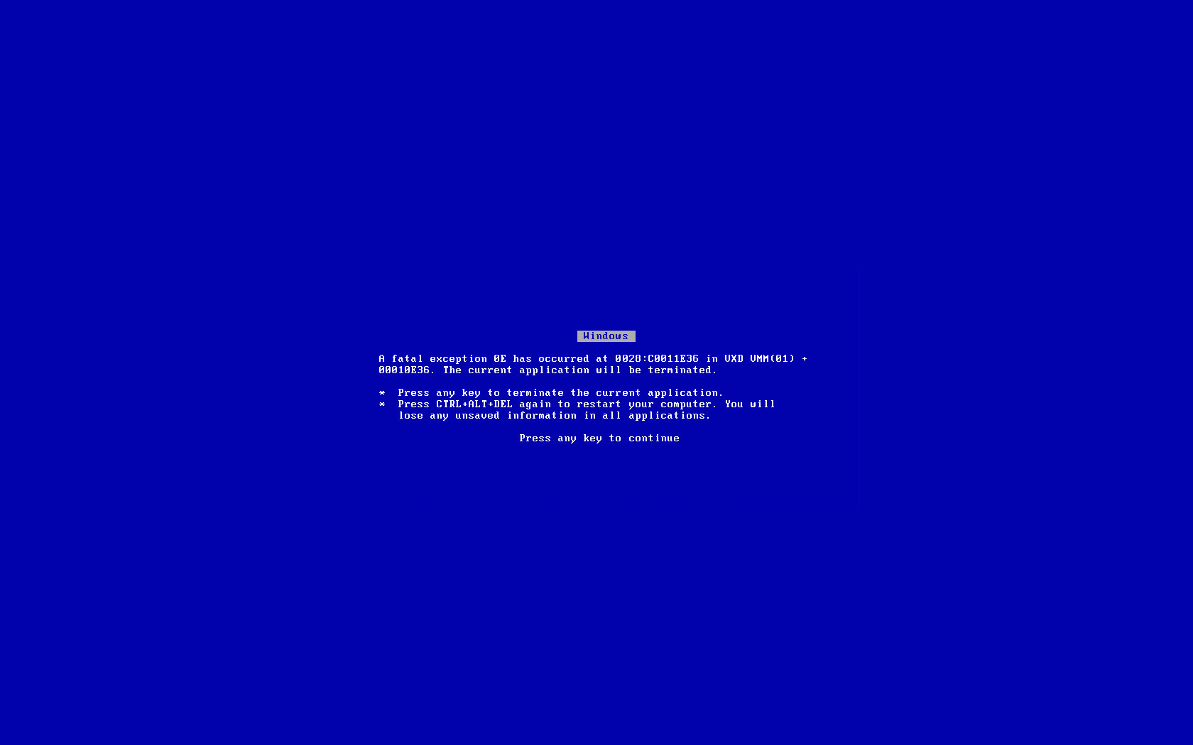

Slide 4
Defect (or bug, fault)
A flaw in a component that can cause the system to behave incorrectly. e.g., an incorrect statement.
A defect, if encountered during execution, may cause a failure.

Slide 5
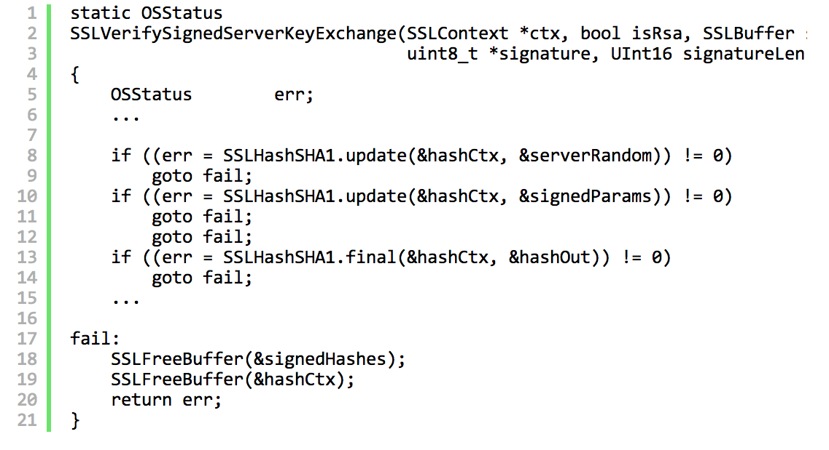

Slide 6
Fault in Apple’s Secure Socket Layer code

Slide 7
Error (mistake)
A human action that produces an incorrect result.

Slide 8
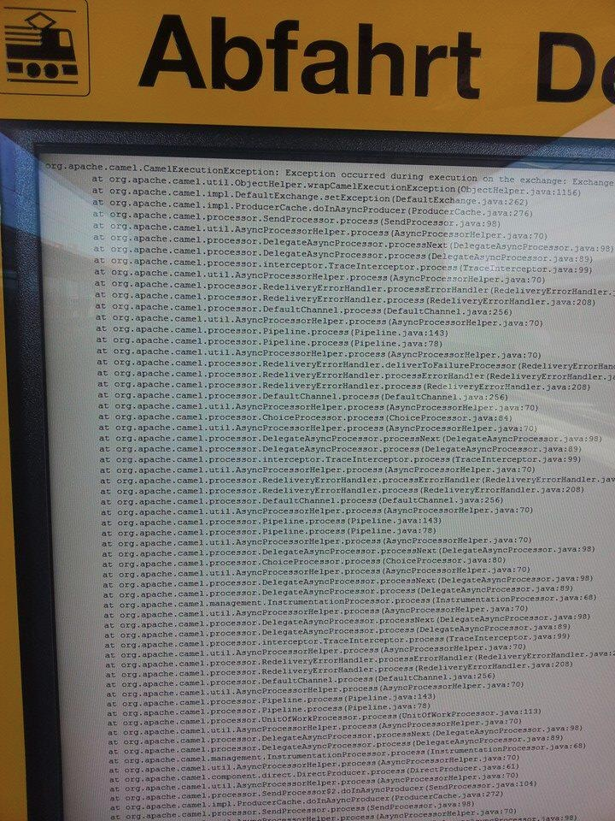

Slide 9
Travel Information:
Fault or Failure?

Slide 10
Travel information failure to deliver useful information,
caused by fault in code.

Slide 11
It’s definitely important to have a common vocabulary!

