Slide 1

Let’s test all the cases!
And, of course, let’s write automated tests.

Slide 2
divisible by 4,
not divisible by 100
Ex: 2016, 2020
Divisible by 4, divisible by 100,
but also divisible by 400
Ex: 2000
Not divisible by 4.
Ex: 2015, 2017
Divisible by 4, divisible by 100,
but not divisible by 400
Ex: 1500, 1900

Slide 3

public class LeapYear { public boolean isLeapYear(int year) { if (year % 400 == 0) return true; if (year % 100 == 0) return false;
return
(year % 4 == 0) ? true : false; } }

Slide 4
@Test public void test01() {
LeapYear ly = new LeapYear();
boolean leap = ly.isLeapYear(2016);
Assertions.assertTrue(leap);
}

Slide 5
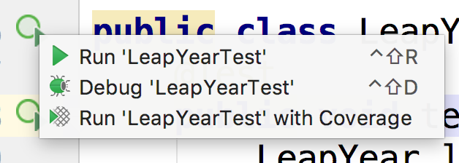
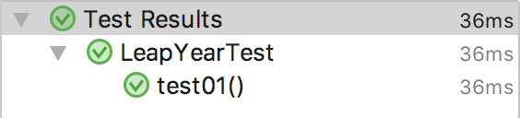

Slide 6
divisible by 4,
not divisible by 100
Examples:
2016
2020
2024
2028
…
Which one should I choose?

Slide 7
divisible by 4,
not divisible by 100
Any! They all belong to the same equivalence partitioning!

Slide 8
@Test public void test01() {
LeapYear ly = new LeapYear();
boolean leap = ly.isLeapYear(2016);
Assertions.assertTrue(leap);
}

Slide 9
@Test public void
leapYearsThatAreNonCenturialYears() {
LeapYear ly = new LeapYear();
boolean leap = ly.isLeapYear(2016);
Assertions.assertTrue(leap);
}

Slide 10
@Test public void leapCenturialYears() { LeapYear ly = new LeapYear();
boolean leap = ly.isLeapYear(2000);
Assertions.assertTrue(leap); }

Slide 11
@Test public void nonLeapCenturialYears() { LeapYear ly = new LeapYear();
boolean leap = ly.isLeapYear(1500);
Assertions.assertFalse(leap); }

Slide 12
@Test public void nonLeapYears() { LeapYear ly = new LeapYear();
boolean leap = ly.isLeapYear(2017);
Assertions.assertFalse(leap); }

Slide 13
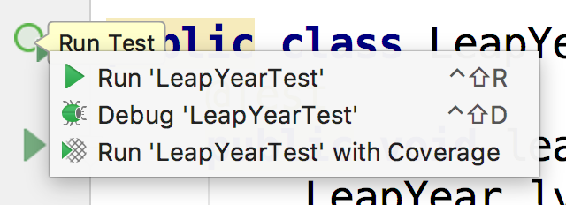
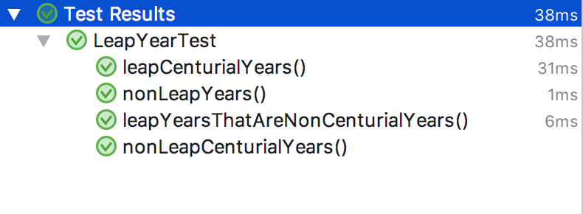

Slide 14
divisible by 4,
not divisible by 100
Ex: 2016, 2020
Divisible by 4, divisible by 100,
but also divisible by 400
Automated!
Ex: 2000
Not divisible by 4.
Ex: 2015, 2017
Divisible by 4, divisible by 100,
but not divisible by 400
Ex: 1500, 1900

