Slide 1
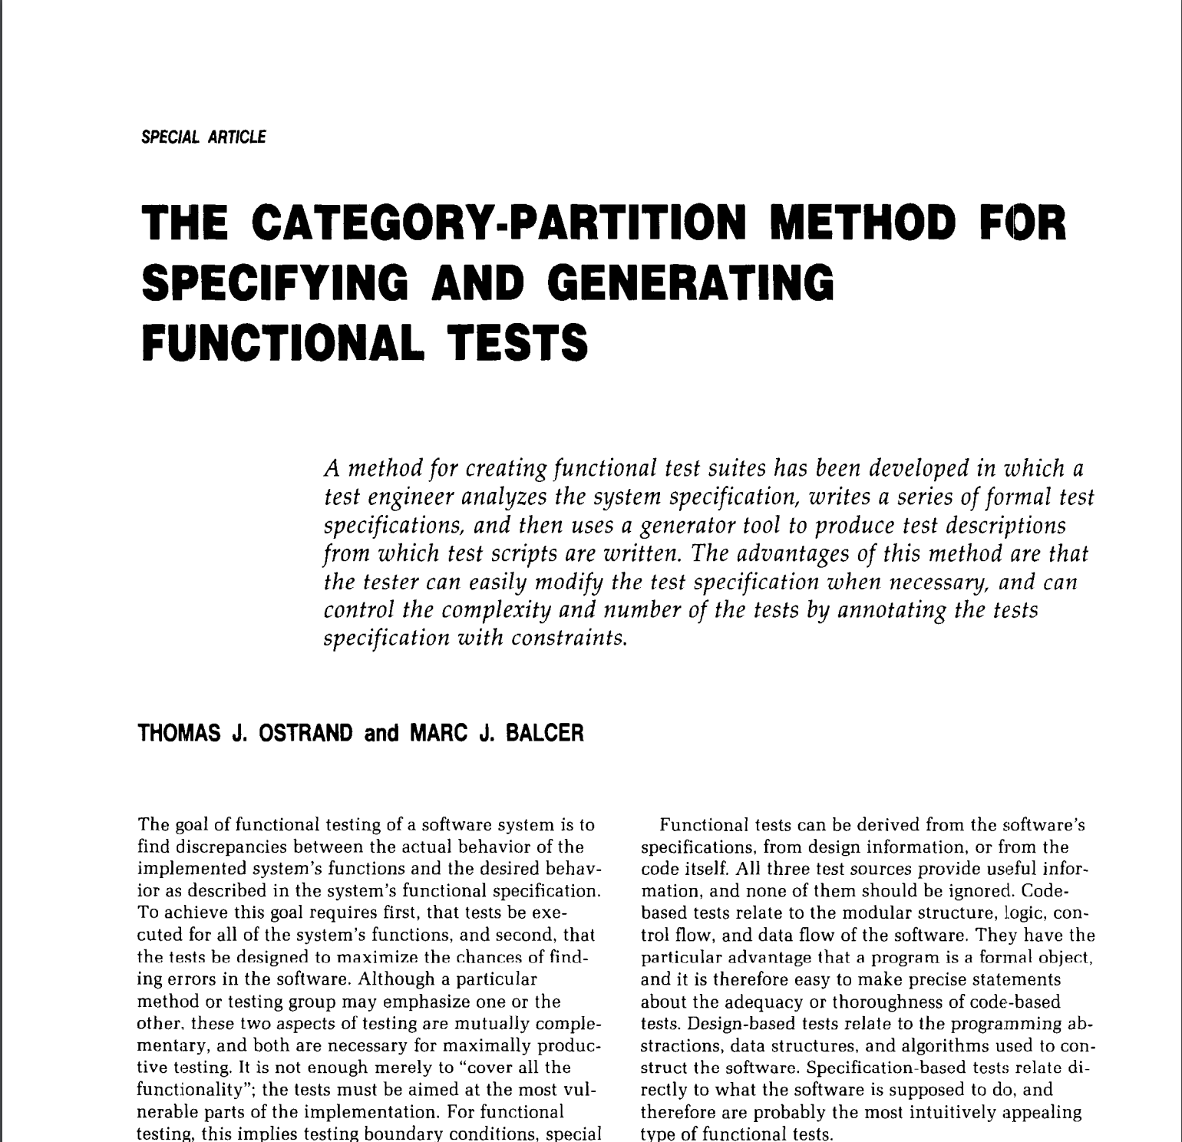

Slide 2
Identify the parameters
The characteristics of each parameter
From the specs
Not from the specs
Add constraints (minimize)
Remove invalid combinations
Reduce number of exceptional behaviors
Generate combinations

Slide 3
Identify the parameters
The characteristics of each parameter
From the specs
Not from the specs
Add constraints (minimize)
Remove invalid combinations
Reduce number of exceptional behaviors
Generate combinations

Slide 4
Identify the parameters
The characteristics of each parameter
From the specs
Not from the specs
Add constraints (minimize)
Remove invalid combinations
Reduce number of exceptional behaviors
Generate combinations

Slide 5
Identify the parameters
The characteristics of each parameter
From the specs
Not from the specs
Add constraints (minimize)
Remove invalid combinations
Reduce number of exceptional behaviors
Generate combinations

Slide 6

The system should give 25% of discount on the raw amount of the cart when it’s Christmas!

Slide 7
Two important variables:
The current date
The raw amount

Slide 8
The current date
Christmas
Not Christmas

Slide 9
The raw amount
Positive number
Zero
Negative number [exceptional]

Slide 10
Christmas
Not Christmas
Positive number
Zero
Negative number [exceptional]
Positive number
Zero
Negative number [exceptional]

Slide 11
Christmas
Not Christmas
Positive number
Zero
Negative number [exceptional]
Positive number
Zero
Negative number [exceptional]

