Slide 1
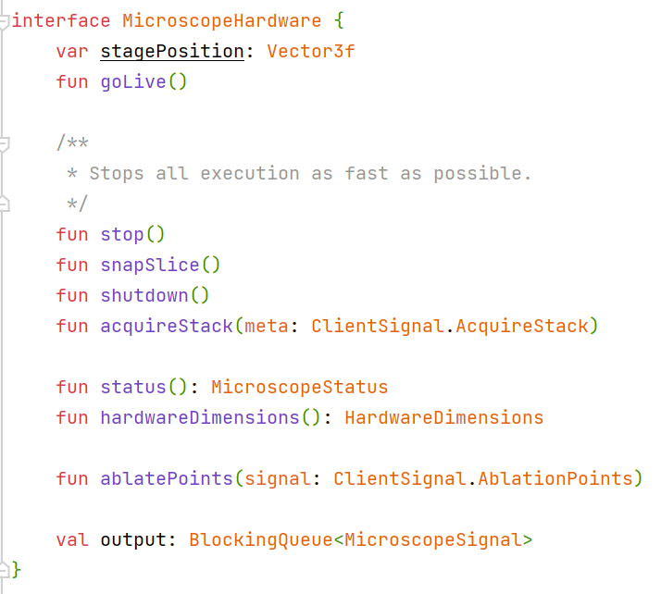
Hardware
Drivers
MicroManager
Microscenery core
Plugin interface
MicroManagerWrapper: MicroscopeHardware
Microscenery plugin
RemoteMicroscopeServer
Optional
Zmq/protobuffer
RemoteMicroscopeClient: MicroscopeHardware
Optional
Microscenery
StageSpaceManager

