Slide 1
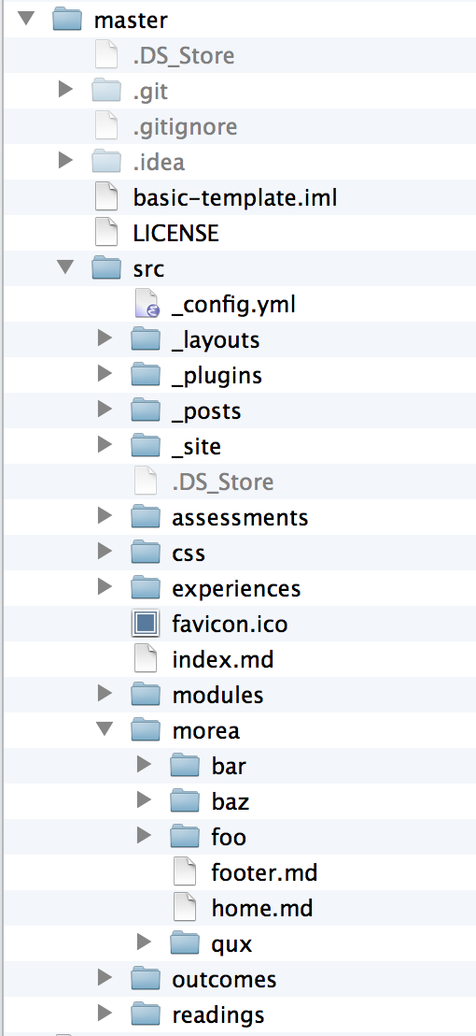
GitHub
Managed
Jekyll
Managed
Morea
Managed

