Slide 1
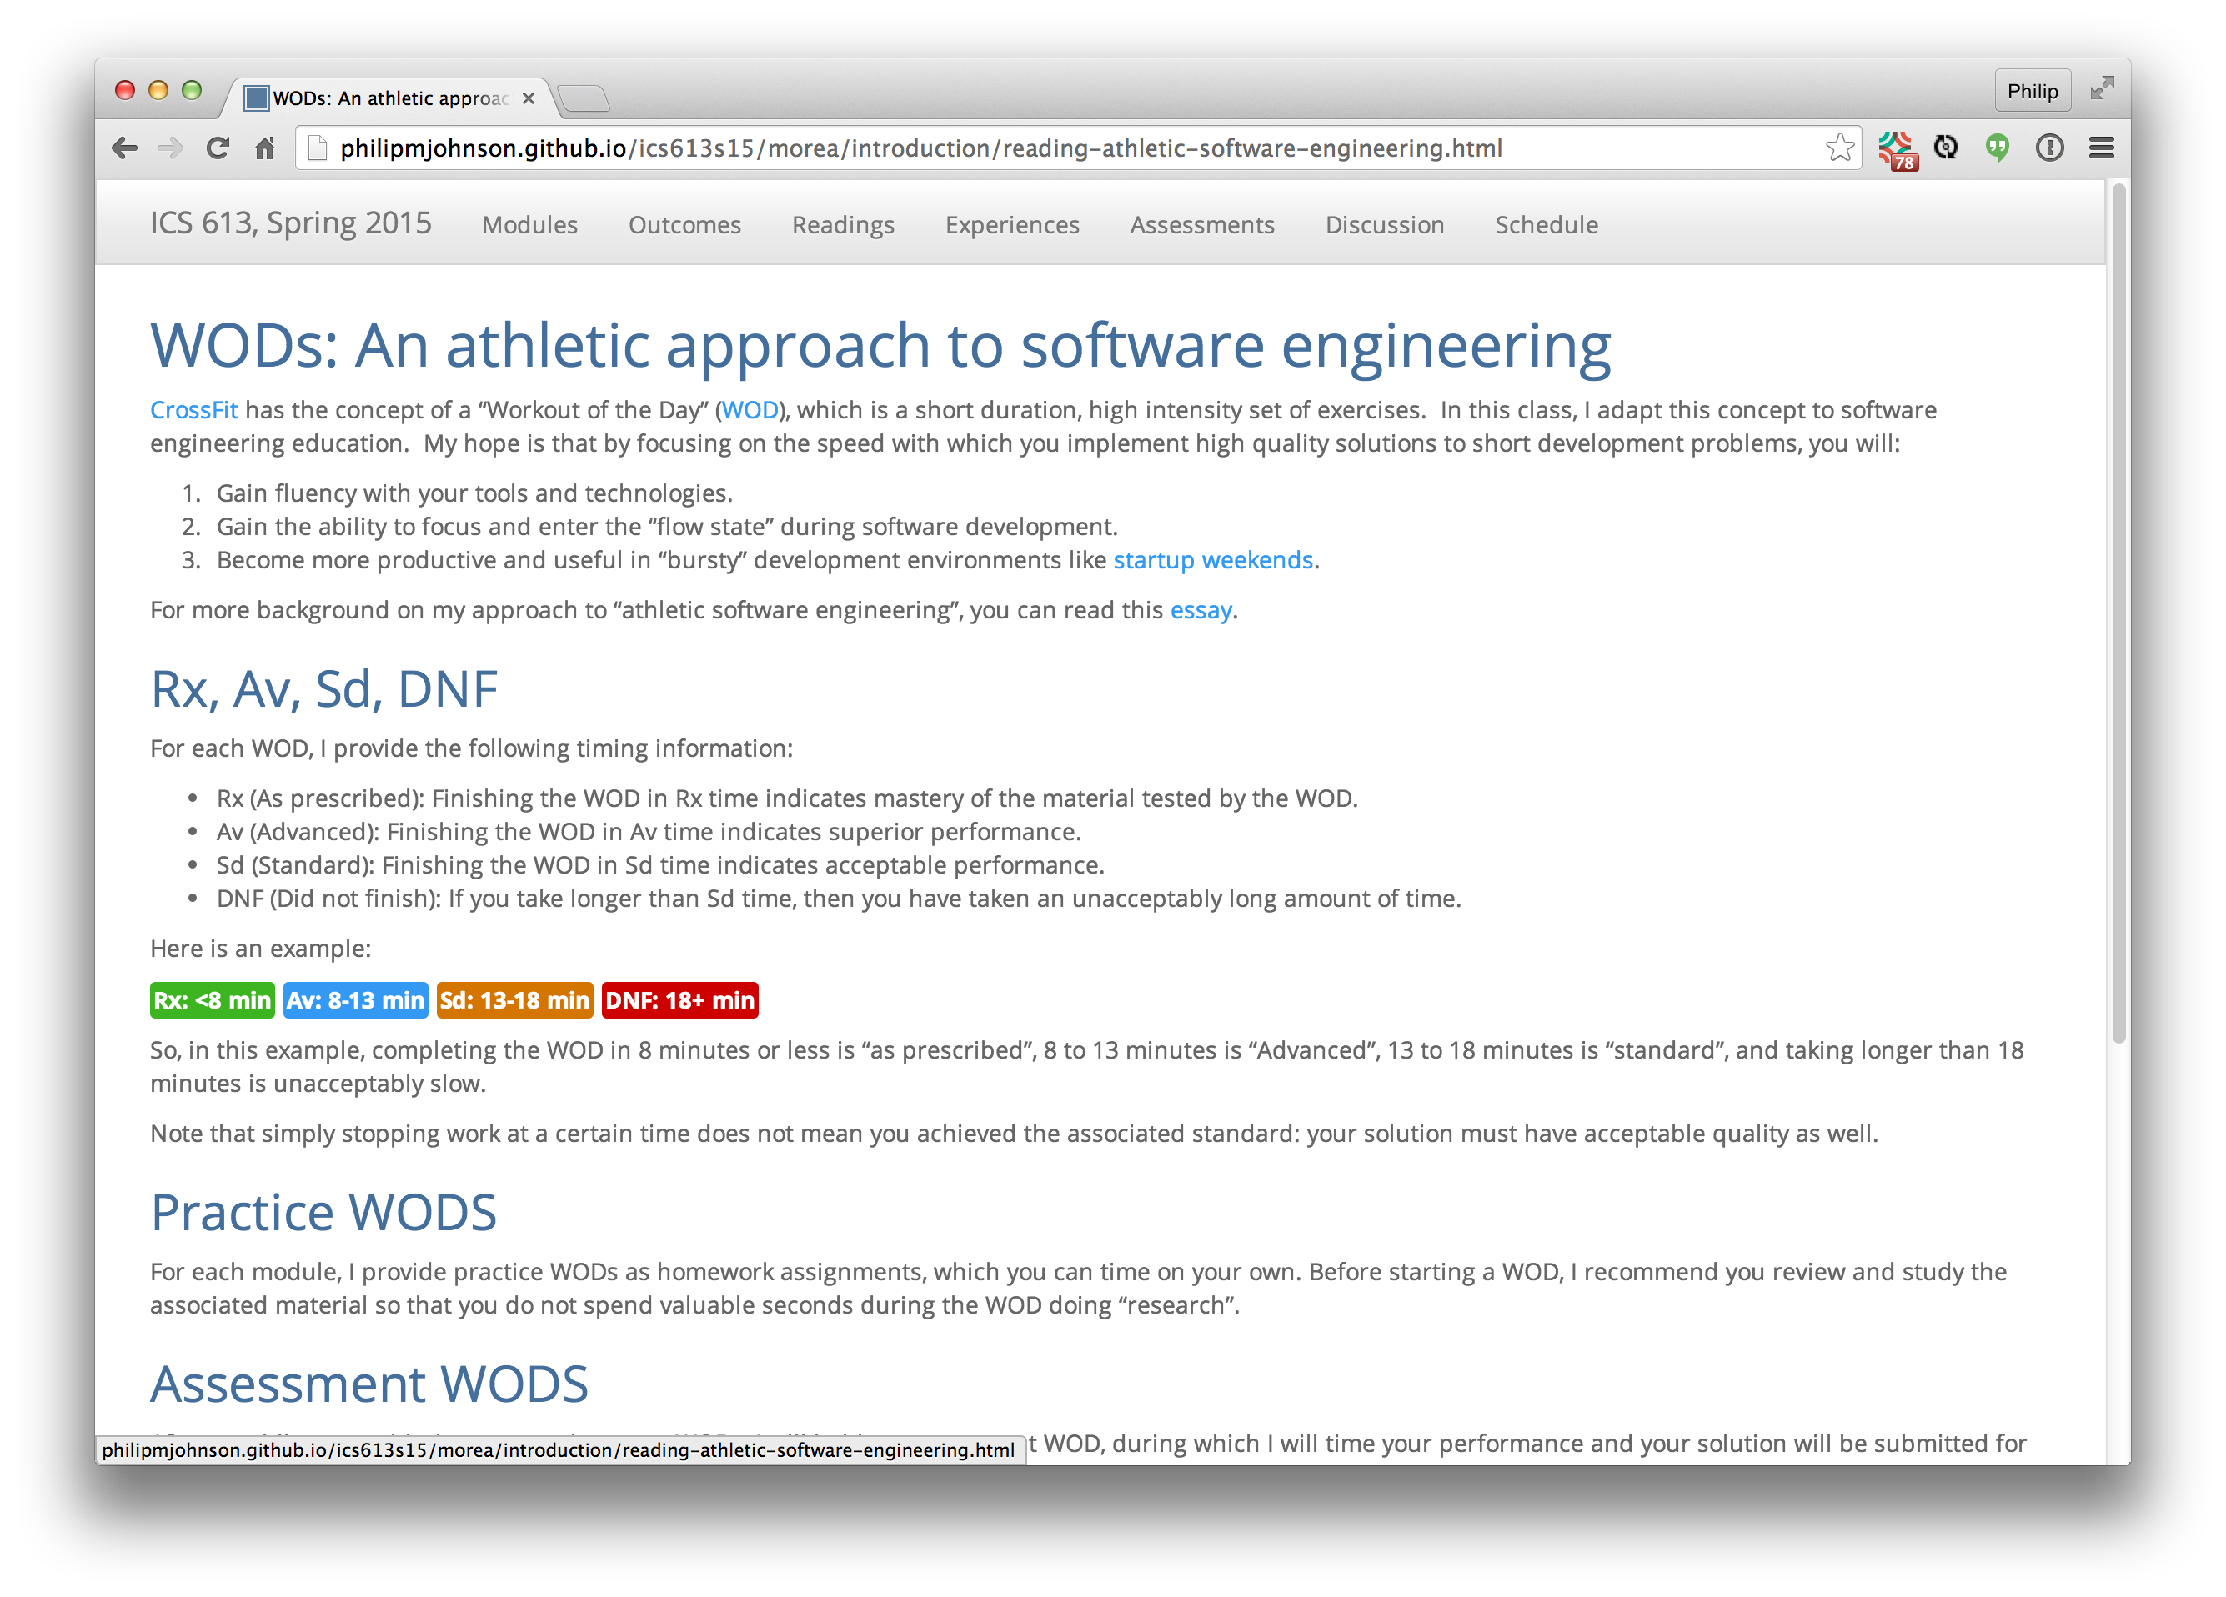

Athletic Software Engineering Education
Philip Johnson, Information and Computer Sciences, University of Hawaii at Manoa
ABSTRACT
My idea
How our idea works
Challenges/Resources Needed
I have taught software development for over 20 years. One of the most difficult tasks is to incentivize students to internalize the mechanics of software development: skillful use of the languages, tools, and technologies so that their attention can focus on the problem at hand.
Athletic software engineering is a pedagogy in which the course is organized into a series of skills to be acquired. For each skill, students are given practice "Workouts" along with videos showing the instructor performing the Workout efficiently and effectively. Students are advised to repeat the Workout until they can complete it as efficiently as the instructor.
In class, students are given a new problem involving the skill and a time limit in which to complete it.
Athletic software engineering works well in any course in which the content can be formulated as a set of skills to be mastered, and where sample "Workouts" involving the skill can be accomplished in 10 – 25 minutes.
It does not appear to be appropriate for courses involving "soft skills" such as customer interaction.
Enter text here
Implications for future value? Questions to the community related to the type of feedback you want.
Please contact Philip Johnson if you would like more information about the approach.
The Context, or who my/our idea impacts.
Athletic software engineering impacts both on instructors designing courses as well as the students taking the course.
For instructors, material must be structured as a set of skills to be required that can be assessed through in-class, timed exercises. You can combine the athletic approach with longer assignments, but we find that at least half of the course material should be "athletic" in order for the approach to be effective.
For students, the athletic approach introduces a certain amount of psychological stress into the classroom setting, since the vast majority of class time is spent doing timed assesssment Workouts, rather than spacing out while the instructor drones on at the front of the class.
How I (we) will evaluate whether it works., or any results (so far)
We evaluated athletic software engineering in the Fall, 2013 semester with the following results:
100% of the students preferred "Workouts" to the conventional classroom style.
The 2 instructors who have used this pedagogy prefer it, although it requires additional work to design and implement practice Workouts demonstrating "good form".
Successful students repeat at least some workout assignments multiple times in order to gain efficiency.
Athletic software engineering solves the "multitasking" or "divided attention" problem. While working on class material, students do not do Facebook, email, text messaging, etc. They are in the "flow state", just as an athlete in a 100 yard dash is in the "flow state".
We are currently teaching two courses in an athletic style and will have additional results after the Spring, 2015 semester.
CONTACT
For more information on the approach, google "athletic software engineering" and read the first two links from philipmjohnson.org. These postings provide more detail about the motivation for the approach and the results from the first semester of implementation.

