Slide 1
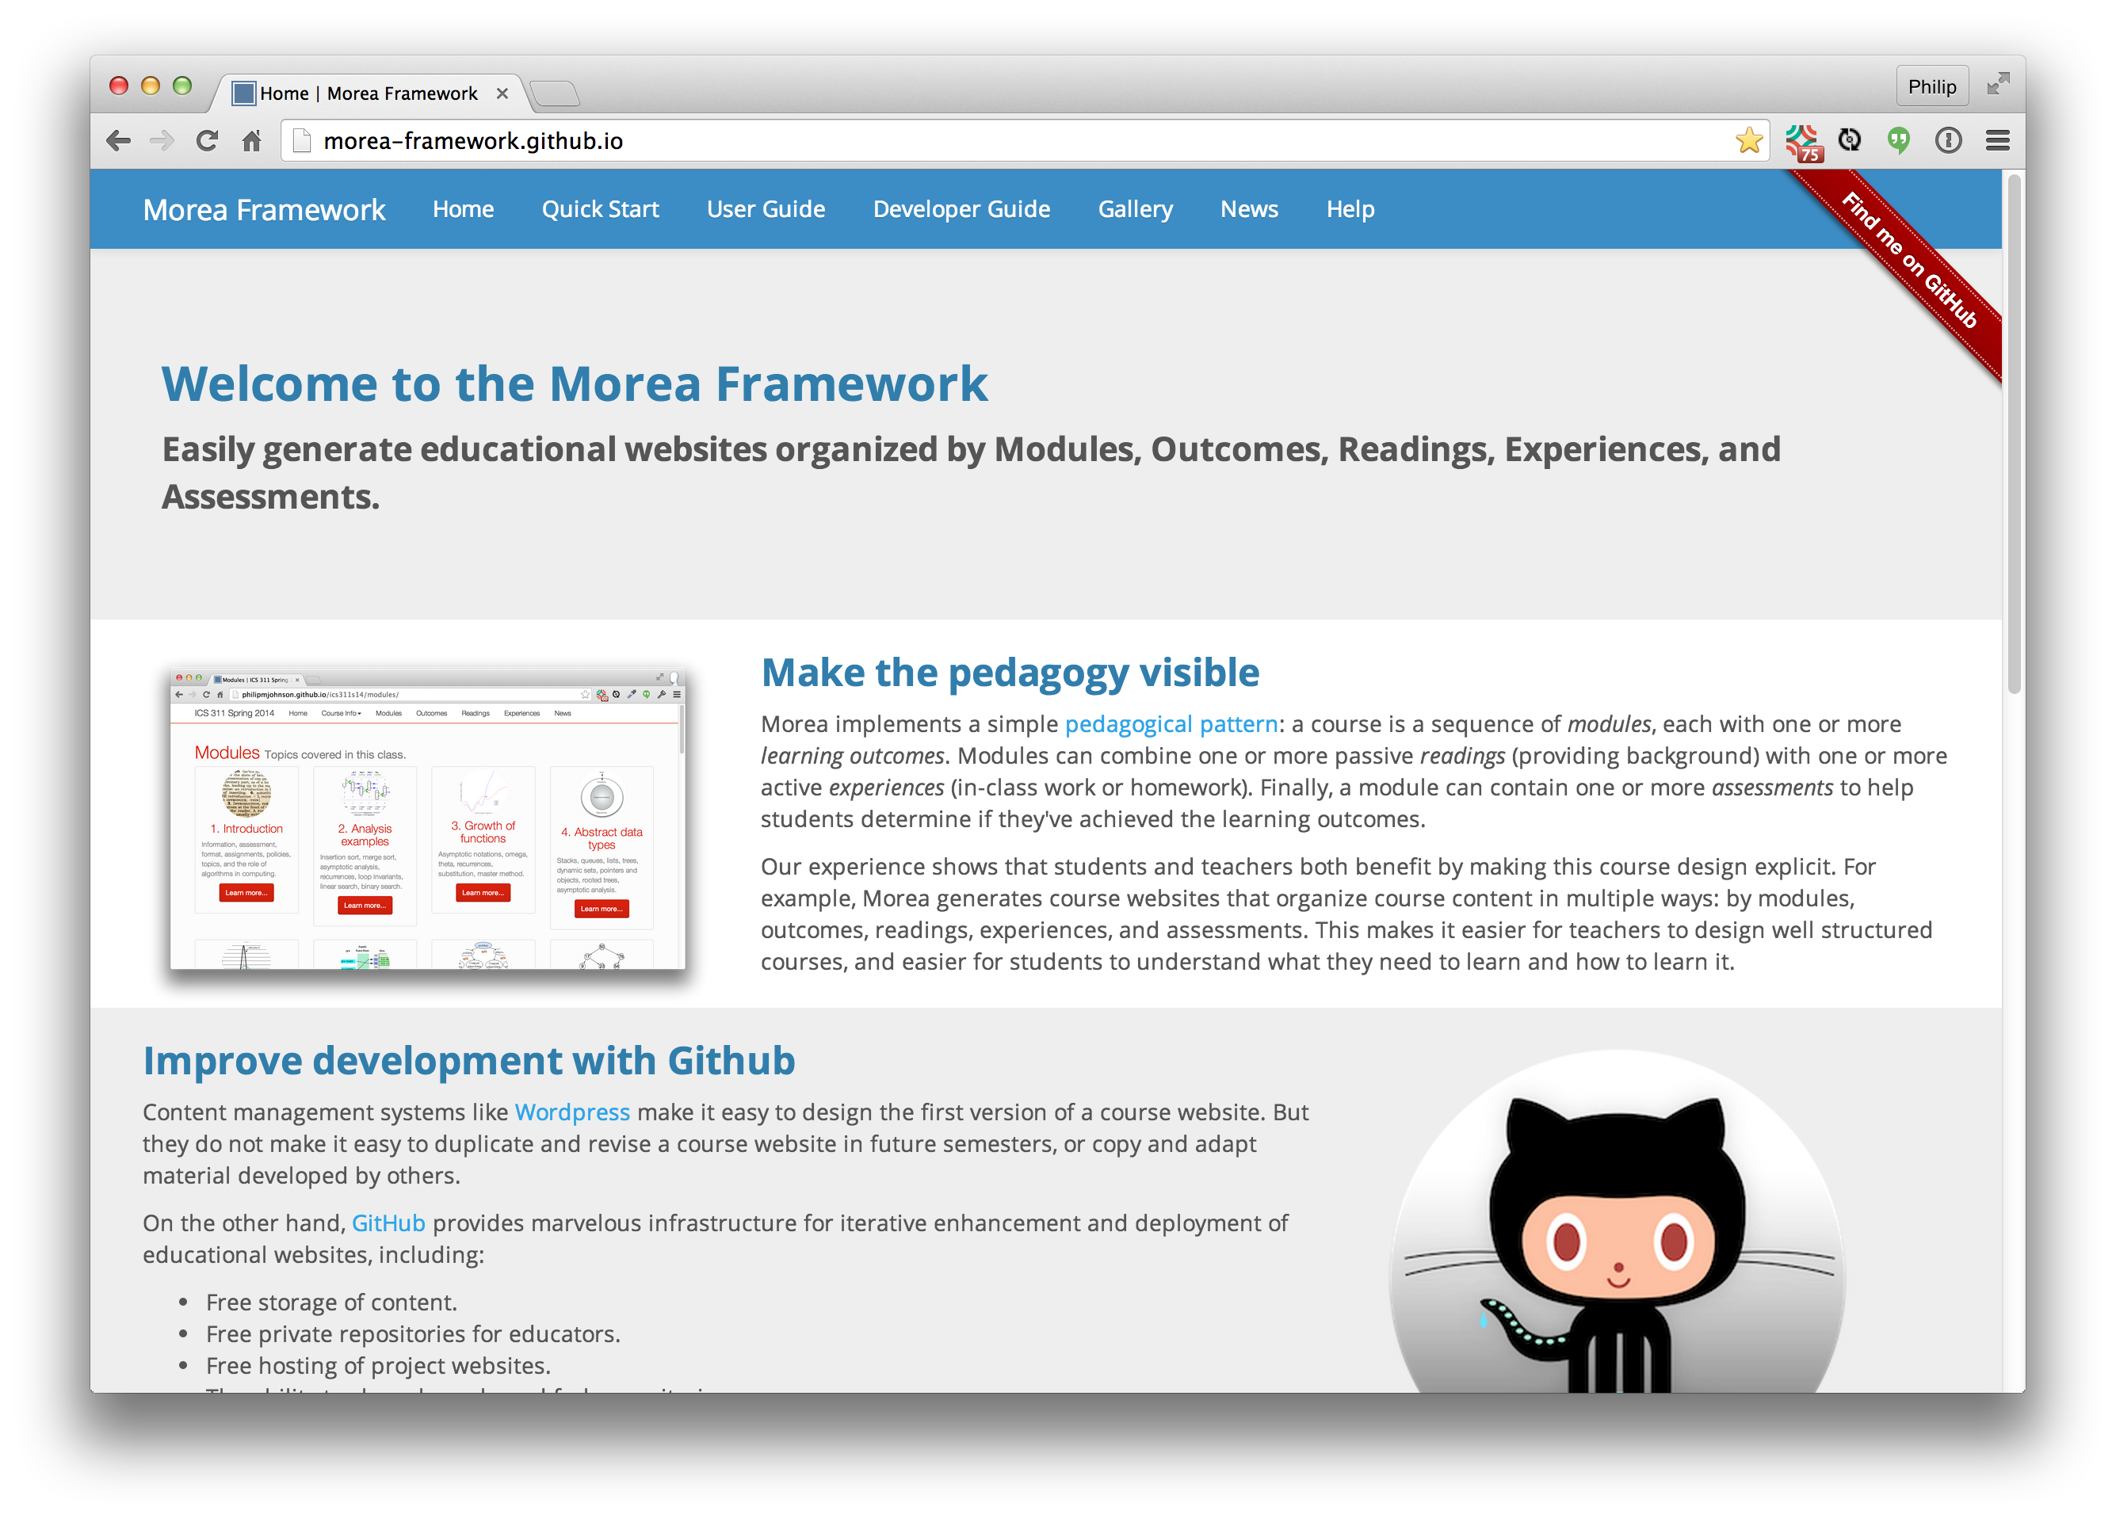

The Morea Framework: Modules, Outcomes, Readings, Experiences, Assessments
http://morea-framework.github.io
Philip Johnson, Information and Computer Sciences, University of Hawaii at Manoa
ABSTRACT
My idea
How our idea works
Challenges/Resources Needed
It is possible to combine GitHub, git, markdown, the Jekyll static site generator, and a simple Ruby plugin to provide a course site generator with several benefits:
Source files can be written in Markdown but rendered in HTML5 with a responsive format.
All of the collaborative power of git and GitHub is available (clone, merge, fork, pull requests, branches, etc.)
No cost to educators or students: all technology is open source and/or available without cost.
By structuring the course by modules, outcomes, readings, experiences, and assessments, the intent of the course is more clear to both students and instructors.
The biggest challenge for educators wishing to use the Morea Framework is that it requires a certain level of technological sophistication from the educator to implement a site.
While Morea is not rocket science, educators will need to use the command line, markdown, and git. No programming is required, fortunately!
Enter text here
Implications for future value? Questions to the community related to the type of feedback you want.
Please feel free to visit the home page to learn more about this technology.
We are interested in feedback concerning the barriers to adoption and how our approach relates to other pedagogical patterns.
The Context, or who my/our idea impacts.
The Morea Framework impacts both on instructors designing courses as well as the students taking the course.
For instructors, the ability to explicitly specify modules, outcomes, readings, experiences, and assessments can reveal opportunities for improvement in the course design. For example, the assessment may not match the objectives for a given module.
For students, the course structure presented by Morea helps them to better understand the intent of the course. By better understanding the intent, we hope that students can better succeed in acquiring the learning objectives.
How I (we) will evaluate whether it works., or any results (so far)
The Morea Framework is in use by a few instructors in the Department of Information and Computer Sciences and one instructor in the Shidler School of Business at UH Manoa.
There is interest from instructors at other universities, and we hope to learn of their experiences during Spring 2015.
You can go to the "Gallery" page at the website to follow links to course websites have been implemented using Morea.
If there is interest, we could design a more formal evaluation procedure in which we distribute surveys to instructors and students using Morea to determine its strengths and weaknesses.
CONTACT
Website: http://morea-framework.github.io
Email: johnson@hawaii.edu
Name: Philip Johnson

