Slide 1
San Francisco Crime Vehicle THEFT analysis
BY ALVIN HSIEH
data SOURCE:
https://data.sfgov.org/Public-Safety/Map-Crime-Incidents-from-1-Jan-2003/gxxq-x39z

Slide 2
Background
Many Vehicle Thefts go unresolved for years (vehicle stolen, not items from vehicles)
Data came from Government Open Data program for San Francisco
https://data.sfgov.org/Public-Safety/Map-Crime-Incidents-from-1-Jan-2003/gxxq-x39z
Vehicle Theft are difficult to resolve since there are large windows of time from Vehicle stolen and report time

Slide 3
Potential ways to find resolution
Use what is available to make a prediction as a baseline
See if there is a way to see groups (1 or more) that are creating these crimes to improve resolution
See if we can predict the directional patterns in the crime
Note: The dates are from 01-01-16 to 03-08-17

Slide 4
Sample Data
IncidntNum Category Descript DayOfWeek \
0 150098373 VEHICLE THEFT STOLEN AUTOMOBILE Sunday
1 150098464 VEHICLE THEFT STOLEN AUTOMOBILE Sunday
2 150098715 VEHICLE THEFT STOLEN AUTOMOBILE Sunday
3 150098743 VEHICLE THEFT STOLEN AUTOMOBILE Wednesday
4 150099086 VEHICLE THEFT STOLEN TRUCK Sunday
Date Time PdDistrict Resolution \
0 02/01/2015 12:00:00 AM 12:45 NORTHERN NONE
1 02/01/2015 12:00:00 AM 11:45 NORTHERN NONE
2 02/01/2015 12:00:00 AM 08:00 RICHMOND UNFOUNDED
3 01/28/2015 12:00:00 AM 16:00 TARAVAL NONE
4 02/01/2015 12:00:00 AM 01:00 INGLESIDE NONE
Address X Y \
0 FRANKLIN ST / TURK ST -122.422277 37.781753
1 GROVE ST / VANNESS AV -122.419885 37.778251
2 GOLDEN GATE AV / STANYAN ST -122.455126 37.777024
3 LINCOLN WY / 38TH AV -122.497614 37.764543
4 CRESCENT AV / PORTER ST -122.418099 37.734953
Location
0 (37.7817528767881, -122.42227702764)
1 (37.7782510832412, -122.419884939457)
2 (37.777023633257, -122.455125552189)
3 (37.7645433165084, -122.49761402653)
4 (37.7349529289018, -122.418098776629)

Slide 5
Data Cleanup
RangeIndex: 120514 entries, 0 to 120513
Data columns (total 12 columns):
IncidntNum 120514 non-null int64
Category 120514 non-null object
Descript 120514 non-null object
DayOfWeek 120514 non-null object
Date 120514 non-null object
Time 120514 non-null object
PdDistrict 120514 non-null object
Resolution 120514 non-null object
Address 120514 non-null object
X 120514 non-null float64
Y 120514 non-null float64
Location 120514 non-null object
dtypes: float64(2), int64(1), object(9)
memory usage: 11.0+ MB

Slide 6
Data Conversion
Converting text to numbers for analysis
Problems of conversion process
Timing out due to too much data
Reducing amount of data
Sorting the data in order
Indexing resulting multiplying results
Splitting data then merge data back
Creating new variables
K-means Cluster classifications
Separating data to convert or calculate reducing calculation time
Calculating Magnitude and Degrees

Slide 7
Convert Resolution to Predict
# Evaluates the Resolution column to match 'NONE' to TRUE/FALSE
res = sfcrime.Resolution == 'NONE'
# initially set all lines to resolved, then changed all items that not resolved to 0
sfcrime['Resolve'] = 1
sfcrime.loc[res, 'Resolve'] = 0
==============================================
% of data classified
0 0.917238
1 0.082762
Name: Resolve, dtype: float64

Slide 8
Prepping Data for Analysis
Removed Columns: 'Category', 'Address', 'Location', 'Resolution‘ Feature columns: ['IncidntNum', 'Descript', 'DayOfWeek', 'Date', 'Time', 'PdDistrict', 'X', 'Y', 'Resolve'] Target column: Resolve
Feature values:
IncidntNum Descript DayOfWeek Date Time \
0 150098373 STOLEN AUTOMOBILE Sunday 02/01/2015 12:00:00 AM 12:45
1 150098464 STOLEN AUTOMOBILE Sunday 02/01/2015 12:00:00 AM 11:45
2 150098715 STOLEN AUTOMOBILE Sunday 02/01/2015 12:00:00 AM 08:00
3 150098743 STOLEN AUTOMOBILE Wednesday 01/28/2015 12:00:00 AM 16:00
4 150099086 STOLEN TRUCK Sunday 02/01/2015 12:00:00 AM 01:00
PdDistrict X Y Resolve
0 NORTHERN -122.422277 37.781753 0
1 NORTHERN -122.419885 37.778251 0
2 RICHMOND -122.455126 37.777024 1
3 TARAVAL -122.497614 37.764543 0
4 INGLESIDE -122.418099 37.734953 0

Slide 9
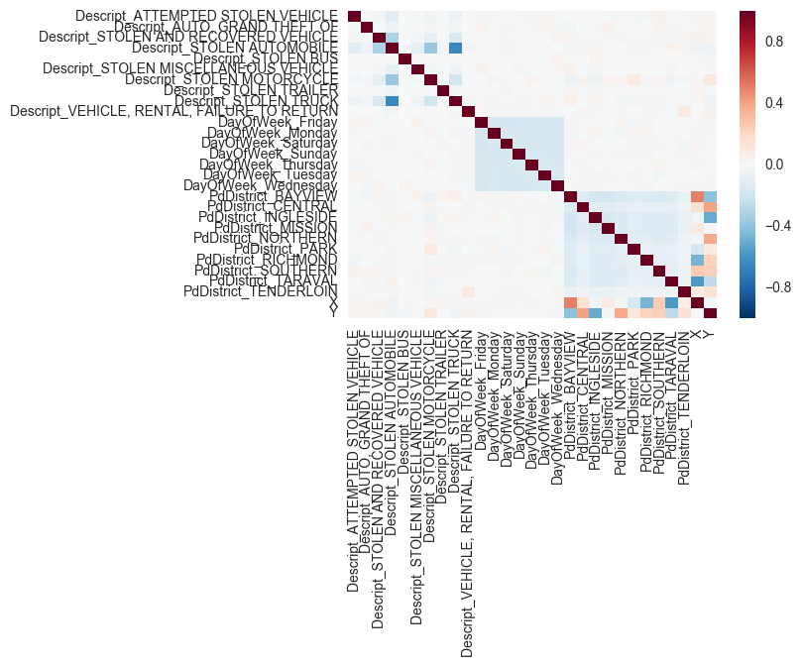
Correlation Heatmap

Slide 10
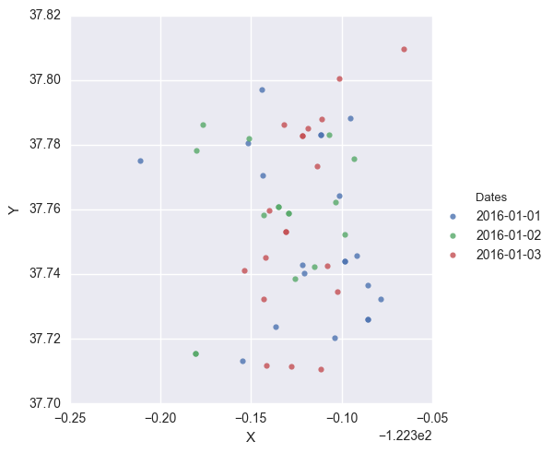
Sample data graph

Slide 11
Logistic regression predicting resolution
Prediction on information that is either resolved or not resolved
Removed columns:'Category', 'Address', 'Location', 'Resolution’
Accuracy Model Score: 0.917586069387

Slide 12
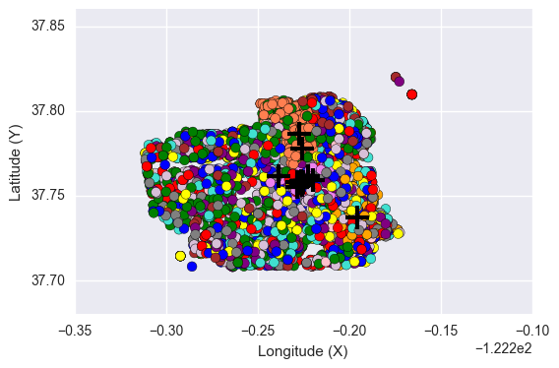
Cluster -- K-mean analysis

Slide 13
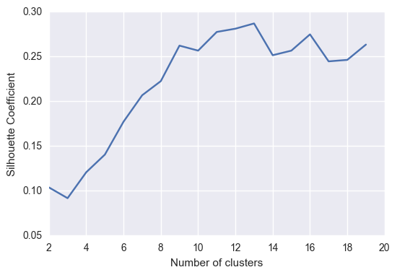
Silhouette calculation to optimize clusters

Slide 14
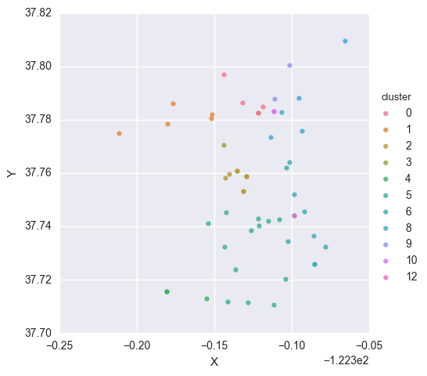
Graph of k-means on graph
Note: Dates are 01-01-16 to 01-06-16

Slide 15
Logistic regression with k-mean
Add Cluster by K-mean to the data
Predict using Logistic Regression
Accuracy Model with K-mean Score: 0.998271965971
Baseline Accuracy Model Score: 0.917586069387

Slide 16
conclusion
Clustering the events helps in understanding if a vehicle theft crime will be resolved better
There are about 13 groups performing vehicle thefts around San Francisco
Potentially, we are able to analyze further to capture Vehicle thieves

Slide 17
future
I started to work on calculating the Magnitude and Degrees. If I continue, I can predict the distance and direction that they will possible head towards. You would create a Regression formula using all your features to predict the model for Magnitude then another for Degree. Once you use the 2, you can use the formulas to calculate each. When you use both with a new longitude and latitude, you can calculate the position of the next crime (potentially).
I can also try to use Machine Learning to predict the next point of crime.
Calculate using more data
Calculate using other categories to see their patterns as well.
Calculate for other cities, states, or even countries

Slide 18
Acknowledgement
Zack Peterson
George Mcintre
Mario Carrillo
General Assembly Class DS-SF-31
General Assemby

