Slide 1
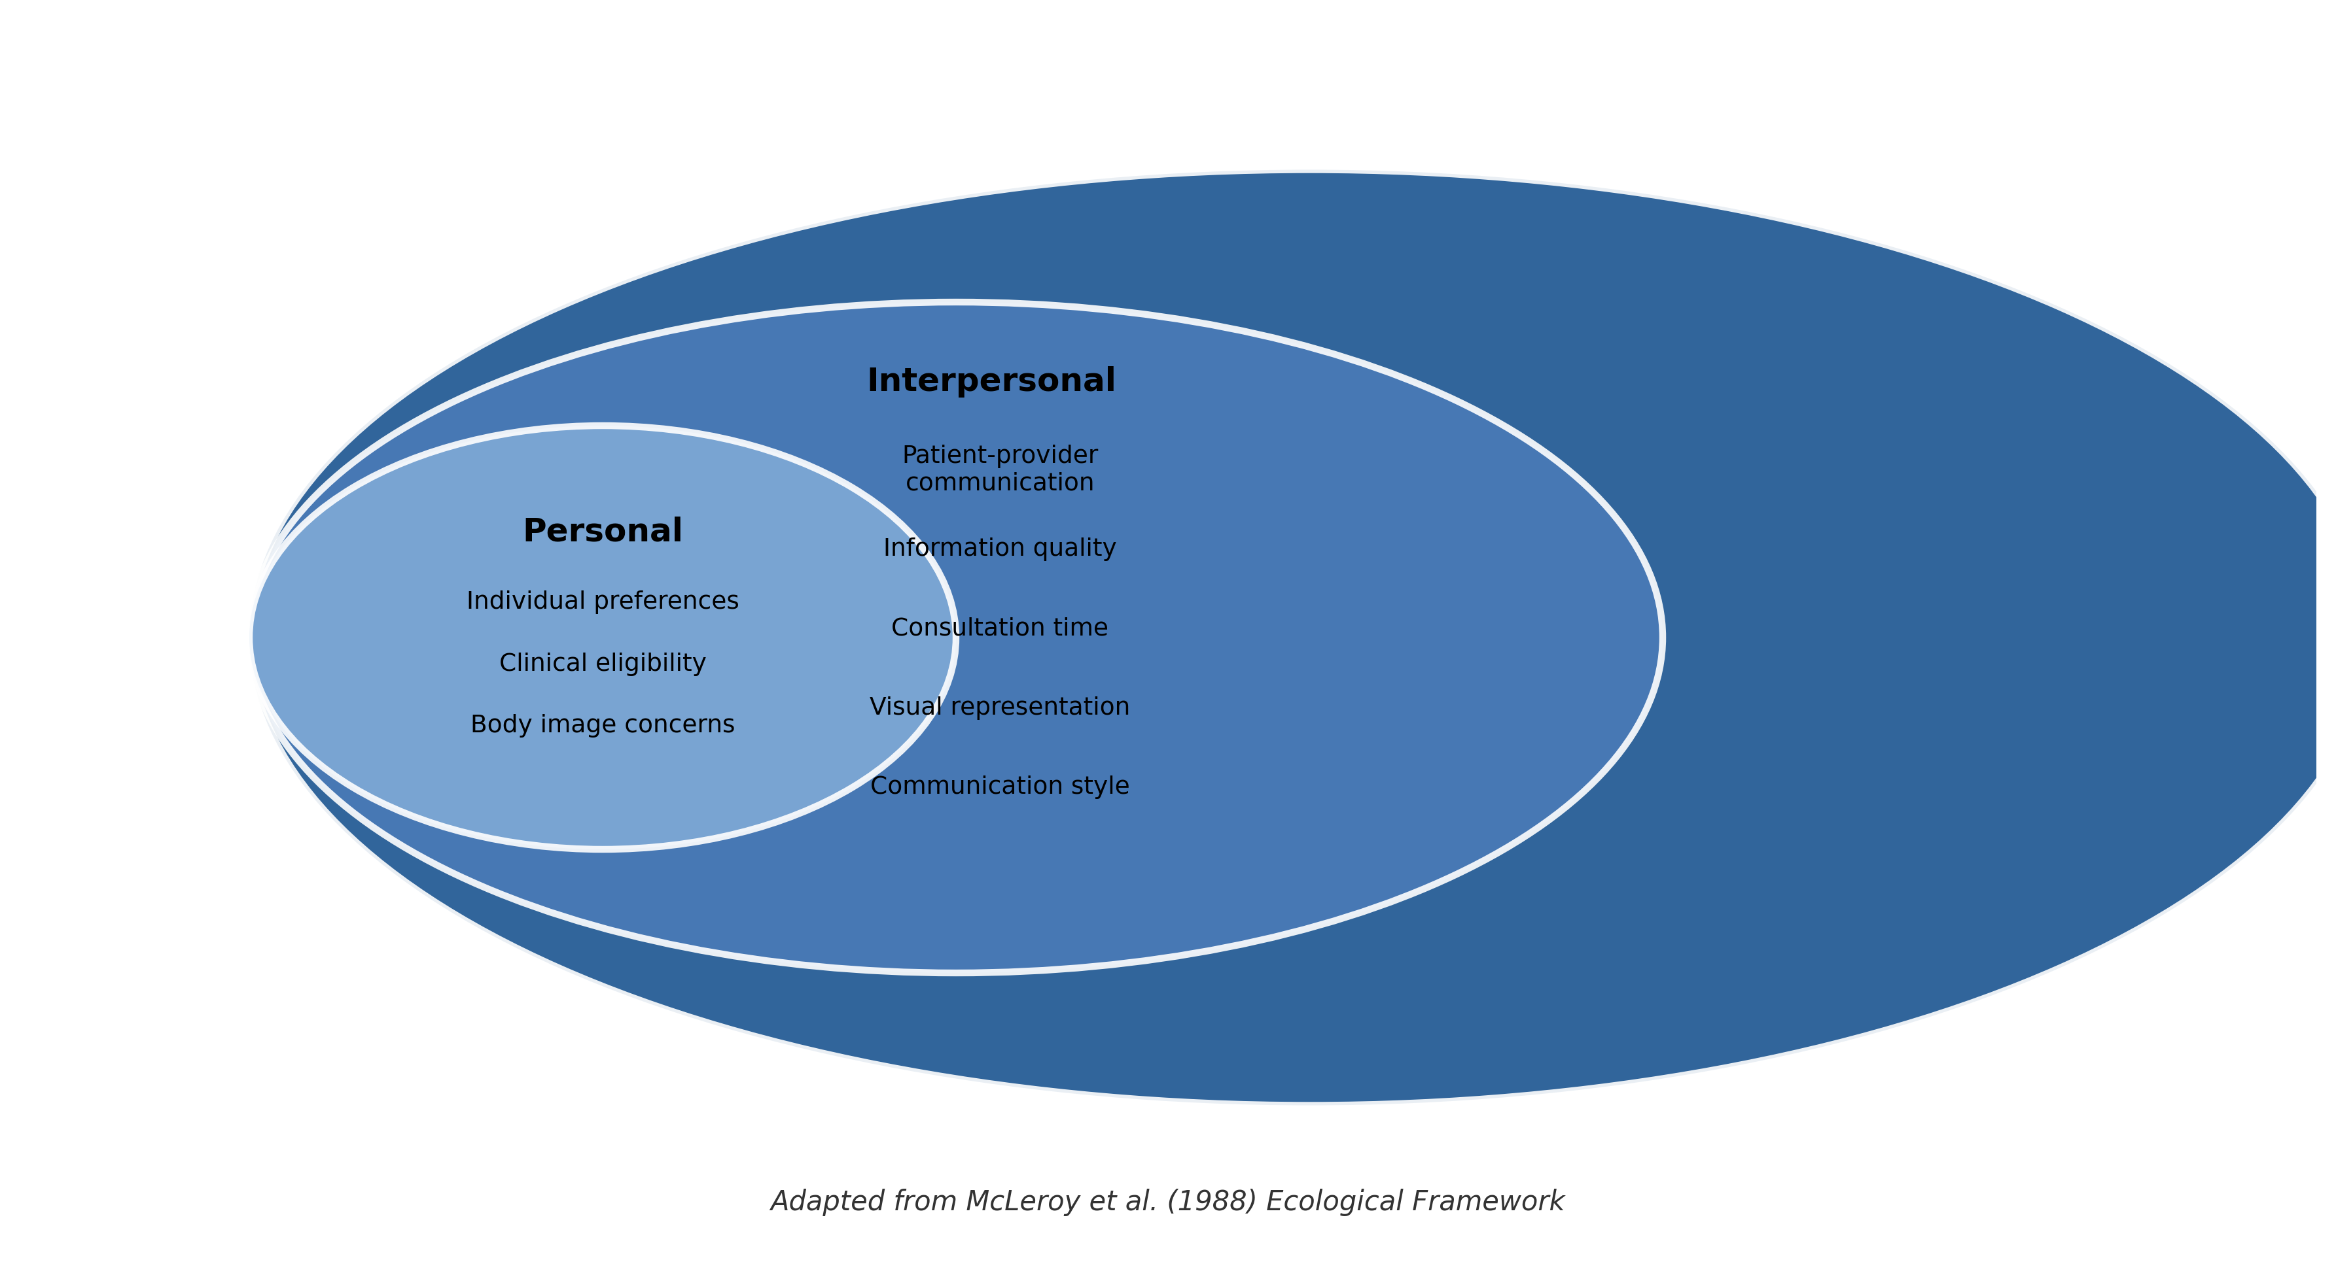
Socioecological Framework
Adapted from McLeroy et al. (1988) Ecological Framework

