Slide 1
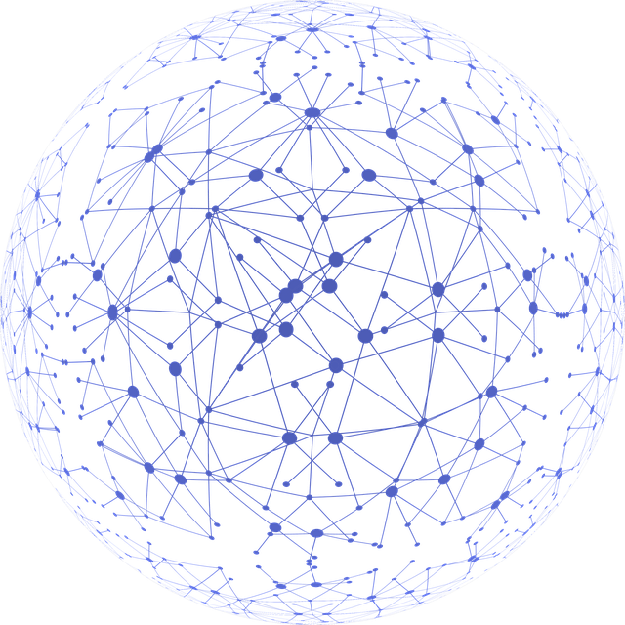
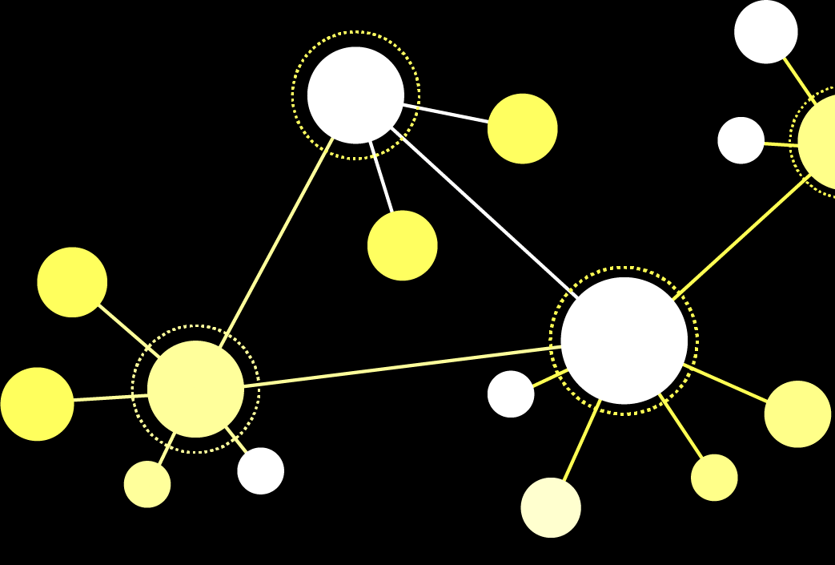
Resilience In Weighted Networks
Aslan Ahmet Haykır
Sevgi Nur Bilgin
Enes Bilgin
Notes:
Hello everybody,
In this project we tried to analyze resilience of weighted networks

Slide 2

What is the resilience of networks ?
Notes:
What is the resilience of system ?
-Defined as a system’s ability to retain its basic functionality when errors, failures, and environmental
changes occur,
it is a crucial property of many networked systems.

Slide 3
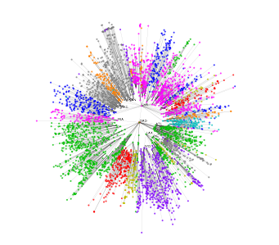

How can we measure the resilience ?
Largest connected component size (LCC)
Global Efficiency
Notes:
So How can measure it ?
(Pass) There are too many metrics to measure it but we gonna focus on largest connected component size so we are able to see how structure percolates
(Pass) And another metric we used, the global efficiency which will provide us to see efficiency of network globally even if network is separated to multiple components.
Most of the previous works , generally focused on mostly local properties of graphs to measure resilience.

Slide 4
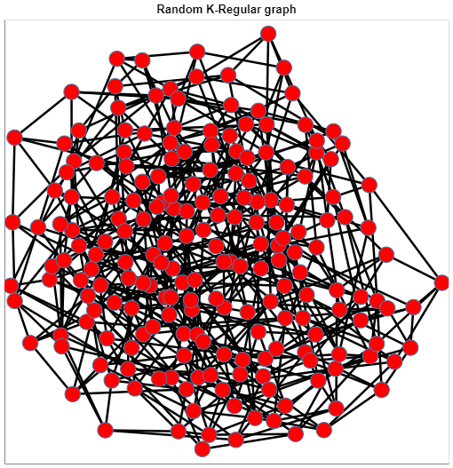
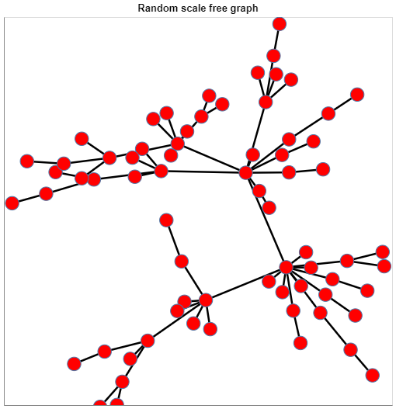
Network Models
K- Regular Networks
Scale- Free Networks
Notes:
We have chosen two different network type for analyze.
(Pass) First one K-Regular, an homogeneous network in which every member has equal link
(Pass)And the other one is Scale Free networks in which most of nodes have one or two links and some of them has most of the links as hubs like internet

Slide 5
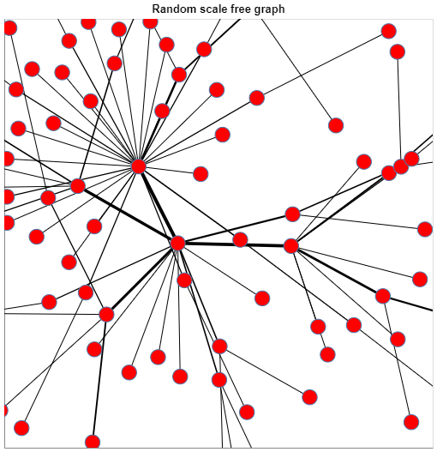
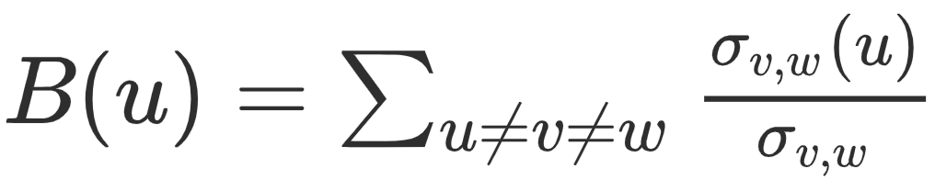
What do nodes and edges represents ?
Notes:
If you ask what these edges and nodes represent ?
You can think of these graphs as computer network and the nodes represent routers and switches so the edges will represent cables carrying the information and data.
So how we assign weights to the edges ?
In the figure, Weights will reflect the capacity of each edge (you can think of the capacity as quantity of information flows).
(Pass) so We measure this capacity using edge betweenness centrality then normalize it.
(Pass) If we measure the global efficiency with this weight distribution, higher weights will be avoided by shortest path algorithm so we take reciprocal of edge.

Slide 6
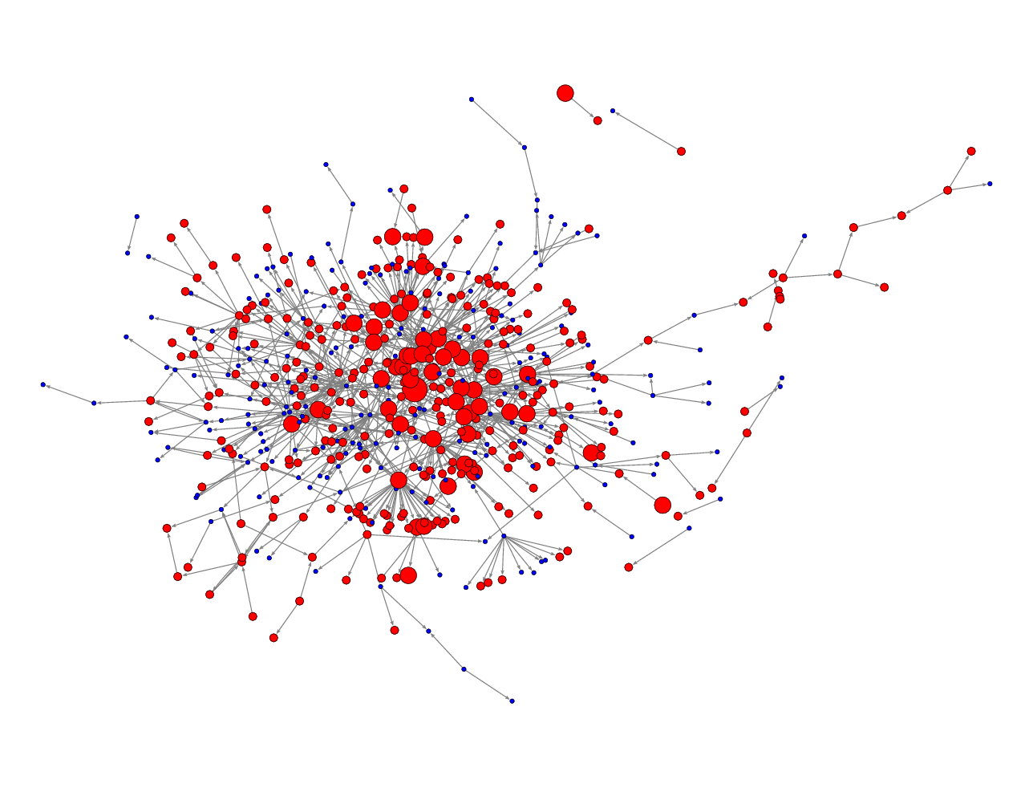
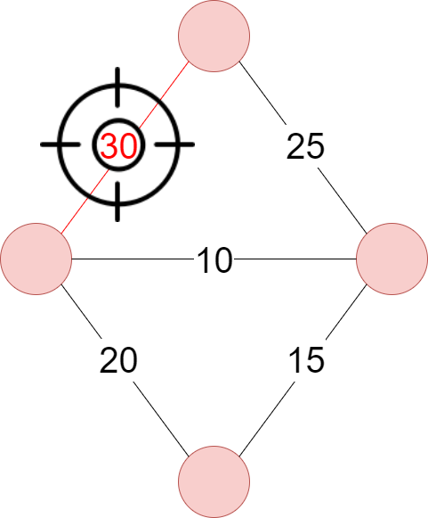
Attack Models
Notes:
Let's come to how we attack these networks ?
We have planned to attack the edges. Most of previous work they had targeted the nodes to see how those affects the systems
However, in real-life systems, edge failure is also an important factor responsible for performance degradation.

Slide 7
Attack Strategies
Highest weight
Notes:
So we define two attack strategies
The first one is Highest weight
In each attack step, we remove the edge with the highest weight.
Because heights weights edges carry most of the information

Slide 8
Attack Strategies
Random removal
Notes:
Random removal.
Edges are removed randomly. In each step, we randomly choose an edge and remove it.
Because the random attack will represent the daily failures of the system.

Slide 9
Null Model by Rubinov and Sporns
Each iteration
Randomly select 4 nodes
That have positive connections (u1,u2) , (u3,u4) and
negative connections (u1,u3) , (u2,u4)
Reverse the signs of these 4 connections
Randomize the connection weights
Notes:
We also used The Rubinov and Sporns algorithm to create null models and
the main property of this model, it preserves strength distribution of original networks
.

Slide 10
EXPERIMENTS

Slide 11
Dataset Properties
 | Node Count | Edge Count
Scale Free Network | 1000 | 1996
K-Regular Network | 1000 | 2000
Notes:
We make our first analyze with these datasets.
They nearly have same number of nodes and edges.

Slide 12
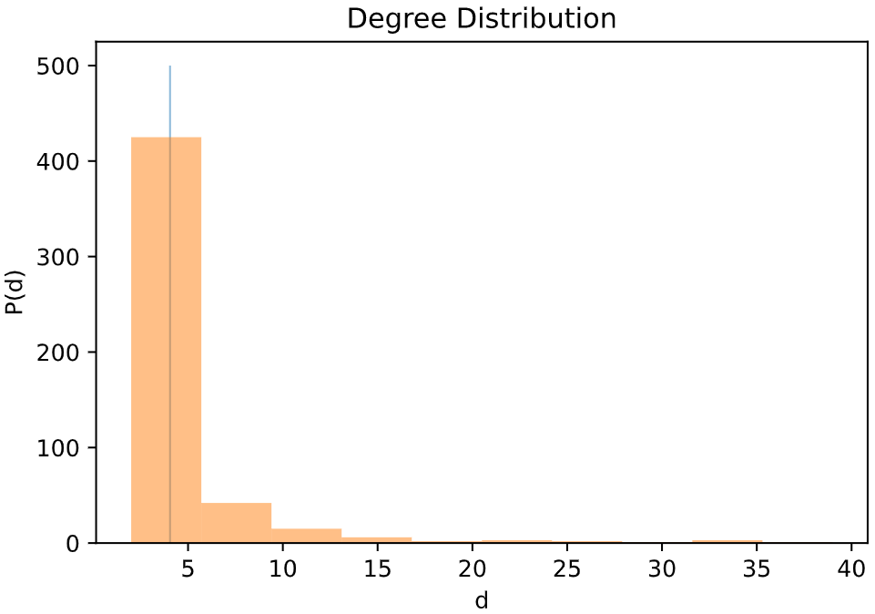
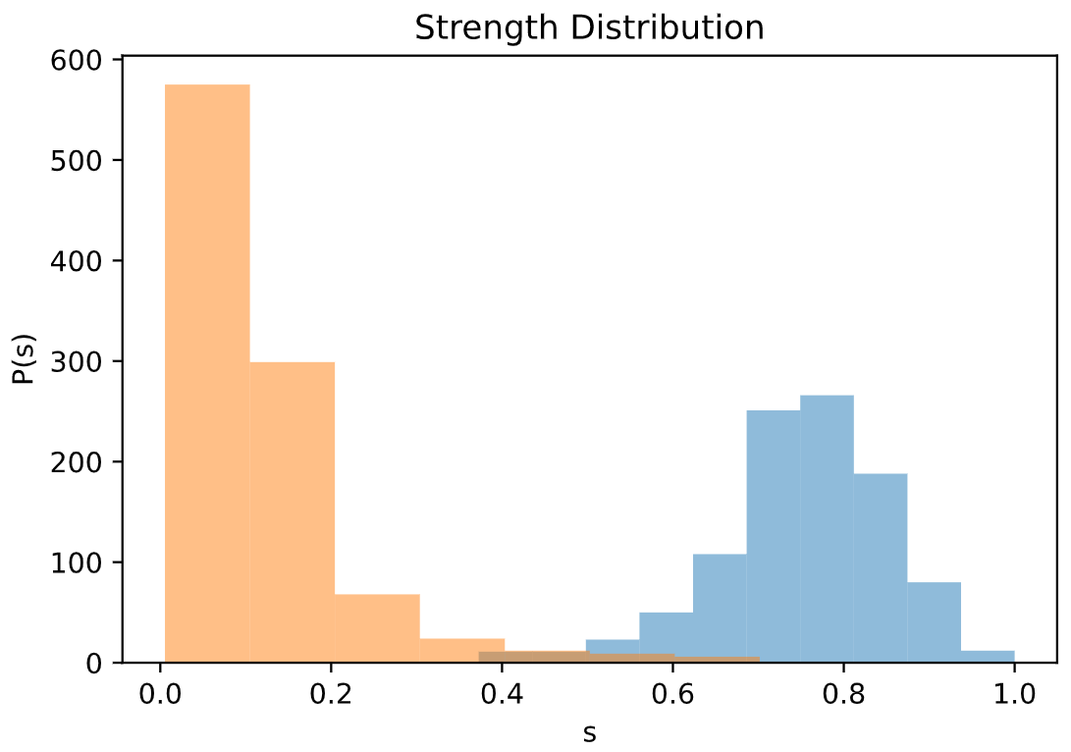
Dataset Properties
Notes:
These plots represent the distribution of our sample networks.
Orange one is Scale Free
the Blue one is K-regular

Slide 13
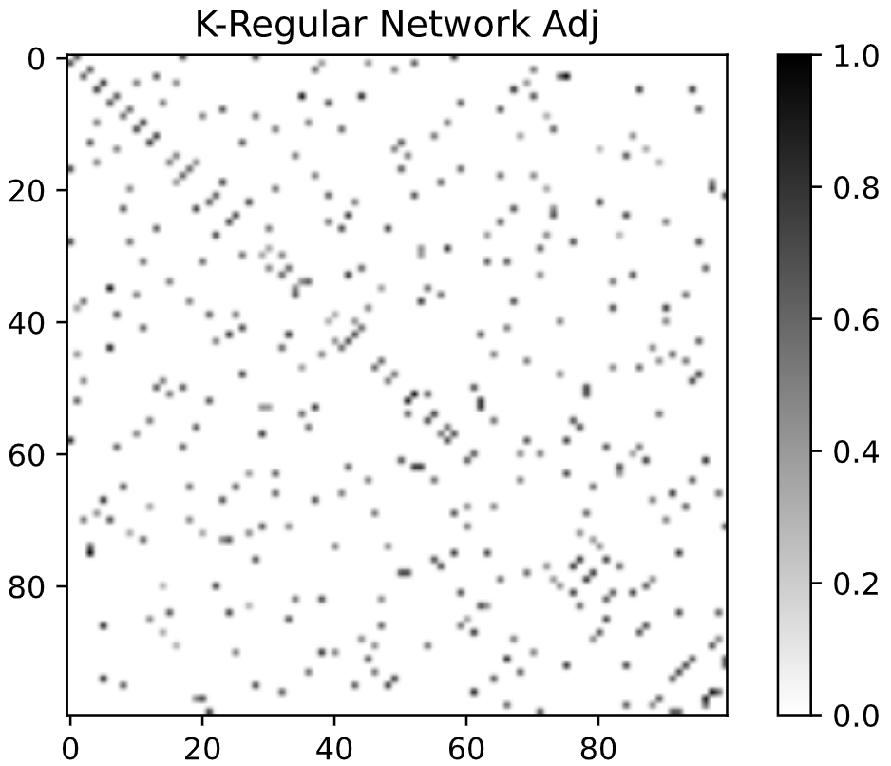
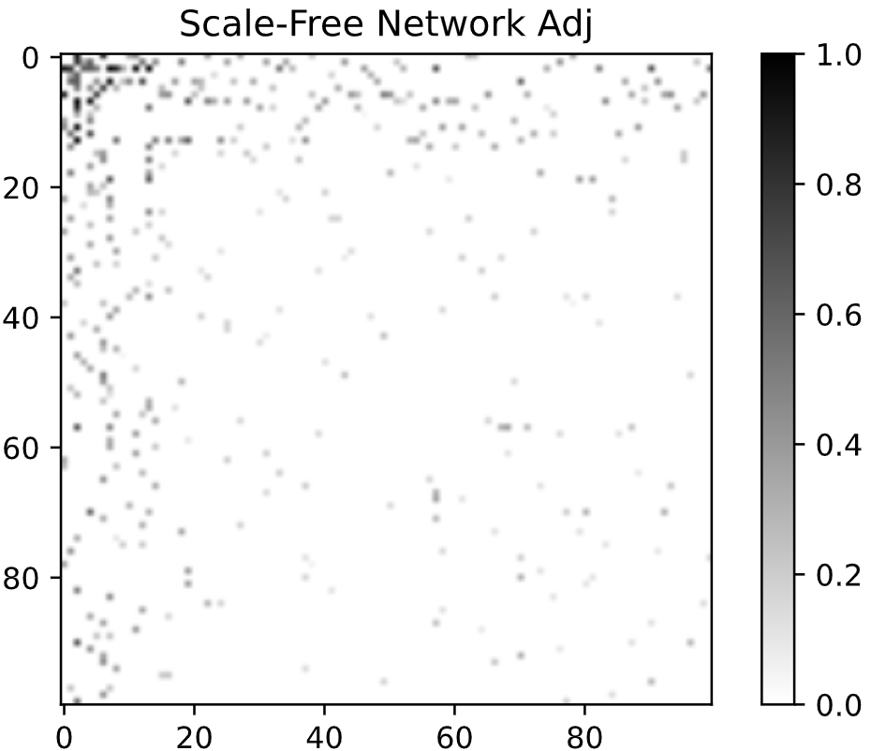
Dataset Properties
Notes:
These are adjacency matrices of our sample graphs

Slide 14

RESULTS
Notes:
Lets see the result of each experiments

Slide 15
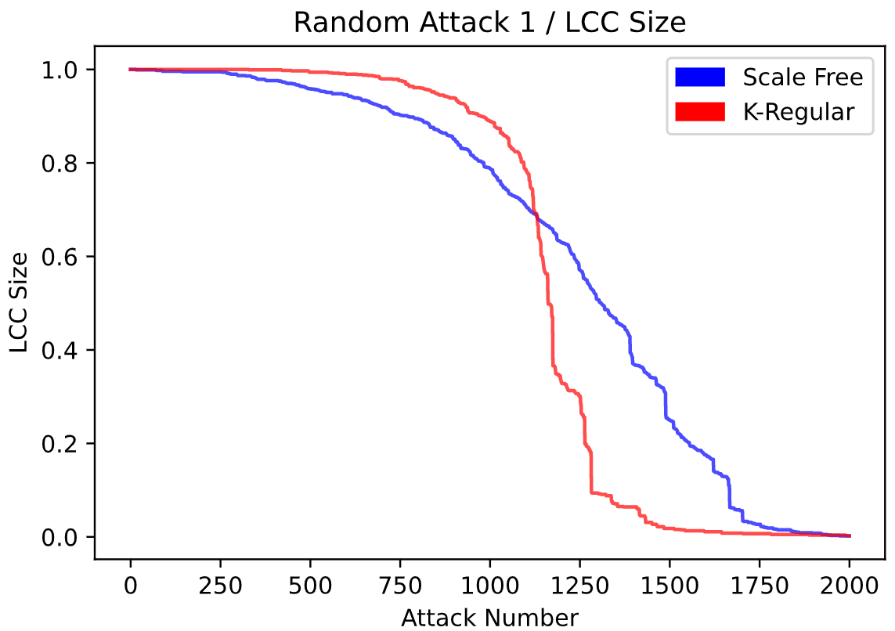
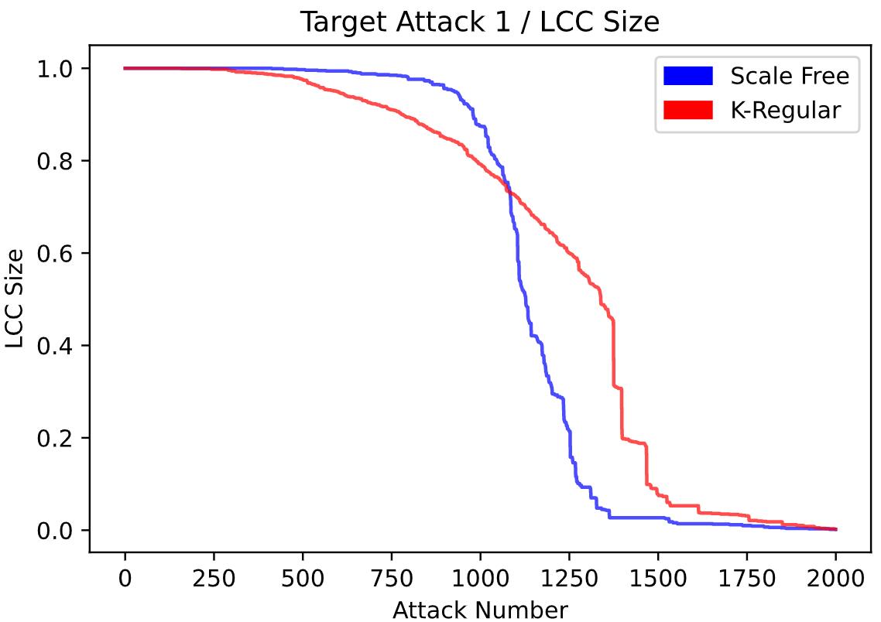
Results
Notes:
In these figures, you can see with every new attack how LCC size is changing.
The first figure present random attack on both graph and
it seems that the Scale-Free networks are fragmented slower than K-Regular and also doesn't present a sharp fall as K-Regular network
The second figure represents target attacks, as expected scale free networks fragmented suddenly.

Slide 16
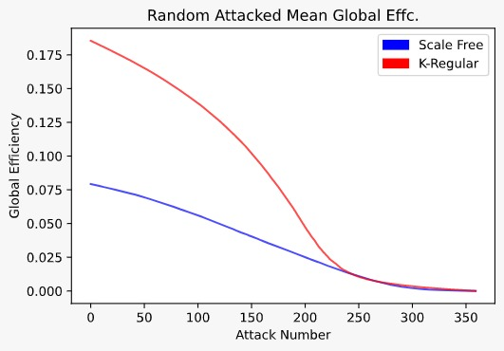
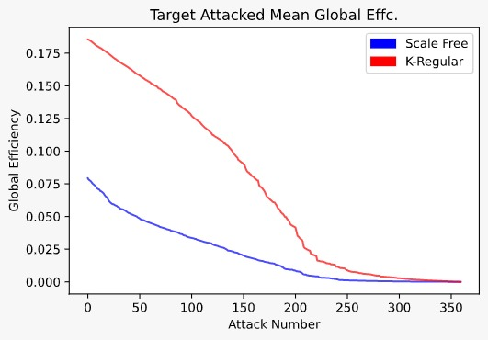
Results
Notes:
In these figures, you can see how global efficiency is changing with every new attack.
The first figure present random attack on both graph.
As expected, in the first place K-regular networks are more efficient than scale free network due to homogeneous link distribution
but with every new attack, it fastly losts its efficiency according to the scale free.
In the second figure,
k-regular networks show same behaviour but the scale free network has lived a small sudden fall due to attack to its heights weights.
.

Slide 17
Dataset Properties
 | Node Count | Edge Count
Scale Free Network | 180 | 356
K-Regular Network | 180 | 360
We have simulated our network with previous null model. At the end, we have 100 graphs with same strength distribution.
Notes:
We also simulate experiments with 100 networks created by null model

Slide 18
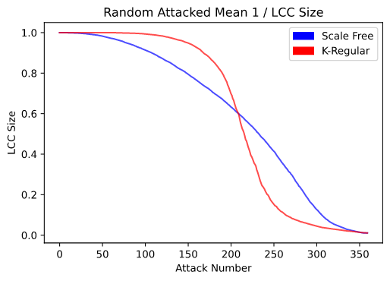
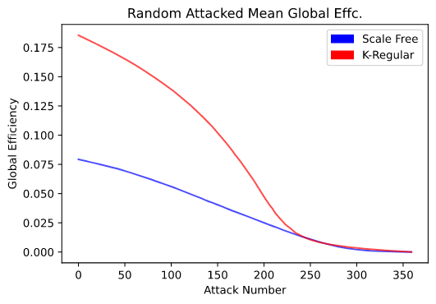
Mean Results
Notes:
We see similar results as previous.
But this time we show how lcc size and global efficiency changes with random attacks

Slide 19
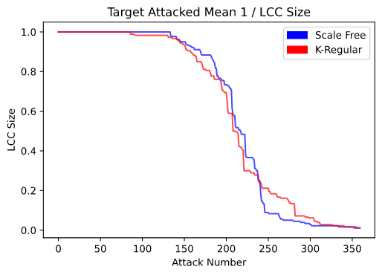
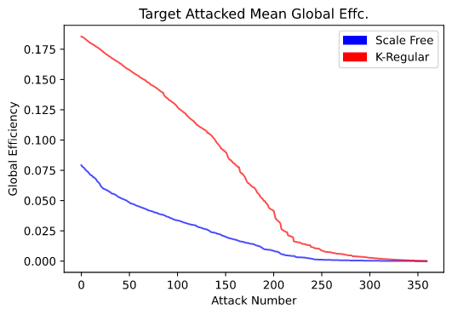
Mean Results
Notes:
Our conclusions
K-regular networks has higher efficiency than scale-free networks
but Scale free networks seems to be resilient than K-regular networks especially under random attacks.

Slide 20
Thank you for listening

