Slide 1

MOREHOUSE SUPERCOMPUTING FACILITY (MSF)
WELCOME TO
HPC OFFICE HOURS
Dr. Ashley Scruse · Deputy Director, MSF
Tonight: getting you onto the supercomputer
Notes:
Name, Deputy Director, MSF.
Relaxed hour. No jobs, no code.

Slide 2
TONIGHT, WE DIP OUR TOES IN
01
02
03
Get access
Finish onboarding
Explore the system
THE ONE REQUIREMENT Leave tonight with MFA set up and able to log in.
Everything else is optional. Follow along or just watch. No jobs, no code, nothing to memorize.
MOREHOUSE SUPERCOMPUTING FACILITY · HPC OFFICE HOURS
Notes:
Three steps.
Only requirement: MFA + login.
Then: switch to guide page for MFA.

Slide 3
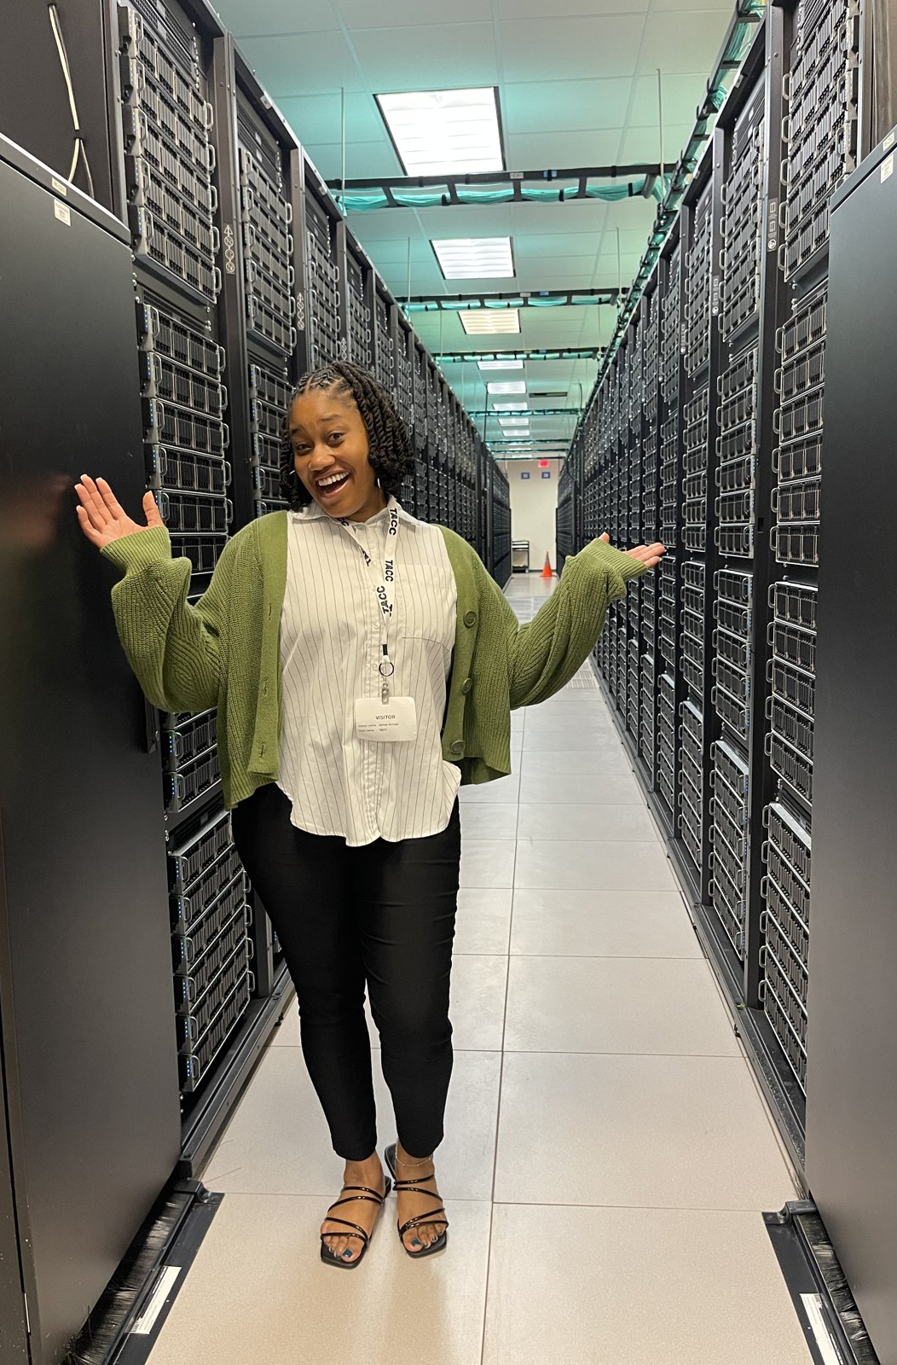
YOU NOW HAVE ACCESS TO A NATIONAL SUPERCOMPUTER
A national academic computing resource, shared by researchers across the country
Thousands of computers, called nodes, working together
Built for work too big or too slow for a laptop
MOREHOUSE SUPERCOMPUTING FACILITY · HPC OFFICE HOURS
Notes:
Stragglers keep working on MFA.
National resource, shared.
Nodes = computers working together.

Slide 4
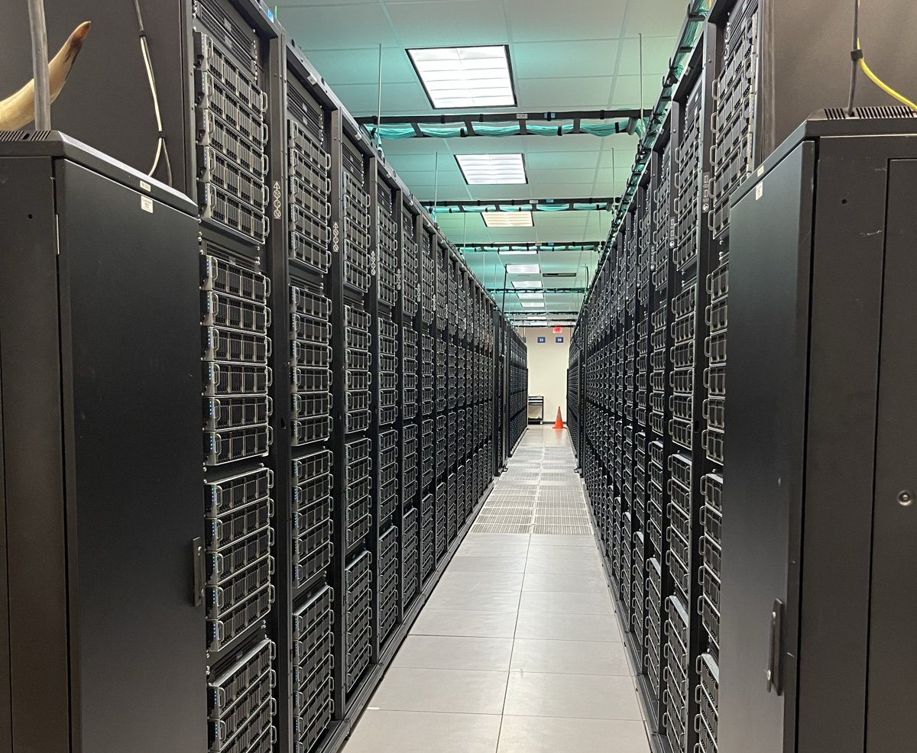
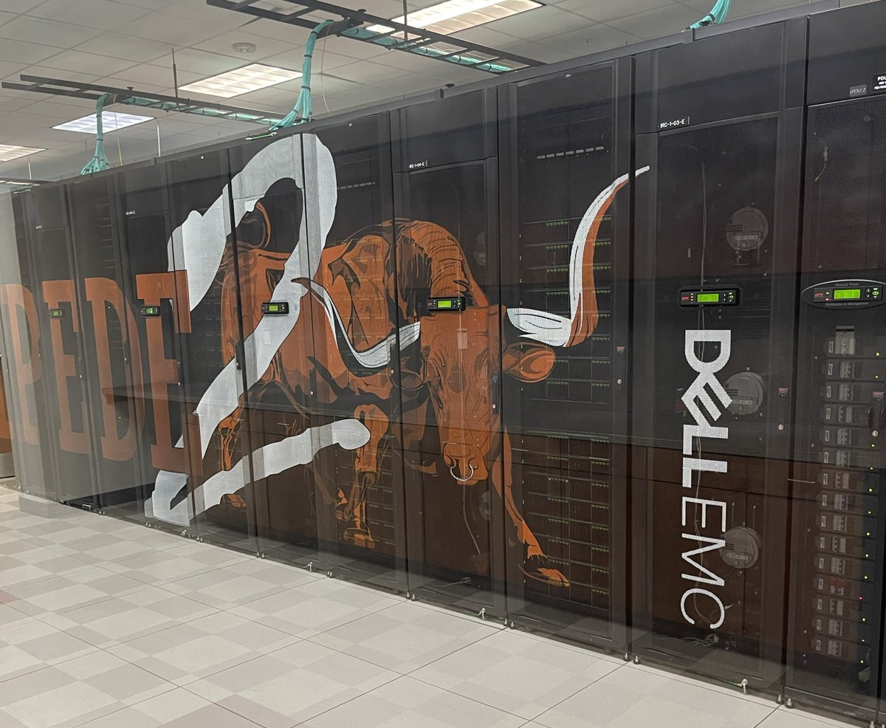
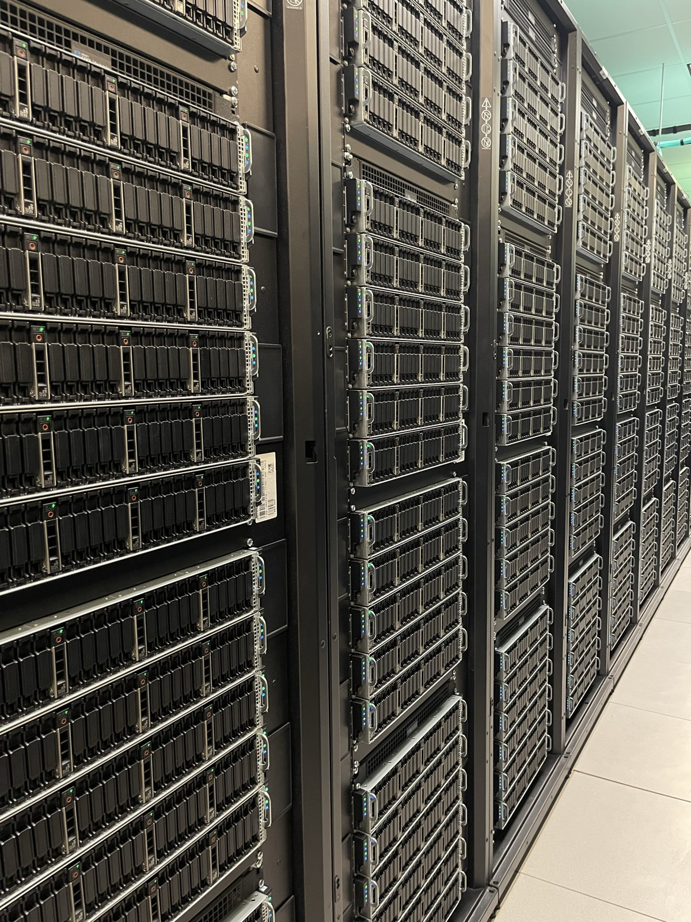
ONE RESOURCE, SEVERAL SYSTEMS
VISTA
STAMPEDE3
FRONTERA
Our focus tonight
Also available to you
Also available to you
Same account, same login. Each system is built for different kinds of work.
MOREHOUSE SUPERCOMPUTING FACILITY · HPC OFFICE HOURS
Notes:
Same account, same login.
Vista tonight.

Slide 5
WHEN DO YOU NEED IT?
01
02
03
04
Too big
Too slow
Too many
Build skills
Your data is too big to open on a laptop
Your analysis takes hours or days to run
You need to run the same thing many times
Linux, shared computing, and the tools research runs on
GOOD NEWS Your project doesn't have to need a supercomputer. Learning how to use one counts.
MOREHOUSE SUPERCOMPUTING FACILITY · HPC OFFICE HOURS
Notes:
Too big, too slow, too many.
Card 4: learning counts.

Slide 6
SECTION
A SHARED SYSTEM
You share this machine with researchers around the world. Shared systems come with rules.
MOREHOUSE SUPERCOMPUTING FACILITY · HPC OFFICE HOURS
Notes:
Shared machine = rules.

Slide 7
NODE VS. CORE
CORE
NODE
VISTA
One worker inside a processor
One whole computer, full of cores
All the nodes wired together
›
›
1
144
856
worker
cores per CPU node (72 per GPU node)
nodes: 256 CPU + 600 GPU
VISTA IN TOTAL 856 nodes and 80,064 cores working together.
MOREHOUSE SUPERCOMPUTING FACILITY · HPC OFFICE HOURS
Notes:
Core = one worker.
Node = 144 cores (72 on GPU nodes).
Vista = 856 nodes, 80,064 cores.

Slide 8
LOGIN NODES VS. COMPUTE NODES
LOGIN NODE
COMPUTE NODE
Where you land when you log in
Where the real work runs
Shared by everyone at once
Reserved for you
Organize files, edit, submit
Heavy analysis, big data
THINK OF IT AS The login node is the lobby. The compute nodes are the labs.
MOREHOUSE SUPERCOMPUTING FACILITY · HPC OFFICE HOURS
Notes:
Login node = lobby. Shared.
Compute = labs.
Sets up rule 1.

Slide 9
THREE PLACES FOR YOUR FILES
 | $HOME | $WORK | $SCRATCH
Space | 23 GB | 1 TB | No limit
For | Settings, small scripts | Your projects | Big, temporary runs
Backed up | Yes | No | No
Deleted automatically | Never | Never | After 10 days untouched
RULE OF THUMB Keep your projects in $WORK. Treat $SCRATCH as temporary.
MOREHOUSE SUPERCOMPUTING FACILITY · HPC OFFICE HOURS
Notes:
HOME small, backed up.
WORK = your projects.
SCRATCH = temporary, 10 days.
These are the folders you'll see in Tapis.

Slide 10
THREE WAYS TO GET A COMPUTE NODE
01
02
03
Queue
Interactive session
Reservation
Submit a job and wait your turn. First come, first served. Best for long or overnight runs.
Work on a compute node live. Good for testing code. Coming in the next workshop.
Book nodes ahead of time with a ticket in the user portal. "Two Grace Hopper GPU nodes on Vista, Thursday 8am to 8pm."
TEST BEFORE YOU QUEUE A script that fails after hours in line sends you to the back of the line.
MOREHOUSE SUPERCOMPUTING FACILITY · HPC OFFICE HOURS
Notes:
Queue: wait your turn.
Interactive: next workshop.
Reservation: ticket.
Story: waited hours, script failed instantly.

Slide 11
THE RULES OF THE SYSTEM
1
No heavy work on the login node. It is shared. Heavy work goes to compute nodes.
2
Your account is yours. Never share your password or MFA.
3
Keep a copy of anything important. $SCRATCH is cleaned out automatically.
4
Stuck? Ask. Breaking something by guessing is worse than asking.
MOREHOUSE SUPERCOMPUTING FACILITY · HPC OFFICE HOURS
Notes:
Four rules. Read them out.
Then: switch to Tapis.

Slide 12
WHAT'S NEXT: REAL DATA FOR YOUR OPIL WORK
The data: the CFPB Consumer Complaint Database. About 10 million real complaints about money transfers, prepaid cards, and digital payments, too big for a laptop.
OCT 14 WHAT THE DATA SAYS
NOV 4 FINDING THE PAIN POINT
Count complaints by product, company, state, and year. Each team edits one cell for its own sector and state.
Read the complaint narratives at scale and pull the theme closest to your team's business problem.
You leave with: Three numbers for your Monetization Canvas (due Oct 23).
You leave with: The pain point, with numbers, for your business model and your Dec 4 pitch.
WHY IT MATTERS Swap "we think people struggle with payments" for "this many people said so." The pain points you find this fall become the requirements for your open payments prototype in the spring.
MOREHOUSE SUPERCOMPUTING FACILITY · HPC OFFICE HOURS
Notes:
CFPB complaints, ~10M.
Oct 14: three numbers for the Canvas.
Nov 4: the pain point.
Fall evidence = spring prototype.

Slide 13
LET'S CONNECT
DR. ASHLEY SCRUSE
STAY LOCKED IN
LINKEDIN
MSF LINKEDIN
linkedin.com/in/ashleyscruse
[MSF LinkedIn URL]
EMAIL
CBPC LINKEDIN
ashley.scruse@morehouse.edu
linkedin.com/company/morehousecbpc
GITHUB
CBPC
github.com/ashleyscruse
bpccenter.org
MSF GITHUB
github.com/morehouse-supercomputing
Guide from tonight: morehouse-supercomputing.github.io/hpc-office-hours
MOREHOUSE SUPERCOMPUTING FACILITY · HPC OFFICE HOURS
Notes:
Connect. Guide link.
Questions.

