Slide 1

New Branch location
GymNextGen
Where to open new store and office in Miami, fl.

Slide 2
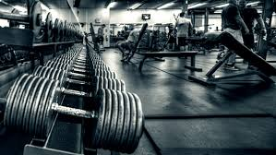
Future looking
Societies evolves to be more fitness and health conscious.
Major cities require larger number of gyms and sport stores in the heart of their more populous places.
More people is avid for lifestyle change and ways to be more active.
Committed to help people and service providers in their search for better life.
Our next step, Miami, Fl

Slide 3
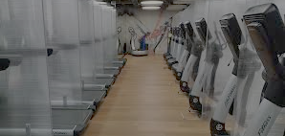




The Problem
Market Share
Financial
Proximity
Cost
Location
Market Share will decline if Company Expansion is not carefully planned.
Optimum decisions will avoid financial unbalance.
Company motto is to grow and work closely with all our customers.
Careful selection of new branch location will avoid requiring more than one branch in the city.
But how to find Optimum Location?

Slide 4


Data hunting
Foursquare service
FourSquare is a service company specialized in providing many sorts of geospatial data oriented to business and customers.
Tables containing information of businesses name, type, geographical coordinates and addresses which are located within a certain radius from a given location.
Result: Table of Gym locations in Miami, Fl.

Slide 5
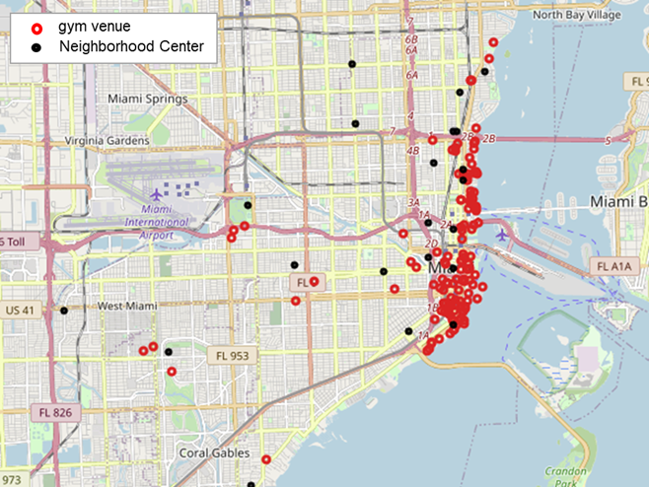
Data exploration
Cleaning and visualization
All Data Obtained was quality controlled and cleaned and stored in a pandas DataFrame for manipulation.
The resulting dataset consisted of 129 gym locations.
Most of the venues were more densily located along the beach.

Slide 6
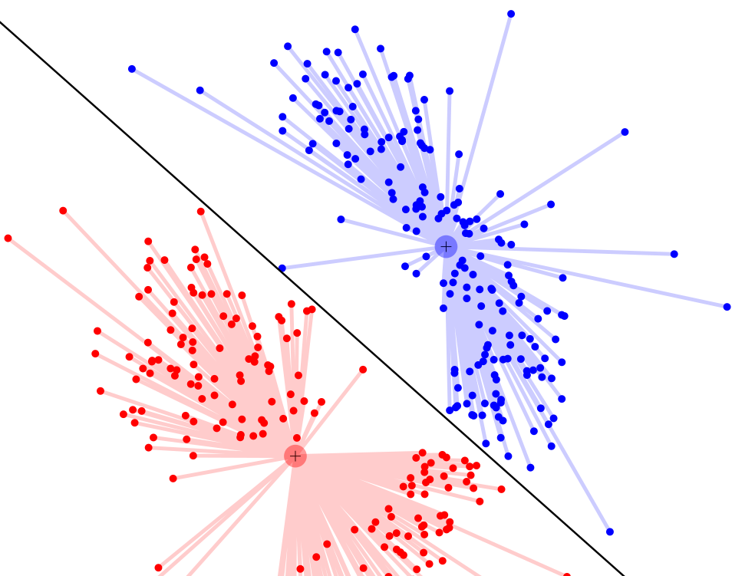
Optimum locations
Use of k-means algorithm
K-means algorithm splits a given population based on its distance to a cluster center.
Cluster Centers are iteratively selected such that minimum distance to all samples are achieved.
By input the gym locations data, algorithm is expected to output locations which minimize the geographical distance to all the gyms in their area.
Require pre-define number of clusters.

Slide 7
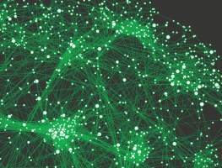
Optimum locations
What metric
How to select the best cluster center as optimum location of new branch location?
Metrics considered:
Max Number of Gyms in the cluster.
Minimum mean distance between the gym locations and cluster center.
Maximize a pseudo density metric: Number of Gyms divided by mean distance.
The pseudo density metric was selected as includes the first two in a single number.

Slide 8
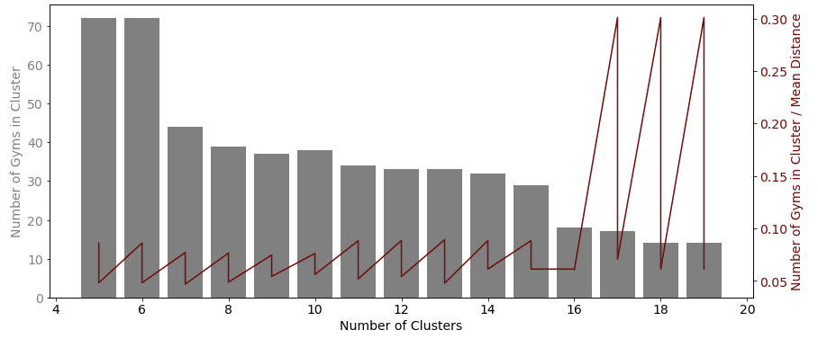
K-MEANS RUN FOR MULTIPLE NUMBER OF CLUSTERS
To understand the impact of the number of cluster that the city is divided into the result of optimum location
Higher than nineteen (19) clusters, empty clusters start appearing so the realizations were bounded to nineteen clusters maximum.
Higher than sixteen (16 clusters) algorithm runs into problems as starts finding clusters with to small frequency cluster together in a small region of the city.
More stable results were found when selected to divide the city between seven (7) and fifteen (15) clusters.

Slide 9
K-MEANS RUN FOR MULTIPLE NUMBER OF CLUSTERS
To understand the impact of the number of cluster that the city is divided into the result of optimum location
 | Cluster Centroid
Clusters Number | Latitude | Longitude | Number of Gyms | Mean Distance | Gyms/MeanDist | ranking
11 | 25.76278 | -80.1923 | 34 | 385 | 0.088 | best place
11 | 25.77301 | -80.1906 | 24 | 462 | 0.052 | second best
12 | 25.76193 | -80.1921 | 33 | 373 | 0.089 | best place
12 | 25.77255 | -80.1916 | 29 | 535 | 0.054 | second best
13 | 25.76141 | -80.1927 | 33 | 370 | 0.089 | best place
13 | 25.77217 | -80.1887 | 20 | 418 | 0.048 | second best
14 | 25.76245 | -80.1921 | 32 | 362 | 0.088 | best place
14 | 25.7928 | -80.1873 | 14 | 228 | 0.061 | second best
15 | 25.76175 | -80.1926 | 29 | 328 | 0.088 | best place
15 | 25.7928 | -80.1873 | 14 | 228 | 0.061 | second best
Splitting the city between eleven (11) and fifteen (15) clusters result in locations with more than thirty nearby locations within a mean distance between 330 and 385 m.

Slide 10
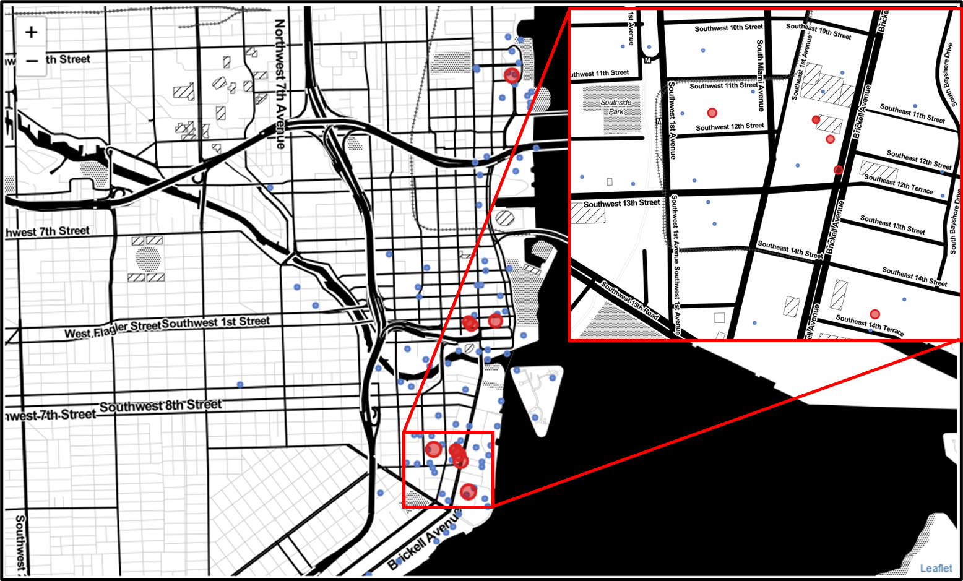
MAPPING BEST LOCATIONS
The best cluster centers resulting of dividing the city between eleven (11) and fifteen (15) clusters were post in a city map.
Most of the best cluster centers identified clearly concentrate in a small area of the city.
Therefore the best area for a new branch is bounded by the Southeast 1st Avenue, the Brickell Avenue, the Southwest 14th Street and Sourtheast 10th Street.

Slide 11
Summary conclusions
Our company specialized in gym services and products is looking to expand by opening a branch in Miami, Fl.
Available census of gym locations in the city was used to select best location for new branch.
K-means algorithm splitted the city in a number of areas and result in best locations.
Most suitable locations were found to be in area bounded by the Southeast 1st Avenue, the Brickell Avenue, the Southwest 14th Street and Sourtheast 10th Street.
The analysis presented recommends to explore options to open a branch in Miami, Fl in the mentioned area.

Slide 12
Thank You

