Slide 1

Report for week 6
Mohammadreza kazemi

Slide 2

Major improvements
The position of generators are not fixed anymore
Convolutional NN was implemented
ResNet was implemented

Slide 3
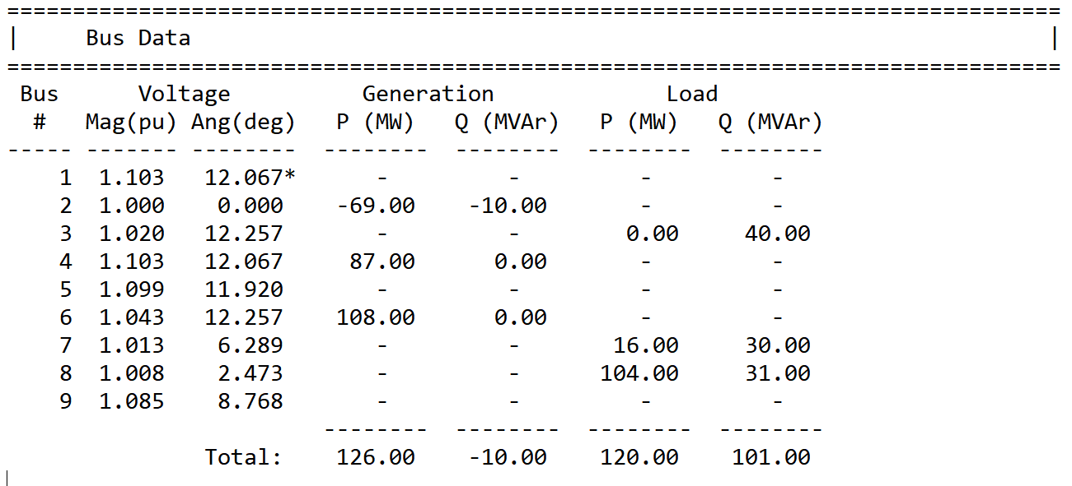





The position of generators are not fixed anymore
Previously, the Position of generators were fixed to bus #1 to 3
Now, the position for demand and supply is randomly generated

Slide 4
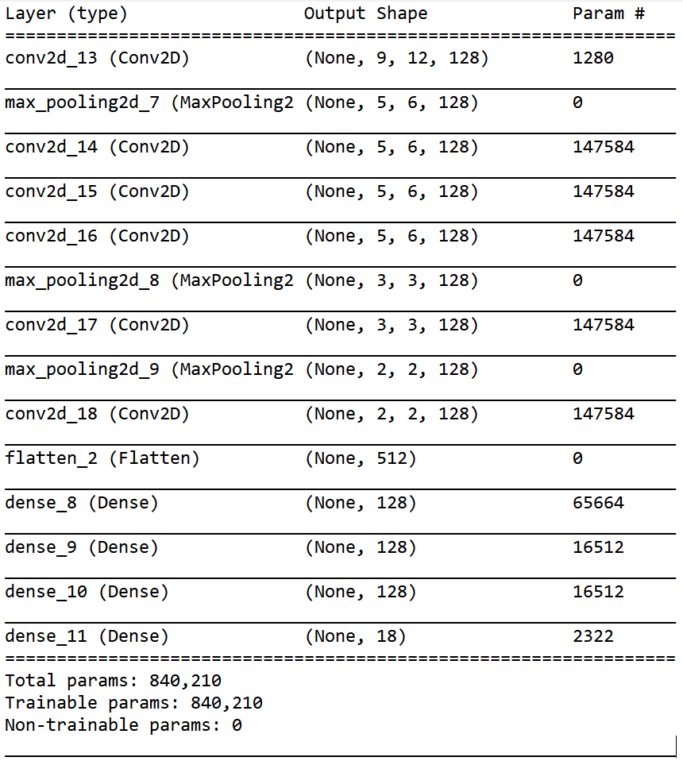
Convolutional NN was implemented
input
A Convolutional NN was implemented
CNN outperformed Fully Connected NN
output

Slide 5
Comparisons between fcnn and cnn
Mean Absolute Error for FCNN with fixed generation and load position: 0.85
Mean Absolute Error for FCNN with variable generation and load position: NaN (No experiment was done)
Mean Absolute Error for CNN with fixed generation and load positions: 0.35
Mean Absolute Error for CNN with variable generation and load positions: 0.52
I believe it is safe to say that CNN outperformed FCNN

Slide 6
Some numbers for CNN
Training:
loss: 0.9694 - accuracy: 0.9928 - mae: 0.5137 - mse: 0.9694
Testing:
loss: 1.0681 - accuracy: 1.0000 - mae: 0.5234 - mse: 1.0681

Slide 7
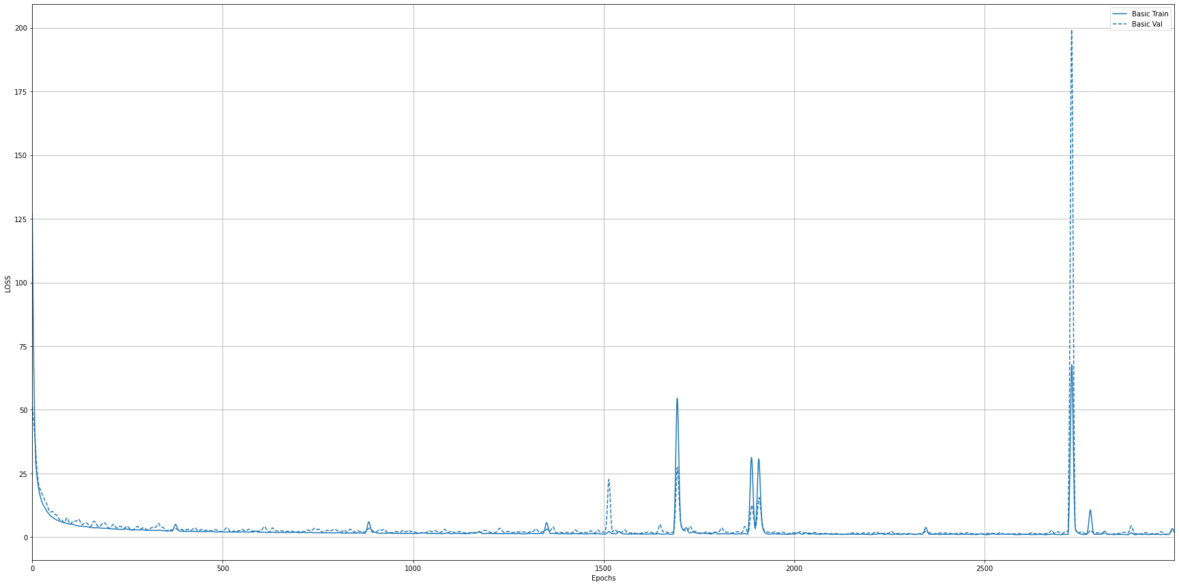
Loss vs. epochs for cnn

Slide 8
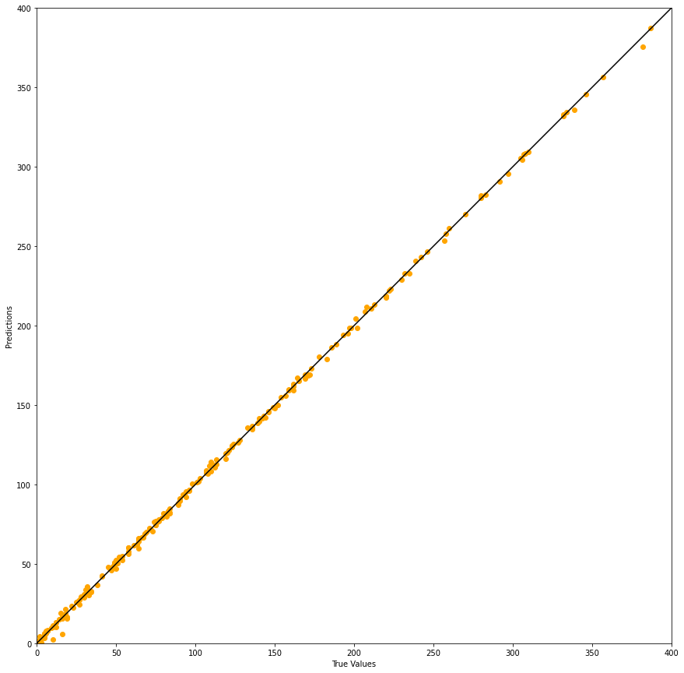
True value vs. prediction

Slide 9
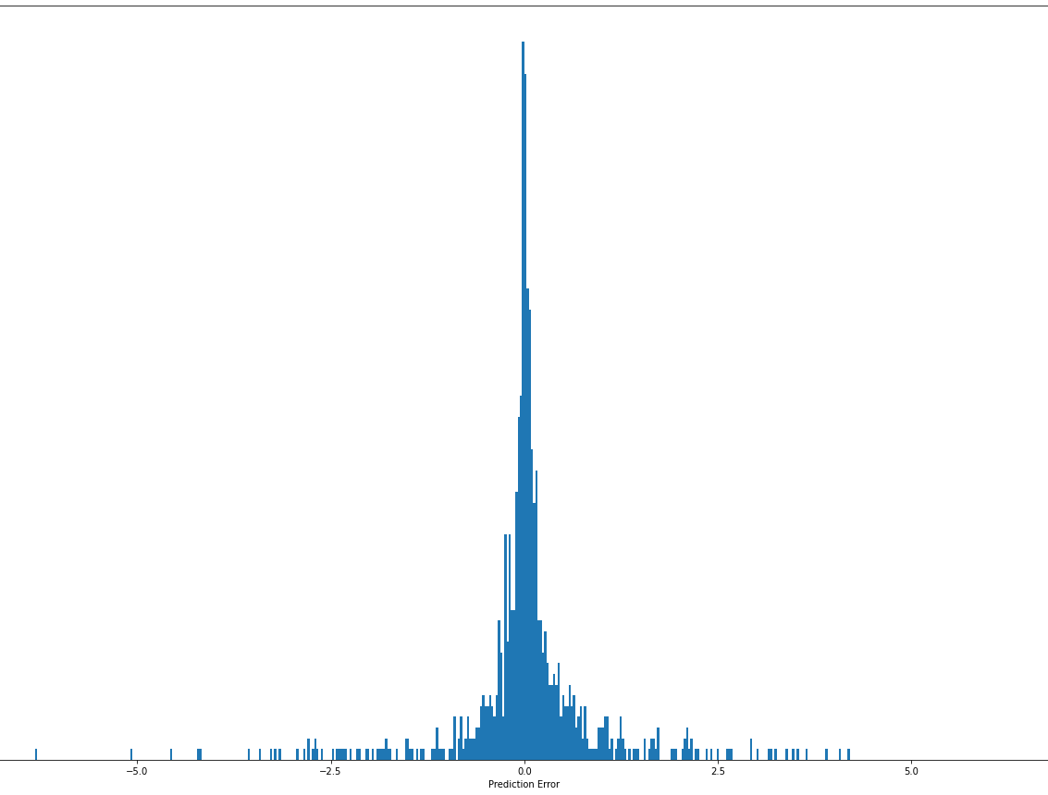
Prediction error vs. count

Slide 10
Test Case 1 (CNN prediction)
Case: 3
Bus # | Generation P (True Value) | Generation P (Prediction) | Generation Q (True Value) | Generation Q (Prediction)
0 | -124.0 | -121.693504 | 30.0 | 30.201191
1 | 0.0 | -0.284206 | 0.0 | 0.907698
2 | 0.0 | 0.535467 | 0.0 | 0.606632
3 | 0.0 | -0.372101 | 0.0 | -0.136823
4 | 92.0 | 92.520256 | 0.0 | -0.042954
5 | 176.0 | 175.870483 | 0.0 | -0.110085
6 | 0.0 | 0.881297 | 0.0 | -0.027453
7 | 0.0 | -0.302840 | 0.0 | 0.061926
8 | 0.0 | 0.365462 | 0.0 | -0.041741

Slide 11
Test Case 2 (CNN prediction)
Bus # | Generation P (True Value) | Generation P (Prediction) | Generation Q (True Value) | Generation Q (Prediction)
0 | 170.0 | 169.818253 | 67.0 | 66.918182
1 | 0.0 | 0.195781 | 0.0 | -0.370815
2 | 91.0 | 89.946724 | 15.0 | 14.529804
3 | 0.0 | -0.208835 | 0.0 | 0.058383
4 | 0.0 | 0.099604 | 0.0 | 0.026538
5 | 0.0 | 0.288580 | 0.0 | 0.073228
6 | 99.0 | 100.341103 | 0.0 | 0.005307
7 | 0.0 | 0.622381 | 0.0 | -0.046634
8 | 0.0 | 0.025451 | 0.0 | 0.075404

Slide 12
Test Case 3 (CNN prediction)
Bus # | Generation P (True Value) | Generation P (Prediction) | Generation Q (True Value) | Generation Q (Prediction)
0 | 0.0 | -0.401420 | 0.0 | -0.176424
1 | 0.0 | -0.301592 | 0.0 | 0.460730
2 | -45.0 | -45.227913 | 89.0 | 89.443909
3 | 0.0 | -0.561829 | 0.0 | 0.044143
4 | 0.0 | -0.152657 | 0.0 | 0.002158
5 | 0.0 | 0.348304 | 0.0 | 0.050586
6 | 11.0 | 12.743074 | 0.0 | 0.123529
7 | 226.0 | 224.611450 | 0.0 | -0.065079
8 | 0.0 | 0.313832 | 0.0 | 0.166100

Slide 13
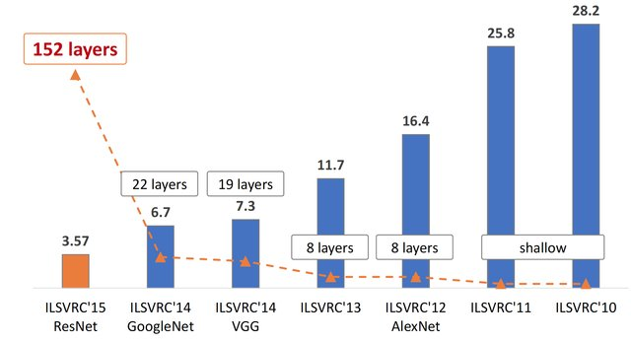
ResNet
Beside CNN, I implemented ResNet, but unfortunately Its implementation was done just last night, and I didn’t get a chance to fully run it. But over 53 epochs, the result was not promising compared to other models. However, I insist on running it, because it is the winner of “ImageNet Large Scale Visual Recognition Challenge” and it beat other models in every category.
Fig. 1. The evolution of the winning entries on the ImageNet Large Scale Visual Recognition Challenge from 2010 to 2015. Since 2012, CNNs have outperformed hand-crafted descriptors and shallow networks by a large margin. Image re-printed with permission.
Source: https://www.researchgate.net/publication/321896881_Iris_Recognition_with_Off-the-Shelf_CNN_Features_A_Deep_Learning_Perspective/figures?lo=1

Slide 14

Thank You

