Slide 1

Blackwell Data Science Team: Credit One Loan Assessment Presented by: Morela Montoya

Slide 2

Statement of Goals
The Data Science Team’s goal is to create a predictive model that will determine the risk of issuing loans to customers based on our clients' background and historical payments.
Assessing clients’ loan risk will help Credit One minimize the number of high-risk clients they sign on that are at likely to default on their loans.
To accomplish our goals the Data Science Team will be using the BADIR Data Science Framework.

Slide 3
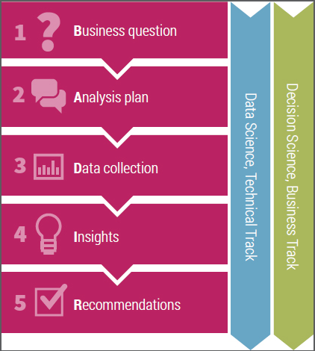
Data Science Framework: BADIR
The BADIR Data Science Framework is a streamlined problem-solving method to efficiently tackle business questions and deliver actionable recommendations. BADIR is an acronym for the following mythology:
Business Question – Identify significance of the problem and how it affects stakeholders and within which context.
Analysis Plan – Create a hypothesis and criteria to prove or disprove each hypothesis. Ensure only relevant data is collected and the data specifications.
Data Collection – Collect relevant data as established in the analysis plan. Cleanse the data and validate it to ensure that it’s accurate.
Insights – Review patterns and revisit the hypothesis. Check if the data can prove or disprove each hypothesis.
Recommendations – Present information that members need to know. Discuss actionable recommendations based on key insights. Provide supporting materials.

Slide 4
Data Sources and Data Management
Approximately 30,000 data points from customers examined extracted from the Credit One SQL Database and stored in a Pandas Dataframe. The following parameters will be studied for correlation:
Credit Amount Given
Gender
Education
Marital status
Age
Past 6 Month Payment Status
Past 6 Month Bill Statement
Past 6 Months Payment History
Clients Behavior

Slide 5
Initial Review: Known Issues with Data
During Pre-Processing initial issues were observed and resolved as shown below:
Features were not labeled with descriptive names.
Resolution: Features were re-labeled with descriptive names.
Three rows in the dataframe did not contain data, instead they contained original feature description.
Resolution: Rows were removed from the dataframe. The IDs numbering were kept the same in case there was any connection with specific customers. However, this could cause a secondary issue when indexing specific rows.
All features were ‘Object’ datatype when values were initially imported into the dataframe.
Resolution: Features were changed to numerical type where it was appropriate. Gender, Education, and Client Behavior were kept as objects because their values were strings.
In order to create a predictive model, entries need to be numerical datatype but Gender, Education, and Client Behavior have string entries.
Resolution: Create new columns that can transform the data to numerical categories.

Slide 6
Data Process Flowchart
After establishing the business question and hypothesis, data can be collected and processed to determine if the hypothesis can be proved or disproved. Below shows the data process flowchart that will be followed to evaluate our hypothesis.
Import data collected
Build connection with SQL database and extract data into a pandas dataframe.
Pre-Process data
Check data types.
Exploratory Data Analysis (EDA)
Review summary statistics.
Check for duplicates
Check for missing data or empty strings.
Review Pandas Profiling to check if there are any other unusual or unexpected issues with the data.
Compare features to determine if there is any correlation with the dependent variable.
Use visualizations like matplotlib, seaborn and pandas plots to demonstrate relationships.
Create a predictive model
Verify that data is within the scope of the analysis plan by checking min, max, range, distribution of the data.
Test Hypothesis
Based on the relationships seen in the EDA, a predictive model will be trained using the SkiKit-Learn Test/Train Split function.
Cross-validation will help confirm the best-fitting model to achieve the greatest accuracy.
After creating a model, a decision tree can be created to determine which parameters are most important at predicting a client’s behavior.
A prediction accuracy of >75% will be used as the metric to determine if the hypothesis can be proved or disproved.

Slide 7
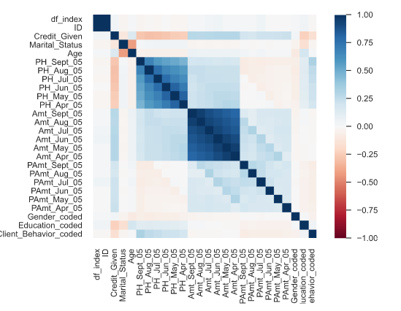
Initial Data Insights
Initial review of the data shows that approximately 22% of client’s have defaulted on their loan.
The correlation chart does not show any clear relationships with the dependent variable (Client Behavior) because of its binary nature. Additional plots of feature subsets will be analyzed to determine if there are any other relationships between client demographic data and client behavior.
The heat map shows a correlation between the number of months that a person has had their payment delayed and customer default.
Pearson’s r correlation from Pandas Profiling Report

