Slide 1
Comparison between two network decomposition methods: k-core and k-dense
Gabriele Cocco and Davide Morelli
{cocco|morelli}@di.unipi.it

Slide 2
Outline
Implementing k-dense in igraph
Decompose the internet topology using k-core and k-dense
Extract and analyze the maximal communities

Slide 3
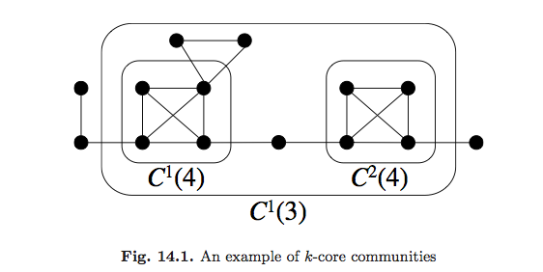
K-core
A k-core of a graph G is a maximal connected subgraph of G in which all vertices have degree at least k

Slide 4
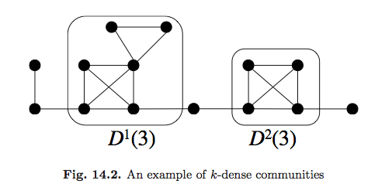
K-dense
A subnetwork D(k) of G is called k-dense if each pair of adjacent nodes in D(k) has more than or equal to (k − 2) common adjacent nodes in D(k)

Slide 5
k-dense implies k-core
K-core
K-dense

Slide 6
Implementing k-dense
Coreness functions already implemented in igraph, but it is not a decomposition function (no subgraph is returned)
K-dense implementation relies on k-core subgraphs
We then implemented k-core first, then k-dense

Slide 7
Dettagli implementativi
TODO

Slide 8
Internet topology 2007-2012

Slide 9
Internet topology 2007-2012

Slide 10
k-core vs k-dense

Slide 11
K=77
K | K-core | K-dense
71 | 13 | 0
72 | 7 | 0
73 | 20 | 0
74 | 8 | 0
75 | 34 | 0
76 | 141 | 0
77 | 0 | 0
78 | 0 | 0

Slide 12
Characterizing maximal communities

Slide 13
Characterizing maximal communities

Slide 14
Conclusions
k-dense communities nodes are more interconnected
k-dense filters out meaningless nodes (e.g. “bridge nodes” between cliques)
Gli hub che connettono nodi poco connessi sono filtrati via

