Slide 1
Comparison between network decomposition methods: k-core and k-dense
Gabriele Cocco and Davide Morelli
{cocco|morelli}@di.unipi.it

Slide 2
Outline
Implement k-dense in iGraph
Decompose the internet topology using k-core and k-dense methods
Extract and analyze the maximal communities

Slide 3
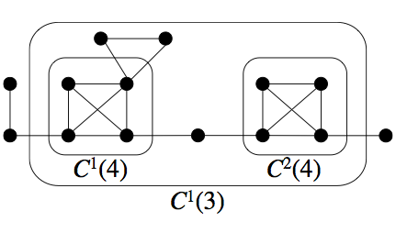
K-core
A k-core of a graph G is a set of maximal connected sub-graphs of G in which all vertices have degree at least k - 1
Coreness of a node n: max value of k for which exists a k-core of G containing n

Slide 4
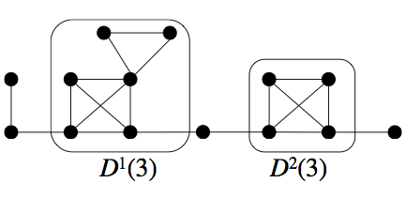
K-dense
A k-dense of a graph G is a set of maximal connected sub-graphs of G where each pair of adjacent nodes have at least (k - 2) common adjacent nodes
It follows that each node must have (k – 1) neighbors
If a sub-graph is k-dense, it is k-core too

Slide 5
k-dense vs k-core
K-core
K-dense
Gives more importance to the total amount of nodes “connections”
Some nodes included even if they are not really part of a community
Some nodes excluded even if quite connected
Gives more importance to the sharing of nodes
Tends to filter out “bridge”nodes

Slide 6
Implementing k-dense
IGraph implements coreness, not k-core
Coreness(G) returns a list of pair <n, k>, where k is the coreness of n
Not a decomposition function (any sub-graph returned)
General k-dense implementation relies on k-core communities
We needed to implement k-core decomposition first, then k-dense

Slide 7
Implementing k-dense
Coreness functions in IGraph very fast
Optimized thanks to the fact it doesn’t need to return a sub-graph
It doesn’t even build any sub-graph internally
K-core decomposition many times slower
A fast “Density" function for k-dense like Coreness for K-core should be investigated

Slide 8
Internet topology 2007-2012

Slide 9
Internet topology 2007-2012

Slide 10
k-core vs k-dense

Slide 11
Wide-connected nodes
K-core detects 141 nodes with 75 neighbors
K-dense shows that they loosely form a clique (they share few adjacent nodes)
Max number of k for k-dense is 50, versus 76 of k-core
K | K-core | K-dense
72 | 7 | 0
73 | 20 | 0
74 | 8 | 0
75 | 34 | 0
76 | 141 | 0
77 | 0 | 0

Slide 12
Maximal communities
k-core
k-dense
Largest community:
k: 76
# nodes: 141
Assortativity: -0.16
Largest community:
k: 50
# nodes: 64
Assortativity: -0.11

Slide 13
Maximal communities

Slide 14
Maximal communities
Fareness of n: sum of distances from other nodes
Closeness of n: 1 / fareness
Nodes in k-dense are generally nearer from each other (many edges connecting common neighbors)
Transitivity (clustering): #connections between neighbors / possible connections between neighbors
K-dense definition implies strong connections (many common neighbors)

Slide 15
Conclusions
k-dense communities nodes are more interconnected (closer to a clique)
k-dense filters out meaningless nodes (e.g. “bridge nodes” between communities)
k-core still useful to detects widely-connected sub-graphs that k-dense doesn’t detect

