Slide 1
Big Mountain Resort
Pricing Model
October 29, 2020

Slide 2
Problem statement:
What is the maximum price Big Mountain could charge, given its resort characteristics, in order to increase revenues by at least $1.54M this season.

Slide 3
Understanding the problem
Context
Criteria for success
Scope for solution
Big Mountain Resort feels that its pricing mechanism may no be appropriate as it might not be capitalizing on its facilities as much as they could.
Big Mountain is able to generate at least $1.54M more in revenue this season with the proposed pricing.
Determine if Big Mountain Resort’s price is higher enough given the resort’s characteristics and how much more could it increase its price.

Slide 4
Main conclusion:
Big Mountain Resort could charge a price of $95.88 per adult ticket on the weekends, considering the current facilities and resort characteristics.

Slide 5
Conclusions (cont.)
Business scenario #2 should be pursued
Scenario number 2 would maximize additional revenue.
It is estimated that the additional revenue of adding 1 run, 150 feet of vertical drop and adding 1 chair would be around $2.8M. This additional revenue would more than cover the expected increase in operating costs of $1.54M
No additional revenue from scenario #3 and #4
Scenario #3 doesn’t add additional revenue over scenario #2.
Scenario #4 offers no additional revenue.
Closing runs should be done in steps.
Closing 9 or 10 runs would have the effect of reducing support for the ticket price by $1.33.
Closing just one run could have no effect in the price, 2 runs would reduce support for the price by $0.17, 3, 4 or 5 by $0.27, and 6, 7 or 8 by $0.73.

Slide 6
Modeling Results and Analysis

Slide 7
Estimation models
A random forest model was chosen as it showed a lower cross-validation mean absolute error by almost $1. This model also exhibits less variability.
Linear regression model
Model performance:
Mean Absolute Error (MAE): 11.79
MAE standard deviation : 1.62
Random forest regression model
Model performance:
Mean Absolute Error (MAE): 9.52
MAE standard deviation: 1.49

Slide 8
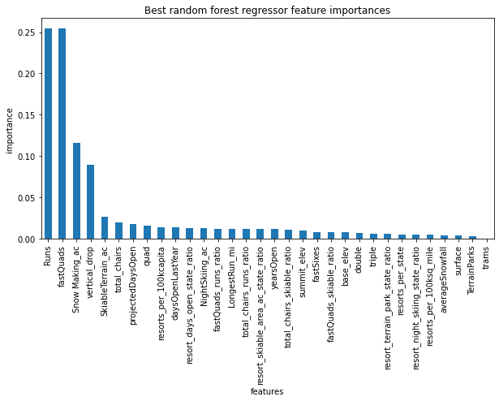
Most Important Resort Features
Dominant top features according to the random forest model are:
Number of fast quads.
Total number of runs.
Area covered by snow makers.
Vertical drop.
Skiable terrain area

