Slide 1
Autoencoders
Prof. Ashwini S Gavali
Department of AI&DS,
CSMSS,CSCOE,Chh. Sambhajiagar

Slide 2
Introduction
Autoencoders are a type of artificial neural network used in unsupervised learning tasks, particularly for dimensionality reduction and feature extraction.
They are designed to learn efficient representations of input data by training a network to encode the data into a lower-dimensional latent space and then decode it back to the original input.
Autoencoders can be useful for tasks such as data visualization, data compression, and noise reduction.
Autoencoders also find applications in anomaly detection. Since autoencoders learn to reconstruct normal instances of the input data, they tend to perform poorly on anomalous or out-of-distribution samples. By comparing the reconstruction error of a new instance with a threshold, autoencoders can be used to identify anomalies or outliers.

Slide 3
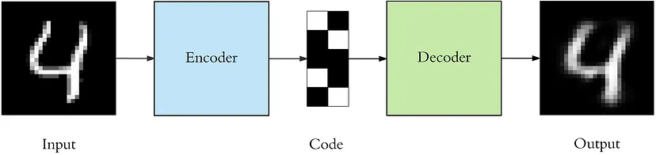
Architecture of Autoencoders
An autoencoder consists of 3 components: encoder, code and decoder. The encoder network maps the input data to a lower-dimensional latent space, while the decoder network reconstructs the input data from the encoded representation. The encoder and decoder networks are typically symmetric, and the network is trained end-to-end to minimize the reconstruction error between the original input and the decoded output.
Code (also called as latent space) refers to the lower-dimensional representation of input data that is learned by the encoder network. It is a compressed and abstract representation of the original data.

Slide 4
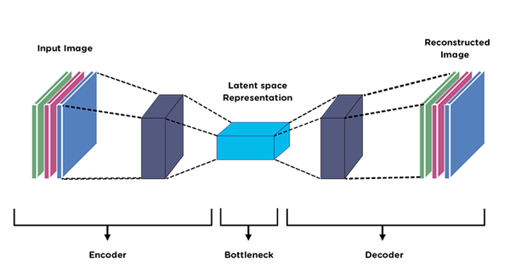
Architecture of Autoencoders

Slide 5
Architecture of Autoencoders
There are 4 hyperparameters that we need to set before training an autoencoder:
Code size: number of nodes in the middle layer. Smaller size results in more compression.
Number of layers: the autoencoder can be as deep as we like. In the figure above we have 2 layers in both the encoder and decoder, without considering the input and output.
Number of nodes per layer: The number of nodes per layer decreases with each subsequent layer of the encoder, and increases back in the decoder. Also the decoder is symmetric to the encoder in terms of layer structure.
Loss function: we either use mean squared error (mse) or binary crossentropy. If the input values are in the range [0, 1] then we typically use crossentropy, otherwise we use the mean squared error.

Slide 6
Steps for training autoencoders
The following are the general steps involved in training autoencoders:
Data Preparation: Gather a dataset that is suitable for the task you want the autoencoder to perform. Ensure that the data is preprocessed and normalized appropriately. Split the dataset into training and validation sets.
Autoencoder Architecture: Design the architecture of the autoencoder. Determine the number of layers, the type of layers (e.g., fully connected, convolutional), and the size of the latent space.
Define Loss Function: Choose an appropriate loss function for your specific task. Common choices include mean squared error (MSE) for reconstruction tasks and binary cross-entropy for binary outputs.
Compile the Model: Set the optimizer and the chosen loss function for the autoencoder model. The optimizer determines the algorithm used for updating the weights during training.

Slide 7
Steps for training autoencoders
5.Training Loop: Train the autoencoder model using the training dataset. The training loop involves the following steps:
a. Feed the input data to the autoencoder and obtain the reconstructed output.
b. Calculate the loss between the input data and the reconstructed output using the chosen loss function.
c. Use backpropagation to compute the gradients and update the weights of the autoencoder.
d. Repeat steps a-c for a specified number of epochs or until convergence is achieved.

Slide 8
Steps for training autoencoders
6. Evaluate Performance: Monitor the performance of the autoencoder during training using the validation set. Calculate evaluation metrics such as loss, accuracy, or other relevant metrics to assess the model's performance.
7. Fine-tuning and Hyperparameter Optimization: Experiment with different hyperparameters, such as learning rate, batch size, number of layers, or regularization techniques, to improve the autoencoder's performance. Fine-tuning can involve adjusting these hyperparameters and retraining the model.
8. Model Evaluation: Once training is complete, evaluate the trained autoencoder on a separate test set or real-world data to assess its performance in practical scenarios

Slide 9
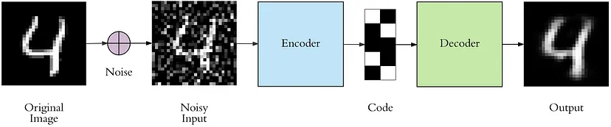
Application of autoencoders- Image denoising
Image denoising using autoencoders involves training an autoencoder to remove noise from corrupted images while preserving the important underlying structures and details.
This way the autoencoder can’t simply copy the input to its output because the input also contains random noise. We are asking it to subtract the noise and produce the underlying meaningful data. This is called a denoising autoencoder.

Slide 10
Image denoising
The top row contains the original images. We add random Gaussian noise to them and the noisy data becomes the input to the autoencoder. The autoencoder doesn’t see the original image at all. But then we expect the autoencoder to regenerate the noise-free original image.
There is only one small difference between the implementation of denoising autoencoder and the regular one. The architecture doesn’t change at all, only the output in regular autoencoder is same as input whereas for denoising autoencoder input is noisy image and output is original image.

