Slide 1
Variants of Gradient Descent
Prof. A.S.Gavali
Department of AI&DS
CSMSS,CSCOE,Aurangabad

Slide 2
Contents
Challenges
Gradient descent variants
Gradient descent optimization algorithms

Slide 3
Gradient Descent Gradient descent is popular algorithm to perform optimization of deep learning.
Gradient descent is a way to minimize an objective function 𝐽(𝜃)
𝐽(𝜃)： Objective function
𝜃 ∈ 𝑅^{𝑑}：Model’s parameters
𝜂：Learning rate. This determines the size of the steps we take to reach a (local) minimum.
❑_{𝜃}𝐽(𝜃)
𝐽(𝜃)
Update equation
𝜃 = 𝜃 − 𝜂 ∗ ❑_{𝜃}𝐽(𝜃)
𝑙𝑜𝑐𝑎𝑙 𝑚𝑖𝑛𝑖𝑚𝑢𝑚
_{𝜃}∗
𝜃

Slide 4
Gradient descent variants
There are three variants of gradient descent.
Batch gradient descent
Stochastic gradient descent
Mini-batch gradient descent
The difference of these algorithms is the amount of data.
This term is different with each method
Update equation
𝜃 = 𝜃 − 𝜂 ∗ ❑_{𝜃}𝐽(𝜃)

Slide 5
Trade-off
Depending on the amount of data, they make a trade-off :
The accuracy of the parameter update
The time it takes to perform an update.
Method | Accuracy | Time | Memory Usage | Online Learning
Batch gradient descent | ○ | Slow | High | ×
Stochastic gradient descent | △ | High | Low | ○
Mini-batch gradient descent | ○ | Midium | Midium | ○

Slide 6
Batch gradient descent
This method computes the gradient of the cost function with the entire training dataset.
Update equation
We need to calculate the gradients for the whole dataset to perform just one update.
𝜃 = 𝜃 − 𝜂 ∗ ❑_{𝜃}𝐽(𝜃)
Code

Slide 7
Batch gradient descent
Advantage
It is guaranteed to converge to the global minimum for convex error surfaces and to a local minimum for non- convex surfaces.
Disadvantages
It can be very slow.
It is intractable for datasets that do not fit in memory.
It does not allow us to update our model online.

Slide 8

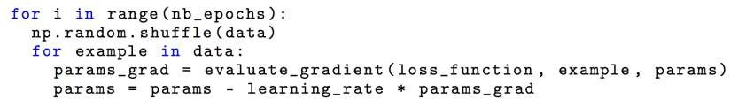
Stochastic gradient descent
This method performs a parameter update for each training example 𝑥 ^{𝑖} and label 𝑦^{𝑖}.
Update equation
We need to calculate the gradients for the whole dataset to perform just one update.
𝜃 = 𝜃 − 𝜂 ∗ ❑_{𝜃}𝐽(𝜃; 𝑥 ^{𝑖} ; 𝑦^{(𝑖)})
Code
Note : we shuffle the training data at every epoch

Slide 9
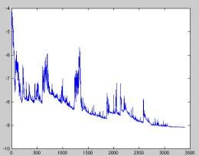
Stochastic gradient descent
Advantage
It is usually much faster than batch gradient descent.
It can be used to learn online.
Disadvantages
It performs frequent updates with a high variance that
cause the objective function to fluctuate heavily.

Slide 10
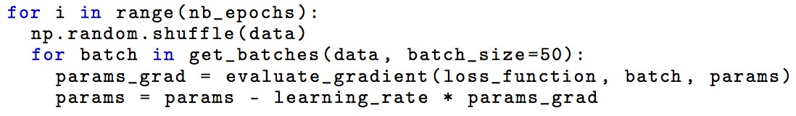
Mini-batch gradient descent
This method takes the best of both batch and SGD, and performs an update for every mini-batch of 𝑛.
Update equation
𝜃 = 𝜃 − 𝜂 ∗ ❑_{𝜃}𝐽(𝜃; 𝑥 ^{𝑖:𝑖+𝑛} ; 𝑦^{(𝑖:𝑖+𝑛)})
Code

Slide 11
Mini-batch gradient descent
Advantage :
It reduces the variance of the parameter updates.
This can lead to more stable convergence.
Disadvantage :
It also performs frequent updates with a high variance that
cause the objective function to fluctuate heavily.
We have to set mini-batch size.

Slide 12
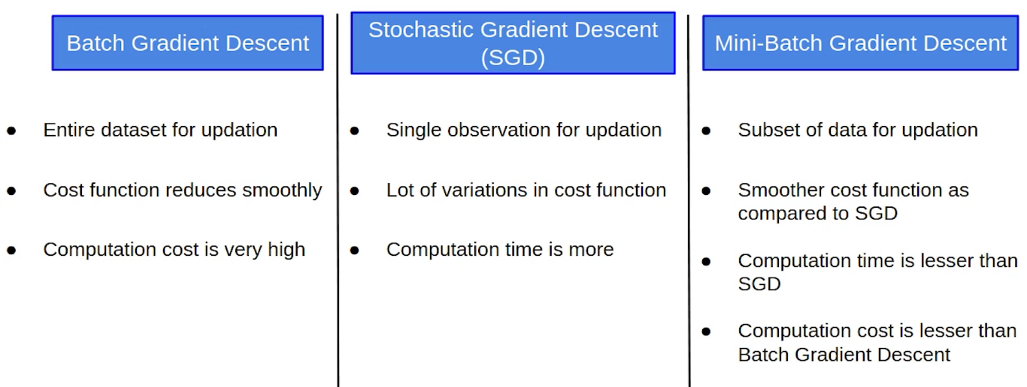
Comparisons

Slide 13
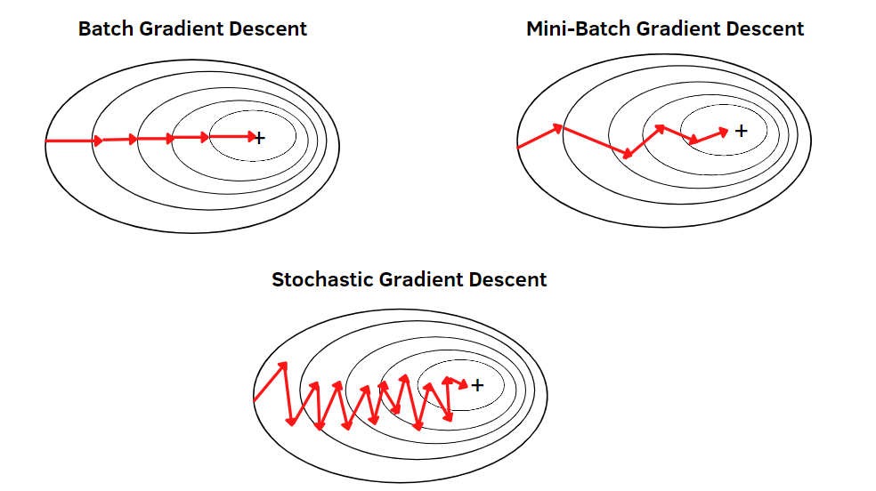
The fluctuation : Batch vs SGD vs Mini-Batch GD
・Batch gradient descent converges to the minimum of the basin the parameters are placed in and the fluctuation is small.
・SGD’s fluctuation is large but it enables to jump to new and potentially better local minima.
However, this ultimately complicates convergence to the exact minimum, as SGD will keep overshooting

Slide 14
Gradient descent optimization algorithms
To deal with the challenges, some algorithms are widely used by the Deep Learning community.
Momentum
RMSprop
Adam
Visualization of algorithms
Which optimizer to use?

Slide 15
The difficulty of SGD
The problem with gradient descent is that the weight update at a moment (t) is governed by the learning rate and gradient at that moment only. It doesn’t take into account the past steps taken while traversing the cost space.

Slide 16

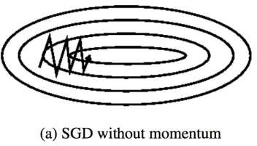
The difficulty of SGD and Mini-Batch
SGD has trouble navigating ravines which are common around local optima.
Areas where the surface curves much more steeply in one dimension than in another is very difficult for SGD.

Slide 17
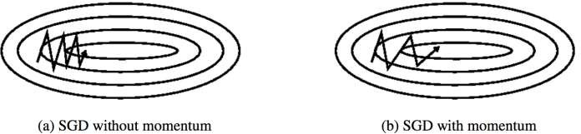
SGD With Momentum
Momentum is a method that helps accelerate SGD.
To account for the momentum, we can use a moving average over the past gradients.
This can be done by using an Exponential Moving Average(EMA). An exponential moving average is a moving average that assigns a greater weight on the most recent values.

Slide 18
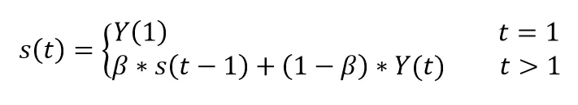
Exponential Moving Average(EMA).
The EMA for a series Y may be calculated recursively
The coefficient β represents the degree of weighting increase, a constant smoothing factor between 0 and 1. A lower β discounts older observations faster.
Y(t) is the value at a period t.
S(t) is the value of the EMA at any period t.

Slide 19
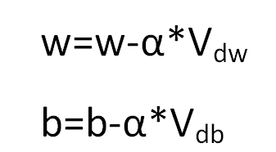
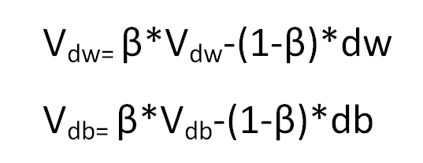

In our case of a sequence of gradients, the new weight and bias update equation at iteration t becomes
WhereWhere
Let's break it down.
V_{dw} and V_{dw} is the exponential weighted average of dw and db at iteration t
β: Momentum constant
Dw and db are the gradient at iteration t
Assume the weight update at the zeroth iteration t=0 is zero
The momentum term β is usually
set to 0.9 or a similar value.

Slide 20
Momentum
Momentum is a method that helps accelerate SGD.
It does this by adding a fraction of past time step to the current time step.
The ball accumulates momentum as it rolls downhill, becoming faster and faster on the way.
The momentum term 𝛾 is usually
action 𝛾 of the update vector of the
ent update vector
set to 0.9 or a similar value.

Slide 21
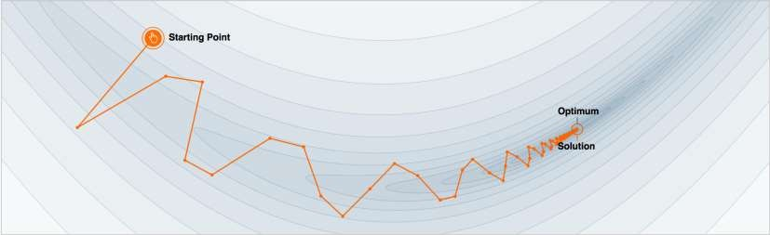
Why Momentum Really Works
The momentum term reduces updates for dimensions whose gradients change directions.
The momentum term increases for dimensions whose gradients point in the same directions.
Demo : http://distill.pub/2017/momentum/

Slide 22
RMSprop
Stands for Root mean square prop.
This algorithm speeds up the gradient descent.
RMSprop divides the learning rate by an exponentially decaying average of squared gradients.
The use of a decaying moving average allows the algorithm to forget early gradients and focus on the most recently observed partial gradients seen during the progress of the search.

Slide 23
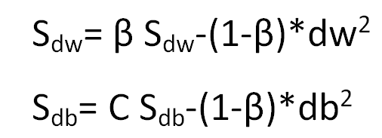
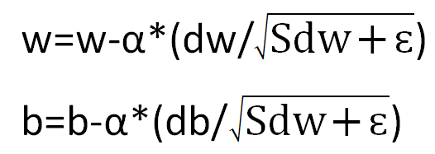

RMSprop
In this case of a sequence of gradients, the new weight and bias update equation at iteration t becomes
Let's break it down.
S_{dw} and S_{dw} is the exponential weighted average of squares of dw and db respectively at iteration t. $ɛ$ is very small number which is added to avoid divide by Zero
β: Momentum constant
Dw and db are the gradient at iteration t
Assume the weight update at the zeroth iteration t=0 is zero
Hinton suggests β to be set to 0.9, while a good default value for the learning rate α is 0.001.

Slide 24
Adam
Stands for Adaptive Moment Estimation.
Adam optimization and RMSprop are among the optimization algorithms that worked very well with a lot of NN architectures.
Adam optimization simply puts RMSprop and momentum together!
It uses an exponentially decaying average of past squared gradients like RMSprop
It uses exponentially decaying average of past gradients similar to momentum.

Slide 25
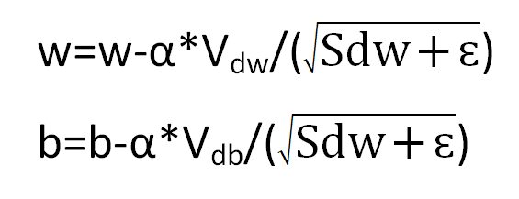
Adam
The Weights are updated using following formula:
Note : default values of 0.9 for 𝛽₁, 0.999 for 𝛽₂, and 10⁻⁸ for 𝜀

Slide 26
DISCLAIMER
The material for the presentation has been compiled from various sources such as
books, tutorials (offline and online), lecture notes, several resources available on
Internet. The information contained in this lecture/presentation is for general
information and education purpose only. While we endeavor to keep the information up to date and correct, we make no representation of any kind about the completeness and accuracy of the material. The information shared through this presentation material should be used for educational purpose only.

Slide 27
THANK YOU

