Slide 1
Introduction Deep Learning
Prof. A.S.Gavali
Department of AI&DS
CSMSS,CSCOE,Aurangabad

Slide 2
INTRODUCTION
3

Slide 3
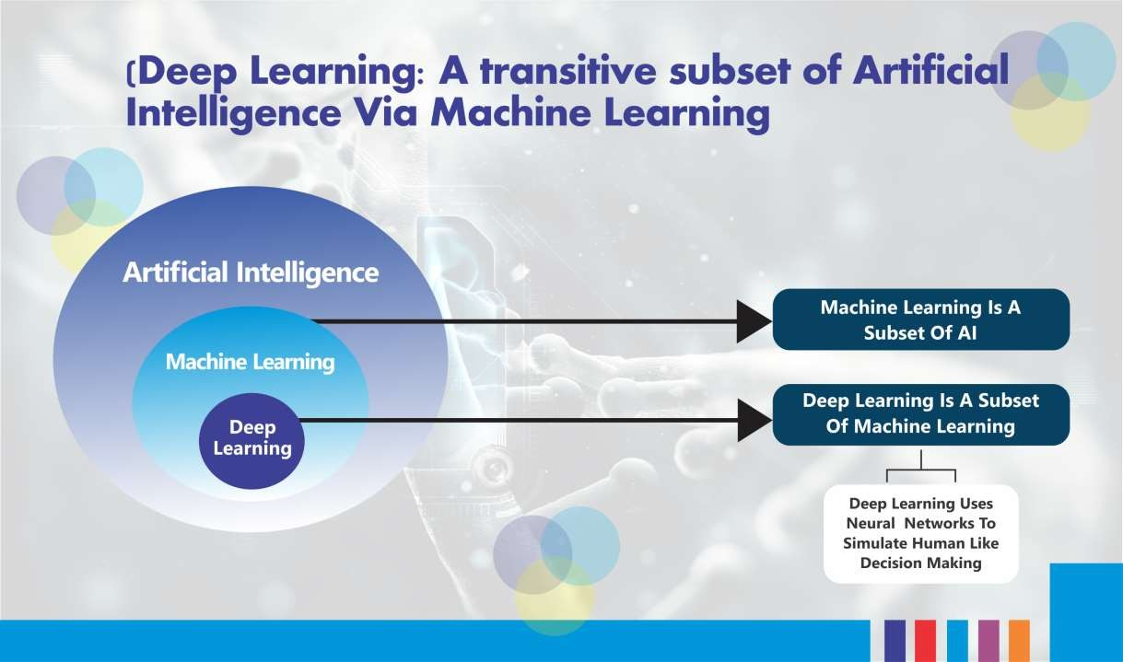
Figure 1 : Subsets of AI(Adapted from: www.edureka.co)
4

Slide 4
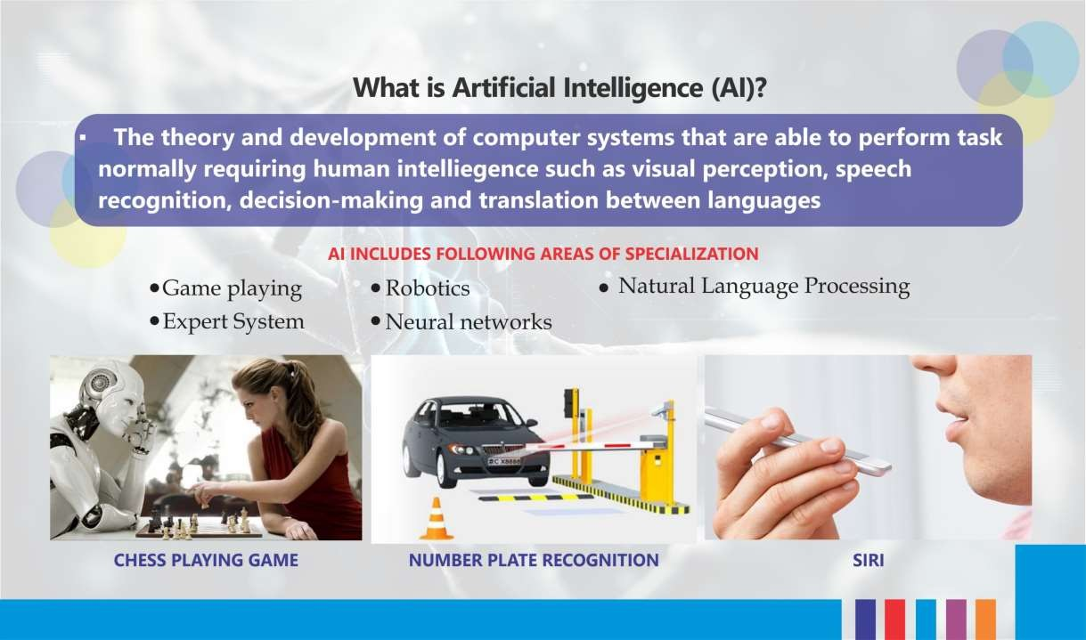
Figure 2: Some Applications of Artificial Intelligence
5

Slide 5
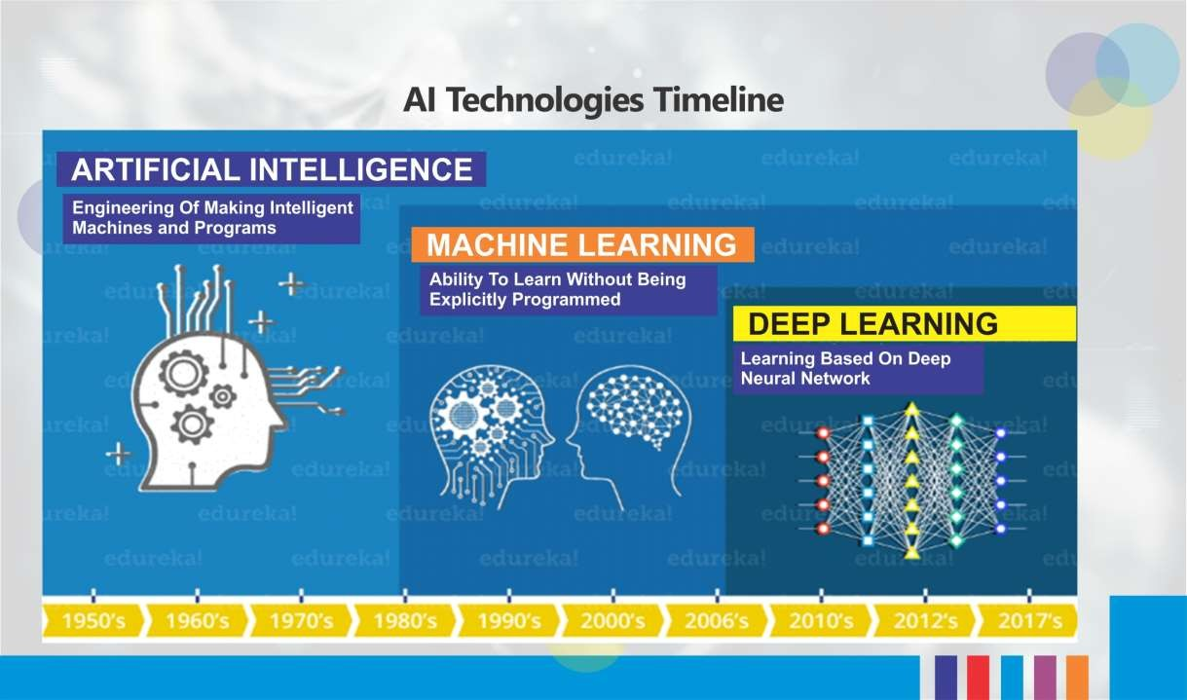
Figure 3: AI Technologies Timeline (Adapted from: www.edureka.co)
5

Slide 6
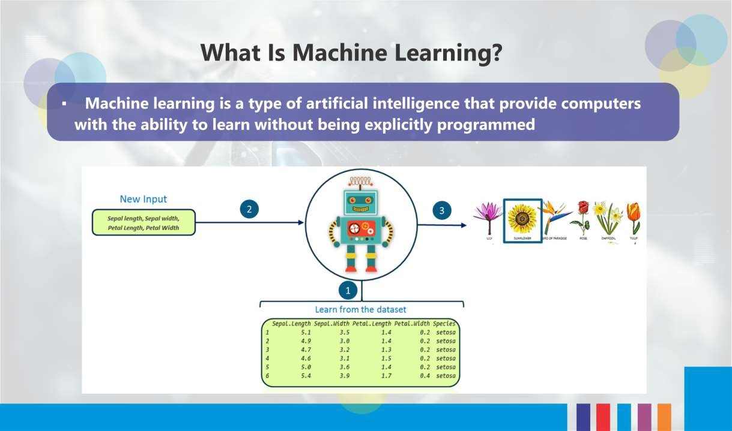
Figure 4: Process Involved in Machine Learning (Adapted from: www.edureka.co)
6

Slide 7
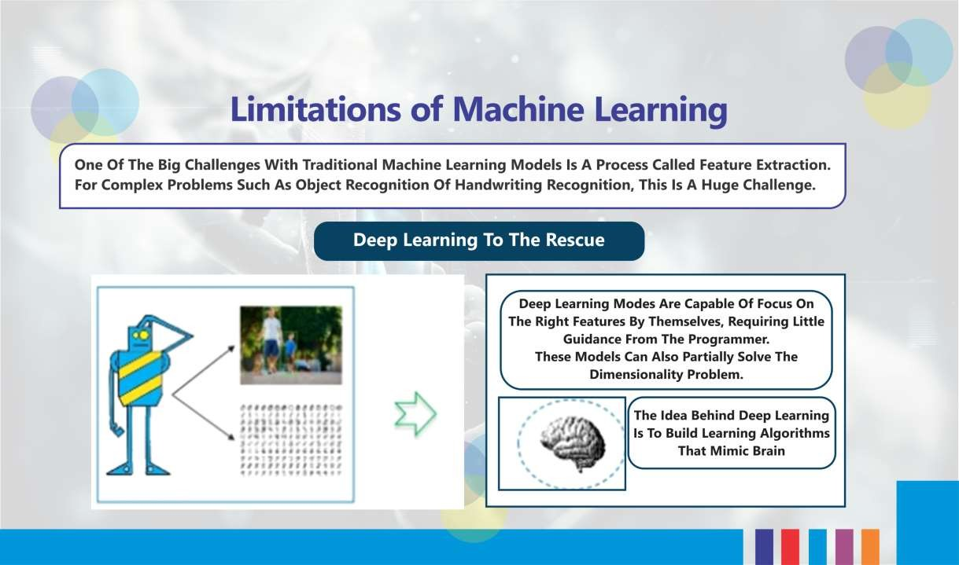
Figure 5: Limitation of ML (Source: www.edureka.co)
7

Slide 8
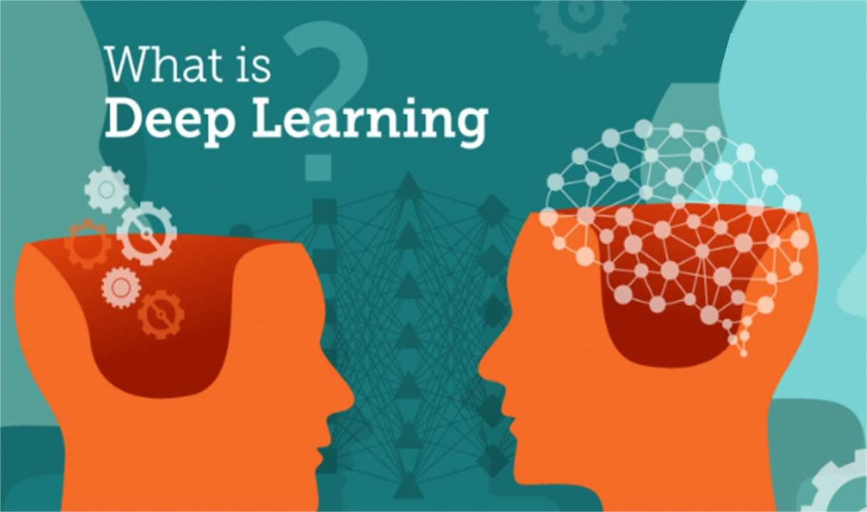

Slide 9
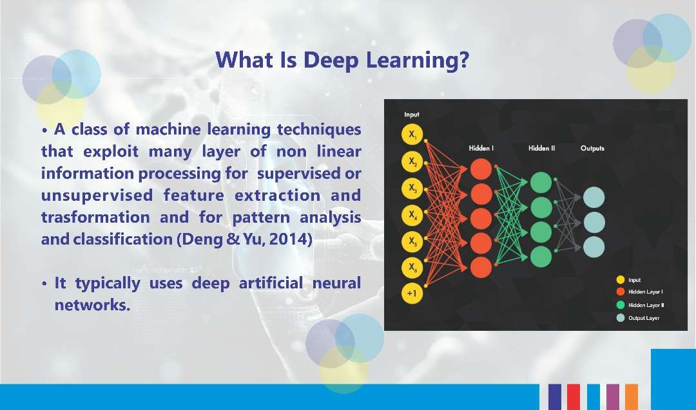
Figure 6: Artificial Neural Networks
(Adapted from: www.edureka.co)
12

Slide 10
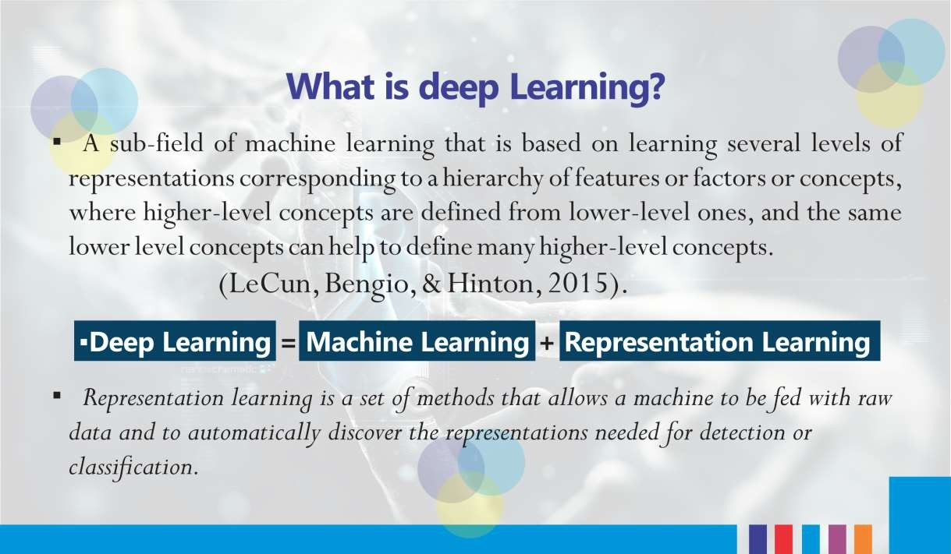
(Deng & Yu, 2014).

Slide 11
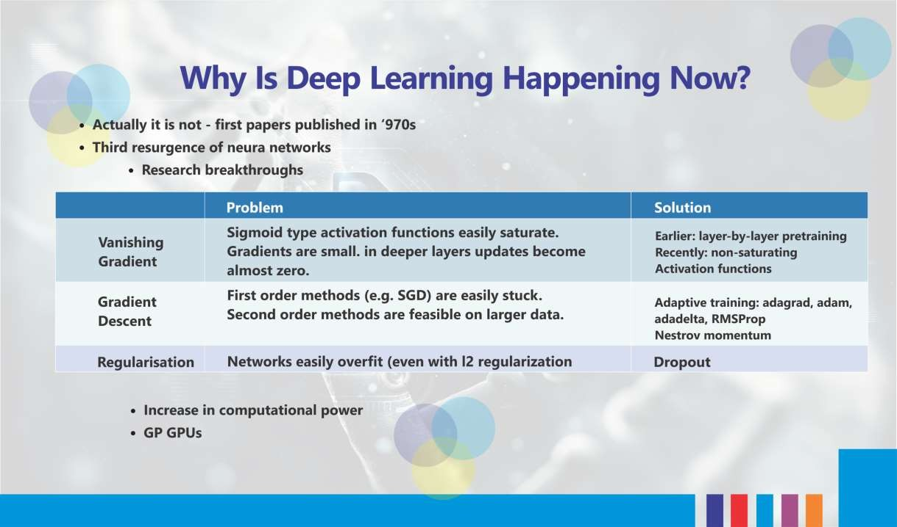
l
Adapted from: www.edureka.co

Slide 12
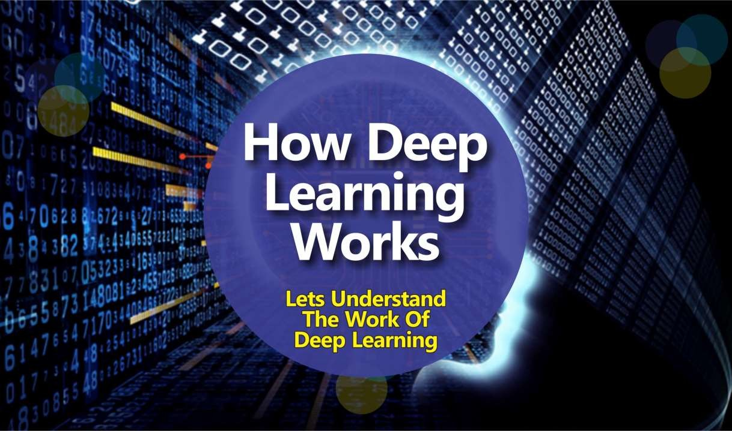

Slide 13
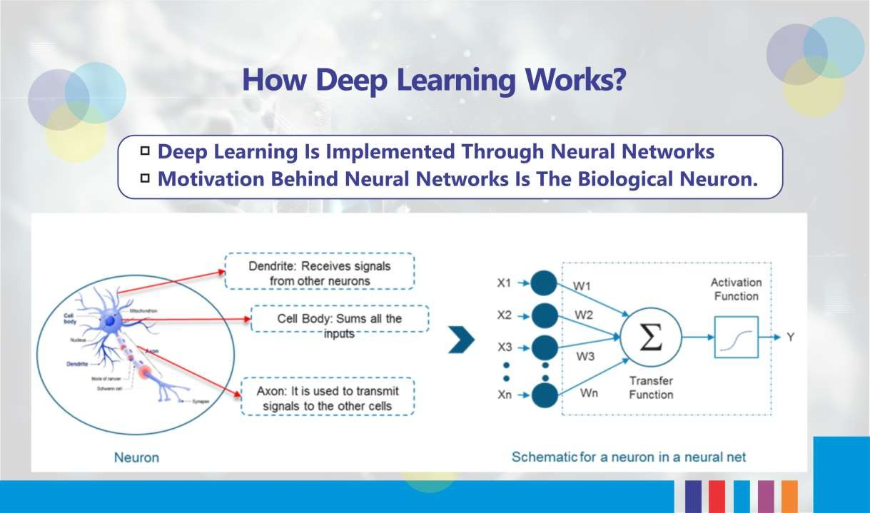
Figure 7: Biological and Artificial Neuron (Adapted from: www.edureka.co)

Slide 14
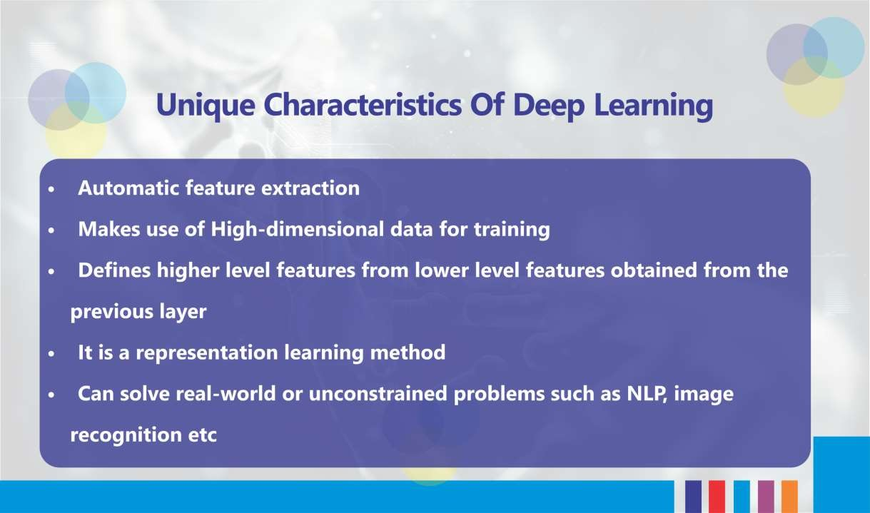

Slide 15
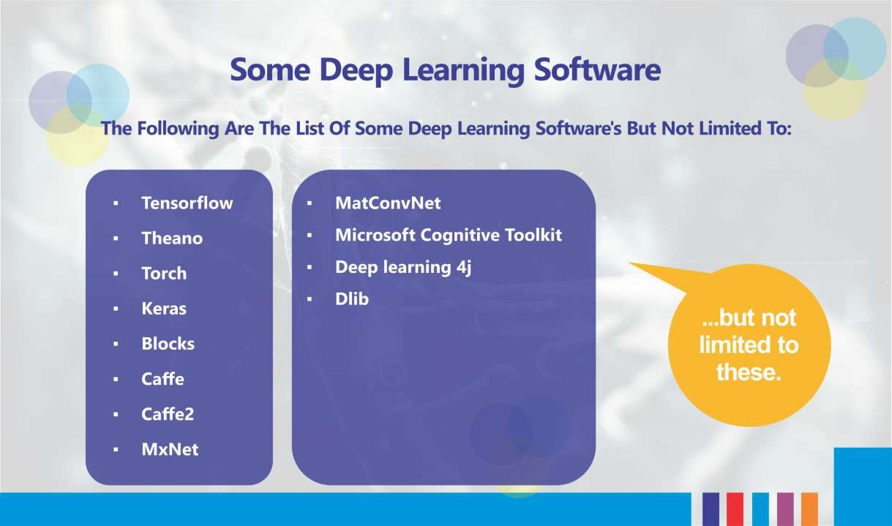
15
23

Slide 16
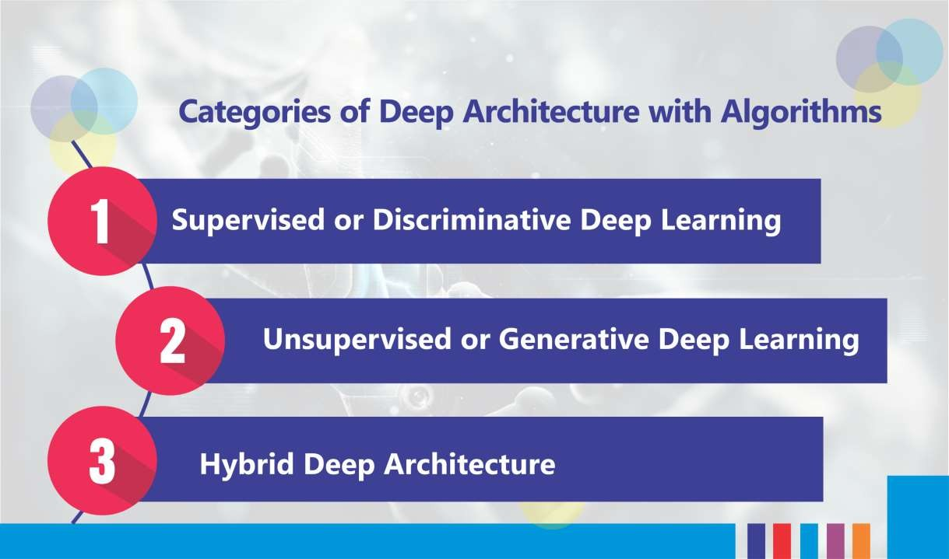

Slide 17
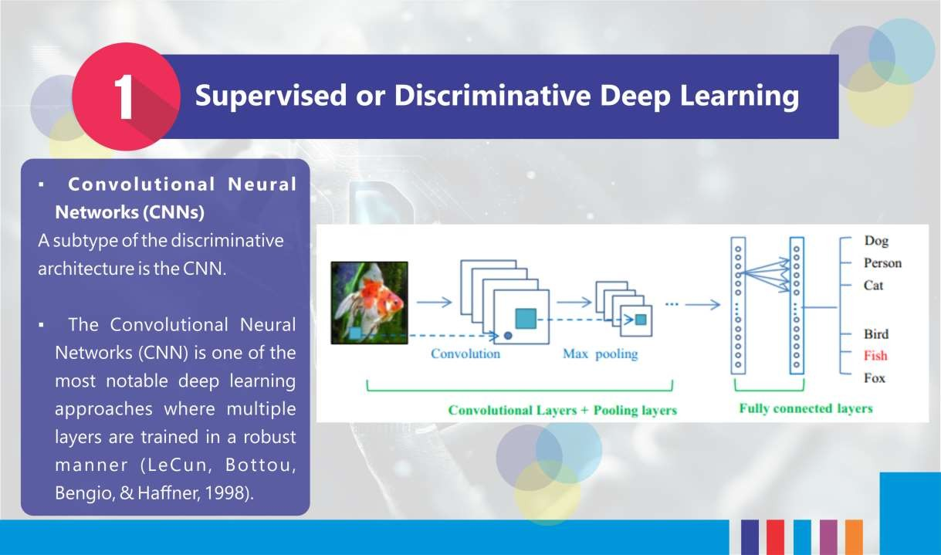
Figure 8: Pipeline of the general CNN Architecture (Source: Guo et al., 2016)

Slide 18
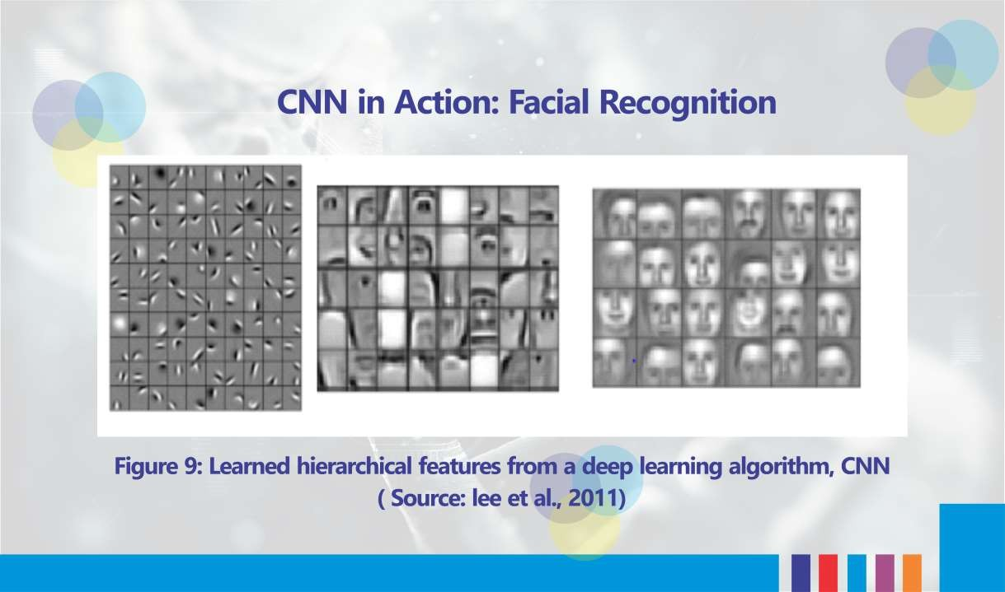

Slide 19
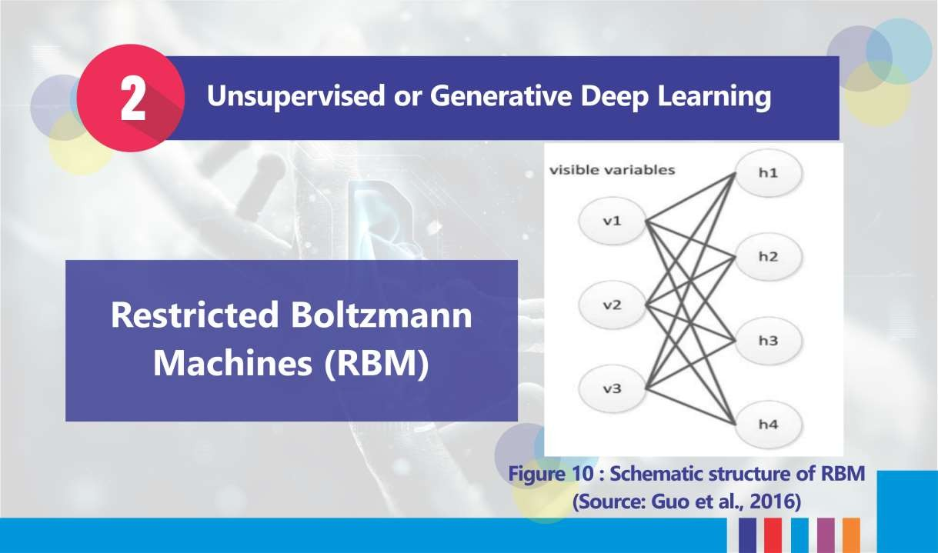

Slide 20
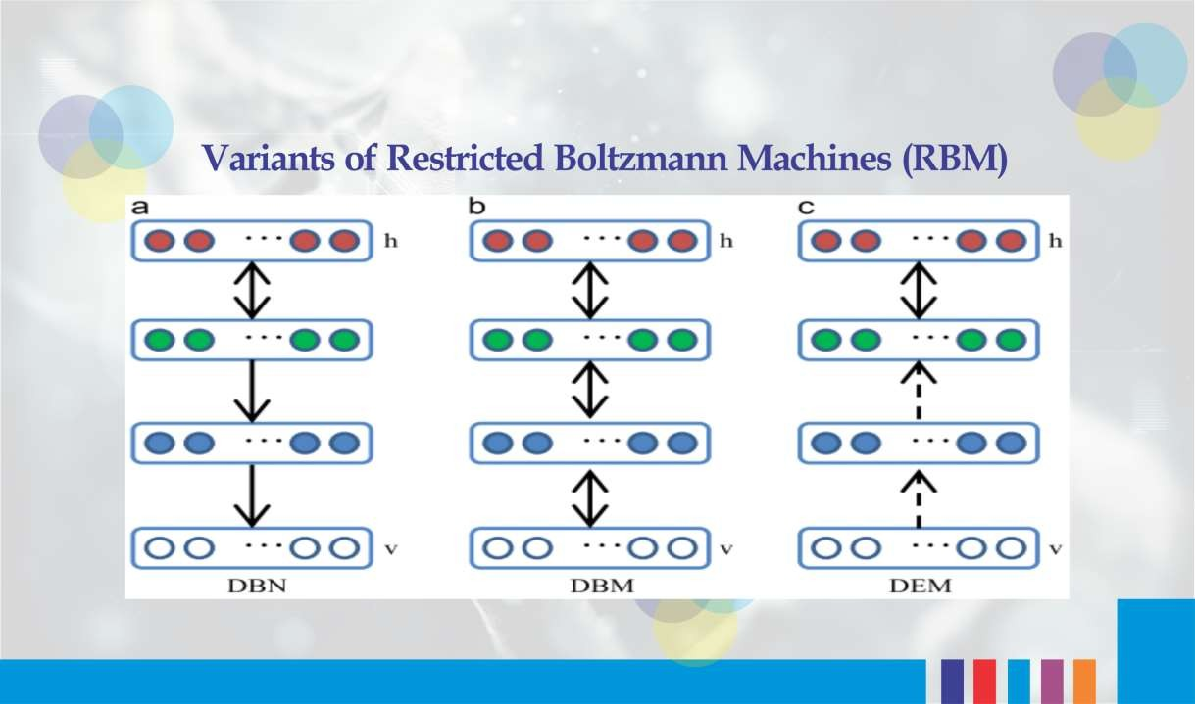
Figure 11: DBN, DBN and DEM (Source: Guo et al., 2016).

Slide 21
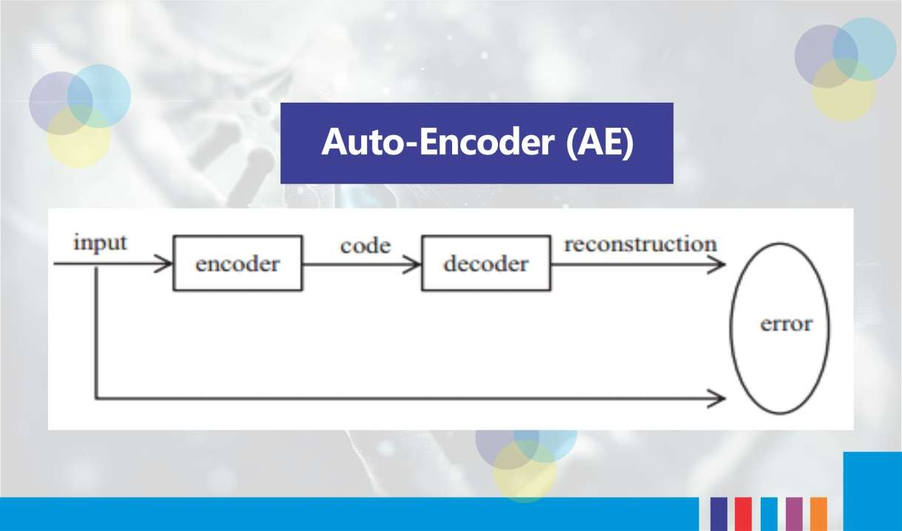
Figure 12: The pipeline of an autoencoder (Source: Guo et al., 2016).

Slide 22
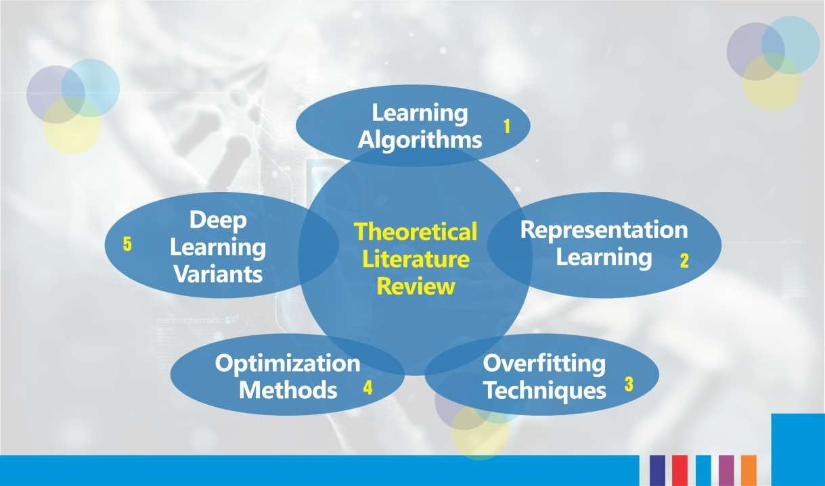

Slide 23
DISCLAIMER
The material for the presentation has been compiled from various sources such as
books, tutorials (offline and online), lecture notes, several resources available on
Internet. The information contained in this lecture/presentation is for general
information and education purpose only. While we endeavor to keep the information up to date and correct, we make no representation of any kind about the completeness and accuracy of the material. The information shared through this presentation material should be used for educational purpose only.

Slide 24
THANK YOU

