Slide 1
Deep Learning
Prof. A.S.Gavali
CSMSS,CSCOE,Aurangabad

Slide 2




What is Deep Learning?
Part of the machine learning field of learning representations of data. Exceptional effective at learning patterns.
Utilizes learning algorithms that derive meaning out of data by using a hierarchy of multiple layers that mimic the neural networks of our brain.
If you provide the system tons of information, it begins to
understand it and respond in useful ways.

Slide 3

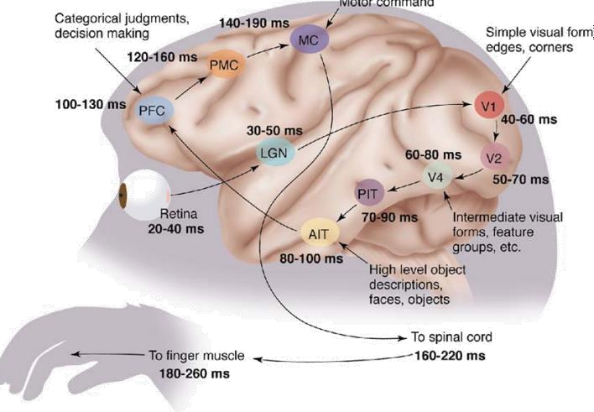


Inspired by the Brain
The first hierarchy of neurons that receives information in the visual cortex are sensitive to specific edges while brain regions further down the visual pipeline are sensitive to more complex structures such as faces.
Our brain has lots of neurons connected together and the strength of connections between neurons represents long term knowledge.
1
One learning algorithm hypothesis: all significant mental algorithms
are learned except for the learning and reward machinery itself.

Slide 4










Deep Learning - Basics
No more feature engineering
Machine Learning Process Costs lots of time
Input Data
Feature
Engineering
Traditional Learning Algorithm
Input Data
Deep Learning Algorithm
Deep Learning Process

Slide 5

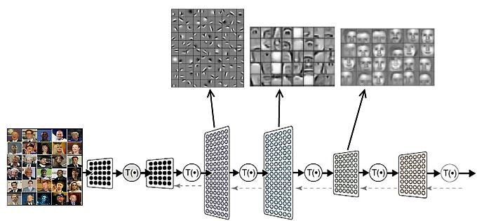
Deep Learning - Basics
What did it learn?
Edges Nose, Eye… Faces

Slide 6

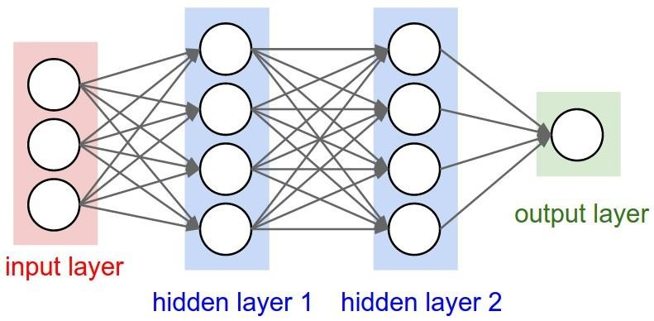
Deep Learning - Basics
Artificial Neural Networks
Consists of one input, one output and multiple fully-connected hidden layers in- between. Each layer is represented as a series of neurons and progressively extracts higher and higher-level features of the input until the final layer essentially makes a decision about what the input shows. The more layers the network has, the higher- level features it will learn.

Slide 7

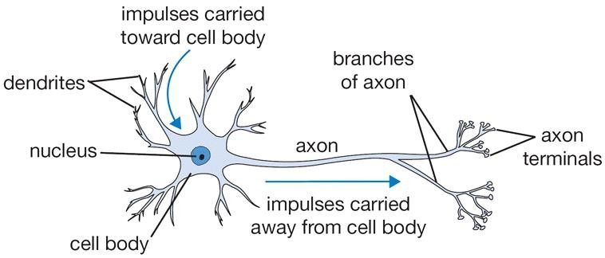
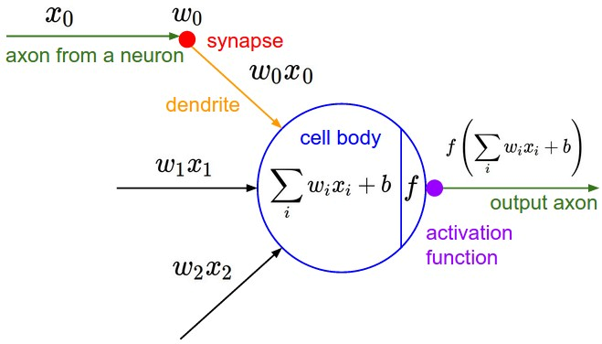


Deep Learning - Basics
The Neuron
An artificial neuron contains a nonlinear activation function and has
several incoming and outgoing weighted connections.
Neurons are trained to filter and detect specific features or patterns (e.g. edge, nose) by receiving weighted input, transforming it with the activation function und passing it to the outgoing connections.

Slide 8

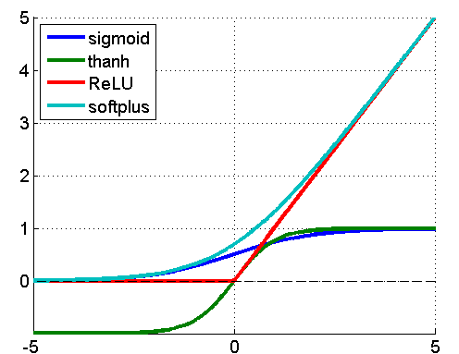

Deep Learning - Basics
Non-linear Activation Function
Most deep networks use ReLU - max(0,x) - nowadays for hidden layers, since it trains much faster, is more expressive than logistic function and prevents the gradient vanishing problem.
Non-linearity is needed to learn complex (non-linear) representations of data, otherwise the NN would be just a linear function.

Slide 9






Deep Learning - Basics
The Training Process
Sample labeled data
Forward it trough the network to get predictions
Update the connection weights
Backpropagate the errors
Learns by generating an error signal that measures the difference between the predictions of the network and the desired values and then using this error signals o change the weights (or parameters) so that predictions get more accurate.

Slide 10
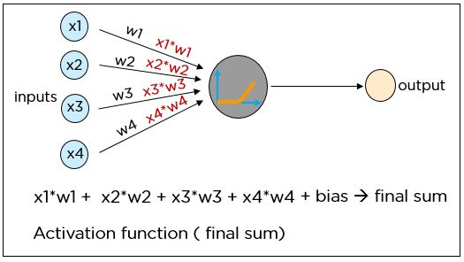
What are Neural Networks?
A neural network is a system modeled on the human brain, consisting of an input layer, multiple hidden layers, and an output layer. Data is fed as input to the neurons. The information is transferred to the next layer using appropriate weights and biases. The output is the final value predicted by the artificial neuron.
Each neuron in a neural network performs the following operations:
The product of each input and the weight of the channel it is passed over is found
The sum of the weighted products is computed, which is called the weighted sum
A bias value of the neuron is added to the weighted sum
The final sum is then subjected to a particular function known as the activation function

Slide 11
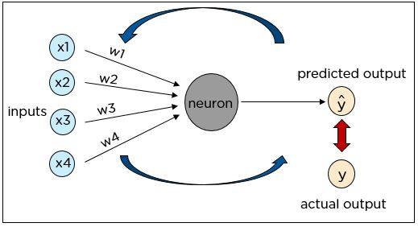
Cost Function
The cost function is one of the significant components of a neural network.
The cost value is the difference between the neural nets predicted output and the actual output from a set of labeled training data.
The least-cost value is obtained by making adjustments to the weights and biases iteratively throughout the training process.

Slide 12
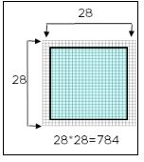
Suppose we have to train the neural network to identify shapes i.e circle,square etc. Consider the shapes are images of 28*28 pixels.
How Do Neural Networks Work?

Slide 13
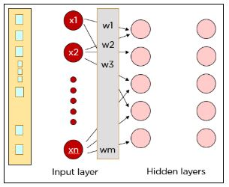
How Do Neural Networks Work?
Step 1:Each pixel is fed as input to the neurons in the first layer. Hidden layers improve the accuracy of the output. Data is passed on from layer to layer overweight channels. Each neuron in one layer is weighted to each of the neurons in the next layer.

Slide 14
How Do Neural Networks Work?
Step 2:Each neuron in the first hidden layer takes a subset of the inputs and processes it. All the inputs are multiplied by their respective weights and a bias is added. The output of the weighted sum is applied to an activation function. The results of the activation function determine which neurons will be activated in the following layer.
Step 1: x1*w1 + x2*w2 + b1
Step 2: Φ(x1* w1 + x2*w2 + b1)
where Φ is an activation function

Slide 15
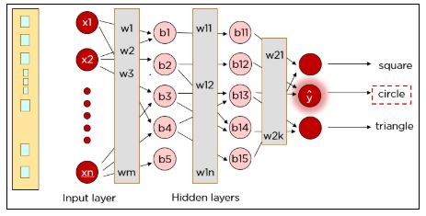
How Do Neural Networks Work?
The previous steps are performed again to ensure the information reaches the output layer, after which a single neuron in the output layer gets activated based on the activation function’s value.

Slide 16
How Do Neural Networks Work?
The previous steps are performed again to ensure the information reaches the output layer, after which a single neuron in the output layer gets activated based on the activation function’s value. As you can see, our actual input was a square, but the neural network predicted the output as a circle. So, what went wrong?

Slide 17
How Do Neural Networks Work?
The neural network has to be trained until the predicted output is correct and the predicted output is compared to the actual output by calculating the cost function.
The cost function is calculated using the formula where Y is the actual value and Y hat is the predicted value. The cost function determines the error in the prediction and reports it back to the neural network. This is called backpropagation.

Slide 18
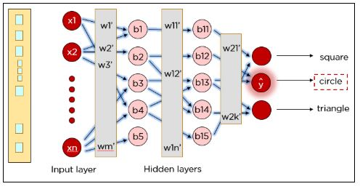
How Do Neural Networks Work?
The weights are adjusted to reduce the error. The network is trained with the new weights.

Slide 19
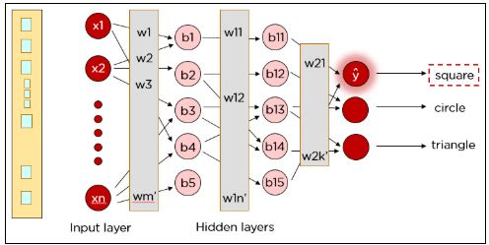
How Do Neural Networks Work?
Once again, the cost is determined and the backpropagation procedure is continued until the cost cannot be reduced any further.
Similarly, our network can be trained to predict circles and triangles too.

Slide 20
DISCLAIMER
The material for the presentation has been compiled from various sources such as
books, tutorials (offline and online), lecture notes, several resources available on
Internet. The information contained in this lecture/presentation is for general
information and education purpose only. While we endeavor to keep the information up to date and correct, we make no representation of any kind about the completeness and accuracy of the material. The information shared through this presentation material should be used for educational purpose only.

Slide 21
THANK YOU

