Slide 1
Convolutional Neural Networks
Prof. A.S.Gavali
Department of AI&DS
CSMSS,CSCOE,Aurangabad

Slide 2
Agenda
Introduction
Archetecture Overview
How ConvNet Works
ConvNet Layers
Convolutional Layer
Pooling Layer
Normalization Layer (ReLU)
Fully-Connected Layer
Demos & Parameters
Hyper Parameters
Mnist dataset on AWS
CIFAR-10 ConvNetJS
Case Studies

Slide 3
Agenda
Introduction
Archetecture Overview
How ConvNet Works
ConvNet Layers
Convolutional Layer
Pooling Layer
Normalization Layer (ReLU)
Fully-Connected Layer
Demos & Parameters
Hyper Parameters
Mnist dataset on AWS
CIFAR-10 ConvNetJS
Case Studies

Slide 4
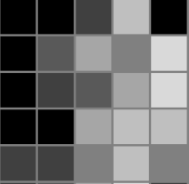

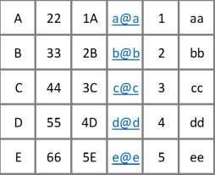
Introduction
A convolutional neural network (or ConvNet) is a type of feed-forward artificial neural network
The architecture of a ConvNet is designed to take advantage of the 2D structure of an input image.
VS
✗
A ConvNet is comprised of one or more convolutional layers (often with a pooling step) and then followed by one or more fully connected layers as in a standard multilayer neural network.

Slide 5
Agenda
Introduction
Archetecture Overview
How ConvNet Works
ConvNet Layers
Convolutional Layer
Pooling Layer
Normalization Layer (ReLU)
Fully-Connected Layer
Demos & Parameters
Hyper Parameters
Mnist dataset on AWS
CIFAR-10 ConvNetJS
Case Studies

Slide 6
Motivation behind ConvNets
Consider an image of size 200x200x3 (200 wide, 200 high, 3 color channels)
a single fully-connected neuron in a first hidden layer of a regular Neural Network would have 200*200*3
= 120,000 weights.
Due to the presence of several such neurons, this full connectivity is wasteful and the huge number of parameters would quickly lead to overfitting
However, in a ConvNet, the neurons in a layer will only be connected to a small region of the layer
before it, instead of all of the neurons in a fully-connected manner.
the final output layer would have dimensions 1x1xN, because by the end of the ConvNet architecture we will reduce the full image into a single vector of class scores (for N classes), arranged along the depth dimension

Slide 7
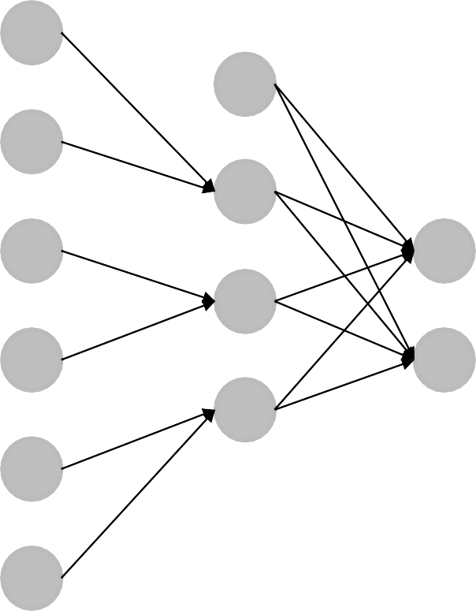
MLP VS ConvNet
Input
Input
Hidden
Hidden
Output
Output
Multilayered Perceptron: All Fully Connected Layers
Convolutional Neural Network With Partially Connected Convolution Layer

Slide 8
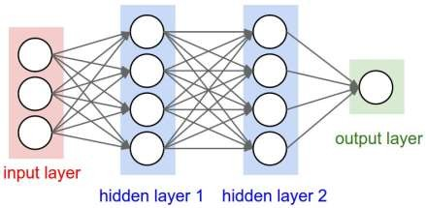
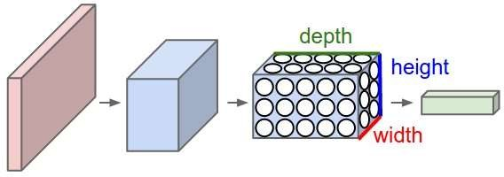
MLP vs ConvNet
A regular 3-layer Neural
Network.
A ConvNet arranges its neurons in three dimensions (width, height, depth), as visualized in one of the layers.

Slide 9
Agenda
Introduction
Archetecture Overview
How ConvNet Works
ConvNet Layers
Convolutional Layer
Pooling Layer
Normalization Layer (ReLU)
Fully-Connected Layer
Demos & Parameters
Hyper Parameters
Mnist dataset on AWS
CIFAR-10 ConvNetJS
Case Studies

Slide 10
How ConvNet Works
For example, a ConvNet takes the input as an image which can be classified as ‘X’ or ‘O’
A two-dimensional array of pixels
CNN
X or O
In a simple case, ‘X’ would look like:

Slide 11


How ConvNet Works
What about trickier cases?
CNN
X
CNN
O

Slide 12
?
How ConvNet Works – What Computer Sees
=
-1 | -1 | -1 | -1 | -1 | -1 | -1 | -1 | -1
-1 | 1 | -1 | -1 | -1 | -1 | -1 | 1 | -1
-1 | -1 | 1 | -1 | -1 | -1 | 1 | -1 | -1
-1 | -1 | -1 | 1 | -1 | 1 | -1 | -1 | -1
-1 | -1 | -1 | -1 | 1 | -1 | -1 | -1 | -1
-1 | -1 | -1 | 1 | -1 | 1 | -1 | -1 | -1
-1 | -1 | 1 | -1 | -1 | -1 | 1 | -1 | -1
-1 | 1 | -1 | -1 | -1 | -1 | -1 | 1 | -1
-1 | -1 | -1 | -1 | -1 | -1 | -1 | -1 | -1
-1 | -1 | -1 | -1 | -1 | -1 | -1 | -1 | -1
-1 | -1 | -1 | -1 | -1 | -1 | 1 | -1 | -1
-1 | 1 | -1 | -1 | -1 | 1 | -1 | -1 | -1
-1 | -1 | 1 | 1 | -1 | 1 | -1 | -1 | -1
-1 | -1 | -1 | -1 | 1 | -1 | -1 | -1 | -1
-1 | -1 | -1 | 1 | -1 | 1 | 1 | -1 | -1
-1 | -1 | -1 | 1 | -1 | -1 | -1 | 1 | -1
-1 | -1 | 1 | -1 | -1 | -1 | -1 | -1 | -1
-1 | -1 | -1 | -1 | -1 | -1 | -1 | -1 | -1

Slide 13
=
How ConvNet Works
x
-1 | -1 | -1 | -1 | -1 | -1 | -1 | -1 | -1
-1 | 1 | -1 | -1 | -1 | -1 | -1 | 1 | -1
-1 | -1 | 1 | -1 | -1 | -1 | 1 | -1 | -1
-1 | -1 | -1 | 1 | -1 | 1 | -1 | -1 | -1
-1 | -1 | -1 | -1 | 1 | -1 | -1 | -1 | -1
-1 | -1 | -1 | 1 | -1 | 1 | -1 | -1 | -1
-1 | -1 | 1 | -1 | -1 | -1 | 1 | -1 | -1
-1 | 1 | -1 | -1 | -1 | -1 | -1 | 1 | -1
-1 | -1 | -1 | -1 | -1 | -1 | -1 | -1 | -1
-1 | -1 | -1 | -1 | -1 | -1 | -1 | -1 | -1
-1 | -1 | -1 | -1 | -1 | -1 | 1 | -1 | -1
-1 | 1 | -1 | -1 | -1 | 1 | -1 | -1 | -1
-1 | -1 | 1 | 1 | -1 | 1 | -1 | -1 | -1
-1 | -1 | -1 | -1 | 1 | -1 | -1 | -1 | -1
-1 | -1 | -1 | 1 | -1 | 1 | 1 | -1 | -1
-1 | -1 | -1 | 1 | -1 | -1 | -1 | 1 | -1
-1 | -1 | 1 | -1 | -1 | -1 | -1 | -1 | -1
-1 | -1 | -1 | -1 | -1 | -1 | -1 | -1 | -1

Slide 14
How ConvNet Works – What Computer Sees
Since the pattern doesnot match exactly, the computer will not be able to classify this as ‘X’
-1 | -1 | -1 | -1 | -1 | -1 | -1 | -1 | -1
-1 | X | -1 | -1 | -1 | -1 | X | X | -1
-1 | X | X | -1 | -1 | X | X | -1 | -1
-1 | -1 | X | 1 | -1 | 1 | -1 | -1 | -1
-1 | -1 | -1 | -1 | 1 | -1 | -1 | -1 | -1
-1 | -1 | -1 | 1 | -1 | 1 | X | -1 | -1
-1 | -1 | X | X | -1 | -1 | X | X | -1
-1 | X | X | -1 | -1 | -1 | -1 | X | -1
-1 | -1 | -1 | -1 | -1 | -1 | -1 | -1 | -1

Slide 15
Agenda
Introduction
Archetecture Overview
How ConvNet Works
ConvNet Layers
Convolutional Layer
Pooling Layer
Normalization Layer (ReLU)
Fully-Connected Layer
Demos & Parameters
Hyper Parameters
Mnist dataset on AWS
CIFAR-10 ConvNetJS
Case Studies

Slide 16
ConvNet Layers (At a Glance)
CONV layer will compute the output of neurons that are connected to local regions in the input, each computing a dot product between their weights and a small region they are connected to in the input volume.
RELU layer will apply an elementwise activation function, such as the max(0,x) thresholding at zero. This leaves the size of the volume unchanged.
POOL layer will perform a downsampling operation along the spatial dimensions (width, height).
FC (i.e. fully-connected) layer will compute the class scores, resulting in volume of size [1x1xN],
where each of the N numbers correspond to a class score, such as among the N categories.

Slide 17
Agenda
Introduction
Archetecture Overview
How ConvNet Works
ConvNet Layers
Convolutional Layer
Pooling Layer
Normalization Layer (ReLU)
Fully-Connected Layer
Demos & Parameters
Hyper Parameters
Mnist dataset on AWS
CIFAR-10 ConvNetJS
Case Studies

Slide 18
Recall – What Computer Sees
Since the pattern doesnot match exactly, the computer will not be able to classify this as ‘X’
-1 | -1 | -1 | -1 | -1 | -1 | -1 | -1 | -1
-1 | X | -1 | -1 | -1 | -1 | X | X | -1
-1 | X | X | -1 | -1 | X | X | -1 | -1
-1 | -1 | X | 1 | -1 | 1 | -1 | -1 | -1
-1 | -1 | -1 | -1 | 1 | -1 | -1 | -1 | -1
-1 | -1 | -1 | 1 | -1 | 1 | X | -1 | -1
-1 | -1 | X | X | -1 | -1 | X | X | -1
-1 | X | X | -1 | -1 | -1 | -1 | X | -1
-1 | -1 | -1 | -1 | -1 | -1 | -1 | -1 | -1
What got changed?

Slide 19
Convolutional Layer
Convolution layer will work to identify patterns (features) instead of individual pixels
=
=
=

Slide 20
Convolutional Layer - Filters
The CONV layer’s parameters consist of a set of learnable filters.
Every filter is small spatially (along width and height), but extends through the full depth of the input volume.
During the forward pass, we slide (more precisely, convolve) each filter across the width and height of the input volume and compute dot products between the entries of the filter and the input at any position.
1 | -1 | -1
-1 | 1 | -1
-1 | -1 | 1
1 | -1 | 1
-1 | 1 | -1
1 | -1 | 1
-1 | -1 | 1
-1 | 1 | -1
1 | -1 | -1

Slide 21
Convolutional Layer - Filters
Sliding the filter over the width and height of the input gives 2-dimensional activation map that responds to that filter at every spatial position.
1 | -1 | -1
-1 | 1 | -1
-1 | -1 | 1
1 | -1 | 1
-1 | 1 | -1
1 | -1 | 1
-1 | -1 | 1
-1 | 1 | -1
1 | -1 | -1

Slide 22
Convolutional Layer - Strides
The distance that filter is moved across the input from the previous layer each activation is referred to as the stride.
Input
Input
Hidden
Hidden
Output
Output
1-D convolution
Filters: 1
Filter Size: 2
Stride: 2
1-D convolution
Filters: 1
Filter Size: 2
Stride: 1

Slide 23
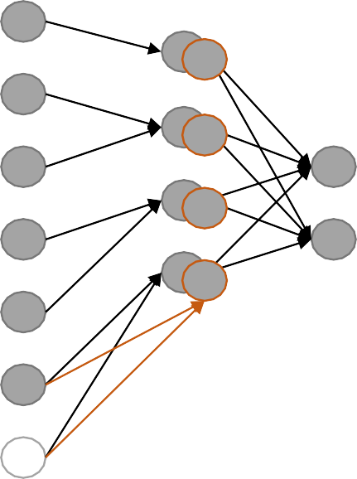
Convolutional Layer - Padding
Sometimes it is convenient to pad the input volume with zeros around the border.
Zero padding is allows us to preserve the spatial size of the output volumes
0
Input
Hidden
0
Input
Hidden
Output
Output
1 D convolution with: Filters: 1
1 D convolution with: Filters: 2
Filter Size: 2
Stride: 2
Padding: 1
Filter Size: 2
Stride: 2
Padding: 1
0
0

Slide 24
Convolutional Layer – Filters – Navigation Example
Strides = 1, Filter Size = 3 X 3 X 1, Padding = 0
1 | -1 | -1
-1 | 1 | -1
-1 | -1 | 1
-1 | -1 | -1 | -1 | -1 | -1 | -1 | -1 | -1
-1 | 1 | -1 | -1 | -1 | -1 | -1 | 1 | -1
-1 | -1 | 1 | -1 | -1 | -1 | 1 | -1 | -1
-1 | -1 | -1 | 1 | -1 | 1 | -1 | -1 | -1
-1 | -1 | -1 | -1 | 1 | -1 | -1 | -1 | -1
-1 | -1 | -1 | 1 | -1 | 1 | -1 | -1 | -1
-1 | -1 | 1 | -1 | -1 | -1 | 1 | -1 | -1
-1 | 1 | -1 | -1 | -1 | -1 | -1 | 1 | -1
-1 | -1 | -1 | -1 | -1 | -1 | -1 | -1 | -1

Slide 25
Convolutional Layer – Filters – Navigation Example
1 | -1 | -1
-1 | 1 | -1
-1 | -1 | 1
-1 | -1 | -1 | -1 | -1 | -1 | -1 | -1 | -1
-1 | 1 | -1 | -1 | -1 | -1 | -1 | 1 | -1
-1 | -1 | 1 | -1 | -1 | -1 | 1 | -1 | -1
-1 | -1 | -1 | 1 | -1 | 1 | -1 | -1 | -1
-1 | -1 | -1 | -1 | 1 | -1 | -1 | -1 | -1
-1 | -1 | -1 | 1 | -1 | 1 | -1 | -1 | -1
-1 | -1 | 1 | -1 | -1 | -1 | 1 | -1 | -1
-1 | 1 | -1 | -1 | -1 | -1 | -1 | 1 | -1
-1 | -1 | -1 | -1 | -1 | -1 | -1 | -1 | -1

Slide 26
Convolutional Layer – Filters – Navigation Example
1 | -1 | -1
-1 | 1 | -1
-1 | -1 | 1
-1 | -1 | -1 | -1 | -1 | -1 | -1 | -1 | -1
-1 | 1 | -1 | -1 | -1 | -1 | -1 | 1 | -1
-1 | -1 | 1 | -1 | -1 | -1 | 1 | -1 | -1
-1 | -1 | -1 | 1 | -1 | 1 | -1 | -1 | -1
-1 | -1 | -1 | -1 | 1 | -1 | -1 | -1 | -1
-1 | -1 | -1 | 1 | -1 | 1 | -1 | -1 | -1
-1 | -1 | 1 | -1 | -1 | -1 | 1 | -1 | -1
-1 | 1 | -1 | -1 | -1 | -1 | -1 | 1 | -1
-1 | -1 | -1 | -1 | -1 | -1 | -1 | -1 | -1

Slide 27
Convolutional Layer – Filters – Navigation Example
1 | -1 | -1
-1 | 1 | -1
-1 | -1 | 1
-1 | -1 | -1 | -1 | -1 | -1 | -1 | -1 | -1
-1 | 1 | -1 | -1 | -1 | -1 | -1 | 1 | -1
-1 | -1 | 1 | -1 | -1 | -1 | 1 | -1 | -1
-1 | -1 | -1 | 1 | -1 | 1 | -1 | -1 | -1
-1 | -1 | -1 | -1 | 1 | -1 | -1 | -1 | -1
-1 | -1 | -1 | 1 | -1 | 1 | -1 | -1 | -1
-1 | -1 | 1 | -1 | -1 | -1 | 1 | -1 | -1
-1 | 1 | -1 | -1 | -1 | -1 | -1 | 1 | -1
-1 | -1 | -1 | -1 | -1 | -1 | -1 | -1 | -1

Slide 28
Convolutional Layer – Filters – Navigation Example
1 | -1 | -1
-1 | 1 | -1
-1 | -1 | 1
-1 | -1 | -1 | -1 | -1 | -1 | -1 | -1 | -1
-1 | 1 | -1 | -1 | -1 | -1 | -1 | 1 | -1
-1 | -1 | 1 | -1 | -1 | -1 | 1 | -1 | -1
-1 | -1 | -1 | 1 | -1 | 1 | -1 | -1 | -1
-1 | -1 | -1 | -1 | 1 | -1 | -1 | -1 | -1
-1 | -1 | -1 | 1 | -1 | 1 | -1 | -1 | -1
-1 | -1 | 1 | -1 | -1 | -1 | 1 | -1 | -1
-1 | 1 | -1 | -1 | -1 | -1 | -1 | 1 | -1
-1 | -1 | -1 | -1 | -1 | -1 | -1 | -1 | -1

Slide 29
Convolutional Layer – Filters – Navigation Example
1 | -1 | -1
-1 | 1 | -1
-1 | -1 | 1
-1 | -1 | -1 | -1 | -1 | -1 | -1 | -1 | -1
-1 | 1 | -1 | -1 | -1 | -1 | -1 | 1 | -1
-1 | -1 | 1 | -1 | -1 | -1 | 1 | -1 | -1
-1 | -1 | -1 | 1 | -1 | 1 | -1 | -1 | -1
-1 | -1 | -1 | -1 | 1 | -1 | -1 | -1 | -1
-1 | -1 | -1 | 1 | -1 | 1 | -1 | -1 | -1
-1 | -1 | 1 | -1 | -1 | -1 | 1 | -1 | -1
-1 | 1 | -1 | -1 | -1 | -1 | -1 | 1 | -1
-1 | -1 | -1 | -1 | -1 | -1 | -1 | -1 | -1

Slide 30
Convolutional Layer – Filters – Navigation Example
1 | -1 | -1
-1 | 1 | -1
-1 | -1 | 1
-1 | -1 | -1 | -1 | -1 | -1 | -1 | -1 | -1
-1 | 1 | -1 | -1 | -1 | -1 | -1 | 1 | -1
-1 | -1 | 1 | -1 | -1 | -1 | 1 | -1 | -1
-1 | -1 | -1 | 1 | -1 | 1 | -1 | -1 | -1
-1 | -1 | -1 | -1 | 1 | -1 | -1 | -1 | -1
-1 | -1 | -1 | 1 | -1 | 1 | -1 | -1 | -1
-1 | -1 | 1 | -1 | -1 | -1 | 1 | -1 | -1
-1 | 1 | -1 | -1 | -1 | -1 | -1 | 1 | -1
-1 | -1 | -1 | -1 | -1 | -1 | -1 | -1 | -1

Slide 31
Convolutional Layer – Filters – Navigation Example
1 | -1 | -1
-1 | 1 | -1
-1 | -1 | 1
-1 | -1 | -1 | -1 | -1 | -1 | -1 | -1 | -1
-1 | 1 | -1 | -1 | -1 | -1 | -1 | 1 | -1
-1 | -1 | 1 | -1 | -1 | -1 | 1 | -1 | -1
-1 | -1 | -1 | 1 | -1 | 1 | -1 | -1 | -1
-1 | -1 | -1 | -1 | 1 | -1 | -1 | -1 | -1
-1 | -1 | -1 | 1 | -1 | 1 | -1 | -1 | -1
-1 | -1 | 1 | -1 | -1 | -1 | 1 | -1 | -1
-1 | 1 | -1 | -1 | -1 | -1 | -1 | 1 | -1
-1 | -1 | -1 | -1 | -1 | -1 | -1 | -1 | -1

Slide 32
Convolutional Layer – Filters – Navigation Example
1 | -1 | -1
-1 | 1 | -1
-1 | -1 | 1
-1 | -1 | -1 | -1 | -1 | -1 | -1 | -1 | -1
-1 | 1 | -1 | -1 | -1 | -1 | -1 | 1 | -1
-1 | -1 | 1 | -1 | -1 | -1 | 1 | -1 | -1
-1 | -1 | -1 | 1 | -1 | 1 | -1 | -1 | -1
-1 | -1 | -1 | -1 | 1 | -1 | -1 | -1 | -1
-1 | -1 | -1 | 1 | -1 | 1 | -1 | -1 | -1
-1 | -1 | 1 | -1 | -1 | -1 | 1 | -1 | -1
-1 | 1 | -1 | -1 | -1 | -1 | -1 | 1 | -1
-1 | -1 | -1 | -1 | -1 | -1 | -1 | -1 | -1

Slide 33

Convolutional Layer – Filters – Computation Example
1 | -1 | -1
-1 | 1 | -1
-1 | -1 | 1
 |  |  |  | -1 | -1 | -1 | -1 | -1 | -1 | -1 | -1 | -1
 |  |  |  | -1 | 1 | -1 | -1 | -1 | -1 | -1 | 1 | -1
 |  |  |  | -1 | -1 | 1 | -1 | -1 | -1 | 1 | -1 | -1
 |  |  |  | -1 | -1 | -1 | 1 | -1 | 1 | -1 | -1 | -1
 |  |  |  | -1 | -1 | -1 | -1 | 1 | -1 | -1 | -1 | -1
 |  |  |  | -1 | -1 | -1 | 1 | -1 | 1 | -1 | -1 | -1
 |  |  |  | -1 | -1 | 1 | -1 | -1 | -1 | 1 | -1 | -1
 |  |  |  | -1 | 1 | -1 | -1 | -1 | -1 | -1 | 1 | -1
 |  |  |  | -1 | -1 | -1 | -1 | -1 | -1 | -1 | -1 | -1

Slide 34
Convolutional Layer – Filters – Computation Example
1 | -1 | -1
-1 | 1 | -1
-1 | -1 | 1
 |  |  |  | -1 | -1 | -1 | -1 | -1 | -1 | -1 | -1 | -1
 |  |  |  | -1 | 1 | -1 | -1 | -1 | -1 | -1 | 1 | -1
 |  |  |  | -1 | -1 | 1 | -1 | -1 | -1 | 1 | -1 | -1
 |  |  |  | -1 | -1 | -1 | 1 | -1 | 1 | -1 | -1 | -1
 |  |  |  | -1 | -1 | -1 | -1 | 1 | -1 | -1 | -1 | -1
 |  |  |  | -1 | -1 | -1 | 1 | -1 | 1 | -1 | -1 | -1
 |  |  |  | -1 | -1 | 1 | -1 | -1 | -1 | 1 | -1 | -1
 |  |  |  | -1 | 1 | -1 | -1 | -1 | -1 | -1 | 1 | -1
 |  |  |  | -1 | -1 | -1 | -1 | -1 | -1 | -1 | -1 | -1
1

Slide 35


Convolutional Layer – Filters – Computation Example
1 | -1 | -1
-1 | 1 | -1
-1 | -1 | 1
 |  |  |  | -1 | -1 | -1 | -1 | -1 | -1 | -1 | -1 | -1
 |  |  |  | -1 | 1 | -1 | -1 | -1 | -1 | -1 | 1 | -1
 |  |  |  | -1 | -1 | 1 | -1 | -1 | -1 | 1 | -1 | -1
 |  |  |  | -1 | -1 | -1 | 1 | -1 | 1 | -1 | -1 | -1
 |  |  |  | -1 | -1 | -1 | -1 | 1 | -1 | -1 | -1 | -1
 |  |  |  | -1 | -1 | -1 | 1 | -1 | 1 | -1 | -1 | -1
 |  |  |  | -1 | -1 | 1 | -1 | -1 | -1 | 1 | -1 | -1
 |  |  |  | -1 | 1 | -1 | -1 | -1 | -1 | -1 | 1 | -1
 |  |  |  | -1 | -1 | -1 | -1 | -1 | -1 | -1 | -1 | -1
1 | 1

Slide 36
Convolutional Layer – Filters – Computation Example
1 | -1 | -1
-1 | 1 | -1
-1 | -1 | 1
1 | 1 | 1
-1 | -1 | -1 | -1 | -1 | -1 | -1 | -1 | -1
-1 | 1 | -1 | -1 | -1 | -1 | -1 | 1 | -1
-1 | -1 | 1 | -1 | -1 | -1 | 1 | -1 | -1
-1 | -1 | -1 | 1 | -1 | 1 | -1 | -1 | -1
-1 | -1 | -1 | -1 | 1 | -1 | -1 | -1 | -1
-1 | -1 | -1 | 1 | -1 | 1 | -1 | -1 | -1
-1 | -1 | 1 | -1 | -1 | -1 | 1 | -1 | -1
-1 | 1 | -1 | -1 | -1 | -1 | -1 | 1 | -1
-1 | -1 | -1 | -1 | -1 | -1 | -1 | -1 | -1

Slide 37


Convolutional Layer – Filters – Computation Example
1 | -1 | -1
-1 | 1 | -1
-1 | -1 | 1
1 | 1 | 1
1
-1 | -1 | -1 | -1 | -1 | -1 | -1 | -1 | -1
-1 | 1 | -1 | -1 | -1 | -1 | -1 | 1 | -1
-1 | -1 | 1 | -1 | -1 | -1 | 1 | -1 | -1
-1 | -1 | -1 | 1 | -1 | 1 | -1 | -1 | -1
-1 | -1 | -1 | -1 | 1 | -1 | -1 | -1 | -1
-1 | -1 | -1 | 1 | -1 | 1 | -1 | -1 | -1
-1 | -1 | 1 | -1 | -1 | -1 | 1 | -1 | -1
-1 | 1 | -1 | -1 | -1 | -1 | -1 | 1 | -1
-1 | -1 | -1 | -1 | -1 | -1 | -1 | -1 | -1

Slide 38

Convolutional Layer – Filters – Computation Example
1 | -1 | -1
-1 | 1 | -1
-1 | -1 | 1
 |  |  |  | -1 | -1 | -1 | -1 | -1 | -1 | -1 | -1 | -1
 |  |  |  | -1 | 1 | -1 | -1 | -1 | -1 | -1 | 1 | -1
 |  |  |  | -1 | -1 | 1 | -1 | -1 | -1 | 1 | -1 | -1
 |  |  |  | -1 | -1 | -1 | 1 | -1 | 1 | -1 | -1 | -1
 |  |  |  | -1 | -1 | -1 | -1 | 1 | -1 | -1 | -1 | -1
 |  |  |  | -1 | -1 | -1 | 1 | -1 | 1 | -1 | -1 | -1
 |  |  |  | -1 | -1 | 1 | -1 | -1 | -1 | 1 | -1 | -1
 |  |  |  | -1 | 1 | -1 | -1 | -1 | -1 | -1 | 1 | -1
 |  |  |  | -1 | -1 | -1 | -1 | -1 | -1 | -1 | -1 | -1
1 | 1 | 1
1 | 1

Slide 39
Convolutional Layer – Filters – Computation Example
1 | -1 | -1
-1 | 1 | -1
-1 | -1 | 1
1 | 1 | 1
1 | 1 | 1
-1 | -1 | -1 | -1 | -1 | -1 | -1 | -1 | -1
-1 | 1 | -1 | -1 | -1 | -1 | -1 | 1 | -1
-1 | -1 | 1 | -1 | -1 | -1 | 1 | -1 | -1
-1 | -1 | -1 | 1 | -1 | 1 | -1 | -1 | -1
-1 | -1 | -1 | -1 | 1 | -1 | -1 | -1 | -1
-1 | -1 | -1 | 1 | -1 | 1 | -1 | -1 | -1
-1 | -1 | 1 | -1 | -1 | -1 | 1 | -1 | -1
-1 | 1 | -1 | -1 | -1 | -1 | -1 | 1 | -1
-1 | -1 | -1 | -1 | -1 | -1 | -1 | -1 | -1

Slide 40
Convolutional Layer – Filters – Computation Example
1 | -1 | -1
-1 | 1 | -1
-1 | -1 | 1
 |  |  |  | -1 | -1 | -1 | -1 | -1 | -1 | -1 | -1 | -1
 |  |  |  | -1 | 1 | -1 | -1 | -1 | -1 | -1 | 1 | -1
 |  |  |  | -1 | -1 | 1 | -1 | -1 | -1 | 1 | -1 | -1
 |  |  |  | -1 | -1 | -1 | 1 | -1 | 1 | -1 | -1 | -1
 |  |  |  | -1 | -1 | -1 | -1 | 1 | -1 | -1 | -1 | -1
 |  |  |  | -1 | -1 | -1 | 1 | -1 | 1 | -1 | -1 | -1
 |  |  |  | -1 | -1 | 1 | -1 | -1 | -1 | 1 | -1 | -1
 |  |  |  | -1 | 1 | -1 | -1 | -1 | -1 | -1 | 1 | -1
 |  |  |  | -1 | -1 | -1 | -1 | -1 | -1 | -1 | -1 | -1
1 | 1 | 1
1 | 1 | 1
1

Slide 41
Convolutional Layer – Filters – Computation Example
1 | -1 | -1
-1 | 1 | -1
-1 | -1 | 1
 |  |  |  | -1 | -1 | -1 | -1 | -1 | -1 | -1 | -1 | -1
 |  |  |  | -1 | 1 | -1 | -1 | -1 | -1 | -1 | 1 | -1
 |  |  |  | -1 | -1 | 1 | -1 | -1 | -1 | 1 | -1 | -1
 |  |  |  | -1 | -1 | -1 | 1 | -1 | 1 | -1 | -1 | -1
 |  |  |  | -1 | -1 | -1 | -1 | 1 | -1 | -1 | -1 | -1
 |  |  |  | -1 | -1 | -1 | 1 | -1 | 1 | -1 | -1 | -1
 |  |  |  | -1 | -1 | 1 | -1 | -1 | -1 | 1 | -1 | -1
 |  |  |  | -1 | 1 | -1 | -1 | -1 | -1 | -1 | 1 | -1
 |  |  |  | -1 | -1 | -1 | -1 | -1 | -1 | -1 | -1 | -1
1 | 1 | 1
1 | 1 | 1
1 | 1

Slide 42
Convolutional Layer – Filters – Computation Example
1 | -1 | -1
-1 | 1 | -1
-1 | -1 | 1
 |  |  |  |  | -1 | -1 | -1 | -1 | -1 | -1 | -1 | -1 | -1
 |  |  |  |  | -1 | 1 | -1 | -1 | -1 | -1 | -1 | 1 | -1
 |  |  |  |  | -1 | -1 | 1 | -1 | -1 | -1 | 1 | -1 | -1
 |  |  |  |  | -1 | -1 | -1 | 1 | -1 | 1 | -1 | -1 | -1
 |  |  |  |  | -1 | -1 | -1 | -1 | 1 | -1 | -1 | -1 | -1
 |  |  |  |  | -1 | -1 | -1 | 1 | -1 | 1 | -1 | -1 | -1
 |  |  |  |  | -1 | -1 | 1 | -1 | -1 | -1 | 1 | -1 | -1
 |  |  |  |  | -1 | 1 | -1 | -1 | -1 | -1 | -1 | 1 | -1
 |  |  |  |  | -1 | -1 | -1 | -1 | -1 | -1 | -1 | -1 | -1
1 | 1 | 1
1 | 1 | 1
1 | 1 | 1

Slide 43
Convolutional Layer – Filters – Computation Example
1 | -1 | -1
-1 | 1 | -1
-1 | -1 | 1
1 | 1 | 1
1 | 1 | 1
1 | 1 | 1
-1 | -1 | -1 | -1 | -1 | -1 | -1 | -1 | -1
-1 | 1 | -1 | -1 | -1 | -1 | -1 | 1 | -1
-1 | -1 | 1 | -1 | -1 | -1 | 1 | -1 | -1 |  |  |  | 1
-1 | -1 | -1 | 1 | -1 | 1 | -1 | -1 | -1
-1 | -1 | -1 | -1 | 1 | -1 | -1 | -1 | -1
-1 | -1 | -1 | 1 | -1 | 1 | -1 | -1 | -1
-1 | -1 | 1 | -1 | -1 | -1 | 1 | -1 | -1
-1 | 1 | -1 | -1 | -1 | -1 | -1 | 1 | -1
-1 | -1 | -1 | -1 | -1 | -1 | -1 | -1 | -1

Slide 44
Convolutional Layer – Filters – Computation Example
1 | -1 | -1
-1 | 1 | -1
-1 | -1 | 1
 |  |  |  | -1 | -1 | -1 | -1 | -1 | -1 | -1 | -1 | -1
 |  |  |  | -1 | 1 | -1 | -1 | -1 | -1 | -1 | 1 | -1
 |  |  |  | -1 | -1 | 1 | -1 | -1 | -1 | 1 | -1 | -1
 |  |  |  | -1 | -1 | -1 | 1 | -1 | 1 | -1 | -1 | -1
 |  |  |  | -1 | -1 | -1 | -1 | 1 | -1 | -1 | -1 | -1
 |  |  |  | -1 | -1 | -1 | 1 | -1 | 1 | -1 | -1 | -1
 |  |  |  | -1 | -1 | 1 | -1 | -1 | -1 | 1 | -1 | -1
 |  |  |  | -1 | 1 | -1 | -1 | -1 | -1 | -1 | 1 | -1
 |  |  |  | -1 | -1 | -1 | -1 | -1 | -1 | -1 | -1 | -1
1

Slide 45

Convolutional Layer – Filters – Computation Example
1 | -1 | -1
-1 | 1 | -1
-1 | -1 | 1
1 | 1 | -1
-1 | -1 | -1 | -1 | -1 | -1 | -1 | -1 | -1
-1 | 1 | -1 | -1 | -1 | -1 | -1 | 1 | -1
-1 | -1 | 1 | -1 | -1 | -1 | 1 | -1 | -1
-1 | -1 | -1 | 1 | -1 | 1 | -1 | -1 | -1
-1 | -1 | -1 | -1 | 1 | -1 | -1 | -1 | -1
-1 | -1 | -1 | 1 | -1 | 1 | -1 | -1 | -1
-1 | -1 | 1 | -1 | -1 | -1 | 1 | -1 | -1
-1 | 1 | -1 | -1 | -1 | -1 | -1 | 1 | -1
-1 | -1 | -1 | -1 | -1 | -1 | -1 | -1 | -1

Slide 46
Convolutional Layer – Filters – Computation Example
1 | -1 | -1
-1 | 1 | -1
-1 | -1 | 1
1 | 1 | -1
1 | 1 | 1
-1 | 1 | 1
-1 | -1 | -1 | -1 | -1 | -1 | -1 | -1 | -1
-1 | 1 | -1 | -1 | -1 | -1 | -1 | 1 | -1
-1 | -1 | 1 | -1 | -1 | -1 | 1 | -1 | -1
-1 | -1 | -1 | 1 | -1 | 1 | -1 | -1 | -1
-1 | -1 | -1 | -1 | 1 | -1 | -1 | -1 | -1
-1 | -1 | -1 | 1 | -1 | 1 | -1 | -1 | -1
-1 | -1 | 1 | -1 | -1 | -1 | 1 | -1 | -1
-1 | 1 | -1 | -1 | -1 | -1 | -1 | 1 | -1
-1 | -1 | -1 | -1 | -1 | -1 | -1 | -1 | -1

Slide 47

Convolutional Layer – Filters – Computation Example
1 | -1 | -1
-1 | 1 | -1
-1 | -1 | 1
1 1
-1
1 1
-1
1 1 1
1 1 1
-1
1
1
-1
1 1
-1 | -1 | -1 | -1 | -1 | -1 | -1 | -1 | -1
-1 | 1 | -1 | -1 | -1 | -1 | -1 | 1 | -1
-1 | -1 | 1 | -1 | -1 | -1 | 1 | -1 | -1 |  |  |  | 1
-1 | -1 | -1 | 1 | -1 | 1 | -1 | -1 | -1
-1 | -1 | -1 | -1 | 1 | -1 | -1 | -1 | -1 |  |  |  |  |  | 55
-1 | -1 | -1 | 1 | -1 | 1 | -1 | -1 | -1
-1 | -1 | 1 | -1 | -1 | -1 | 1 | -1 | -1
-1 | 1 | -1 | -1 | -1 | -1 | -1 | 1 | -1
-1 | -1 | -1 | -1 | -1 | -1 | -1 | -1 | -1

Slide 48
Convolutional Layer – Filters – Computation Example
Input Size (W): 9 Filter Size (F): 3 X 3
Stride (S): 1
Filters: 1
9 X 9
7 X 7
Padding (P): 0
-1 | -1 | -1 | -1 | -1 | -1 | -1 | -1 | -1
-1 | 1 | -1 | -1 | -1 | -1 | -1 | 1 | -1
-1 | -1 | 1 | -1 | -1 | -1 | 1 | -1 | -1
-1 | -1 | -1 | 1 | -1 | 1 | -1 | -1 | -1
-1 | -1 | -1 | -1 | 1 | -1 | -1 | -1 | -1
-1 | -1 | -1 | 1 | -1 | 1 | -1 | -1 | -1
-1 | -1 | 1 | -1 | -1 | -1 | 1 | -1 | -1
-1 | 1 | -1 | -1 | -1 | -1 | -1 | 1 | -1
-1 | -1 | -1 | -1 | -1 | -1 | -1 | -1 | -1
0.77 | -0.11 | 0.11 | 0.33 | 0.55 | -0.11 | 0.33
-0.11 | 1.00 | -0.11 | 0.33 | -0.11 | 0.11 | -0.11
0.11 | -0.11 | 1.00 | -0.33 | 0.11 | -0.11 | 0.55
0.33 | 0.33 | -0.33 | 0.55 | -0.33 | 0.33 | 0.33
0.55 | -0.11 | 0.11 | -0.33 | 1.00 | -0.11 | 0.11
-0.11 | 0.11 | -0.11 | 0.33 | -0.11 | 1.00 | -0.11
0.33 | -0.11 | 0.55 | 0.33 | 0.11 | -0.11 | 0.77
1 | -1 | -1
-1 | 1 | -1
-1 | -1 | 1
=
Feature Map Size = 1+ (W – F + 2P)/S
= 1+ (9 – 3 + 2 X 0)/1 = 7

Slide 49
Convolutional Layer – Filters – Output Feature Map
Output Feature Map of One complete convolution:
Filters: 3
Filter Size: 3 X 3
Stride: 1
-1 | -1 | -1 | -1 | -1 | -1 | -1 | -1 | -1
-1 | 1 | -1 | -1 | -1 | -1 | -1 | 1 | -1
-1 | -1 | 1 | -1 | -1 | -1 | 1 | -1 | -1
-1 | -1 | -1 | 1 | -1 | 1 | -1 | -1 | -1
-1 | -1 | -1 | -1 | 1 | -1 | -1 | -1 | -1
-1 | -1 | -1 | 1 | -1 | 1 | -1 | -1 | -1
-1 | -1 | 1 | -1 | -1 | -1 | 1 | -1 | -1
-1 | 1 | -1 | -1 | -1 | -1 | -1 | 1 | -1
-1 | -1 | -1 | -1 | -1 | -1 | -1 | -1 | -1
0.77 | -0.11 | 0.11 | 0.33 | 0.55 | -0.11 | 0.33
-0.11 | 1.00 | -0.11 | 0.33 | -0.11 | 0.11 | -0.11
0.11 | -0.11 | 1.00 | -0.33 | 0.11 | -0.11 | 0.55
0.33 | 0.33 | -0.33 | 0.55 | -0.33 | 0.33 | 0.33
0.55 | -0.11 | 0.11 | -0.33 | 1.00 | -0.11 | 0.11
-0.11 | 0.11 | -0.11 | 0.33 | -0.11 | 1.00 | -0.11
0.33 | -0.11 | 0.55 | 0.33 | 0.11 | -0.11 | 0.77
1 | -1 | -1
-1 | 1 | -1
-1 | -1 | 1
=
-1 | -1 | -1 | -1 | -1 | -1 | -1 | -1 | -1
-1 | 1 | -1 | -1 | -1 | -1 | -1 | 1 | -1
-1 | -1 | 1 | -1 | -1 | -1 | 1 | -1 | -1
-1 | -1 | -1 | 1 | -1 | 1 | -1 | -1 | -1
-1 | -1 | -1 | -1 | 1 | -1 | -1 | -1 | -1
-1 | -1 | -1 | 1 | -1 | 1 | -1 | -1 | -1
-1 | -1 | 1 | -1 | -1 | -1 | 1 | -1 | -1
-1 | 1 | -1 | -1 | -1 | -1 | -1 | 1 | -1
-1 | -1 | -1 | -1 | -1 | -1 | -1 | -1 | -1
0.33 | -0.55 | 0.11 | -0.11 | 0.11 | -0.55 | 0.33
-0.55 | 0.55 | -0.55 | 0.33 | -0.55 | 0.55 | -0.55
0.11 | -0.55 | 0.55 | -0.77 | 0.55 | -0.55 | 0.11
-0.11 | 0.33 | -0.77 | 1.00 | -0.77 | 0.33 | -0.11
0.11 | -0.55 | 0.55 | -0.77 | 0.55 | -0.55 | 0.11
-0.55 | 0.55 | -0.55 | 0.33 | -0.55 | 0.55 | -0.55
0.33 | -0.55 | 0.11 | -0.11 | 0.11 | -0.55 | 0.33
1 | -1 | 1
-1 | 1 | -1
1 | -1 | 1
=
Conclusion:
Input Image:
9 X 9
Output of Convolution:
7 X 7 X 3
-1 | -1 | -1 | -1 | -1 | -1 | -1 | -1 | -1
-1 | 1 | -1 | -1 | -1 | -1 | -1 | 1 | -1
-1 | -1 | 1 | -1 | -1 | -1 | 1 | -1 | -1
-1 | -1 | -1 | 1 | -1 | 1 | -1 | -1 | -1
-1 | -1 | -1 | -1 | 1 | -1 | -1 | -1 | -1
-1 | -1 | -1 | 1 | -1 | 1 | -1 | -1 | -1
-1 | -1 | 1 | -1 | -1 | -1 | 1 | -1 | -1
-1 | 1 | -1 | -1 | -1 | -1 | -1 | 1 | -1
-1 | -1 | -1 | -1 | -1 | -1 | -1 | -1 | -1
0.33 | -0.11 | 0.55 | 0.33 | 0.11 | -0.11 | 0.77
-0.11 | 0.11 | -0.11 | 0.33 | -0.11 | 1.00 | -0.11
0.55 | -0.11 | 0.11 | -0.33 | 1.00 | -0.11 | 0.11
0.33 | 0.33 | -0.33 | 0.55 | -0.33 | 0.33 | 0.33
0.11 | -0.11 | 1.00 | -0.33 | 0.11 | -0.11 | 0.55
-0.11 | 1.00 | -0.11 | 0.33 | -0.11 | 0.11 | -0.11
0.77 | -0.11 | 0.11 | 0.33 | 0.55 | -0.11 | 0.33
-1 | -1 | 1
-1 | 1 | -1
1 | -1 | -1
=

Slide 50
Convolutional Layer – Output
0.77 | -0.11 | 0.11 | 0.33 | 0.55 | -0.11 | 0.33
-0.11 | 1.00 | -0.11 | 0.33 | -0.11 | 0.11 | -0.11
0.11 | -0.11 | 1.00 | -0.33 | 0.11 | -0.11 | 0.55
0.33 | 0.33 | -0.33 | 0.55 | -0.33 | 0.33 | 0.33
0.55 | -0.11 | 0.11 | -0.33 | 1.00 | -0.11 | 0.11
-0.11 | 0.11 | -0.11 | 0.33 | -0.11 | 1.00 | -0.11
0.33 | -0.11 | 0.55 | 0.33 | 0.11 | -0.11 | 0.77
-1 | -1 | -1 | -1 | -1 | -1 | -1 | -1 | -1
-1 | 1 | -1 | -1 | -1 | -1 | -1 | 1 | -1
-1 | -1 | 1 | -1 | -1 | -1 | 1 | -1 | -1
-1 | -1 | -1 | 1 | -1 | 1 | -1 | -1 | -1
-1 | -1 | -1 | -1 | 1 | -1 | -1 | -1 | -1
-1 | -1 | -1 | 1 | -1 | 1 | -1 | -1 | -1
-1 | -1 | 1 | -1 | -1 | -1 | 1 | -1 | -1
-1 | 1 | -1 | -1 | -1 | -1 | -1 | 1 | -1
-1 | -1 | -1 | -1 | -1 | -1 | -1 | -1 | -1
0.33 | -0.55 | 0.11 | -0.11 | 0.11 | -0.55 | 0.33
-0.55 | 0.55 | -0.55 | 0.33 | -0.55 | 0.55 | -0.55
0.11 | -0.55 | 0.55 | -0.77 | 0.55 | -0.55 | 0.11
-0.11 | 0.33 | -0.77 | 1.00 | -0.77 | 0.33 | -0.11
0.11 | -0.55 | 0.55 | -0.77 | 0.55 | -0.55 | 0.11
-0.55 | 0.55 | -0.55 | 0.33 | -0.55 | 0.55 | -0.55
0.33 | -0.55 | 0.11 | -0.11 | 0.11 | -0.55 | 0.33
0.33 | -0.11 | 0.55 | 0.33 | 0.11 | -0.11 | 0.77
-0.11 | 0.11 | -0.11 | 0.33 | -0.11 | 1.00 | -0.11
0.55 | -0.11 | 0.11 | -0.33 | 1.00 | -0.11 | 0.11
0.33 | 0.33 | -0.33 | 0.55 | -0.33 | 0.33 | 0.33
0.11 | -0.11 | 1.00 | -0.33 | 0.11 | -0.11 | 0.55
-0.11 | 1.00 | -0.11 | 0.33 | -0.11 | 0.11 | -0.11
0.77 | -0.11 | 0.11 | 0.33 | 0.55 | -0.11 | 0.33

Slide 51
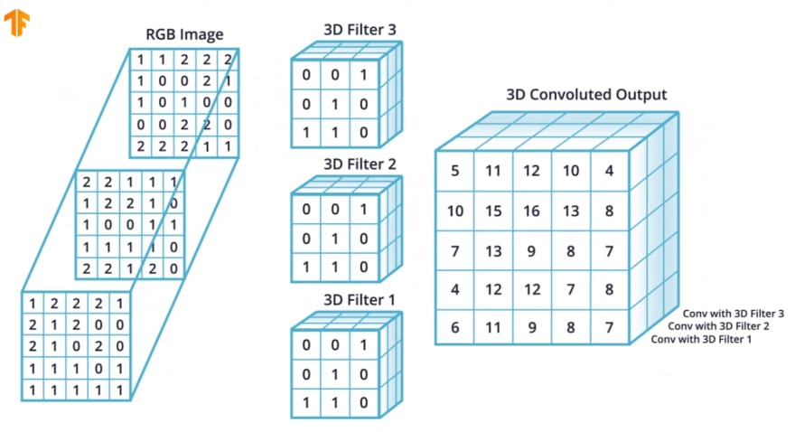
Convolution Operation on RGB images

Slide 52
Agenda
Introduction
Archetecture Overview
How ConvNet Works
ConvNet Layers
Convolutional Layer
Pooling Layer
Normalization Layer (ReLU)
Fully-Connected Layer
Demos & Parameters
Hyper Parameters
Mnist dataset on AWS
CIFAR-10 ConvNetJS
Case Studies

Slide 53
Rectified Linear Units (ReLUs)
0.77 | -0.11 | 0.11 | 0.33 | 0.55 | -0.11 | 0.33
-0.11 | 1.00 | -0.11 | 0.33 | -0.11 | 0.11 | -0.11
0.11 | -0.11 | 1.00 | -0.33 | 0.11 | -0.11 | 0.55
0.33 | 0.33 | -0.33 | 0.55 | -0.33 | 0.33 | 0.33
0.55 | -0.11 | 0.11 | -0.33 | 1.00 | -0.11 | 0.11
-0.11 | 0.11 | -0.11 | 0.33 | -0.11 | 1.00 | -0.11
0.33 | -0.11 | 0.55 | 0.33 | 0.11 | -0.11 | 0.77
0.77

Slide 54
Rectified Linear Units (ReLUs)
0.77 | -0.11 | 0.11 | 0.33 | 0.55 | -0.11 | 0.33
-0.11 | 1.00 | -0.11 | 0.33 | -0.11 | 0.11 | -0.11
0.11 | -0.11 | 1.00 | -0.33 | 0.11 | -0.11 | 0.55
0.33 | 0.33 | -0.33 | 0.55 | -0.33 | 0.33 | 0.33
0.55 | -0.11 | 0.11 | -0.33 | 1.00 | -0.11 | 0.11
-0.11 | 0.11 | -0.11 | 0.33 | -0.11 | 1.00 | -0.11
0.33 | -0.11 | 0.55 | 0.33 | 0.11 | -0.11 | 0.77
0.77 0

Slide 55
Rectified Linear Units (ReLUs)
0.77 | -0.11 | 0.11 | 0.33 | 0.55 | -0.11 | 0.33
-0.11 | 1.00 | -0.11 | 0.33 | -0.11 | 0.11 | -0.11
0.11 | -0.11 | 1.00 | -0.33 | 0.11 | -0.11 | 0.55
0.33 | 0.33 | -0.33 | 0.55 | -0.33 | 0.33 | 0.33
0.55 | -0.11 | 0.11 | -0.33 | 1.00 | -0.11 | 0.11
-0.11 | 0.11 | -0.11 | 0.33 | -0.11 | 1.00 | -0.11
0.33 | -0.11 | 0.55 | 0.33 | 0.11 | -0.11 | 0.77
0.77 | 0 | 0.11 | 0.33 | 0.55 | 0 | 0.33

Slide 56
Rectified Linear Units (ReLUs)
0.77 | -0.11 | 0.11 | 0.33 | 0.55 | -0.11 | 0.33
-0.11 | 1.00 | -0.11 | 0.33 | -0.11 | 0.11 | -0.11
0.11 | -0.11 | 1.00 | -0.33 | 0.11 | -0.11 | 0.55
0.33 | 0.33 | -0.33 | 0.55 | -0.33 | 0.33 | 0.33
0.55 | -0.11 | 0.11 | -0.33 | 1.00 | -0.11 | 0.11
-0.11 | 0.11 | -0.11 | 0.33 | -0.11 | 1.00 | -0.11
0.33 | -0.11 | 0.55 | 0.33 | 0.11 | -0.11 | 0.77
 | 0.77 | 0 | 0.11 | 0.33 | 0.55 | 0 | 0.33
 | 0 | 1.00 | 0 | 0.33 | 0 | 0.11 | 0
 | 0.11 | 0 | 1.00 | 0 | 0.11 | 0 | 0.55
 | 0.33 | 0.33 | 0 | 0.55 | 0 | 0.33 | 0.33
 | 0.55 | 0 | 0.11 | 0 | 1.00 | 0 | 0.11
 | 0 | 0.11 | 0 | 0.33 | 0 | 1.00 | 0
 | 0.33 | 0 | 0.55 | 0.33 | 0.11 | 0 | 0.77

Slide 57
ReLU layer
0.77 | -0.11 | 0.11 | 0.33 | 0.55 | -0.11 | 0.33
-0.11 | 1.00 | -0.11 | 0.33 | -0.11 | 0.11 | -0.11
0.11 | -0.11 | 1.00 | -0.33 | 0.11 | -0.11 | 0.55
0.33 | 0.33 | -0.33 | 0.55 | -0.33 | 0.33 | 0.33
0.55 | -0.11 | 0.11 | -0.33 | 1.00 | -0.11 | 0.11
-0.11 | 0.11 | -0.11 | 0.33 | -0.11 | 1.00 | -0.11
0.33 | -0.11 | 0.55 | 0.33 | 0.11 | -0.11 | 0.77
0.77 | 0 | 0.11 | 0.33 | 0.55 | 0 | 0.33
0 | 1.00 | 0 | 0.33 | 0 | 0.11 | 0
0.11 | 0 | 1.00 | 0 | 0.11 | 0 | 0.55
0.33 | 0.33 | 0 | 0.55 | 0 | 0.33 | 0.33
0.55 | 0 | 0.11 | 0 | 1.00 | 0 | 0.11
0 | 0.11 | 0 | 0.33 | 0 | 1.00 | 0
0.33 | 0 | 0.55 | 0.33 | 0.11 | 0 | 0.77
0.33 | -0.55 | 0.11 | -0.11 | 0.11 | -0.55 | 0.33
-0.55 | 0.55 | -0.55 | 0.33 | -0.55 | 0.55 | -0.55
0.11 | -0.55 | 0.55 | -0.77 | 0.55 | -0.55 | 0.11
-0.11 | 0.33 | -0.77 | 1.00 | -0.77 | 0.33 | -0.11
0.11 | -0.55 | 0.55 | -0.77 | 0.55 | -0.55 | 0.11
-0.55 | 0.55 | -0.55 | 0.33 | -0.55 | 0.55 | -0.55
0.33 | -0.55 | 0.11 | -0.11 | 0.11 | -0.55 | 0.33
0.33 | 0 | 0.11 | 0 | 0.11 | 0 | 0.33
0 | 0.55 | 0 | 0.33 | 0 | 0.55 | 0
0.11 | 0 | 0.55 | 0 | 0.55 | 0 | 0.11
0 | 0.33 | 0 1.00 0 |  |  | 0.33 | 0
0.11 | 0 | 0.55 | 0 | 0.55 | 0 | 0.11
0 | 0.55 | 0 | 0.33 | 0 | 0.55 | 0
0.33 | 0 | 0.11 | 0 | 0.11 | 0 | 0.33
0.33 | -0.11 | 0.55 | 0.33 | 0.11 | -0.11 | 0.77
-0.11 | 0.11 | -0.11 | 0.33 | -0.11 | 1.00 | -0.11
0.55 | -0.11 | 0.11 | -0.33 | 1.00 | -0.11 | 0.11
0.33 | 0.33 | -0.33 | 0.55 | -0.33 | 0.33 | 0.33
0.11 | -0.11 | 1.00 | -0.33 | 0.11 | -0.11 | 0.55
-0.11 | 1.00 | -0.11 | 0.33 | -0.11 | 0.11 | -0.11
0.77 | -0.11 | 0.11 | 0.33 | 0.55 | -0.11 | 0.33
0.33 | 0 | 0.55 | 0.33 | 0.11 | 0 | 0.77
0 | 0.11 | 0 | 0.33 | 0 | 1.00 | 0
0.55 | 0 | 0.11 | 0 | 1.00 | 0 | 0.11
0.33 | 0.33 | 0 | 0.55 | 0 | 0.33 | 0.33
0.11 | 0 | 1.00 | 0 | 0.11 | 0 | 0.55
0 | 1.00 | 0 | 0.33 | 0 | 0.11 | 0
0.77 | 0 | 0.11 | 0.33 | 0.55 | 0 | 0.33

Slide 58
Agenda
Introduction
Archetecture Overview
How ConvNet Works
ConvNet Layers
Convolutional Layer
Pooling Layer
Normalization Layer (ReLU)
Fully-Connected Layer
Demos & Parameters
Hyper Parameters
Mnist dataset on AWS
CIFAR-10 ConvNetJS
Case Studies

Slide 59
Pooling Layer
The pooling layers down-sample the previous layers feature map.
Its function is to progressively reduce the spatial size of the representation to reduce the amount of parameters and computation in the network
The pooling layer often uses the Max operation to perform the downsampling process

Slide 60

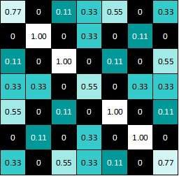
Pooling
Pooling Filter Size = 2 X 2, Stride = 2
1.00

Slide 61
Pooling
Pooling Filter Size = 2 X 2, Stride = 2
1.00 | 0.33

Slide 62
Pooling
Pooling Filter Size = 2 X 2, Stride = 2
1.00 | 0.33 | 0.55

Slide 63
Pooling
Pooling Filter Size = 2 X 2, Stride = 2
1.00 | 0.33 | 0.55 | 0.33

Slide 64
Pooling
Pooling Filter Size = 2 X 2, Stride = 2
1.00 | 0.33 | 0.55 | 0.33
0.33

Slide 65

Pooling
Pooling Filter Size = 2 X 2, Stride = 2
1.00 | 0.33 | 0.55 | 0.33
0.33 | 1.00 | 0.33 | 0.55
0.55 | 0.33 | 1.00 | 0.11
0.33 | 0.55 | 0.11 | 0.77

Slide 66
Padding
Problem with Simple Convolution Layers
For a gray scale (n x n) image and (f x f) filter/kernel, the dimensions of the image resulting from a convolution operation is (n – f + 1) x (n – f + 1). For example, for an (8 x 8) image and (3 x 3) filter, the output resulting after convolution operation would be of size (6 x 6). Thus, the image shrinks every time a convolution operation is performed. This places an upper limit to the number of times such an operation could be performed before the image reduces to nothing thereby precluding us from building deeper networks.
Also, the pixels on the corners and the edges are used much less than those in the middle. For example,

Slide 67
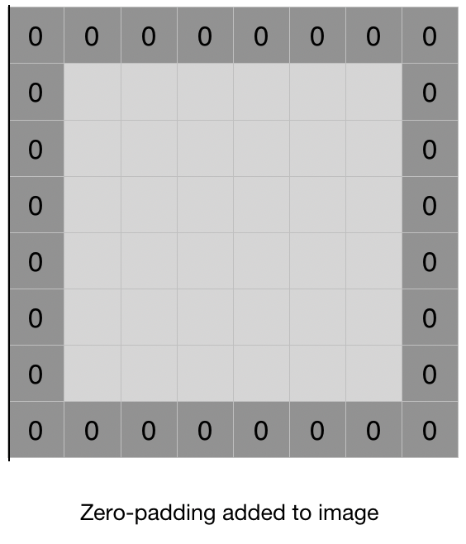
Padding
Padding Input Images
Padding is simply a process of adding layers of zeros to our input images so as to avoid the problems mentioned above.

Slide 68
Padding
Padding prevents shrinking as, if p = number of layers of zeros added to the border of the image, then our (n x n) image becomes (n + 2p) x (n + 2p) image after padding. So, applying convolution-operation (with (f x f) filter) outputs (n + 2p – f + 1) x (n + 2p – f + 1) images. For example, adding one layer of padding to an (8 x 8) image and using a (3 x 3) filter we would get an (8 x 8) output after performing convolution operation.
This increases the contribution of the pixels at the border of the original image by bringing them into the middle of the padded image. Thus, information on the borders is preserved as well as the information in the middle of the image.

Slide 69
Types of Padding
1. Valid Padding: It implies no padding at all. The input image is left in its valid/unaltered shape. So,
[(n x n) image] * [(f x f) filter] —> [(n – f + 1) x (n – f + 1) image]
where * represents a convolution operation.
2. Same Padding: In this case, we add ‘p’ padding layers such that the output image has the same dimensions as the input image. So,
[(n + 2p) x (n + 2p) image] * [(f x f) filter] —> [(n x n) image]
which gives p = (f – 1) / 2 (because n + 2p – f + 1 = n). So, if we use a (the 3 x 3) filter the 1 layer of zeros must be added to the borders for the same padding. Similarly, if (5 x 5) filter is used 2 layers of zeros must be appended to the border of the image.

Slide 70



Layers get stacked
1.00 | 0.33 | 0.55 | 0.33
0.33 | 1.00 | 0.33 | 0.55
0.55 | 0.33 | 1.00 | 0.11
0.33 | 0.55 | 0.11 | 0.77
-1 | -1 | -1 | -1 | -1 | -1 | -1 | -1 | -1
-1 | 1 | -1 | -1 | -1 | -1 | -1 | 1 | -1
-1 | -1 | 1 | -1 | -1 | -1 | 1 | -1 | -1
-1 | -1 | -1 | 1 | -1 | 1 | -1 | -1 | -1
-1 | -1 | -1 | -1 | 1 | -1 | -1 | -1 | -1
-1 | -1 | -1 | 1 | -1 | 1 | -1 | -1 | -1
-1 | -1 | 1 | -1 | -1 | -1 | 1 | -1 | -1
-1 | 1 | -1 | -1 | -1 | -1 | -1 | 1 | -1
-1 | -1 | -1 | -1 | -1 | -1 | -1 | -1 | -1
0.55 | 0.33 | 0.55 | 0.33
0.33 | 1.00 | 0.55 | 0.11
0.55 | 0.55 | 0.55 | 0.11
0.33 | 0.11 | 0.11 | 0.33
0.33 | 0.55 | 1.00 | 0.77
0.55 | 0.55 | 1.00 | 0.33
1.00 | 1.00 | 0.11 | 0.55
0.77 | 0.33 | 0.55 | 0.33

Slide 71


Layers Get Stacked - Example
224 X 224 X 3
224 X 224 X 64
112 X 112 X 64
CONVOLUTION
WITH 64 FILTERS
POOLING
(DOWNSAMPLING)

Slide 72


Deep stacking
1.00 | 0.55
0.55 | 1.00
-1 | -1 | -1 | -1 | -1 | -1 | -1 | -1 | -1
-1 | 1 | -1 | -1 | -1 | -1 | -1 | 1 | -1
-1 | -1 | 1 | -1 | -1 | -1 | 1 | -1 | -1
-1 | -1 | -1 | 1 | -1 | 1 | -1 | -1 | -1
-1 | -1 | -1 | -1 | 1 | -1 | -1 | -1 | -1
-1 | -1 | -1 | 1 | -1 | 1 | -1 | -1 | -1
-1 | -1 | 1 | -1 | -1 | -1 | 1 | -1 | -1
-1 | 1 | -1 | -1 | -1 | -1 | -1 | 1 | -1
-1 | -1 | -1 | -1 | -1 | -1 | -1 | -1 | -1
1.00 | 0.55
0.55 | 0.55
0.55 | 1.00
1.00 | 0.55

Slide 73
Fully connected layer
Fully connected layers are the normal flat feed-forward neural network layers.
1.00
0.55
These layers may have a non-linear activation function or a softmax activation in order to predict classes.
0.55
1.00
0.55
0.55
1.00
1.00
1.00
1.00 | 0.55
0.55 | 0.55
0.55
To compute our output, we simply re- arrange the output matrices as a 1-D array.
0.55
0.55 | 1.00
1.00 | 0.55
0.55
0.55
1.00
1.00
0.55

Slide 74
Fully connected layer
A summation of product of inputs and weights at each output node determines the final prediction
0.55
1.00
1.00
0.55
0.55
0.55
0.55
0.55
1.00
0.55
0.55
1.00
X
O

Slide 75








Putting it all together
X O
-1 | -1 | -1 | -1 | -1 | -1 | -1 | -1 | -1
-1 | 1 | -1 | -1 | -1 | -1 | -1 | 1 | -1
-1 | -1 | 1 | -1 | -1 | -1 | 1 | -1 | -1
-1 | -1 | -1 | 1 | -1 | 1 | -1 | -1 | -1
-1 | -1 | -1 | -1 | 1 | -1 | -1 | -1 | -1
-1 | -1 | -1 | 1 | -1 | 1 | -1 | -1 | -1
-1 | -1 | 1 | -1 | -1 | -1 | 1 | -1 | -1
-1 | 1 | -1 | -1 | -1 | -1 | -1 | 1 | -1
-1 | -1 | -1 | -1 | -1 | -1 | -1 | -1 | -1

Slide 76
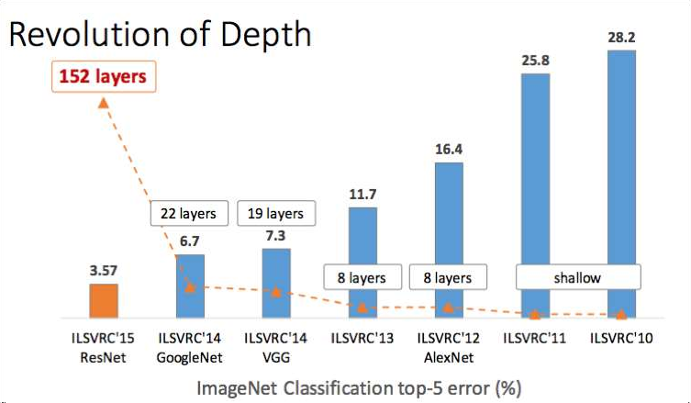
Case Studies
LeNet – 1998
AlexNet – 2012
ZFNet – 2013
VGG – 2014
GoogLeNet – 2014
ResNet – 2015

Slide 77
References
Karpathy, A. (n.d.). CS231n Convolutional Neural Networks for Visual Recognition. Retrieved from http://cs231n.github.io/convolutional-networks/#overview
Rohrer, B. (n.d.). How do Convolutional Neural Networks work?. Retrieved from
http://brohrer.github.io/how_convolutional_neural_networks_work.html
Brownlee, J. (n.d.). Crash Course in Convolutional Neural Networks for Machine Learning. Retrieved from http://machinelearningmastery.com/crash-course-convolutional-neural-networks/
Lidinwise (n.d.). The revolution of depth. Retrieved from https://medium.com/@Lidinwise/the-revolution-of-
depth-facf174924f5#.8or5c77ss
Nervana. (n.d.). Tutorial: Convolutional neural networks. Retrieved from https://www.nervanasys.com/convolutional-neural-networks/

Slide 78

Questions

Slide 79
Thank you!!

