Slide 1
Full Stack Development
Unit No 3: Angular JS [7 Hours]
Overview, Environment Setup, AngularJS – MVC Architecture, directives, Expressions, controllers, Angular Lifecycle, HTML DOM, Angular Modules, Angular Components, Angular Data Binding, Angular services, Dependency Injection.

Slide 2
Full Stack Development
Unit No 3: Angular JS [7 Hours]
Overview:
- AngularJS is a structural framework for dynamic web apps.
AngularJS's data binding and dependency injection eliminate much of the code you would otherwise have to write.
A complete client-side solution
And it all happens within the browser, making it an ideal partner with any server technology.
-AngularJS takes another approach. It attempts to minimize the impedance mismatch between document centric HTML and what an application needs by creating new HTML constructs.
AngularJS teaches the browser new syntax through a construct we call directives.
Examples :
Data binding, as in {{}}.
DOM control structures for repeating, showing and hiding DOM fragments.
Support for forms and form validation.
Attaching new behavior to DOM elements, such as DOM event handling.
Grouping of HTML into reusable components

Slide 3
Full Stack Development
AngularJS Extends HTML:
-AngularJS extends HTML with ng-directives.
-The ng-app directive defines an AngularJS application.
-The ng-model directive binds the value of HTML controls (input, select, textarea) to application data.
-The ng-bind directive binds application data to the HTML view.
Example:
<!DOCTYPE html> <html> <script src="https://ajax.googleapis.com/ajax/libs/angularjs/1.6.9/angular.min.js"></script> <body> <div ng-app=""> <p>Name: <input type="text" ng-model="name"></p> <p ng-bind="name"></p> </div> </body> </html>

Slide 4
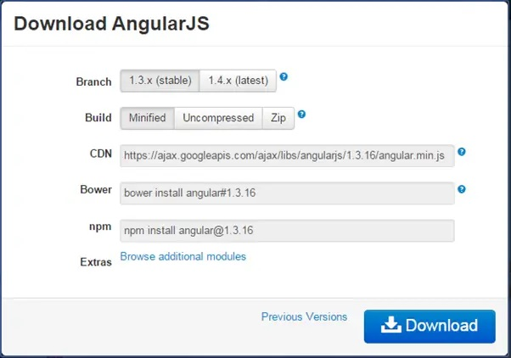
Full Stack Development
Setup AngularJS Development Environment:
We need the following tools to setup a development environment for AngularJS:
AngularJS Library 2. Editor/IDE
3. Browser 4. Web server
AngularJS Library
To download AngularJS library, go to angularjs.org -> click download button, which will open the following popup.
Download AngularJS Library

Slide 5
Full Stack Development
Editor:
AngularJS is eventually HTML and JavaScript code. So you can install any good editor/IDE as per your choice.
The following editors are recommended:
Sublime Text 2. Aptana Studio 3
3. Ultra Edit 4. Eclipse 5. Visual Studio
Online Editor:
You can also use the following online editors for learning purpose.
plnkr.co
jsbin.com
We are using our own online code editor for all the AngularJS examples in these tutorials.
Web server:
Use any web server such as IIS, apache etc., locally for development purpose.
Browser:
You can install any browser of your choice as AngularJS supports cross-browser compatibility. However, it is recommended to use Google Chrome while developing an application.

Slide 6
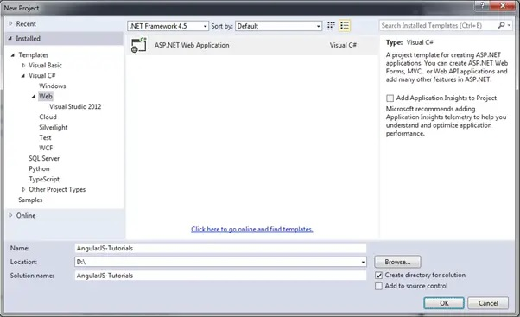
Full Stack Development
Setup AngularJS Project in Visual Studio:
-You can create AngularJS application in any version of Visual Studio. Here, we will use Visual Studio 2013 for web.
-First, create new project by clicking on New Project link on start page. This will open New Project dialog box, as shown below.
Select Web in the left pane and ASP.NET Web Application in the middle pane and then click OK.

Slide 7
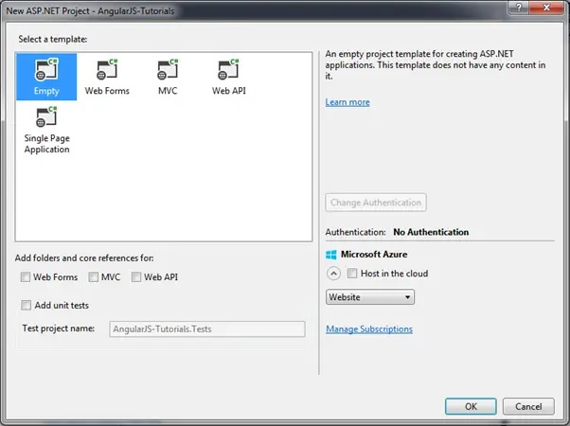
Full Stack Development
In the New ASP.NET Project dialog box, select Empty template and then click OK.

Slide 8
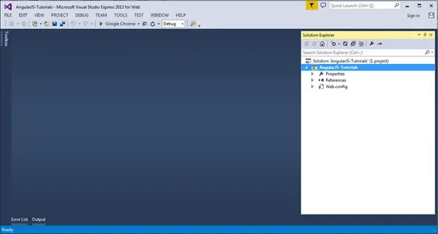
Full Stack Development
This will create an empty website project in Visual Studio.

Slide 9
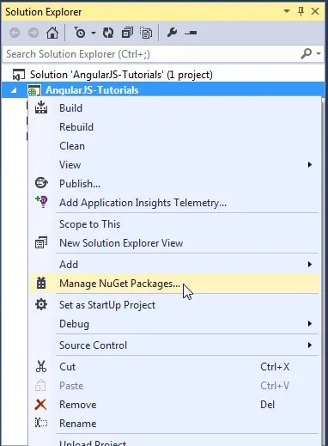
Full Stack Development
Now, install AngularJS library from NuGet package manager. Right click on the project in Solution Explorer and select Manage NuGet Packages..

Slide 10
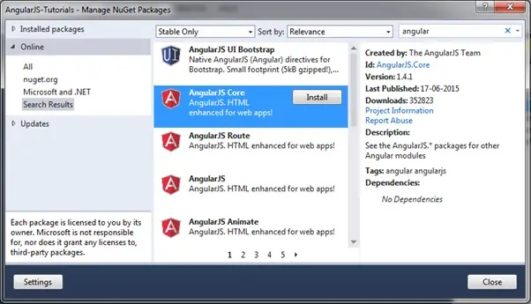
Full Stack Development
Search for "angular" in the Manage NuGet Packages dialog box and install AngularJS Core

Slide 11
Full Stack Development
AngularJS – MVC Architecture:
Model View Controller or MVC as it is popularly called, is a software design pattern for developing web applications. A Model View Controller pattern is made up of the following three parts −
Model − It is the lowest level of the pattern responsible for maintaining data.
View − It is responsible for displaying all or a portion of the data to the user.
Controller − It is a software Code that controls the interactions between the Model and View.
- MVC is popular because it isolates the application logic from the user interface layer and supports separation of concerns.
The controller receives all requests for the application and then works with the model to prepare any data needed by the view.
-The view then uses the data prepared by the controller to generate a final presentable response.
The MVC abstraction can be graphically represented as follows

Slide 12
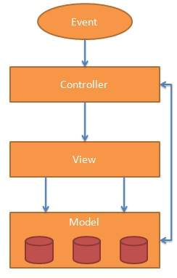
Full Stack Development
AngularJS MVC Architecture

Slide 13
Full Stack Development
The MVC pattern is made up of the following three parts:
Model: It is responsible for managing application data. It responds to the requests from view and to the instructions from controller to update itself.
View: It is responsible for displaying all data or only a portion of data to the users. It also specifies the data in a particular format triggered by the controller's decision to present the data. They are script-based template systems such as JSP, ASP, PHP and very easy to integrate with AJAX technology.
Controller: It is responsible to control the relation between models and views. It responds to user input and performs interactions on the data model objects. The controller receives input, validates it, and then performs business operations that modify the state of the data model.

Slide 14
Full Stack Development
AngularJS Directive:
Directives are markers on the DOM element which tell AngularJS to attach a specified behavior to that DOM element or even transform the DOM element with its children.
Simple AngularJS allows extending HTML with new attributes called Directives.
AngularJS has a set of built-in directives which offers functionality to the applications.
It also defines its own directives. A directive can be defined using some functions which are: Element name, Attribute, Class, and Comment.

Slide 15
Full Stack Development
Why use Directive in AngularJS?
-It gives support to creating custom directives for different types of elements.
-A directive is activated when the same element or matching element is there in front.
-It is used to give more power to HTML by helping them with the new syntax.
-Directive classes, like component classes, can implement life-cycle hooks to influence their configuration and behavior.

Slide 16
Full Stack Development
Directive Components:
-The AngularJS directives extend the attribute with the prefix ng-. Some directive components are discussed below:
1. ng-app: The ng-app directive is used to define the root element of an AngularJS application. This directive automatically initializes the AngularJS application on page load.
Example: This example illustrates the implementation of the ng-app directive in AngularJS
<!DOCTYPE html>
<html>
<head> <title>
AngularJS ng-app Directive </title>
<script src=
"https://ajax.googleapis.com/ajax/libs/angularjs/1.6.9/angular.min.js">
</script> </head>
<body style="text-align:center">
<h1 style="color:green">GeeksforGeeks</h1>
<h3 style="color:green">ng-app directive</h3>
<div ng-app="" ng-init="name='GeeksforGeeks'">
<p>{{ name }} is the portal for geeks.</p>
</div> </body> </html>

Slide 17
Full Stack Development
Directive Components:
2. ng-controller: The ng-controller Directive in AngularJS is used to add the controller to the application. It can be used to add methods, functions, and variables that can be called on some event like a click, etc to perform a certain action.
Example: This example illustrates the implementation of the ng-controller directive in AngularJS.

Slide 18
Full Stack Development
Directive Components:
2. ng-controller: Example
<!DOCTYPE html>
<html> <head> <title>
ng-controller Directive
</title> <script src=
"https://ajax.googleapis.com/ajax/libs/angularjs/1.4.2/angular.min.js">
</script> </head>
<body ng-app="app"
style="text-align:center">
<h1 style="color:green">
GeeksforGeeks </h1>
<h3>ng-controller Directive</h3> <br>
<div ng-controller="geek">
Name: <input class="form-control"
type="text"
ng-model="name"> <br><br>
You entered: <b>
<span>{{name}}</span>
</b> </div> <script>
var app = angular.module('app', []);
app.controller('geek', function($scope) {
$scope.name = "GeeksforGeeks";
});
</script>
</body>
</html>

Slide 19
Full Stack Development
Directive Components:
3. ng-bind: The ng-bind directive is used to bind/replace the text content of a particular element with the value that is entered in the given expression. The value of specified HTML content updates whenever the value of the expression changes in the ng-bind directive.
Example: This example illustrates the implementation of the ng-bind directive in AngularJS.

Slide 20
Full Stack Development
Directive Components:
3. ng-bind:
<!DOCTYPE html>
<html> <head> <title>
ng-checked Directive </title>
<script src=
"https://ajax.googleapis.com/ajax/libs/angularjs/1.6.9/angular.min.js">
</script> </head>
<body ng-app="gfg"
style="text-align:center">
<h1 style="color:green">
GeeksforGeeks
</h1> <h3>ng-bind Directive</h3>
<div ng-controller="app">
num1: <input type="number"
ng-model="num1"
ng-change="product()" />
<br><br>
num2: <input type="number"
ng-model="num2"
ng-change="product()" />
<br><br> <b>Product:</b>
<span ng-bind="result"></span>
</div> <script>
var app = angular.module("gfg", []);
app.controller('app', ['$scope', function($app) {
$app.num1 = 1;
$app.num2 = 1;
$app.product = function() {
$app.result = ($app.num1 * $app.num2); } }]); </script> </body> </html>

Slide 21
Full Stack Development
Benefits of AngularJS Directive:
-Directives are helpful in creating repeat and independent code.
-They modularize the code by clubbing requirement-specific behavioral functions in one place. It does not create objects in the central controller and manipulate them using multiple JavaScript methods.
-Such a type of modular code will have multiple directives that can handle their own functionalities and data, and work should be isolated from other directives.
-As an added benefit, the HTML page and Angular scripts become less messy and more organized.

Slide 22
Full Stack Development
AngularJS Expressions:
AngularJS binds data to HTML using Expressions.
AngularJS Expressions
-AngularJS expressions can be written inside double braces: {{ expression }}.
-AngularJS expressions can also be written inside a directive: ng-bind="expression".
-AngularJS will resolve the expression, and return the result exactly where the expression is written.
-AngularJS expressions are much like JavaScript expressions: They can contain literals, operators, and variables.
Example {{ 5 + 5 }} or {{ firstName + " " + lastName }}

Slide 23
Full Stack Development
AngularJS Expressions:
<!DOCTYPE html> <html> <script src="https://ajax.googleapis.com/ajax/libs/angularjs/1.6.9/angular.min.js"></script> <body> <div ng-app=""> <p>My first expression: {{ 5 + 5 }}</p> </div> </body> </html>

Slide 24
Full Stack Development
AngularJS Expressions:
AngularJS Numbers
AngularJS numbers are similar to JavaScript numbers.
<!DOCTYPE html>
<html>
<script src="http://ajax.googleapis.com/ajax/libs/angularjs/1.4.8/angular.min.js"></script>
<body>
<div ng-app="" ng-init="quantity=5;cost=5">
<p>Total in dollar: {{ quantity * cost }}</p>
</div>
</body>
</html>

Slide 25
Full Stack Development
AngularJS Controllers:
-AngularJS controllers are used to control the flow of data of AngularJS application.
-A controller is defined using ng-controller directive. A controller is a JavaScript object containing attributes/properties and functions.
-Each controller accepts $scope as a parameter which refers to the application/module that controller is to control.
- The ng-controller directive defines the application controller.
A controller is a JavaScript Object, created by a standard JavaScript object constructor.
Use controllers to:
Set up the initial state of the $scope object.
Add behavior to the $scope object.
Do not use controllers to:
Manipulate DOM — Controllers should contain only business logic. Putting any presentation logic into Controllers significantly affects its testability. AngularJS has databinding for most cases and directives to encapsulate manual DOM manipulation.
Format input — Use AngularJS form controls instead.
Filter output — Use AngularJS filters instead.
Share code or state across controllers — Use AngularJS services instead.
Manage the life-cycle of other components (for example, to create service instances).

Slide 26
Full Stack Development
AngularJS Example:
Controller Methods:
The example above demonstrated a controller object with two properties: lastName and firstName.
A controller can also have methods (variables as functions):
<div ng-app="myApp" ng-controller="personCtrl"> First Name: <input type="text" ng-model="firstName"><br> Last Name: <input type="text" ng-model="lastName"><br> <br> Full Name: {{fullName()}} </div> <script> var app = angular.module('myApp', []); app.controller('personCtrl', function($scope) { $scope.firstName = "John"; $scope.lastName = "Doe"; $scope.fullName = function() { return $scope.firstName + " " + $scope.lastName; }; }); </script>

Slide 27
Full Stack Development
AngularJS Controller Example:
<!DOCTYPE html>
<html>
<script src="http://ajax.googleapis.com/ajax/libs/angularjs/1.4.8/angular.min.js"></script>
<body>
<div ng-app="myApp" ng-controller="myCtrl">
First Name: <input type="text" ng-model="firstName"><br>
Last Name: <input type="text" ng-model="lastName"><br>
<br>
Full Name: {{firstName + " " + lastName}}
</div> <script>
var app = angular.module('myApp', []);
app.controller('myCtrl', function($scope) {
$scope.firstName = "Aryan";
$scope.lastName = "Khanna"; });
</script> </body> </html>

Slide 28
Full Stack Development
AngularJS Controller Example:
Controllers In External Files:
-In larger applications, it is common to store controllers in external files.
-Just copy the code between the <script> tags into an external file named personController.js:
AngularJS Example:
<div ng-app="myApp" ng-controller="personCtrl"> First Name: <input type="text" ng-model="firstName"><br> Last Name: <input type="text" ng-model="lastName"><br> <br> Full Name: {{fullName()}} </div> <script src="personController.js"></script>

Slide 29
Full Stack Development
Life Cycle of AngularJS Scope:
-In the flow of javascript code, whenever an event is received by browser then it executes a javascript callback corresponding to it. --And after the completion of callback, DOM objects are re-rendered by a browser.
- If any javascript code is executed outside the context of angularJS by browser then angularJS remain unaware with the changes in the model.
- To detect the model change in angularJS $apply API is used.
Importance of Scope lifecycle:
-This lifecycle is used right from the creation to the destruction phase and thus makes it easier for the developer to create applications.
-Since it uses functions like $apply(), and $digest() it protects the application from any security mishap.
-Model mutation acts as a boon for developers in Angular as it monitors the code as well as updates and reflects the changes made.
-Whenever any child scope is not required, it is destroyed which lowers the load on the server as well as the chunk of memory allocated to the scope is made free.

Slide 30
Full Stack Development
Life Cycle of AngularJS Scope:
Creation – During bootstrap of an application using $injector, root scope is created. And during the linking of a template, many of the directives creates new child scope.
Watcher Registration – Model values can propagate to DOM using a $watch
Model Mutation – To observe mutation in a proper way, an API known as $apply is used.
Mutation Observation – After $apply, a $digest is performed on the root scope in angular JS.
Scope Destruction – If child scope is no longer in use, then it should be destroyed. Child scope creator is responsible to destroy the child scope if no longer in use. Using API $scope.$destroy() child scope creator can do so. Destroying an unused child scope will release memory that is being used by it and stop model propagation too.

Slide 31
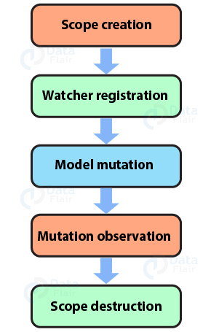
Full Stack Development
Life Cycle of AngularJS Scope:
Life Cycle of AngularJS Scope

Slide 32
Full Stack Development
Life Cycle of AngularJS Scope:
AngularJS Scope Characteristics:
-The various characteristics of the AngularJS scope are as follows:
Context is provided by the scope for expression.
-For example – We are displaying {{name}} in view part so it will be displayed as it is to a user until a value is attached to it and this work is done by scope.
- Scope provides value to property by $scope.name = “daisy”.
-To observe model like a $watch, APIs are provided by scope.
-Any model changes that is outside of “angular realm” can be propagated through the API provided by $scope.

Slide 33
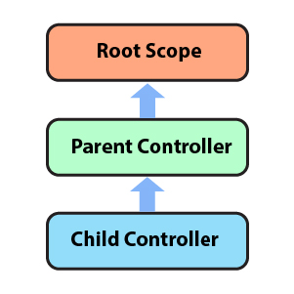
Full Stack Development
Life Cycle of AngularJS Scope:
AngularJS Scope Inheritance:
-Scope is basically controller specific.
-Whenever we nest a controller, that means to declare a controller inside a controller then the child controller inherits the scope of the parent controller.
Scope of Inheritance

Slide 34
Full Stack Development
Life Cycle of AngularJS Scope:
AngularJS Modules:
-An AngularJS module defines an application.
-The module is a container for the different parts of an application.
-The module is a container for the application controllers.
-Controllers always belong to a module.
-AngularJS supports modular approach. Modules are used to separate logic such as services, controllers, application etc.
from the code and maintain the code clean.
We define modules in separate js files and name them as per the module.js file.

Slide 35
Full Stack Development
Life Cycle of AngularJS Scope:
AngularJS Modules:
-In the following example, we are going to create two modules −
1. Application Module − used to initialize an application with controller(s).
2. Controller Module − used to define the controller.
Application Module:
An AngularJS application must create a top level application module. This application module can contain other modules, controllers, filters, etc.
Example:
<!DOCTYPE html> <html > <head>
<script src="~/Scripts/angular.js"></script> </head>
<body ng-app="myApp"> @* HTML content *@ <script>
var myApp = angular.module('myApp', []);
</script>
</body> </html>

Slide 36
Full Stack Development
-In the last example, the angular.module() method creates an application module, where the first parameter is a module name which is same as specified by ng-app directive.
-The second parameter is an array of other dependent modules [].
In the above example we are passing an empty array because there is no dependency.

Slide 37
Full Stack Development
Adding a Controller:
-Add a controller to your application, and refer to the controller with the ng-controller directive:
Example:
<div ng-app="myApp" ng-controller="myCtrl"> {{ firstName + " " + lastName }} </div> <script> var app = angular.module("myApp", []); app.controller("myCtrl", function($scope) { $scope.firstName = "John"; $scope.lastName = "Doe"; }); </script>

Slide 38
Full Stack Development
Modules and Controllers in Files:
-It is common in AngularJS applications to put the module and the controllers in JavaScript files.
-In this example, "myApp.js" contains an application module definition, while "myCtrl.js" contains the controller:
Example:
<!DOCTYPE html> <html> <script src="https://ajax.googleapis.com/ajax/libs/angularjs/1.6.9/angular.min.js"></script> <body>4 <div ng-app="myApp" ng-controller="myCtrl"> {{ firstName + " " + lastName }} </div> <script src="myApp.js"></script> <script src="myCtrl.js"></script> </body> </html>

Slide 39
Full Stack Development
AngularJS Data Binding:
Data binding in AngularJS is the synchronization between the model and the view.
Data Binding is a way to synchronize the data between the model and view components automatically.
AngularJS implements data-binding that treats the model as the single-source-of-truth in your application & for all the time, the view is a projection of the model.
One-way Binding: This type of binding is unidirectional, i.e. this binds the data flow from either component to view(DOM) or from the view(DOM) to the component.
There are various techniques through which the data flow can be bind from component to view or vice-versa.
If the data flow from component to view(DOM), then this task can be accomplished with the help of String Interpolation & Property Binding.
Interpolation: Angular interpolation is used to display a component property in the respective view template with double curly braces syntax. Interpolation is used to transfer properties mentioned in the component class to be reflected in its template.

Slide 40
Full Stack Development
AngularJS Data Binding:
Property Binding:
-Similar to Java, variables defined in the parent class can be inherited by the child class which is templates in this case.
So if we have to store Boolean or other data types then use Property Binding.
In simple words, we bind a property of a DOM element to a field which is a defined property in our component TypeScript code.
Syntax:
[class]="variable_name"
Example:
<h3>Binding Types</h3>
<p>Property Binding</p>
<input type="text"
ng-bind="{{ Geeks }}"><br>
<h5>
Learning Property binding on {{ Geeks }}
</h5>
<img [src]="image" height="50px" weight="40px">

Slide 41
Full Stack Development
-Syntax:
class="{{variable_name}}"
Example:
<h3>Binding Types</h3>
<p>Interpolation</p>
<br>
<h5>
Addition of 3 and 5 with
Interpolation is {{3+5}}
</h5>
<h5>
Addition of 3 and 5 without
Interpolation is 3+5
</h5>
<h2>{{val}}</h2>

Slide 42
Full Stack Development
Event Binding:
-An event is created whenever either a key is pressed or on a mouse clicked.
-It is used to handle the events raised by the user actions like button click, mouse movement, keystrokes, etc.
-When the DOM event happens at an element(e.g. click, keydown, keyup), it calls the specified method in the particular component. --Using Event Binding, we can bind data from DOM to the component and hence can use that data for further purposes.
Example:
<h3>Binding Types</h3>
<p>Event Binding</p>
<button class="btn btn-block"
(click)="Clickme($event)">
Click Here
</button>

Slide 43
Full Stack Development
Two way Binding:
-In this type of binding, the immediate changes to the view & component, will be reflected automatically, i.e. when the changes made to the component or model then the view will render the changes simultaneously.
Similarly, when the data is altered or modified in the view then the model or component will be updated accordingly.
Example:
div style="text-align: center">
<h1 style="color: green">
GeeksforGeeks
</h1>
<h3>Two-way Data Binding</h3>
<input type="text"
placeholder="Enter text"
[(ngModel)]="val" />
<br />
{{ val }}
</div>

Slide 44
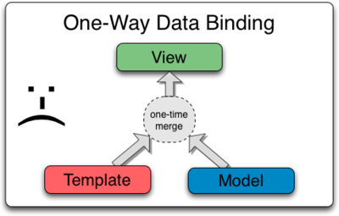
Full Stack Development
Data Binding in Classical Template System:
-Most templating systems bind data in only one direction: they merge template and model components together into a view.
-After the merge occurs, changes to the model or related sections of the view are NOT automatically reflected in the view.
-Worse, any changes that the user makes to the view are not reflected in the model.
This means that the developer has to write code that constantly syncs the view with the model and the model with the view.

Slide 45
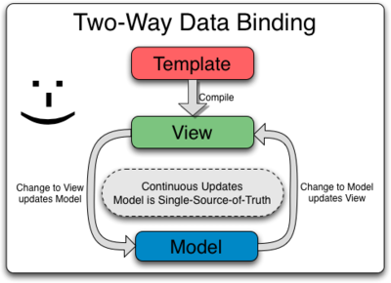
Full Stack Development
Data Binding in AngularJS Templates:
-AngularJS templates work differently.
-First the template (which is the uncompiled HTML along with any additional markup or directives) is compiled on the browser.
-The compilation step produces a live view. Any changes to the view are immediately reflected in the model, and any changes in the model are propagated to the view.
The model is the single-source-of-truth for the application state, greatly simplifying the programming model for the developer.

Slide 46
Full Stack Development
Angular components overview:
-A component is a directive that uses a more straightforward configuration that fits a component-based architecture, which Angular 2 is all about.
-Think of an element as a widget: A piece of HTML code that you can reuse in various places in your web application.
Components
Default Components
§ app.component.css
§ app.component.html
§ app.component.spec.ts
§ app.component.ts
§ app.module.ts
These are the component files that get created by default when you create an application in Angular.

Slide 47
Full Stack Development
Angular components overview:
Types of Components in Angular
Now, there are two types of components in Angular:
Parent
Child
The Parent Component is the one that is predefined and imported when you create the App.
However, the Child component is the one that you can design according to your needs and demand.
Metadata of Angular Component:
There is three-component configuration
import {Component} from ‘@angular/core’; @Component({ Selector: ‘app-root’, templateUrl: ‘./app.component.html’, providers: [”] }) export class AppComponent { title=‘ExternLabs’; }

Slide 48
Full Stack Development
Angular components overview:
Selector: This tells angular where to create and insert the instance of this component. It is a CSS selector. The selector inserts the instance in the HTML wherever it finds the tag of the component. In this case <app-root> </app-root>
template URL: There are two ways to declare this. – You can provide the module relative address of the components HTML template.
Providers: It includes an array of providers­1. They provide everything that a component might require. (provider1: It is an object that implements the interface of one of the providers. The object defines how you can obtain an injectable dependency with a DI token)
Template: A template is a combination of regular HTML and Angular. i.e. HTML and typescript. It contains both, the <html> tags and {angular} scripts.

Slide 49
Full Stack Development
Angular components overview:
-Components are the main building blocks for Angular applications.
-Each component consists of:
An HTML template that declares what renders on the page
A TypeScript class that defines behavior
A CSS selector that defines how the component is used in a template
Optionally, CSS styles applied to the template
- In AngularJS, a Component is a special kind of directive that uses a simpler configuration which is suitable for a component-based application structure. - This makes it easier to write an app in a way that's similar to using Web Components or using the new Angular's style of application architecture.
Prerequisites
To create a component, verify that you have met the following prerequisites:
Install the Angular CLI.
Create an Angular workspace with initial application. If you don't have a project, create one using ng new <project-name>, where <project-name> is the name of your Angular application.

Slide 50
Full Stack Development
-Creating a component
The best way to create a component is with the Angular CLI. You can also create a component manually.
Creating a component using the Angular CLI
To create a component using the Angular CLI:
From a terminal window, navigate to the directory containing your application.
Run the ng generate component <component-name> command, where <component-name> is the name of your new component.
By default, this command creates the following:
A directory named after the component
A component file, <component-name>.component.ts
A template file, <component-name>.component.html
A CSS file, <component-name>.component.css
A testing specification file, <component-name>.component.spec.ts

Slide 51
Full Stack Development
Angular js services:
The Services is a function or an object that avails or limit to the application in AngularJS,
ie., it is used to create variables/data that can be shared and can be used outside the component in which it is defined.
Service facilitates built-in service or can make our own service.
The Service can only be used inside the controller if it is defined as a dependency.
Why to use the AngularJS Service?
-AngularJS supervise the application constantly.
-In order to handle the events or any changes in a proper manner, then the Service that is provided by the AngularJS will prefer to use, instead of Javascript Objects.

Slide 52
Full Stack Development
Angular js services:
There are some commonly used built-in services, are described below:
$http Service: It makes the request to the server, in order to handle the response by the application.
$timeout Service: This service is AngularJS’ version of the window.setTimeout function.
$interval Service: This service is AngularJS’ version of
the window.setInterval function.

Slide 53
Full Stack Development
Angular js services:
Create the AngularJS Service:
STEP 1: Creating a service will follow the below command:
ng g s service-name
s is a short form for service. This creates two files service-name.service.spec.ts which is not supposed to be changed and service-name.service.ts.
STEP 2: After the service is created, we have to include it in the providers of app.module.ts
providers: [Service-nameService],
Here, the first letter of the service-name should be capitalized followed by Service written without any space.

Slide 54
Full Stack Development
Angular js services:
STEP 3: So we have to now make changes in service-name.service.ts to create a JSON variable that is supposed to be made available to various components
Sailors = [22, ‘Dustin’, 7];
The sailors variable here is an array.
STEP 4: In app.component.ts make the following changes:
import the service among the rest of the required imports. Example:
import { Service-nameService } from './service-name.service';
just like the way we did it in providers.
STEP 5: In app.component.html we will print the data stored in newData:
{{newData}}
Note: As we have added ngFor in app.component.html we will have to import FormsModule in app.module.ts

Slide 55
Full Stack Development
AngularJS Dependency Injection:
AngularJS comes with a built-in dependency injection mechanism.
It facilitates you to divide your application into multiple different types of components which can be injected into each other as dependencies.
-Dependency Injection is a software design pattern that specifies how components get holds of their dependencies.
-In this pattern, components are given their dependencies instead of coding them within the component.
-Modularizing your application makes it easier to reuse, configure and test the components in your application.

Slide 56
Full Stack Development
AngularJS Dependency Injection:
It provides following core components which can be injected into each other as dependencies.
Value
Factory
Service
Provider
Constant

Slide 57
Full Stack Development
Value:
Value is a simple JavaScript object, which is required to pass values to the controller during config phase (config phase is when AngularJS bootstraps itself).
//define a module
var mainApp = angular.module("mainApp", []);
//create a value object as "defaultInput" and pass it a data.
mainApp.value("defaultInput", 5);
//inject the value in the controller using its name "defaultInput"
mainApp.controller('CalcController', function($scope, CalcService, defaultInput) {
$scope.number = defaultInput;
$scope.result = CalcService.square($scope.number);
$scope.square = function() {
$scope.result = CalcService.square($scope.number);
}
});

Slide 58
Full Stack Development
Factory:
Factory is a function which is used to return value. It creates a value on demand whenever a service or a controller requires it. It generally uses a factory function to calculate and return the value.
//define a module
var mainApp = angular.module("mainApp", []);
//create a factory "MathService" which provides a method multiply to return multiplication of two numbers
mainApp.factory('MathService', function() {
var factory = {};
factory.multiply = function(a, b) {
return a * b
}
return factory;
});
//inject the factory "MathService" in a service to utilize the multiply method of factory.
mainApp.service('CalcService', function(MathService) {
this.square = function(a) {
return MathService.multiply(a,a);
} }); ...

Slide 59
Full Stack Development
Service:
-Service is a singleton JavaScript object containing a set of functions to perform certain tasks.
-Service is defined using service() function and it is then injected into the controllers.
//define a module
var mainApp = angular.module("mainApp", []);
...
//create a service which defines a method square to return square of a number.
mainApp.service('CalcService', function(MathService) {
this.square = function(a) {
return MathService.multiply(a,a); }
});
//inject the service "CalcService" into the controller
mainApp.controller('CalcController', function($scope, CalcService, defaultInput) {
$scope.number = defaultInput;
$scope.result = CalcService.square($scope.number);
$scope.square = function() {
$scope.result = CalcService.square($scope.number);
} });

Slide 60
Full Stack Development
Provider:
-Provider is used by AngularJS internally to create services, factory, etc. during the config phase.
The following script can be used to create MathService that we created earlier. --Provider is a special factory method with get() method which is used to return the value/service/factory.
//define a module
var mainApp = angular.module("mainApp", []);
...
//create a service using provider which defines a method square to return square of a number.
mainApp.config(function($provide) {
$provide.provider('MathService', function() {
this.$get = function() {
var factory = {};
factory.multiply = function(a, b) {
return a * b;
}
return factory;
};
});
});

Slide 61
Full Stack Development
Constant:
-Constants are used to pass values at the config phase considering the fact that value cannot be used during the config phase.
mainApp.constant("configParam", "constant value")

