Slide 1
Full Stack Development
Unit No 5: Node JS [7 Hours] :
Introduction to Node JS, What is Node JS, Node.js Process Model, Node JS Modules: Functions, Buffer, Module, Core Modules, Local Modules, Built-in Modules. File System, Fs.readFile, Writing a File, Opening a file, deleting a file, Other IO Operations Database operations: Database Connectivity, Connecting String, Configuring, Working with Select Command, Updating Records, Deleting Records, MERN: Overview of MERN, Introduction of MERN.

Slide 2
Full Stack Development
Introduction:
-Node.js is a cross-platform, open-source server environment that can run on Windows, Linux, Unix, macOS, and more.
-Node.js is a back-end JavaScript runtime environment, runs on the V8 JavaScript engine, and executes JavaScript code outside a web browser.
-Node.js lets developers use JavaScript to write command line tools and for server-side scripting.
-The ability to run JavaScript code on the server is often used to generate dynamic web page content before the page is sent to the user's web browser.
- Consequently, Node.js represents a "JavaScript everywhere" paradigm,unifying web-application development around a single programming language, as opposed to using different languages for the server- versus client-side programming.
Node.js has an event-driven architecture capable of asynchronous I/O. These design choices aim to optimize throughput and scalability in web applications with many input/output operations, as well as for real-time Web applications (e.g., real-time communication programs and browser game.

Slide 3
Full Stack Development
Why we use Node.js?
-A common task for a web server can be to open a file on the server and return the content to the client.
-Here is how PHP or ASP handles a file request:
Sends the task to the computer's file system.
Waits while the file system opens and reads the file.
Returns the content to the client.
Ready to handle the next request.
Here is how Node.js handles a file request:
Sends the task to the computer's file system.
Ready to handle the next request.
When the file system has opened and read the file, the server returns the content to the client.
Node.js eliminates the waiting, and simply continues with the next request.
Node.js runs single-threaded, non-blocking, asynchronous programming, which is very memory efficient.

Slide 4
Full Stack Development
Node.js can Perform:
Node.js can generate dynamic page content
Node.js can create, open, read, write, delete, and close files on the server
Node.js can collect form data
Node.js can add, delete, modify data in your database
Node.js File means:
Node.js files contain tasks that will be executed on certain events
A typical event is someone trying to access a port on the server
Node.js files must be initiated on the server before having any effect
Node.js files have extension ".js"

Slide 5
Full Stack Development
Node.js can Perform:
Node.js can generate dynamic page content
Node.js can create, open, read, write, delete, and close files on the server
Node.js can collect form data
Node.js can add, delete, modify data in your database
Node.js File means:
Node.js files contain tasks that will be executed on certain events
A typical event is someone trying to access a port on the server
Node.js files must be initiated on the server before having any effect
Node.js files have extension ".js"

Slide 6
Full Stack Development
Command Line Interface:
-Node.js files must be initiated in the "Command Line Interface" program of your computer.
-How to open the command line interface on your computer depends on the operating system.
-For Windows users, press the start button and look for "Command Prompt", or simply write "cmd" in the search field.

Slide 7
Full Stack Development
Command Line Interface:
-Node.js files must be initiated in the "Command Line Interface" program of your computer.
-How to open the command line interface on your computer depends on the operating system.
-For Windows users, press the start button and look for "Command Prompt", or simply write "cmd" in the search field.

Slide 8
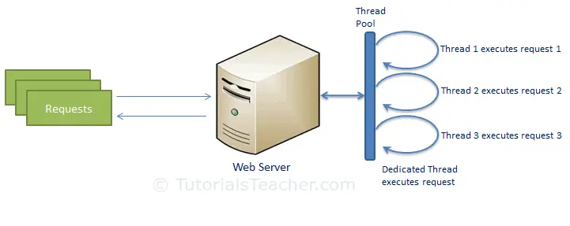
Full Stack Development
Node.js Process Model:
Traditional Web Server Model:
-In the traditional web server model, each request is handled by a dedicated thread from the thread pool.
-If no thread is available in the thread pool at any point of time then the request waits till the next available thread.
-Dedicated thread executes a particular request and does not return to thread pool until it completes the execution and returns a response.
.
Traditional Web Server Model

Slide 9
Full Stack Development
Node.js Process Model:
-Node.js processes user requests differently when compared to a traditional web server model.
Node.js runs in a single process and the application code runs in a single thread and thereby needs less resources than other platforms.
All the user requests to your web application will be handled by a single thread and all the I/O work or long running job is performed asynchronously for a particular request.
So, this single thread doesn't have to wait for the request to complete and is free to handle the next request.
When asynchronous I/O work completes then it processes the request further and sends the response

Slide 10
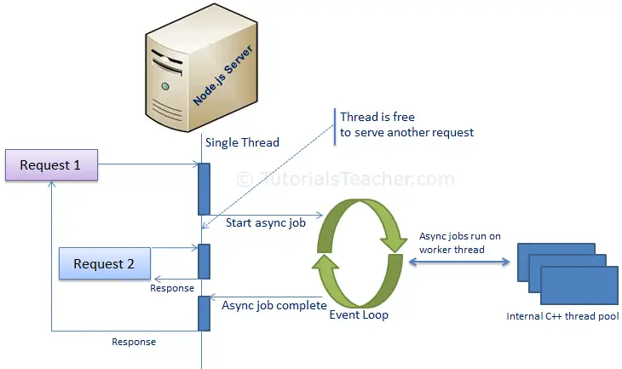
Full Stack Development
Node.js Process Model:
The following figure illustrates asynchronous web server model using Node.js.
Node.js Process Model
-Node.js process model increases the performance and scalability with a few caveats.
- Node.js is not fit for an application which performs CPU-intensive operations like image processing or other heavy computation work because it takes time to process a request and thereby blocks the single thread.

Slide 11
Full Stack Development
Node.js Process Model:
The following figure illustrates asynchronous web server model using Node.js.
Node.js Process Model
-Node.js process model increases the performance and scalability with a few caveats.
- Node.js is not fit for an application which performs CPU-intensive operations like image processing or other heavy computation work because it takes time to process a request and thereby blocks the single thread.

Slide 12
Full Stack Development
Contrary to the traditional web server model, NodeJS uses an event-driven, non-blocking I/O model that makes it lightweight and efficient. The NodeJS process model can be explained with three architectural features of NodeJS.
Single-threaded event loop:
Non-Blocking I/O Model
Event-driven and Asynchronous by default
Single Threaded Event Loop
-NodeJS runs on a single-threaded environment which means each user request processes on a single thread only.
-This makes it use lesser resources and run smoothly using events and emitters.
-Events are a crucial paradigm of the NodeJS process. Events are actions that instruct the runtime what and when something needs to be completed.

Slide 13
Full Stack Development
- Event Emitters are response object instances that can be subscribed to and acted upon to perform operations.
Event Emitters emit events based on certain predefined events accepting a callback.
According to MDN web docs, event loops are responsible for executing the code, collecting and processing events, and executing queued sub-tasks.
Non-Blocking I/O Model:
-Blocking codes or operations are the ones that need to be completed entirely before moving on to another operation.
- Non-blocking codes are asynchronous and accept callback functions to operate.
-As mentioned, every request has a synchronous and asynchronous part.
-The main thread of NodeJS does not keep waiting for the background thread to complete the asynchronous I/O operations.
-The main thread keeps switching between other requests to process their synchronous part while the background thread process the asynchronous part.

Slide 14
Full Stack Development
Event-Driven and Asynchronous By Default:
- Once the execution of the background thread is complete, the background thread emits events to notify the main thread.
- Callback functions are associated with asynchronous processes. - If the main thread is not free, the request waits for the main thread to be free and then takes up the callback request for further execution.
To provide concurrency, I/O events and callbacks, and other time-consuming operations are asynchronous by default.
Node architecture uses libuv, a C library built specifically for NodeJS for handling most asynchronous I/O operation

Slide 15
Full Stack Development
Node.js Module:
-Module in Node.js is a simple or complex functionality organized in single or multiple JavaScript files which can be reused throughout the Node.js application.
-Each module in Node.js has its own context, so it cannot interfere with other modules or pollute global scope.
-Also, each module can be placed in a separate .js file under a separate folder.
Node.js implements CommonJS modules standard.
CommonJS is a group of volunteers who define JavaScript standards for web server, desktop, and console application.

Slide 16
Full Stack Development
Node.js Module Types:
Node.js includes three types of modules:
Core Modules
Local Modules
Third Party Modules
Node.js Core Modules:
- Node.js is a light weight framework.
The core modules include bare minimum functionalities of Node.js.
These core modules are compiled into its binary distribution and load automatically when Node.js process starts.
However, you need to import the core module first in order to use it in your application.

Slide 17
Full Stack Development
Node.js Module Types:
The following table lists some of the important core modules in Node.js.
Core Module | Description
http | http module includes classes, methods and events to create Node.js http server.
url | url module includes methods for URL resolution and parsing.
querystring | querystring module includes methods to deal with query string.
path | path module includes methods to deal with file paths.
fs | fs module includes classes, methods, and events to work with file I/O.
util | util module includes utility functions useful for programmers.

Slide 18
Full Stack Development
Node.js Module Types:
Loading Core Modules:
-In order to use Node.js core or NPM modules, you first need to import it using require() function as shown below.
var module = require('module_name');
-As per above syntax, specify the module name in the require() function.
-The require() function will return an object, function, property or any other JavaScript type, depending on what the specified module returns.
-The following example demonstrates how to use Node.js http module to create a web server.
var http = require('http');
var server = http.createServer(function(req, res)
{ //write code here });
server.listen(5000);
-In the above example, require() function returns an object because http module returns its functionality as an object.
-you can then use its properties and methods using dot notation e.g. http.createServer().

Slide 19
Full Stack Development
Node.js Module Types:
-We can define modules locally as Local Module.
-It consists of different functions declared inside a JavaScript object and we reuse them according to the requirement.
-We can also package it and distribute it using NPM.
Defining local module:
-Local module must be written in a separate JavaScript file.
-In the separate file, we can declare a JavaScript object with different properties and methods.
Create a local module with the filename Welcome.js
const welcome = {
sayHello: function () {
console.log("Hello CSMSS user");
},
currTime: new Date().toLocaleDateString(),
companyName: " CSMSS "
}
module.exports = welcome

Slide 20
Full Stack Development
Node.js Module Types:
In this part, use the above module in the app.js file.
const local = require("./Welcome.js");
local.sayHello();
console.log(local.currTime);
console.log(local.companyName);

Slide 21
Full Stack Development
Node.js Module Types:
Node.js has a set of built-in modules which you can use without any further installation.
Here is a few built-in modules of Node.js version 6.10.3:
Module | Description
assert | Provides a set of assertion tests
buffer | To handle binary data
child_process | To run a child process
cluster | To split a single Node process into multiple processes
crypto | To handle OpenSSL cryptographic functions
dgram | Provides implementation of UDP datagram sockets
dns | To do DNS lookups and name resolution functions
domain | Deprecated. To handle unhandled errors
events | To handle events

Slide 22
Full Stack Development
Node.js Module Types:
Node.js has a set of built-in modules which you can use without any further installation.
Here is a few built-in modules of Node.js version 6.10.3:

