Slide 1
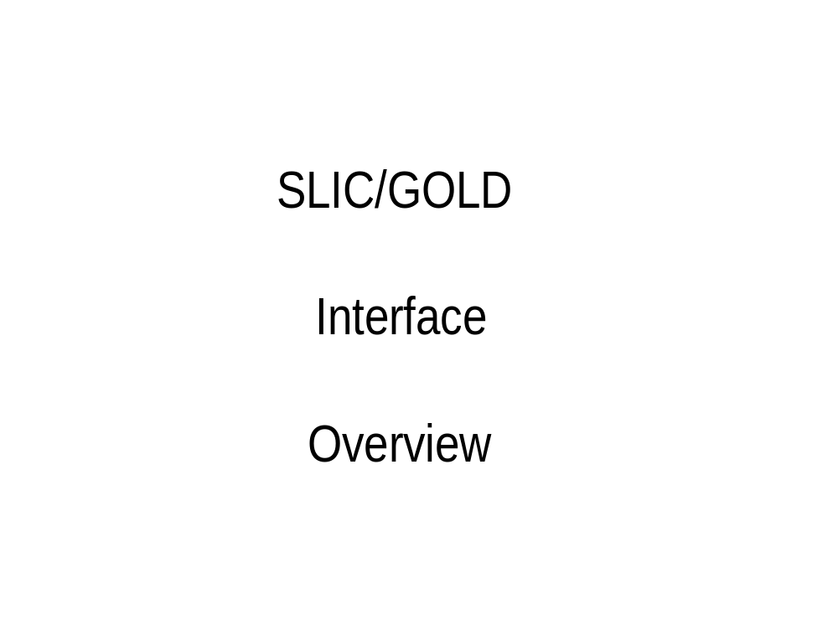
Notes:
1

Slide 2
What is the Problem?
What will drive and filter the movement of SLIC Part Numbers to GOLD?
Driver:
Any insert of an Alternate on the SLIC HB.
Any Design Change Creations in the SLIC HP.
Any insert of a HG with a SMRCODE.
Filter:
F-18 Provisioning has suggested that since any Part Number is a Candidate to be moved to GOLD for FIRST, the the existence of a SLIC HG with a SMRCODE (No special coding necessary).
Any Alternate Parts added in the SLIC HB where the parent Part Number (HA) is a PRIME in GOLD.
Any new Design Change where the Superseded Part Number is a PRIME in GOLD.

Slide 3
Objectives of SLIC/GOLD
Insure correct Part Number/CAGE is in GOLD to reduce research and data errors.
Insure the correct Part Number/CAGE is in GOLD to insure Orders are processed into SAMS Correctly.
Identify Design Changes made in SLIC to GOLD.
Identify Alternate Part Numbers. This Objective can only be accomplished if GOLD is loaded correctly in the CAT1 PART/PRIME.

Slide 4
How does GOLDs’ Part/Prime relate to SLIC?
Gold PRIME is the REFNUMHA/REFNUMHB in SLIC. This the primary Part Number in all of SLIC Relationships. For the exception of where the PART and PRIME is the same, the PRIME will not have a CAGE.
GOLD PART is the Additional Reference Number (ADREFNOHB) in the SLIC.
GOLD MANUFAC_CAGE will be either the CAGECDHX on the SLIC HA or the ADCAGEHB on the HB.
If these relationships are maintained in GOLD, the SLIC/GOLD will not meet it Objectives?

Slide 5
What Triggers a SLIC Part to be moved to Gold?
Items Pre-loaded at Contract Time as part of conversion effort.
A new Alternate Part Number (HB) is added to a Part Number (HA) already in GOLD as a PRIME.
A Design Change occurs in SLIC of a Part Number that is a PRIME in GOLD.
A new Part Number with Application Data is added to SLIC that is not in GOLD.

Slide 6
What happens when a Part Number is Deleted in SLIC?
SLIC will provide notification to the GOLD User a delete has occurred.
Method of notification is still be worked with Boeing/Spirent. Will be announced at a later date. No actual delete of the information will be performed by this interface.
Actual removal of the Part Number from GOLD will be a User Process in GOLD process. SLIC will only notify GOLD the item is no longer in SLIC.

Slide 7
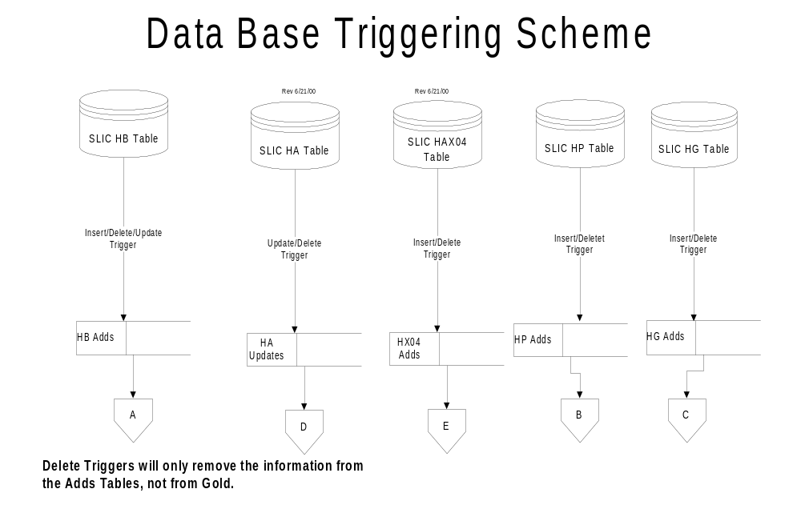
Notes:
2

Slide 8
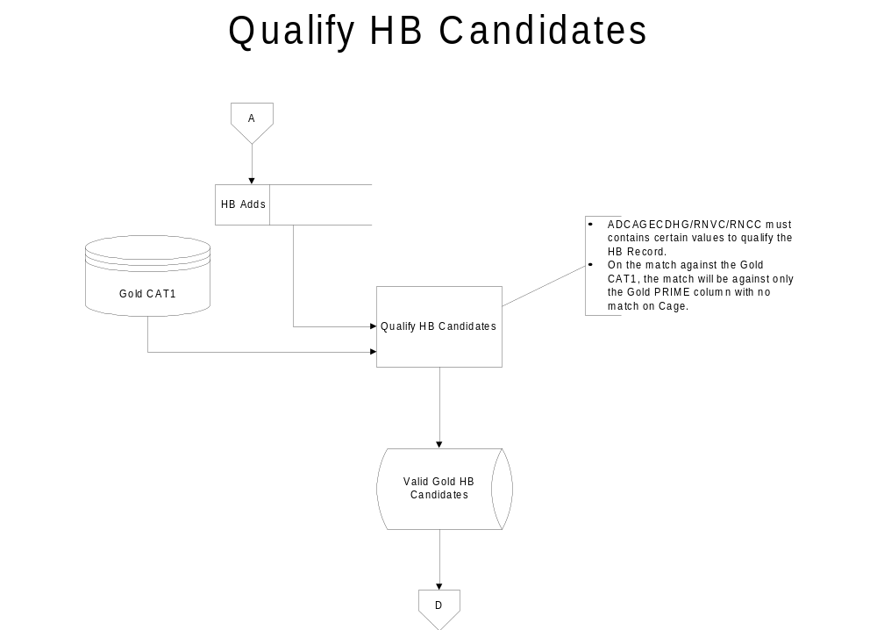
Notes:
3

Slide 9
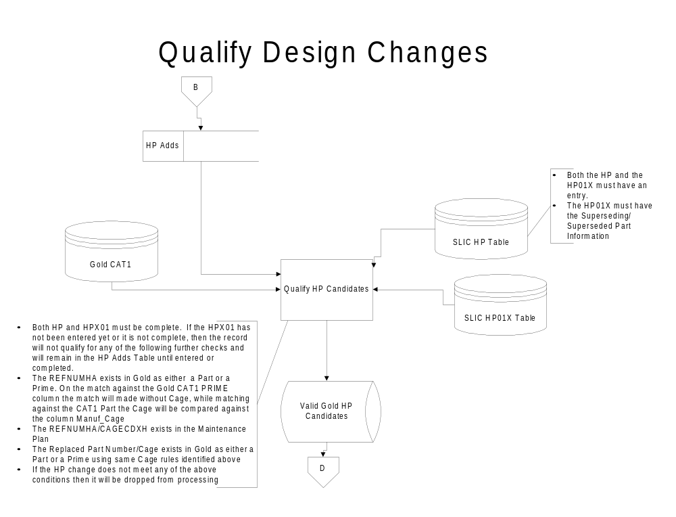
Notes:
4

Slide 10
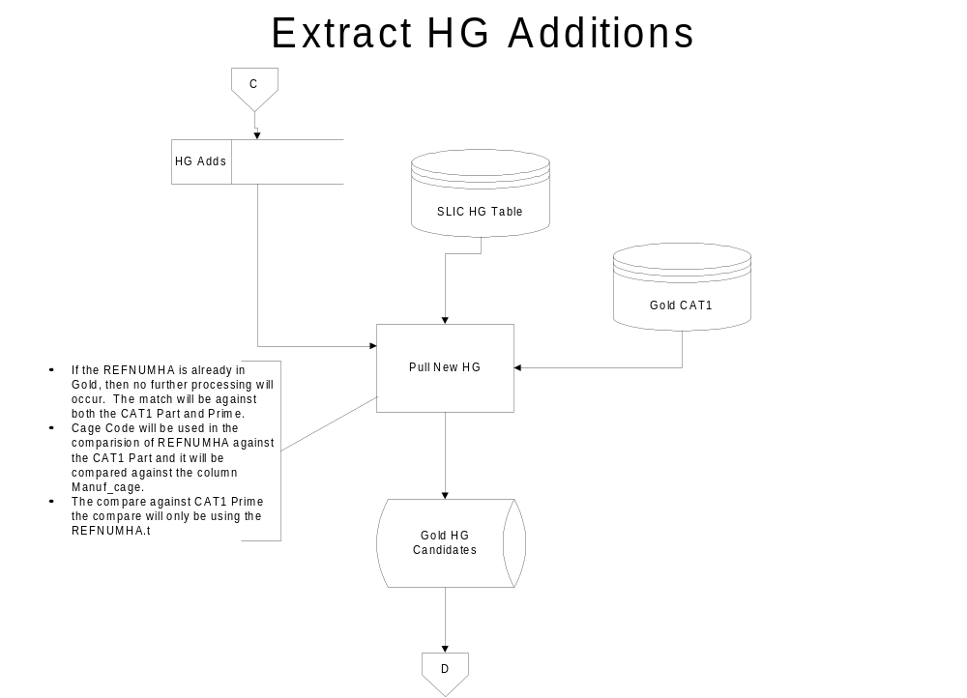
Notes:
5

Slide 11
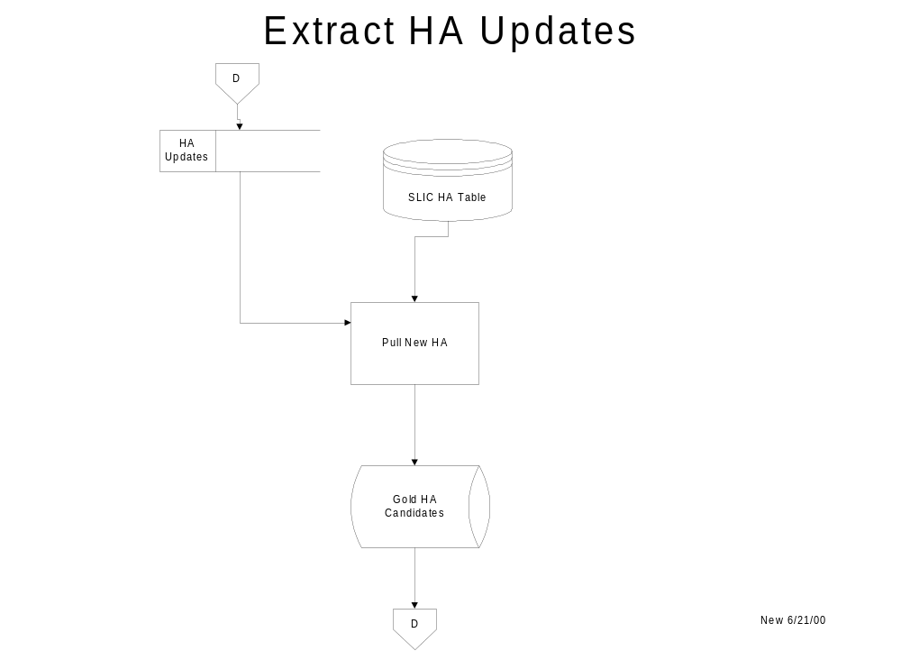
Notes:
5

Slide 12
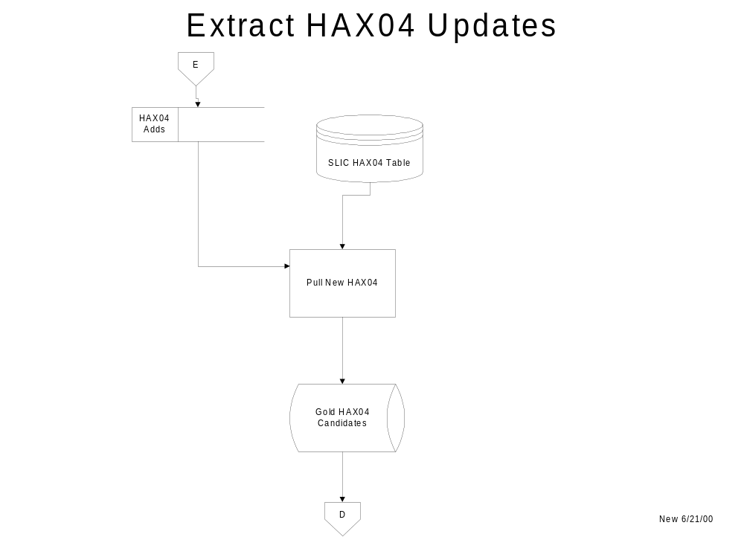
Notes:
5

Slide 13
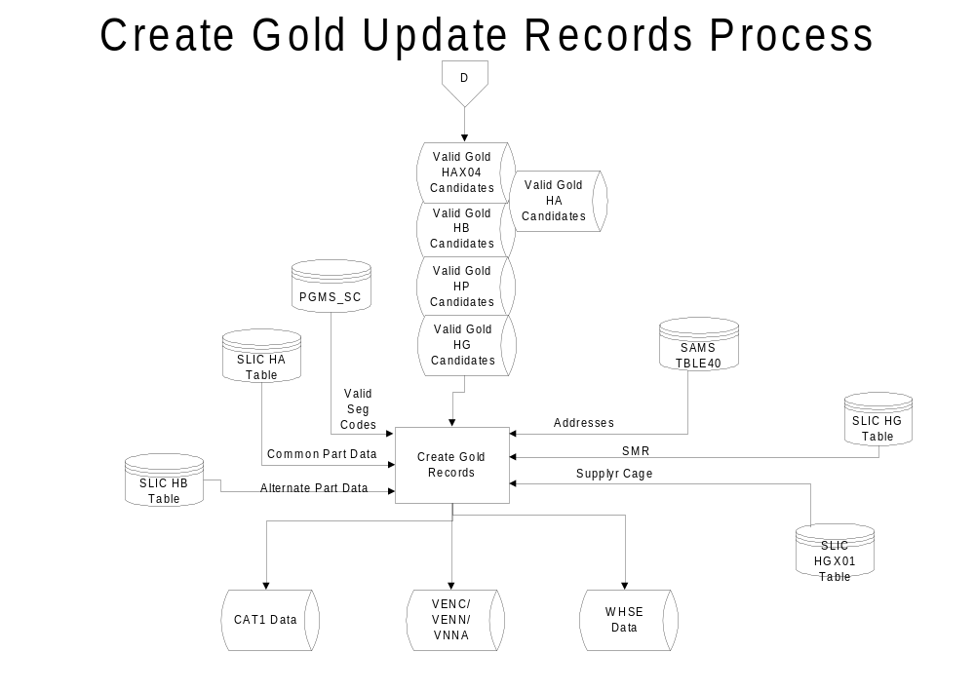
Notes:
6

Slide 14
Alternatives
Utilize the F18 Provisioning.
Establish an intermediate table between SLIC/GOLD that will be filter SLIC Activity.
Any Others?

Slide 15
Alternatives
Utilize the F18 Provisioning.
Establish an intermediate table between SLIC/GOLD that will be filter SLIC Activity.
Any Others?

Slide 16
Data Requirements

