Slide 1
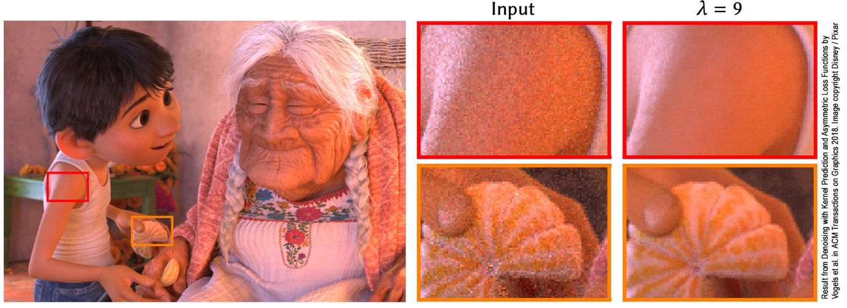
CS 888 Fall’19 Advanced Topics in Computer Graphics: Ray Tracing Seminar
Profs. Morgan McGuire, Stephen Mann, and Craig Kaplan
Cheriton School of Computer Science
University of Waterloo
Notes:
The image is denoising Monte Carlo path tracing using the method of Vogels et al. 2018

Slide 2
Course Info
Friday 10am – 1pm, Sept. 6 – Nov. 29 in DC 2568
https://morgan3d.github.io/advanced-ray-tracing-course/index.html
Read, present, and discuss research papers
On-task electronic devices welcome
Coding warmup due Sept 20: write a pure path tracer
Final project due Nov 29: implement a rendering algorithm, write a short report, and give a 10 min talk
Notes:
This is a graduate seminar. The specific content adapts to your interests and the success of the course depends on your active participation in presentations and discussions.
As this is a graduate course, I invite you to use your phone, tablet, or laptop in class to read the papers electronically, look up terms, and take notes. I’ll be doing that myself.
Please use them only for that purpose—social media, texting, email, and homework for other classes can wait.
Questions about course structure?

Slide 3
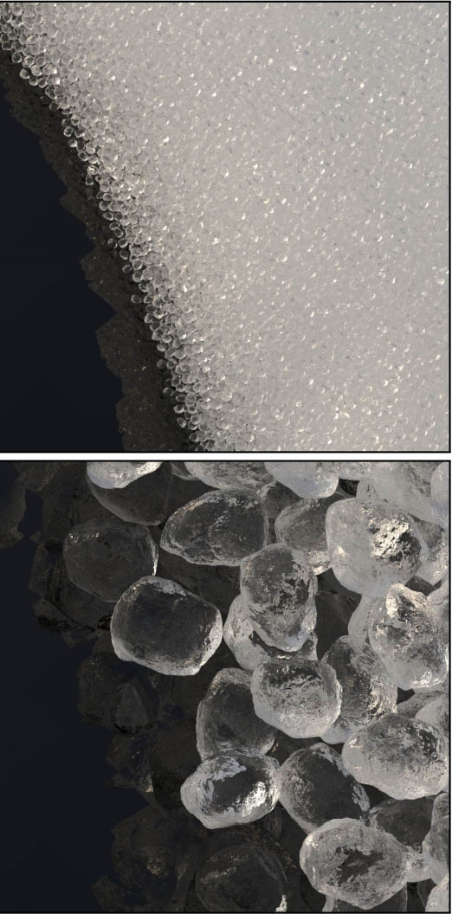
Evaluation
Participation: 25%
Weekly 1-paragraph summaries
Participate in discussions
Warmup (Path Tracing): 10%
Your Presentation: 30%
Presentation clarity
Correctness
Lecture notes
Final Project: 35%
Code and results
3-page report
10 minute presentation
Meng et al. ‘15
Notes:
The 1-paragraph summaries and lecture notes are mostly to help you to think about the material before you discuss or present it. They are also an objective record of your participation.
Paragraphs should have reasonably professional tone and grammar, but you shouldn’t spend more than 20 minutes writing them and they will be graded A/B-/Fail.
Lecture notes for your presentation can be in Powerpoint slides speaker notes or as an outline…look at my PPT slides online for this course.
Questions?

Slide 4
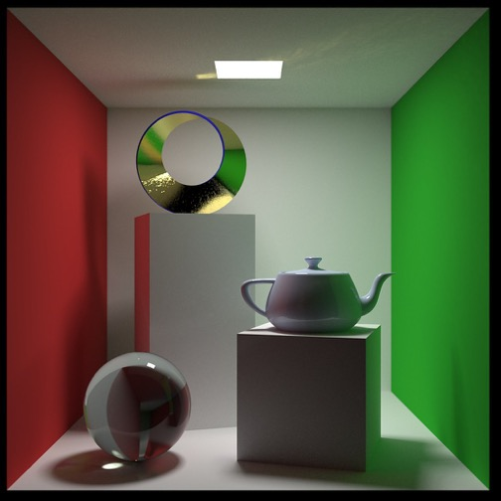
Warmup Project
Implement a pure path tracer
Triangles + spatial data structure, 3D model loading from a standard file format, Lambertian reflection, glossy reflection, refractive transmission, cosine importance sampling, and area sources are required
Direct illumination, point sources, denoising, QMC, MIS, advanced importance sampling, and performance not required
Two-page report + code
Images showing Lambertian, glossy, and refractive scattering
Due Sept. 20, 2019 before class in LEARN
You may use libraries for:
Material (BSDF)
Intersection (e.g., BVH & ray-triangle)
Asset loading & image saving
Image by Wayne Young
https://www.flickr.com/photos/30974264@N02/44441603622
Notes:
There are two goals for this individual assignment:
Review the background material for the course and make it concrete through implementation
Ensure that you have a platform from which you can later write a final project
This is intended to be a relatively straightforward and fun exercise. It should will take between two and 15 hours total, including coding, debugging, and writing up the report. (Although, if you write a very slow tracer and want a high resolution image for your report, the final render might need to run unattended for a while). The report does not have to be very polished. Give a guide to your implementation, discuss any known bugs and limitations, and describe aspects of the images that demonstrate correctness (or those bugs). Cite resources that you used in the program or referred to.
The time variation will depend on how fresh your previous graphics experience is, how familiar the tools you choose are, and how fast your tools are. Note that you should debug by rendering simple models at low resolution with low path counts, so that it only takes a minute to produce an image.
I recommend using a high level framework such as G3D, Falcor, PBRT, or Mitsuba to do the heavy lifting on infrastructure, or at least libraries such as stb_image, FreeImage, Embree, or OptiX. Just make sure that you’re writing the core path tracing logic yourself. I recommend not using ShaderToy for this project because that isn’t a good environment in which to load assets and debug for your final project. If you are very familiar with a game engine such as Unity or Unreal, you may use it, but I generally find that those are not ideally suited for path tracing projects.
My single-file 60-line C++ path tracer that appears in the Graphics Codex would be a reasonable solution for this assignment. Obviously you can’t copy or port directly from my solution or another one, but you are welcome to study them in depth before writing your own.
If it looks like this will take you more than 15 hours, or you think that by the end of the warmup you’d still be unable to sit down with an empty file and sketch out path tracer code without looking at someone else’s code, then please discuss with us whether this is the right course for you this term.
For the code, please do not submit your executable, libraries, Makefile, project file, or assets. Just submit the source file or files.
Questions?

Slide 5
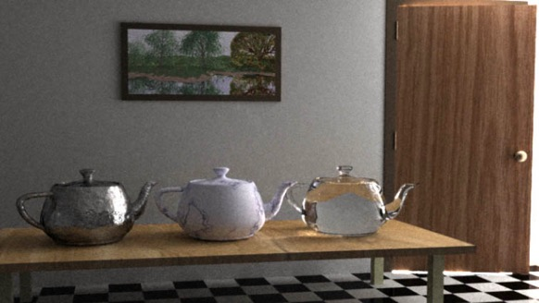
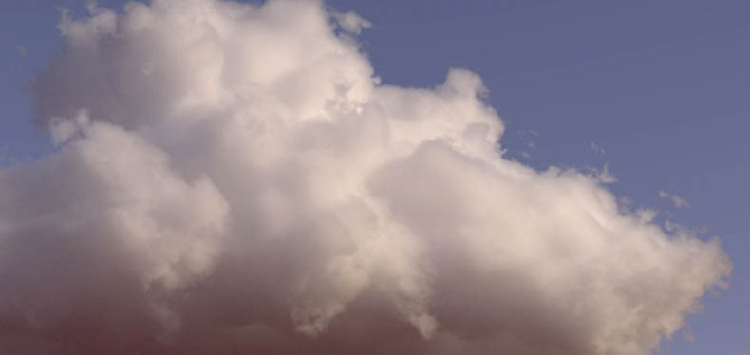
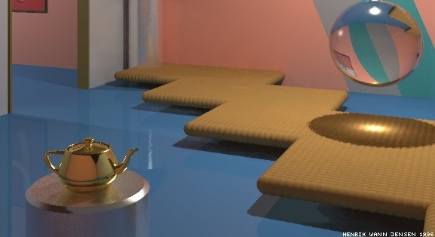
Final Project
Implement a previously-published rendering algorithm
E.g., photon mapping, MLT, decoupled shading, denoising, participating media, gradient-domain rendering
Three-page report with analysis of results due Nov. 29 in LEARN
5-10 minute presentation in class on Nov. 29
Any language, framework, and libraries permitted
Veach & Guibas ‘97
Kallweit et al. ‘17
Jensen ‘96
Notes:
You can start any time and should solicit feedback on your choice and progress in class or by email. I expect that most of you will only work on this during the final weeks of the course. The reading topics are distributed so that the ones you are likely to want to implement appear before that.
Questions?

Slide 6
Student Introductions
Name
Technical interests (e.g., “databases”, “security”, “string theory”, “video games”)
Motivation for taking this course

Slide 7
Questions

