Slide 1
Hadoop! There It Is
A Friendly ACT-W Talk Lead by Morgana Carter

Slide 2

Hadoop!
Twitter: @_oneunit
Slides:
Will Post to GitHub, Share with ACT-W

Slide 3
Agenda
Intro and Ice Breaker
The 15 Minute Guide to Hadoop
Hadoop Alternatives
Hadoop Implementation Guidelines
Demo Time
Notes:
Reminder: This talk will NOT be about Hadoop Administration and Setup. Those are complicated topics which take more than an hour to even begin. No .jar files. Not offended if you choose to leave.

Slide 4
Introductions!
Notes:
Lead by example: Me first: Name. Company. Experience at ACT-W. Prior to Portland: healthcare backend data, political data, financial systems data.
Sixty Second Networking: Each person has 30 seconds to introduce yourself to someone. Repeat twice.
Show of hands: Who is here at Act-W for the first time? Back End Admins or Developers? Data Scientists? Front-end, PMs, team leads curious about Hadoop? Ever used Hadoop?

Slide 5

What Is Hadoop?
Notes:
Hadoop is a framework which can run on any of your existing hardware. It is open sourced. Hadoop consists of two components: A storage platform and an analytics platform.
Bear with me while I slog through some things.

Slide 6


Michael Carafella
Doug Cutting
Notes:
Created by Doug Cutting and Michael Carafella. They were working on a file system for a search engine called Nutch and read a paper that Google published. At the time the project was funded by Yahoo(!) and it was implemented in about 2006. Very new system so keep that in mind.

Slide 7
The Apache Hadoop project develops open-source software for reliable, scalable, distributed computing.
The Apache Hadoop software library is a framework that allows for the distributed processing of large data sets across clusters of computers using simple programming models. It is designed to scale up from single servers to thousands of machines, each offering local computation and storage. Rather than rely on hardware to deliver high-availability, the library itself is designed to detect and handle failures at the application layer, so delivering a highly-available service on top of a cluster of computers, each of which may be prone to failures.

Slide 8

The Apache Hadoop project develops open-source software for reliable, scalable, distributed computing.
The Apache Hadoop software library is a framework that allows for the distributed processing of large data sets across clusters of computers using simple programming models. It is designed to scale up from single servers to thousands of machines, each offering local computation and storage. Rather than rely on hardware to deliver high-availability, the library itself is designed to detect and handle failures at the application layer, so delivering a highly-available service on top of a cluster of computers, each of which may be prone to failures.
Terrible Definition Alert

Slide 9
Open Source Software Library: Rights to study, change, and distribute to anyone for any purpose.
Framework: A collection of software and libraries
Distributed Processing (parallel processing): More than one computer is used to run a program.
Scale to thousands of machines, each offering local computation and storage:
Storage (HDFS)
Computation (MapReduce)
Notes:
Open Source: Free. Anyone can contribute. Cost, flexibility, freedom, security benefits. Strength in numbers – 1000s of developers help write and improve the code. This why you have different vendors: Cloudera, Hortonworks, Pentaho, IBM Open Platform, Datameer, MapR. If you have a very strong SysAdmin, they can install it themselves. But easier to buy.
Framework: a bundle of software, libraries, compilers that lets you do more in less time – you don’t have to write the code + compile statements, they’re all
there for you. Frameworks can be customized to your organizations. Good frameworks go through lots of peer reviews. Each vendor will have their own “flavor” to the framework.
Distributed Processing: Horizontal Scaling, used by Hadoop. The idea that more than one computer is used to run a program or application. Horizontal scalability is the ability to increase capacity by connecting multiple hardware or software entities so that they work as a single logical unit. Vertical scalability, on the other hand, increases capacity by adding more resources, such as more memory or an additional CPU, to a machine. It has to have excess capacity, extra drive bays, and so on, that will end up sitting idle until the moment of expansion comes. Such hardware tends to be significantly more expensive than commodity hardware:
Most Important part of the talk: Hadoop is Storage AND Computation. It is two things. If nothing else, this is the most important part of the talk. We’re going to spend most of the talk discussing these two items.

Slide 10
DATA
FILE
Notes:
First, we are going to talk about HDFS. This stands for “HADOOP DISTRIBUTED FILE SYSTEM. “
So Let’s start with a run of the mill Data File. This will already be on your system. We won’t really talk about how you load the files onto your system, but know there are tools within the Hadoop ecosystem to assist with that.
HDFS: Hadoop Distributed File System. The DFS makes it convenient to share information and files among users on a network in a controlled and authorized way. It does a few things. First, it breaks down data into chunks. (Think of limewire or torrents: Takes a large file and breaks it smaller files). Files are immutable – once you close you file and write it to the system, you cannot edit or rewrite your file. It creates a read-only file.
Second Step: The Broken up files will then make copies of themselves. Once they make enough copies, we are now ready to start creating the distributed file system. In this example, created two chunks and made sure to have a total of 3 of each chunk.
So now we’re ready to visit our cluster. Explain that there is a cluster. Each of the gray boxes is a node or cluster. In the purpose of this example, we have 4 nodes on 1 cluster.
Physically point out that file is broken up and then copies are made and put on different nodes around the cluster. Physically count and point to the nodes it is on. These are copies in its entity. And then next we make copies of Part B. Note that the files can land on different nodes: So The original Data File is now Replicated three times, throughout the cluster.
Let’s do this with different files. For this purpose we have the red file, the green file, and the black file which we have been working with. I apologize, I did not label the files but hopefully you can tell – each one has been chunked into two parts. And here you see the files are distributed around the cluster in no real order. Some nodes are full, others aren’t.
Two situations which you may encounter with Distributed File System. Sometimes we want to read our files. How does this work? First, a caveat: In Hadoop, you can write once and read many times. Yes, there are ways to edit the data but it’s best to think of it as a read-only file system. Depending on your business needs, this may not be useful.
Writing to the cluster: Coordinator Node. This decides which nodes are written to. The coordinator talks directly to node 1. From there, node 1 talks to the other nodes and copies itself. (this is called the pipeline. Admin/Client - > Coordinator Node -> Node 1 (once written, will communicate back that the file is written even though it’s passing data to other notes)-> Other Nodes)
Reading from the cluster: The Coordinator will assess where the files are (where is the black file) and give priority order of which nodes to access first.
Daemons: Data Node Daemen: responsible for reading blocks and writing blocks. Coordinator Node also called the Name Node. Responsible for knowing what’s going on in the cluster and coordinating across the cluster. Knows each node, which file chunk, the name of the file chunk, the properties of the file chunk.
Second Scenario you may encounter is around the failure prevention component of Hadoop. You may hear that “Hadoop is failure-proof”. Well if you worked in It, you know that’s not true. Why is it important to make copies? Let’s say a node crashes or a computer dies. It was storing several different blocks.
Underreplicated blocks: blocks which do not satisfy the minimum copy requirement. Black File Chunk B and Green File Chunk B are underrepresented. These are your underreplicated blocks. The Name Node will recognize the Node is gone. And it will tell the other nodes, I need another file chunk, I need you to create a copy of your block.
Data Locality. This is why it’s so important to have copies of the data. We need to be able to access the data locally on each node. Otherwise, we have to spend time pulling the data across the network and then spend processing time and energy moving the data to the nodes.
Job priority is given to jobs where the files exist. Also important when Daemons are located with data.

Slide 11
PART A
DATA
FILE
PART B
Notes:
HDFS: Hadoop Distributed File System. The DFS makes it convenient to share information and files among users on a network in a controlled and authorized way. It does a few things. First, it breaks down data into chunks. (Think of limewire or torrents: Takes a large file and breaks it smaller files). Files are immutable – once you close you file and write it to the system, you cannot edit or rewrite your file. It creates a read-only file.

Slide 12
PART A
PART A
PART A
DATA
FILE
PART B
PART B
PART B
Notes:
Second Step: The Broken up files will then make copies of themselves. Once they make enough copies, we are now ready to start creating the distributed file system. In this example, created two chunks and made sure to have a total of 3 of each chunk.

Slide 13
Notes:
So now we’re ready to visit our cluster. Explain that there is a cluster. Each of the gray boxes is a node. In the purpose of this example, we have 4 nodes on 1 cluster.
Physically point out that file is broken up and then copies are made and put on different nodes around the cluster. Physically count and point to the nodes it is on. These are copies in its entity. And then next we make copies of Part B. Note that the files can land on different nodes: So The original Data File is now Replicated three times, throughout the cluster.

Slide 14
NODE 1
NODE 2
NODE 3
NODE 4
Notes:
Each of the gray boxes is a node. In the purpose of this example, we have 4 nodes on 1 cluster.
Physically point out that file is broken up and then copies are made and put on different nodes around the cluster. Physically count and point to the nodes it is on. These are copies in its entity. And then next we make copies of Part B. Note that the files can land on different nodes: So The original Data File is now Replicated three times, throughout the cluster.

Slide 15
NODE 1
NODE 2
A
A
NODE 3
NODE 4
A
Notes:
Physically point out that file is broken up and then copies are made and put on different nodes around the cluster. Physically count and point to the nodes it is on. These are copies in its entity. And then next we make copies of Part B. Note that the files can land on different nodes: So The original Data File is now Replicated three times, throughout the cluster

Slide 16
NODE 1
NODE 2
A
A
B
B
NODE 3
NODE 4
A
B
Notes:
Physically point out that file is broken up and then copies are made and put on different nodes around the cluster. Physically count and point to the nodes it is on. These are copies in its entity. And then next we make copies of Part B. Note that the files can land on different nodes: So The original Data File is now Replicated three times, throughout the cluster.
Couple of questions I’ve gotten before: How many clusters can you have? (Many! How you set them up depends on your business. You can have a cluster for different business verticals: marketing, finance, some customer facing product or one cluster for production, one for test, one for development)

Slide 17
A
A
A
DATA
FILE
B
B
B
A
A
A
DATA
FILE
B
B
B
A
A
A
DATA
FILE
B
B
B
Notes:
Let’s do this with different files. For this purpose we have the red file, the green file, and the black file which we have been working with. I apologize, I did not label the files but hopefully you can tell – each one has been chunked into two parts. And here you see the files are distributed around the cluster in no real order. Some nodes are full, others aren’t.

Slide 18
NODE 1
NODE 2
A
A
A
A
A
A
B
B
B
B
B
B
NODE 3
NODE 4
A
A
A
B
B
B
Notes:
Let’s do this with different files. For this purpose we have the pink file, the yellow file, and the black file which we have been working with. I apologize, I did not label the files but hopefully you can tell – each one has been chunked into two parts. And here you see the files are distributed around the cluster in no real order. Some nodes are full, others aren’t. Some Nodes are not full.

Slide 19
Reading a File
Notes:
Two situations which you may encounter with Distributed File System. Sometimes we want to read our files. How does this work? First, a caveat: In Hadoop, you can write once and read many times. Yes, there are ways to edit the data but it’s best to think of it as a read-only file system. Depending on your business needs, this may not be useful.
Next I want to talk about The namenode and jobtracker daemons are master daemons, whereas thedatanode and tasktracker daemons are slave daemons. I don’t really like those names, I feel like those names can only be created when white men are the only people in the room. So I won’t really talk about them but you need to know they exist. Some nodes and trackers are queen bees, some nodes and trackers are worker bees
Writing to the cluster: Coordinator Node. This decides which nodes are written to. The coordinator talks directly to node 1. From there, node 1 talks to the other nodes and copies itself. (this is called the pipeline. Admin/Client - > Coordinator Node -> Node 1 (once written, will communicate back that the file is written even though it’s passing data to other notes)-> Other Nodes)
Reading from the cluster: The Coordinator will assess where the files are (where is the black file) and give priority order of which nodes to access first.
Daemons: Data Node Daemen: responsible for reading blocks and writing blocks. Coordinator Node also called the Name Node. Responsible for knowing what’s going on in the cluster and coordinating across the cluster. Knows each node, which file chunk, the name of the file chunk, the properties of the file chunk.
Second Scenario you may encounter is around the failure prevention component of Hadoop. You may hear that “Hadoop is failure-proof”. Well if you worked in It, you know that’s not true. Why is it important to make copies? Let’s say a node crashes or a computer dies. It was storing several different blocks.
Underreplicated blocks: blocks which do not satisfy the minimum copy requirement. Black File Chunk B and Green File Chunk B are underrepresented. These are your underreplicated blocks. The Name Node will recognize the Node is gone. And it will tell the other nodes, I need another file chunk, I need you to create a copy of your block.
Data Locality. This is why it’s so important to have copies of the data. We need to be able to access the data locally on each node. Otherwise, we have to spend time pulling the data across the network and then spend processing time and energy moving the data to the nodes.
Job priority is given to jobs where the files exist. Also important when Daemons are located with data.

Slide 20
Notes:
Writing to the cluster: Coordinator Node (or the name Node). This decides which nodes are written to. The coordinator talks directly to node 1. From there, node 1 talks to the other nodes and copies itself. (this is called the pipeline. Admin/Client - > Coordinator Node -> Node 1 (once written, will communicate back that the file is written even though it’s passing data to other notes)-> Other Nodes)
Reading from the cluster: The Coordinator will assess where the files are (where is the black file) and give priority order of which nodes to access first.
Daemons: Data Node Daemen: responsible for reading blocks and writing blocks. Coordinator Node also called the Name Node. Responsible for knowing what’s going on in the cluster and coordinating across the cluster. Knows each node, which file chunk, the name of the file chunk, the properties of the file chunk.

Slide 21
NODE 1
NODE 2
A
A
A
A
A
A
B
B
B
B
B
B
NODE 3
NODE 4
A
A
A
B
B
B
Notes:
Writing to the cluster: Coordinator Node (or the name Node). This decides which nodes are written to. The coordinator talks directly to node 1. From there, node 1 talks to the other nodes and copies itself. (this is called the pipeline. Admin/Client - > Coordinator Node -> Node 1 (once written, will communicate back that the file is written even though it’s passing data to other notes)-> Other Nodes)
Reading from the cluster: The Coordinator will assess where the files are (where is the black file) and give priority order of which nodes to access first.
Daemons: Data Node Daemen: responsible for reading blocks and writing blocks. Coordinator Node also called the Name Node. Responsible for knowing what’s going on in the cluster and coordinating across the cluster. Knows each node, which file chunk, the name of the file chunk, the properties of the file chunk.

Slide 22
Failure Prevention
Notes:
Second Scenario you may encounter is around the failure prevention component of Hadoop. You may hear that “Hadoop is failure-proof”. Well if you worked in It, you know that’s not true. Why is it important to make copies? Let’s say a node crashes or a computer dies. It was storing several different blocks.
Underreplicated blocks: blocks which do not satisfy the minimum copy requirement. Black File Chunk B and Green File Chunk B are underrepresented. These are your underreplicated blocks. The Name Node will recognize the Node is gone. And it will tell the other nodes, I need another file chunk, I need you to create a copy of your block.
Data Locality. This is why it’s so important to have copies of the data. We need to be able to access the data locally on each node. Otherwise, we have to spend time pulling the data across the network and then spend processing time and energy moving the data to the nodes.
Job priority is given to jobs where the files exist. Also important when Daemons are located with data

Slide 23
NODE 1
NODE 2
A
A
A
A
A
A
B
B
B
B
B
B
NODE 3
NODE 4
A
A
A
B
B
B
Notes:
Second Scenario you may encounter is around the failure prevention component of Hadoop. You may hear that “Hadoop is failure-proof”. Well if you worked in It, you know that’s not true. Why is it important to make copies? Let’s say a node crashes or a computer dies. It was storing several different blocks.
Underreplicated blocks: blocks which do not satisfy the minimum copy requirement. Black File Chunk B and Green File Chunk B are underrepresented. These are your underreplicated blocks. The Name Node will recognize the Node is gone. And it will tell the other nodes, I need another file chunk, I need you to create a copy of your block.
Data Locality. This is why it’s so important to have copies of the data. We need to be able to access the data locally on each node. Otherwise, we have to spend time pulling the data across the network and then spend processing time and energy moving the data to the nodes.
Job priority is given to jobs where the files exist. Also important when Daemons are located with data

Slide 24
NODE 1
NODE 2
A
A
A
A
A
A
PART B
PART B
B
B
B
B
B
B
NODE 3
NODE 4
A
A
A
B
B
B
Notes:
Second Scenario you may encounter is around the failure prevention component of Hadoop. You may hear that “Hadoop is failure-proof”. Well if you worked in It, you know that’s not true. Why is it important to make copies? Let’s say a node crashes or a computer dies. It was storing several different blocks.
Underreplicated blocks: blocks which do not satisfy the minimum copy requirement. Black File Chunk B and Green File Chunk B are underrepresented. These are your underreplicated blocks. The Name Node will recognize the Node is gone. And it will tell the other nodes, I need another file chunk, I need you to create a copy of your block.
Data Locality. This is why it’s so important to have copies of the data. We need to be able to access the data locally on each node. Otherwise, we have to spend time pulling the data across the network and then spend processing time and energy moving the data to the nodes.
Job priority is given to jobs where the files exist. Also important when Daemons are located with data

Slide 25
NODE 1
NODE 2
A
A
A
A
A
A
B
B
B
B
B
B
NODE 3
NODE 4
A
A
A
B
B
B
Notes:
Second Scenario you may encounter is around the failure prevention component of Hadoop. You may hear that “Hadoop is failure-proof”. Well if you worked in It, you know that’s not true. Why is it important to make copies? Let’s say a node crashes or a computer dies. It was storing several different blocks.
Underreplicated blocks: blocks which do not satisfy the minimum copy requirement. Black File Chunk B and Green File Chunk B are underrepresented. These are your underreplicated blocks. The Name Node will recognize the Node is gone. And it will tell the other nodes, I need another file chunk, I need you to create a copy of your block.
Data Locality. This is why it’s so important to have copies of the data. We need to be able to access the data locally on each node. Otherwise, we have to spend time pulling the data across the network and then spend processing time and energy moving the data to the nodes.
Job priority is given to jobs where the files exist. Also important when Daemons are located with data

Slide 26
NODE 1
NODE 2
A
A
A
A
A
A
B
B
B
B
B
B
NODE 3
NODE 4
A
A
A
B
B
B
B
B
Notes:
Second Scenario you may encounter is around the failure prevention component of Hadoop. You may hear that “Hadoop is failure-proof”. Well if you worked in It, you know that’s not true. Why is it important to make copies? Let’s say a node crashes or a computer dies. It was storing several different blocks.
Underreplicated blocks: blocks which do not satisfy the minimum copy requirement. Black File Chunk B and Green File Chunk B are underrepresented. These are your underreplicated blocks. The Name Node will recognize the Node is gone. And it will tell the other nodes, I need another file chunk, I need you to create a copy of your block.
Data Locality. This is why it’s so important to have copies of the data. We need to be able to access the data locally on each node. Otherwise, we have to spend time pulling the data across the network and then spend processing time and energy moving the data to the nodes.
Job priority is given to jobs where the files exist. Also important when Daemons are located with data

Slide 27
How does this connect to MapReduce?
Notes:
Map Reduce is the second component of Hadoop which works in tandem with HDFS. Some of you probably know about this but if you don’t I want to share a few things which I found helpful in understanding this abstract concept. Hopefully, one of these will resonate with you.

Slide 28
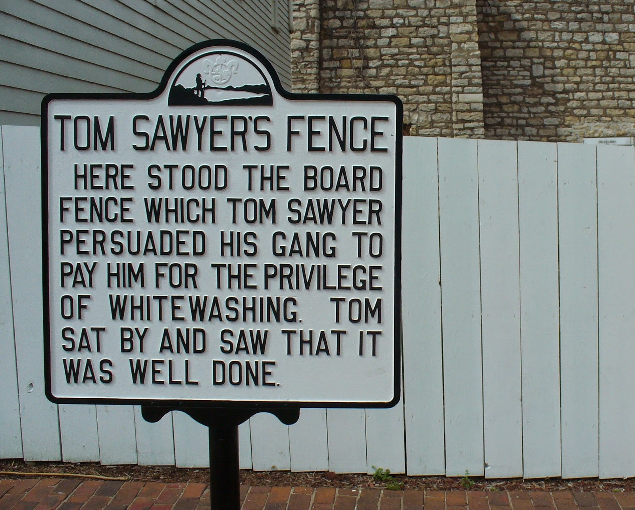
Notes:
HDFS (storage) & MapReduce (compute)
Tom Sawyer: The Original MapReducer (technically he is the original Name Node)
Map: So you split the data into chunks, distribute the chunks across many computers along with a little program that tells each computer how to process a chunk of data. (everything we’ve discussed up to this point)
Reduce: You gather up the processed results from each computer and consolidate it into a result set.
MapReduce is a software approach for cutting problems like this one into smaller problems, mapping each sub-problem to a different processor (usually different machines on a network) and then reducing each intermediate answer to the single final answer you're looking for. Not all problems can be distributed out to separate solvers, but for the ones that can be, you can gain a speedup of several orders of magnitude when compared to the classic, single-processor approach most of us are used to.

Slide 29
Game Time!

Slide 30

Notes:
MapReduce is a software approach for cutting problems like this one into smaller problems, mapping each sub-problem to a different processor (usually different machines on a network) and then reducing each intermediate answer to the single final answer you're looking for. Not all problems can be distributed out to separate solvers, but for the ones that can be, you can gain a speedup of several orders of magnitude when compared to the classic, single-processor approach most of us are used to.
Going back to your problem, let's say you have 200 idle processors at your disposal. So in the mapping step, you cut the input data set into 200 pieces and send each piece out to a different machine. Each computer will now go through its respective chunk of data, count how many times datum X appears, and output its sub-count to a designated reducer, which adds all the counts together. The reduce step can have several reducers, all of which eventually send their answers to a single reducer that outputs the final answer you're looking for.
The most common use of MapReduce is probably querying huge data sets - map the input to different machines and have each one search its (much smaller) subset for whatever key you're looking for and then reduce all outputs to a list of appearances of your key in the input as a whole

Slide 31
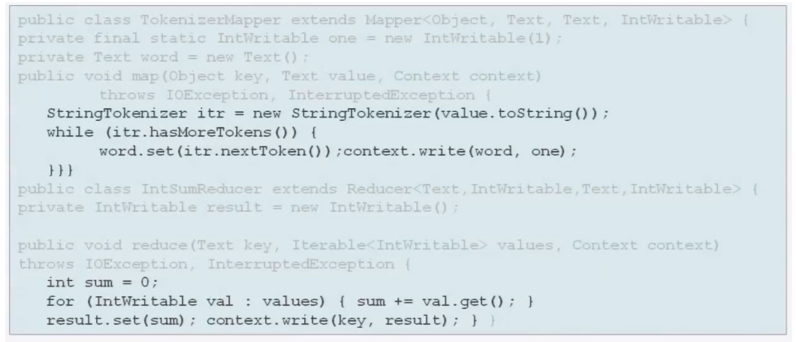
Map Reducer Syntax
Notes:
The native libraries provide developers with the most granularity of coding. Given that all other approaches are essentially abstractions, this language offers the least overhead and best performance. Most Hadoop queries are not singular, rather they are several queries strung together. For our simplistic example with a single query, it is likely the most efficient. However, once you have more complex series of jobs with dependencies, some of the abstractions offer more developer assistance.
In the example below, we see snippets from the standard word count example in Hadoop’s documentation. There are two basic things happening. One, the Mapper looks at a data set and reads it line by line. Then, the Mapper’s StringTokenizer function splits each line into words as key value pairs—this is what generates the intermediate output. To clarify, there is a key value pair for each instance of each word in the input file. At the bottom, we can see that the reducer code has received the key value pairs, counts each instance, and writes the information to disk

Slide 32
Hadoop Alternatives and Extensions

Slide 33
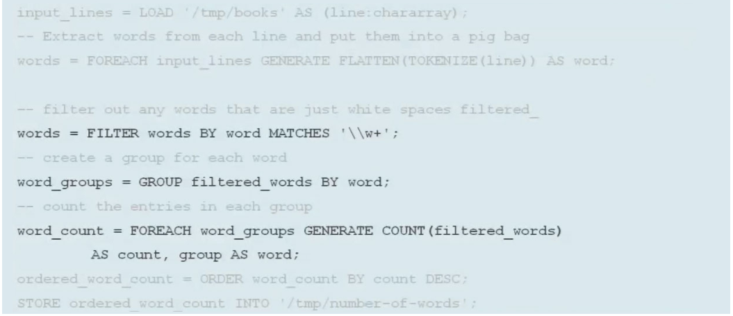

Pig Syntax
Notes:
Apache Pig’s programming language, referred to as Pig Latin, provides a higher level of abstraction for MapReduce programming that is similar to SQL, but it is procedural code not declarative. It can be extended with User Defined Functions (UDFs) written in Java, Python, JavaScript, Ruby, or Groovy and includes tools for data execution, manipulation, and storage. In the example below, we can see Pig Latin used to describe the same word count application as above, but fewer lines of code are used to read, tokenize, filter, and count the data.
Pig or Pig Latin as the language is called,is a high-level language designed to remove the complexities of coding MapReduce applications. Pig converts its operators into MapReduce code. So instead of needing Java programming skills and an understanding of the MapReduce coding infrastructure, people with little programming skills, can simply invoke SORT or FILTER operators without having to code a MapReduce application to accomplish those tasks. One of the strong features of Pig is that the developer / analyst does not have to depend solely on the Pig-supplied operators. It is possible to extend the language by coding one’s own user-defined functions. Executing Pig Pig can run in interactive mode or in script mode. Both of these ways have two options. Local mode gives you access to data in your local file system. It runs in a single Java virtual machine.
First look at Pig data As you might expect, the Pig language has a number of scalar data types used to define individual fields. Some examples are int forintegers, chararray for string data, double and float for numbers with decimal points. Fields are grouped together into tuples. You might think of a tuple as a row in a relational data table or a record in a file. Pig has greater flexibility over a relational table in that all tuples do not have to contain the same number of fields. Tuples are grouped into a bag. Now this is where it can get a little complex. I just said that a bag is a group of tuples, but a “field” in a tuple can actually be a bag that contains other tuples. In this case, the bag is an inner bag. The bag, that contains the tuples that correlate to a row in a relational table, is known as an outer bag. It is also known as a relation. Map data is also supported in Pig.

Slide 34
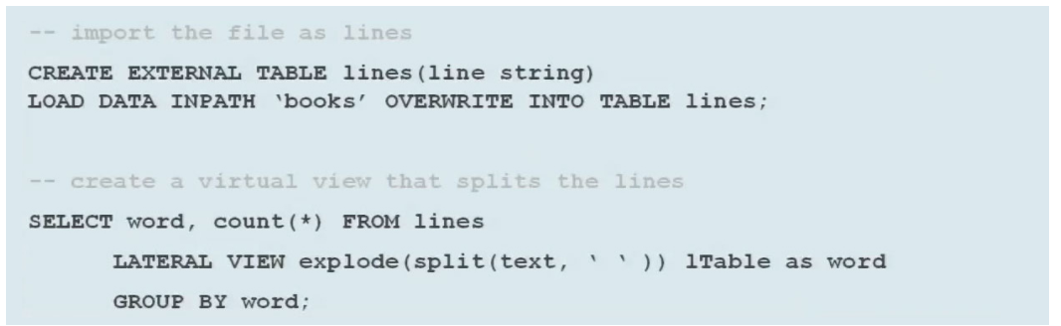

Hive Syntax
Notes:
I love Hive
Pig is a high level programming language, best described as a “data flow language” and not a query language. Being a custom language means there is a higher learning curve for SQL programmers to become comfortable with the Pig language. Pig has powerful data transformation capabilities and is great for ETL. It is not so good for ad-hoc querying. Pig is a nice complement for Hive and the two are often used in tandem in a Hadoop environment.
So what exactly is Hive? Hive is a data warehouse system built on top of Hadoop. Hive facilitates easy data summarization, ad-hoc queries, and the analysis of very large datasets that are stored in Hadoop. Hive provides a SQL interface, better known as HiveQL or HQL for short, which allows for easy querying of data in Hadoop. HQL has its own Data Definition and Data Manipulation languages which are very similar to the DML and DDL many of us already have experience with. In Hive, the HQL queries are implicitly translated into one or more MapReduce jobs, shielding the user from much more advanced and time consuming programming. Hive provides a mechanism to project structure (like tables and partitions) onto the data in Hadoop and uses a metastore to map file structure to tabular form.
Hive is a project that Facebook started in 2008 to make Hadoop behave more like a traditional data warehouse. Hive provides an even more SQL-like interface for MapReduce programming. In the example below, we see how Hive gets data from Hadoop Distributed File System (HDFS), creates a table for lines then does a select count on the table in a very SQL-like fashion. The lateral view applies splits, eliminates spaces, groups, and counts. Each of these commands maps to MapReduce functions covered above. Often considered the slower of the languages to do Hadoop with, this project is being actively worked on to speed it up 100x.
An example often used is that of the Word Count program. The Word Count program is meant to read in documents on Hadoop and return a listing of all the words read in along with the number of occurrences of those words. Writing a custom MapReduce program to do this takes 63 lines of code. Having Hive perform the same task only takes 7 easy lines of code!

Slide 35
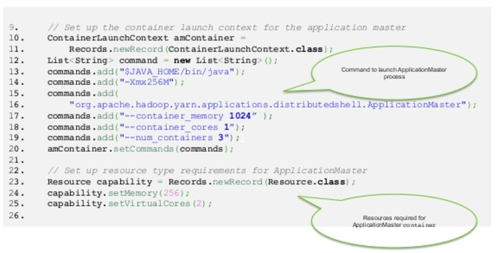
YARN Syntax
Notes:
Yet Another Resource Negotiator (YARN) In 2012, YARN became a sub-project of the larger Apache Hadoop project. Sometimes called MapReduce 2.0, YARN is a software rewrite that decouples MapReduce's resource management and scheduling capabilities from the data processing component.
Sub-project of Apache Hadoop. A way to manage and executive MapReduce. Part of Hadoop 2.0.
. With YARN, Hadoop now has a generic resource-management and distributed application framework, where by, one can implement multiple data processing applications customized for the task at hand. Hadoop MapReduce is now one such application for YARN and I see several others given my vantage point – in future you will see MPI, graph-processing, simple services etc.; all co-existing with MapReduce applications in a Hadoop YARN cluster.

Slide 36
Eclipse: a popular IDE donated by IBM to the open-source community
Lucene: a text search engine library written in Java
Hbase: a Hadoop database
Cassandra: a NoSQL database
Hive: provides data warehousing tools to extract, transform and load (ETL) data, and query this data stored in Hadoop files
Pig: a high level language that generates MapReduce code to analyze large data sets.
Spark: a cluster computing framework often used for analytics on top of Hadoop
ZooKeeper: a centralized configuration service and naming registry for large distributed systems
Ambari: manages and monitors Hadoop clusters through an intuitive web UI
Avro: a data serialization system
UIMA: is the architecture for the development, discovery, composition and deployment for the analysis of unstructured data
YARN: a large-scale operating system for big data applications
MapReduce: a software framework for easily writing applications which processes vast amounts of data
Notes:
Pig and Hive need to exist because MapReduce, you’re typically writing in Java, and you’re writing these things in Java, and it’s very verbose, and it’s very manual. Pig and Hive will give you this higher data language, and you can get the job done faster, but the problem is that you have less control. That’s the trade-off you’re making.
A note about two of these other component: SPARK: Alternate to MapReduce data science has mostly noted its ability to keep data resident in memory, which can speed up iterative machine learning workloads. Comes with its own machine learning library. Said to be 100x faster than MapReduce. Can write it in Java or Scala or Python(PySpark). Can be installed onto any platform, not just Hadoop.
Second, Hbase and Cassandra. These are two of the most popular options for databases. Hadoop does not come with a db and it does not replace it. If you need a DB option, consider one of these (or Couch or MongoDB). Cassandra has a syntax which is a bit more like SQL but Hbase

Slide 37
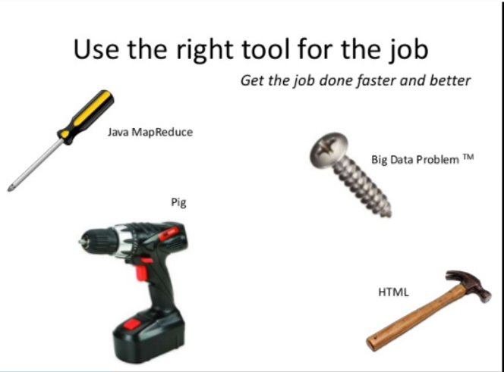

Slide 38
Do I Need Hadoop?

Slide 39
Speed Security
Data Structure
Training Database
You want answers Fast and in Real-Time? Think Again!
Multi-node, Multi-Risk
Do you really have big data?
So…who is going to actually do the work?
Respect the columns
Notes:
Except that is not big data.
Big data is the term used when addressing architecture scaling, put simply, what happens when the data store you're dealing with grows so large that your current hardware is insufficient to maintain performance? Do / can you scale horizontally, vertically or a combination of both.
Hadoop is sort of an all in one solution and deals with distributed storage and processing i.e. how you split your data / processing over multiple servers.
Spark only deals with distributed processing but is more performant then hadoop (map reduce).
Cassandra deals with storage and is only relevant when there are traditional hard disks in use, because of the SSD market you wont find it used in many places.

Slide 40
Cognitive Class AI: Hadoop 101:https://cognitiveclass.ai/learn/hadoop/
Cognitive Class AI: Accessing Hadoop Data Using Hive (BD0141EN) https://cognitiveclass.ai/courses/hadoop-hive/
MapReduce: Simplified Data Processing on Large Clusters, by Jeffrey Dean and Sanjay Ghemawat: http://static.googleusercontent.com/media/research.google.com/en/us/archive/mapreduce-osdi04.pdf
Coursera Hadoop Course: https://www.coursera.org/learn/hadoop
Experfy Pig Course($99): https://www.experfy.com/training/courses/comprehensive-pig
Hortonworks Sandbox: https://hortonworks.com/products/sandbox/
Spinning Up a Free Hadoop Server: https://blog.insightdatascience.com/spinning-up-a-free-hadoop-cluster-step-by-step-c406d56bae42
Mining Massive Data Sets: https://www.youtube.com/playlist?list=PLLssT5z_DsK9JDLcT8T62VtzwyW9LNepV
List of Hadoop and Big Data Books: https://www.analyticsvidhya.com/blog/2015/10/books-big-data-hadoop-apache-spark/
DataBricks (two week free trial): https://databricks.com/product/databricks
Mortar Data: http://blog.mortardata.com/post/61501767090/hadoop-for-data-science

Slide 41
Hadoop!
Twitter: @_oneunit
Slides:
Will Post to GitHub, Share with ACT-W

Slide 42
Thank you!

