Slide 1
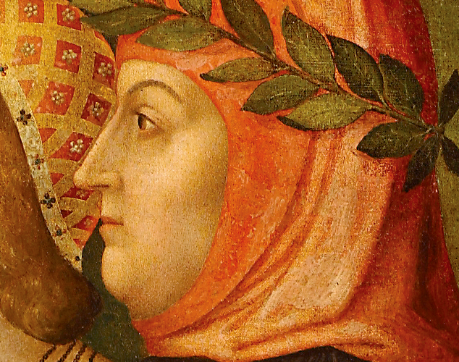
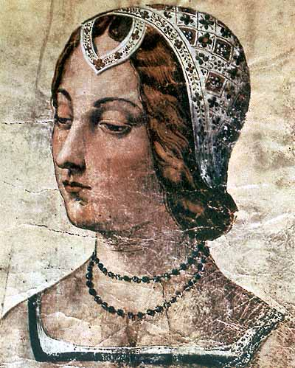
Implementation of the 4th Order Runge-Kutta and Adams-Bashforth-Moulton Methods to Explore Love
Presented by: M. Catherine Yopp

Slide 2

4th Order Runge-Kutta
Pros
Imitates the functionality of Taylor Series w/out derivatives
Self-starting w/ initial conditions
Cons
Not suitable for stiff systems
Higher truncations errors compared to multi-steps
Greater computational cost

Slide 3
4th Order Adams-Bashforth-Moulton
Pros
Great for stiff systems
Lower computational cost
High accuracy
Cons
Not self-starting
Requires assistance of explicit multi-step to begin
Requires assistance of a single step to begin

Slide 4
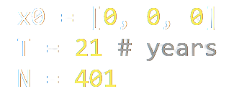
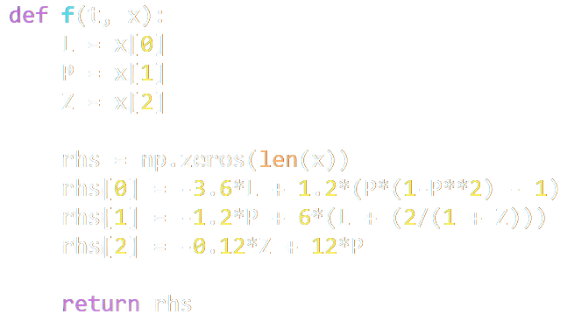
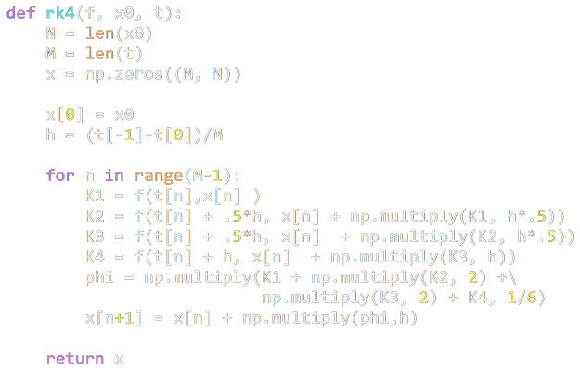

4th order Runge-Kutta Algorithm
Set initial conditions:
$t_{0}=0$
$N=steps$
$t_{N}=T$
$\overset{⃑}{y}\left(t\right)=\overset{⃑}{y_{0}}$
Define right-hand side:
$\overset{⃑}{F}\left(t\right)=[f_{1}\left(t, y_{1},y_{2},…,y_{n}\right),…,f_{n}\left(t,y_{1},y_{2},…,y_{n}\right)]$
For i = 0, 1, 2,…,N-1:
$t_{i+1}=t_{i}+ ∆t$
$\overset{⃑}{K_{1}}= \overset{⃑}{f}\left(t_{i}, \overset{⃑}{y_{i}}\right)$
$\overset{⃑}{K_{2}}= \overset{⃑}{f}(t_{i}+\frac{∆t}{2}, \overset{⃑}{y_{i}}+\frac{∆t∗\overset{⃑}{K_{1} }}{2})$
$\overset{⃑}{K_{3}}= \overset{⃑}{f}(t_{i}+\frac{∆t}{2}, \overset{⃑}{y_{i}}+\frac{∆t∗\overset{⃑}{K_{2} }}{2})$
$\overset{⃑}{K_{4}}= \overset{⃑}{f}(t_{i}+∆t \overset{⃑}{y_{i}}+∆t∗\overset{⃑}{K_{3} })$
${\overset{⃑}{y}}_{i+1}={\overset{⃑}{y}}_{i}+\frac{h}{6}(\overset{⃑}{K_{1}}+2\overset{⃑}{K_{1}}+2\overset{⃑}{K_{1}}+\overset{⃑}{K_{1}})$

Slide 5

4th order Adam-Bashforth-Moulton
Set initial conditions:
$t_{0}=0$
$N=steps$
$t_{N}=T$
$\overset{⃑}{y}\left(t\right)=\overset{⃑}{y_{0}}$
Define right-hand side:
$\overset{⃑}{F}\left(t\right)=[f_{1}\left(t, y_{1},y_{2},…,y_{n}\right),…,f_{n}\left(t,y_{1},y_{2},…,y_{n}\right)]$
For i = 0, 1, 2:
$t_{i+1}=t_{i}− ∆t$
$\overset{⃑}{K_{1}}= \overset{⃑}{f}\left(t_{i}, \overset{⃑}{y_{i}}\right)$
$\overset{⃑}{K_{2}}= \overset{⃑}{f}(t_{i}+\frac{∆t}{2}, \overset{⃑}{y_{i}}+\frac{∆t∗\overset{⃑}{K_{1} }}{2})$
$\overset{⃑}{K_{3}}= \overset{⃑}{f}(t_{i}+\frac{∆t}{2}, \overset{⃑}{y_{i}}+\frac{∆t∗\overset{⃑}{K_{2} }}{2})$
$\overset{⃑}{K_{4}}= \overset{⃑}{f}(t_{i}+∆t \overset{⃑}{y_{i}}+∆t∗\overset{⃑}{K_{3} })$
${\overset{⃑}{y}}_{i+1}={\overset{⃑}{y}}_{i}+\frac{h}{6}(\overset{⃑}{K_{1}}+2\overset{⃑}{K_{2}}+2\overset{⃑}{K_{2}}+\overset{⃑}{K_{4}})$

Slide 6
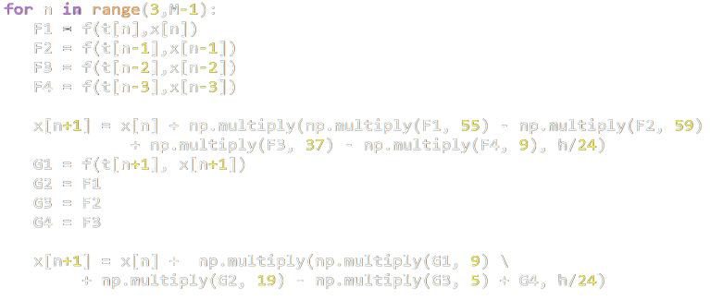

4th order Adam-Bashforth-Moulton
For i = 3, 4, …, N-1:
$t_{i+1}=t_{i}+ ∆t$
$\overset{⃑}{G_{1}}= \overset{⃑}{f}\left(t_{i}, \overset{⃑}{y_{i}}\right)$
$\overset{⃑}{G_{2}}= \overset{⃑}{f}\left(t_{i−1}, {\overset{⃑}{y}}_{i−1}\right)$
$\overset{⃑}{G_{3}}=\overset{⃑}{f}\left(t_{i−2}, {\overset{⃑}{y}}_{i−2}\right)$
$\overset{⃑}{G_{4}}=\overset{⃑}{f}\left(t_{i−3}, {\overset{⃑}{y}}_{i−3}\right)$
${\overset{⃑}{y}}_{i+1}={\overset{⃑}{y}}_{i}+\frac{h}{24}(55\overset{⃑}{G_{1}} −59\overset{⃑}{G_{2}}+37\overset{⃑}{G_{3}}−9\overset{⃑}{G_{4}})$
$\overset{⃑}{H_{1}}= \overset{⃑}{f}\left(t_{i+1}, \overset{⃑}{y_{i+1}}\right)$
$\overset{⃑}{H_{2}}=\overset{⃑}{G_{2}}$
$\overset{⃑}{H_{3}}=\overset{⃑}{G_{3}}$
$\overset{⃑}{H_{4}}=\overset{⃑}{G_{4}}$
${\overset{⃑}{y}}_{i+1}={\overset{⃑}{y}}_{i}+\frac{h}{24}(9\overset{⃑}{G_{1}}+19\overset{⃑}{G_{2}}−5\overset{⃑}{G_{3}}+\overset{⃑}{G_{4}})$

Slide 7
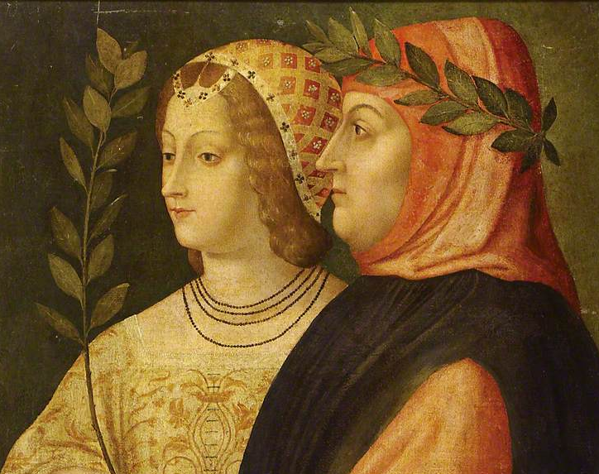

“Laura and Petrarch: An Intriguing Case of Cyclical Love Dynamics”
$$\frac{dL}{Dt}=−3.6L+1.2\left(P\left(1−P^{2}\right)−1\right)$$
$$\frac{dP}{dt}=−1.2P+6(L+\frac{2}{1+z})$$
$$\frac{dZ}{dt}=−0.12Z+12P$$
“Three ordinary differential equations are proposed to model the dynamics of love between Petrarch, a celebrated Italian poet of the 14th century, and Laura, a beautiful but married lady.”
“Laura and Petrarch: An Intriguing Case of Cyclical Love Dynamics”, SIAM J. Appl. Math, 58, pp. 1205-1221, 1998

Slide 8
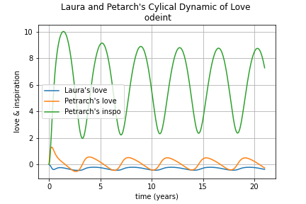
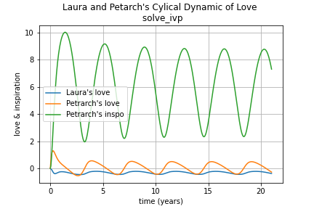
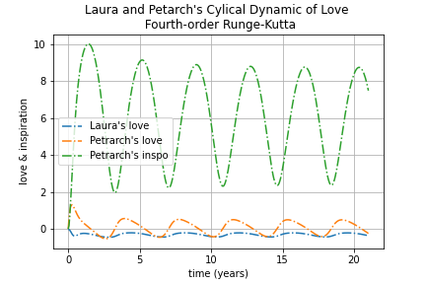
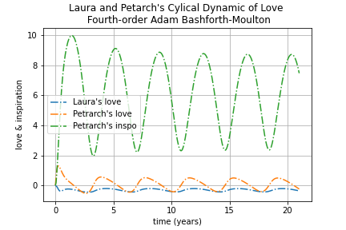
4th order Adams-Bashforth-Moulton
4th order Runge-Kutta
scipy.intergrate.odeint()
scipy.integrate.solve_ivp()

Slide 9
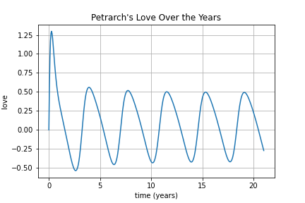
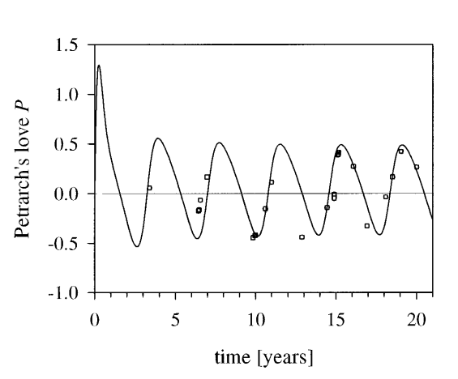

Slide 10
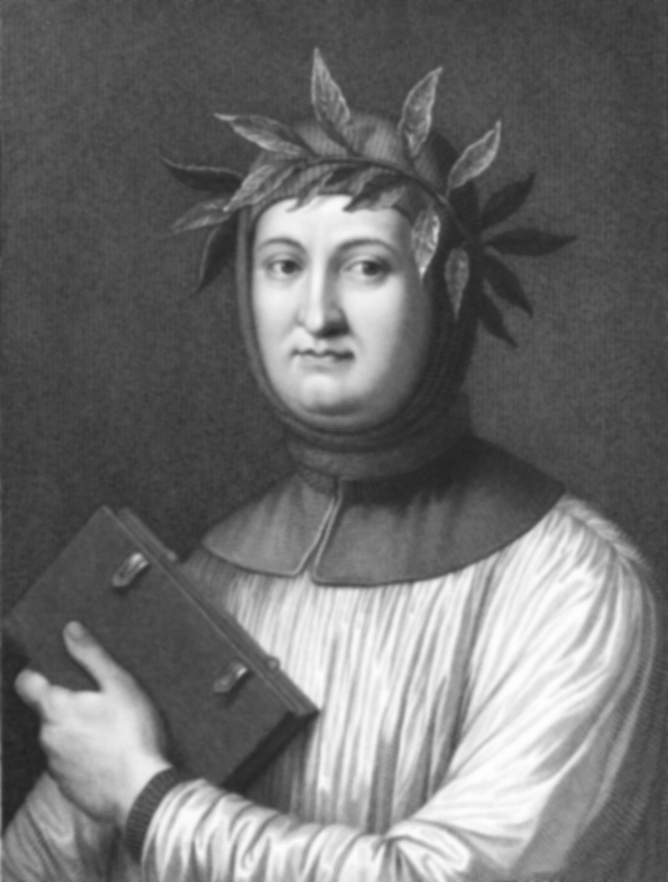
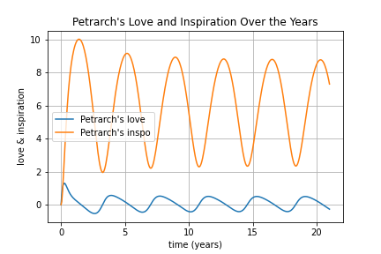
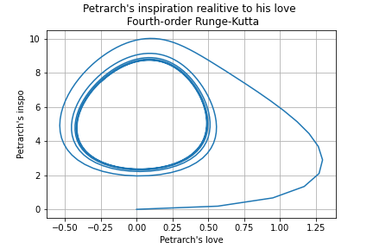

Slide 11
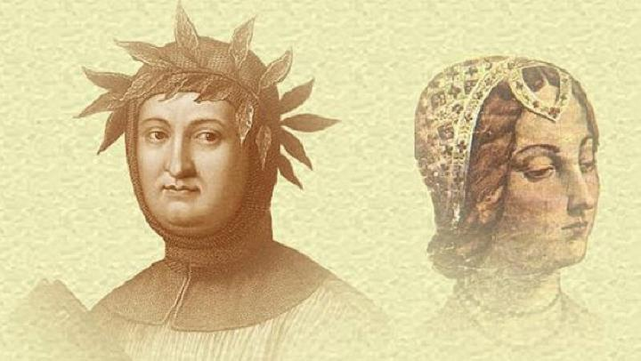
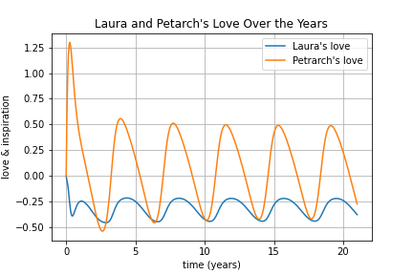
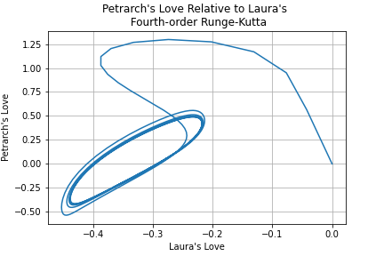

Slide 12

Questions?

