Slide 1

Final Project: Nasa Dataset
By: Morgan Hardin

Slide 2
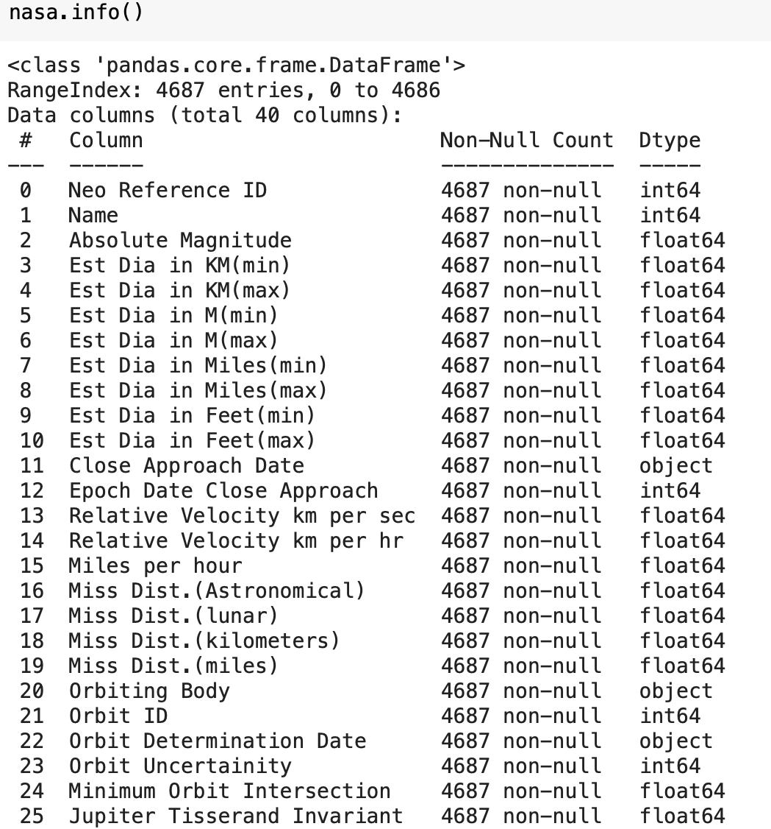
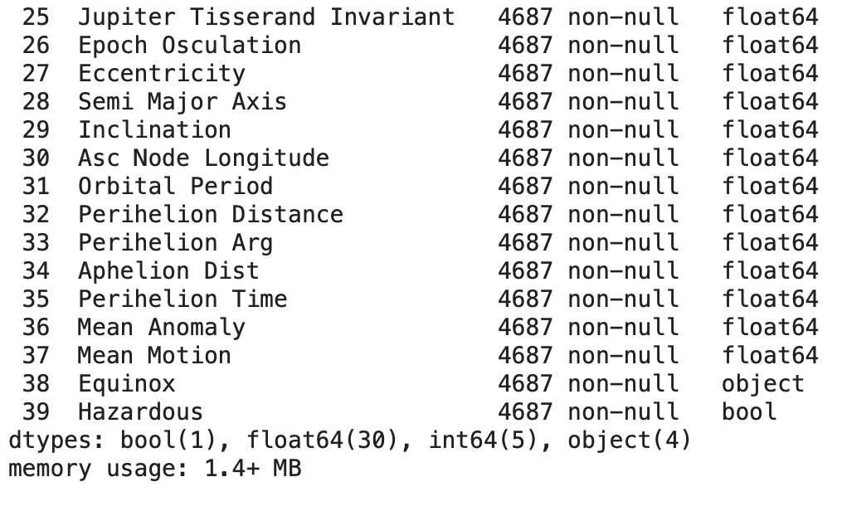
Analyzing the Dataset
Nasa Dataset imported from Kaggle
Has 4,687 non-null entries per column
Has 40 columns
Nearly all columns were numerical except 4
Label Encoder used to change numerical data to categorical data
Target Column: `Hazardous`
Originally boolean but changed to numerical
Goal of the Dataset:
Determine if an asteroid is hazardous or not
If target outcome is 0, asteroid is not hazardous
If target outcome is 1, asteroid is hazardous

Slide 3
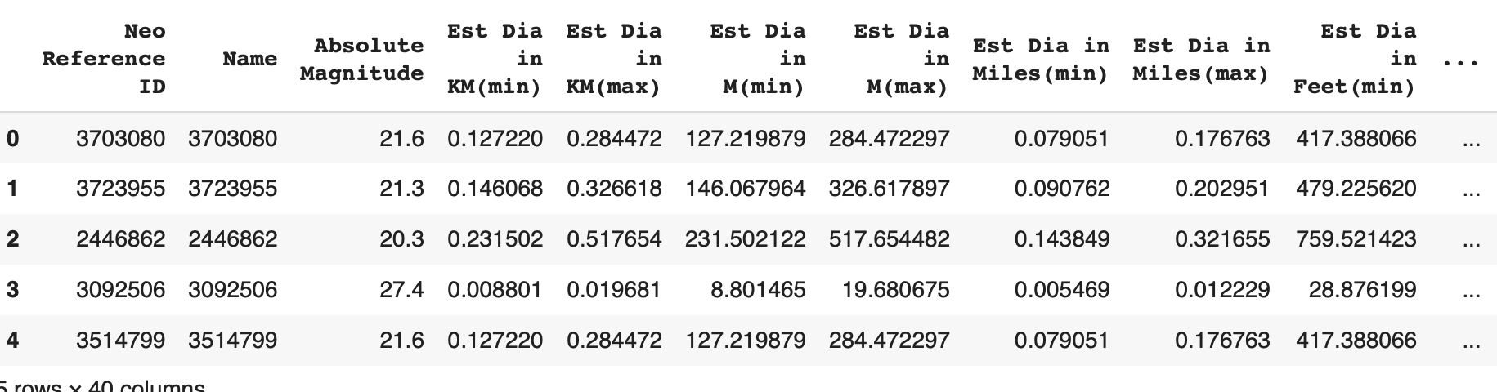
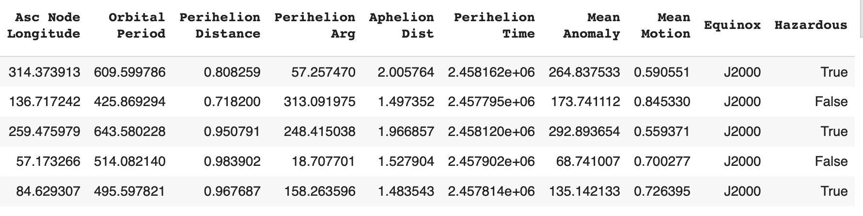
Analyzing the Dataset
No columns dropped due to each one being fairly important, yet some are similar to one another and could have been dropped
Found that this did not impact the scores at all, so no columns were dropped

Slide 4
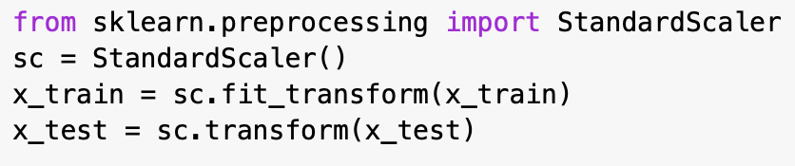
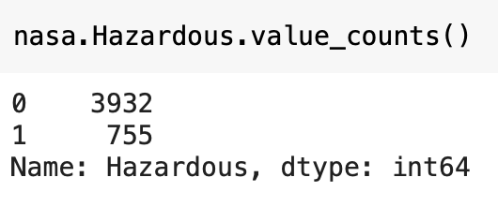
Analyzing the Dataset
`Hazardous` was not evenly distributed
Stratified during train, test, split
Dataset was scaled, only on x variables due to this being a classification problem where y does not need to be scaled
Changed test_size and random_state but neither gave the highest accuracy scores as test_size = 80/20 or random_state = 0
Only slightly better by about 1-2%

Slide 5
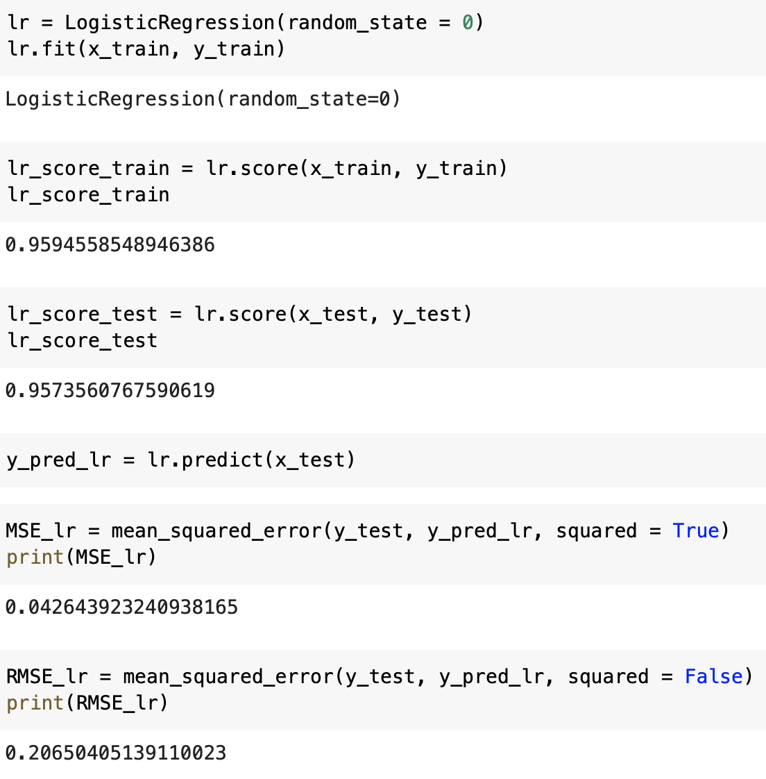
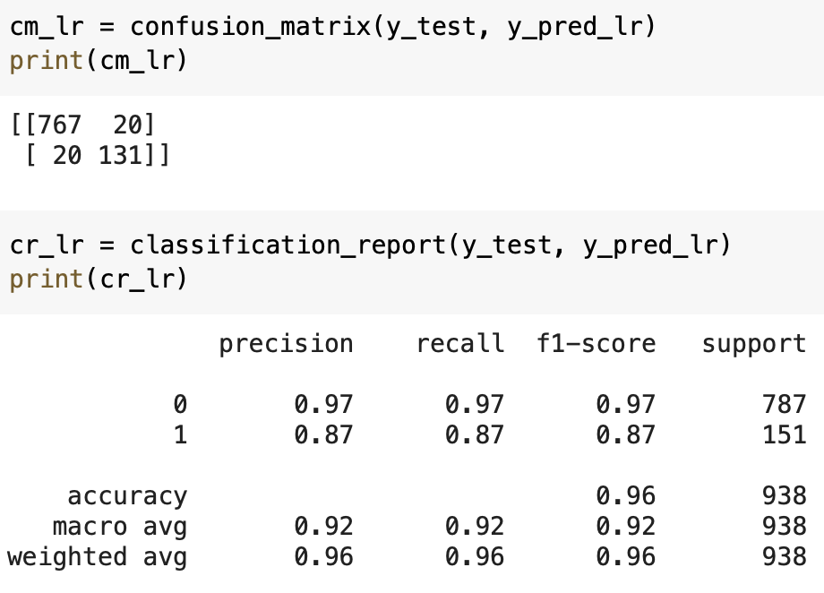
Logistic Regression
Training Score: 96%
Testing Score: 96%
Not overfitted or underfitted
MSE: 0.04
RMSE: 0.21
Great results
Not the best, but also not the worst
Confusion Matrix:
767 TP and 131 TN
20 FP and 20 FN
Classification Report:
Much better job of predicting 0’s

Slide 6
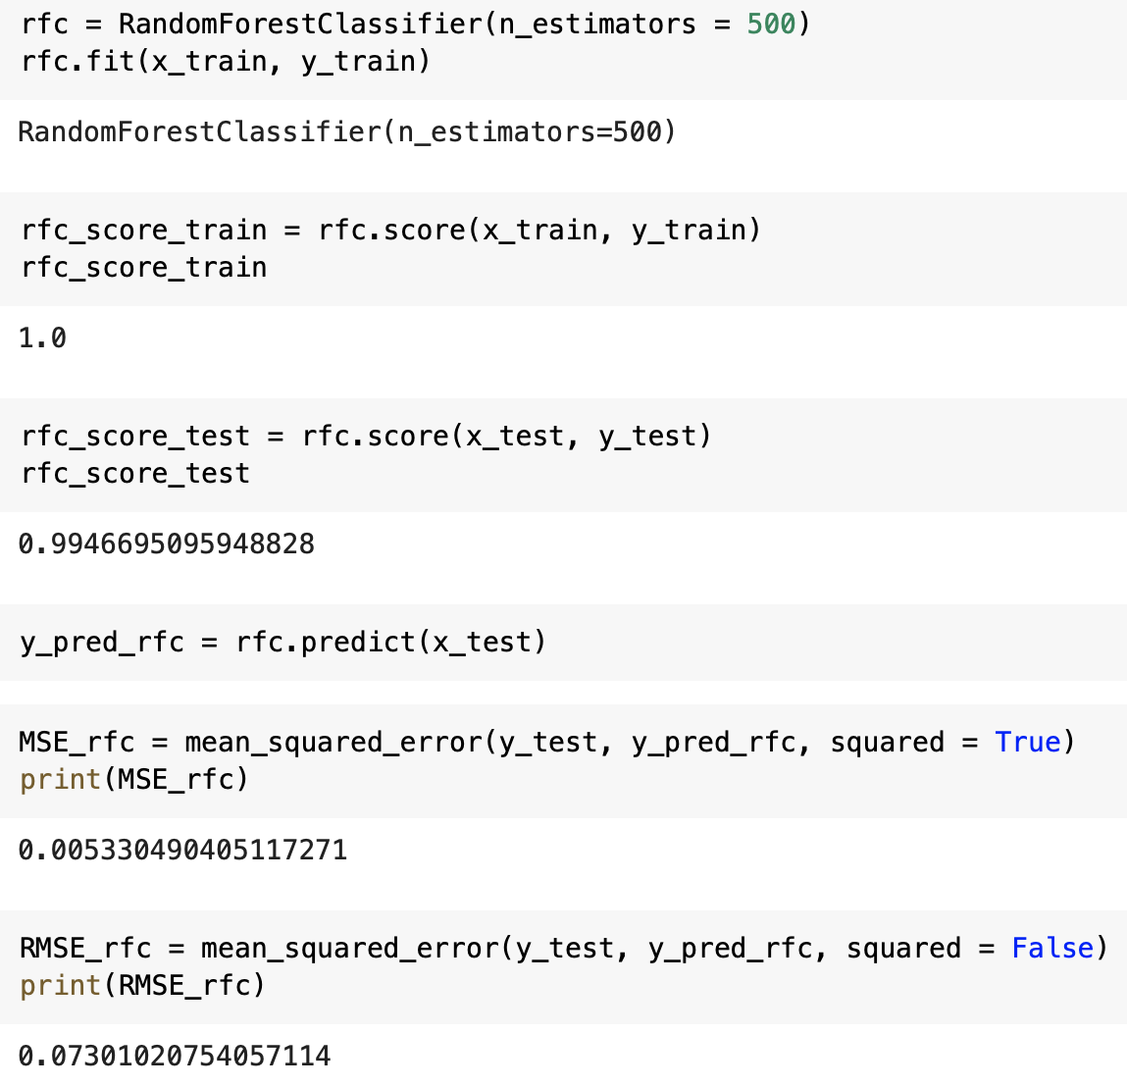
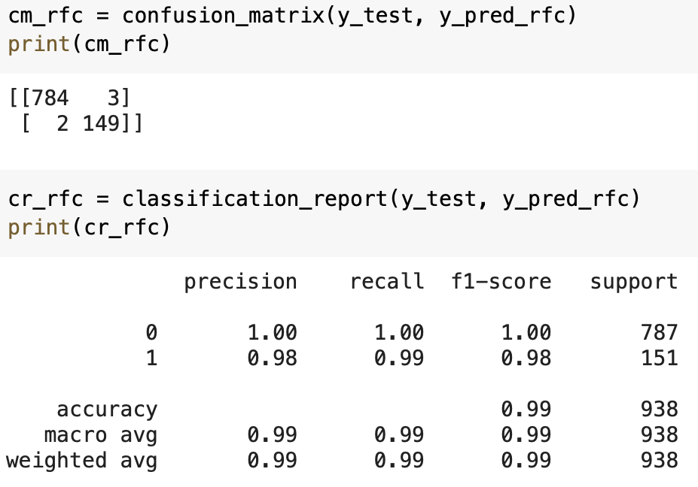
Random Forest Classifier
Training Score: 100%
Testing Score: 99%
Not overfitted or underfitted
MSE: 0.005
RMSE: 0.073
Great results
2nd best results, only by small amount
Confusion Matrix:
784 TP and 149 TN
3 FP and 2 FN
Classification Report:
Did well at predicting both 1’s and 0’s

Slide 7
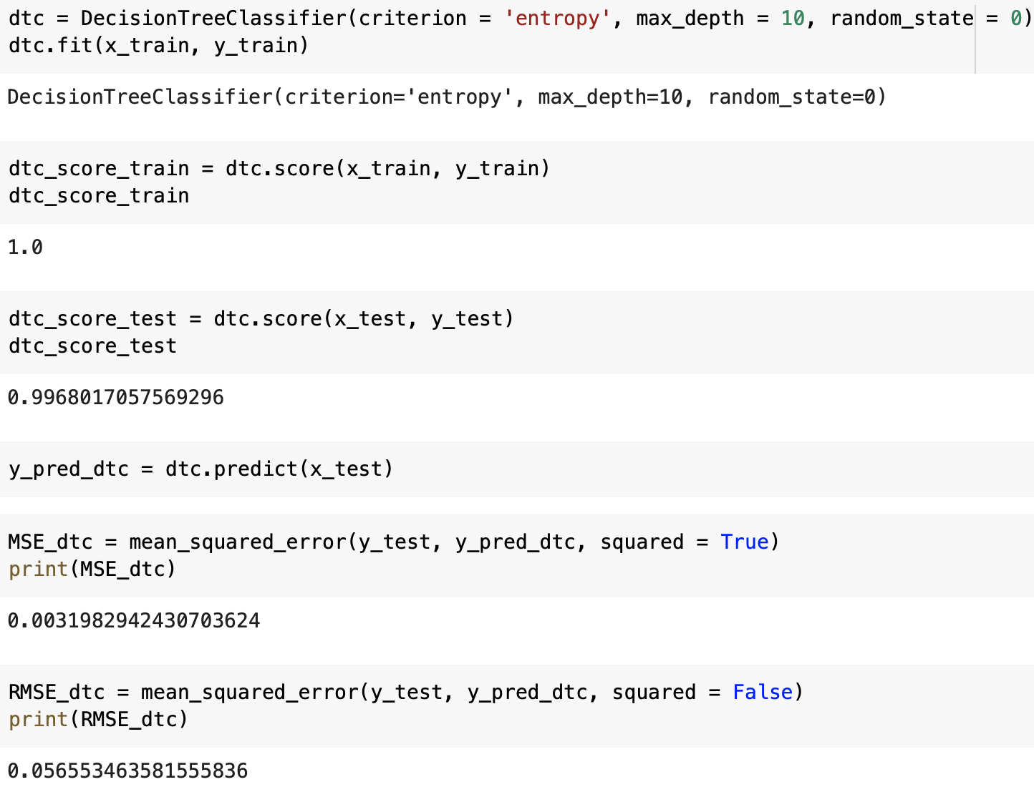
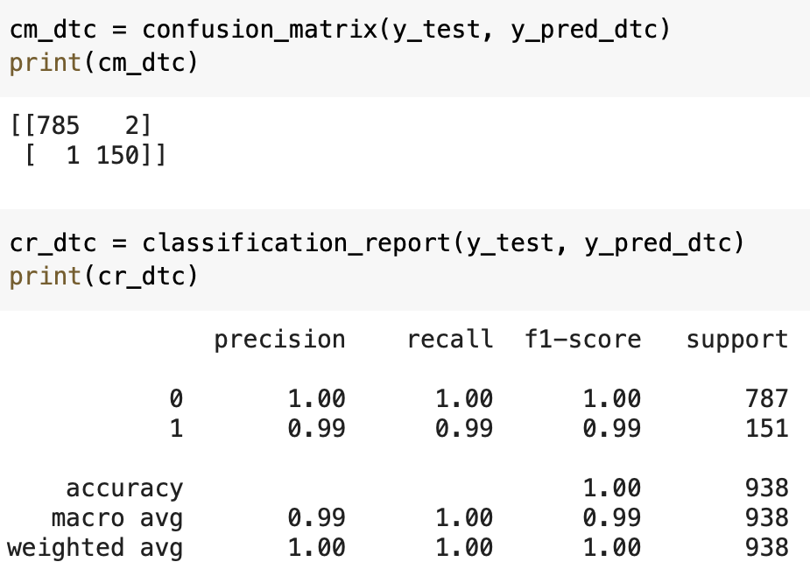
Decision Tree Classifier
Training Score: 100%
Testing Score: 99%
Not overfitted or underfitted
MSE: 0.003
RMSE: 0.57
Best results
Only by a very small margin
Confusion Matrix:
785 TP and 150 TN
2 FP and 1 FN
Classification Report:
Did well at predicting both 1’s and 0’s

Slide 8
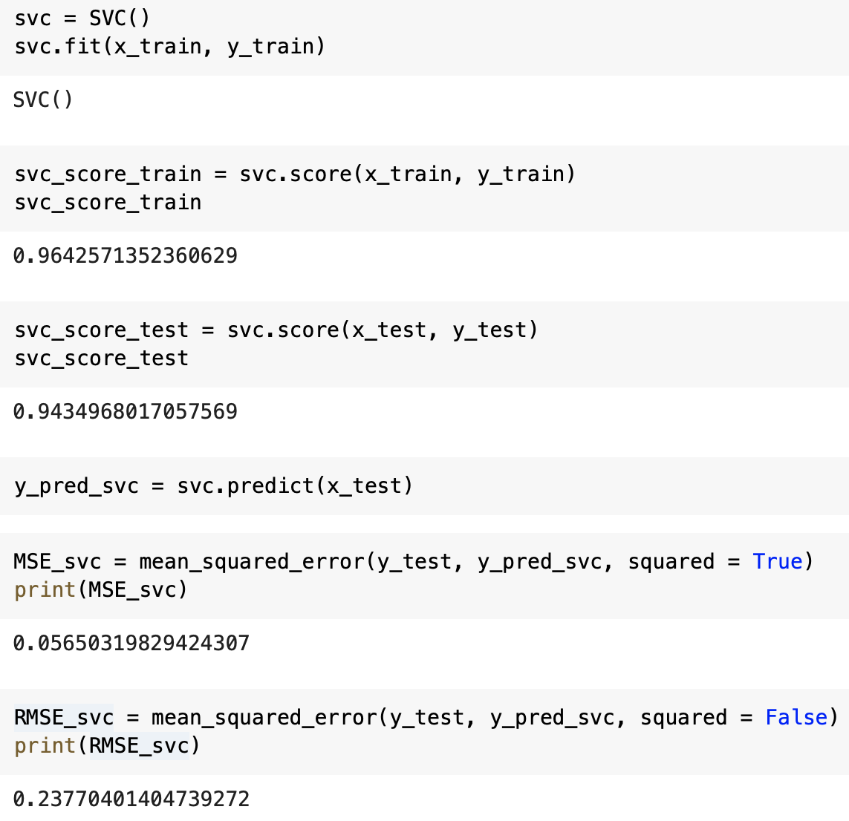
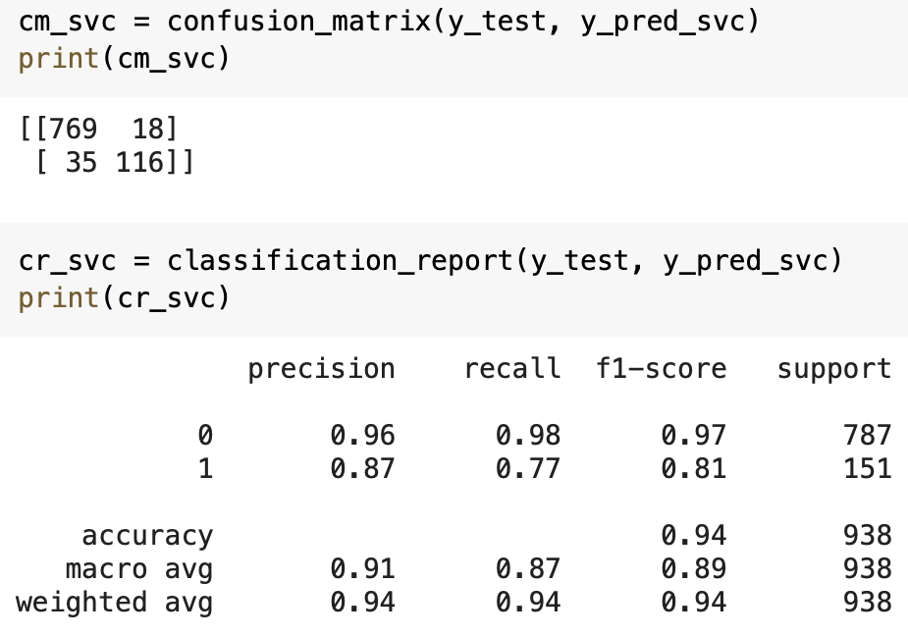
SVC
Training Score: 97%
Testing Score: 94%
Barely overfitted, compared to other models
MSE: 0.057
RMSE: 0.24
Worst results
Not by much, but worst in every aspects
Confusion Matrix:
769 TP and 116 TN
18 FP and 35 FN
Classification Report:
Did better at predicting both 0’s

Slide 9
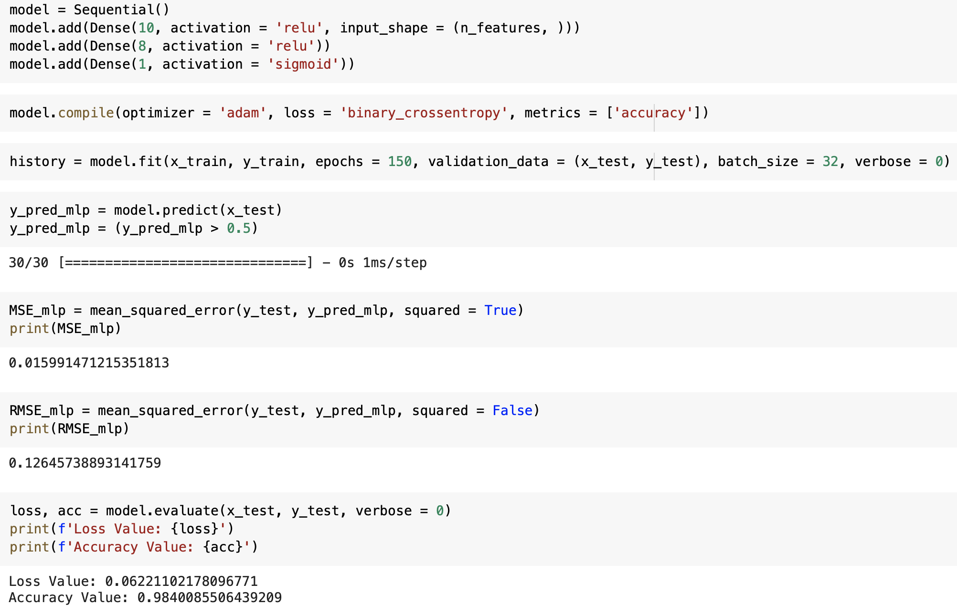
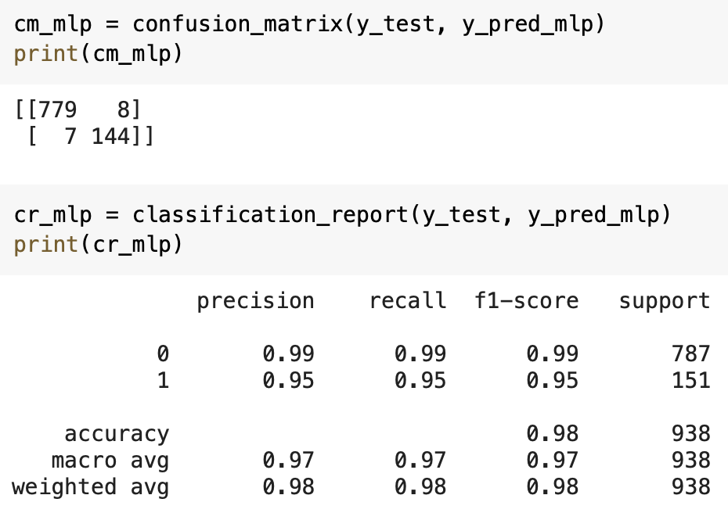
MLP
MSE: 0.016
RMSE: 0.13
Good results
Not the best, not the worst
Loss: 0.06%
Accuracy: 98%
Great results with minimal data lost
Confusion Matrix:
779 TP and 144 TN
8 FP and 7 FN
Classification Report:
Did slightly better at predicting both 0’s

Slide 10
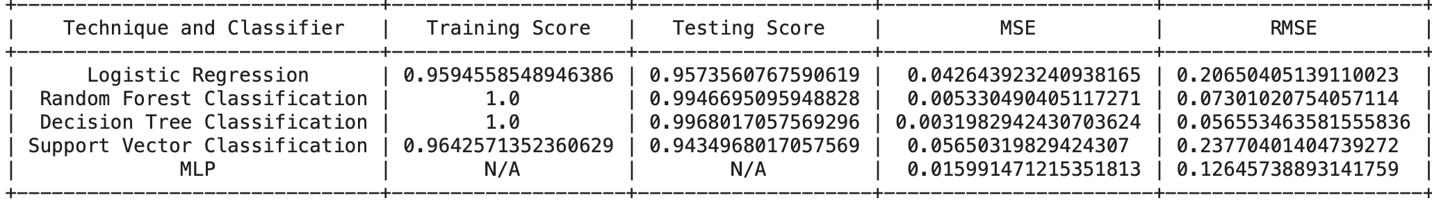
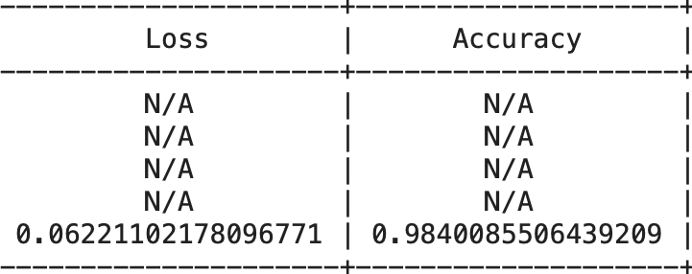
Final Results
Decision Tree Classifier had the best results
Barely beating Random Forest Classifier by an extremely small amount
SVC had the worst results
Overall, every score was more than acceptable for determining if an asteroid is hazardous or not

