Slide 1
Project #1: Wine Classification
By: Morgan Hardin

Slide 2
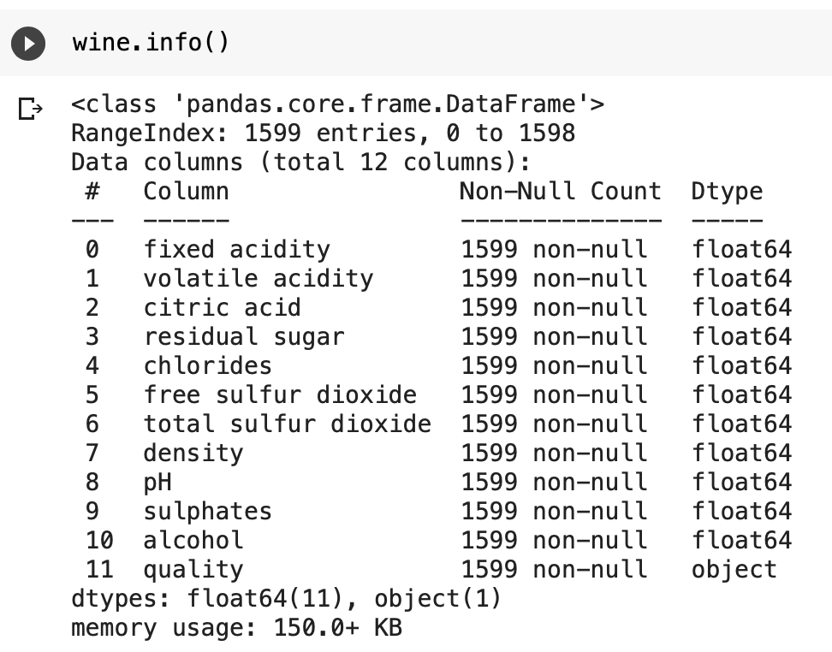
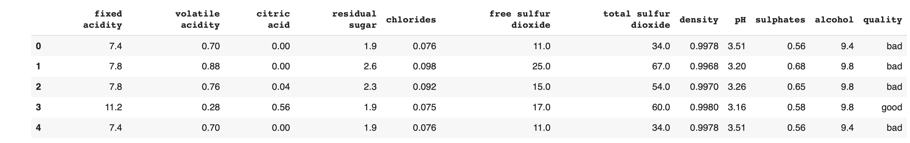
Wine Dataset
Every column is important to the outcome of the quality of the wine
All numerical data types except for the quality column, can be encoded with OrdinalEncoder()
No missing values so no cleaning is needed
Scaling needed for SVC and for total sulfur dioxide column

Slide 3
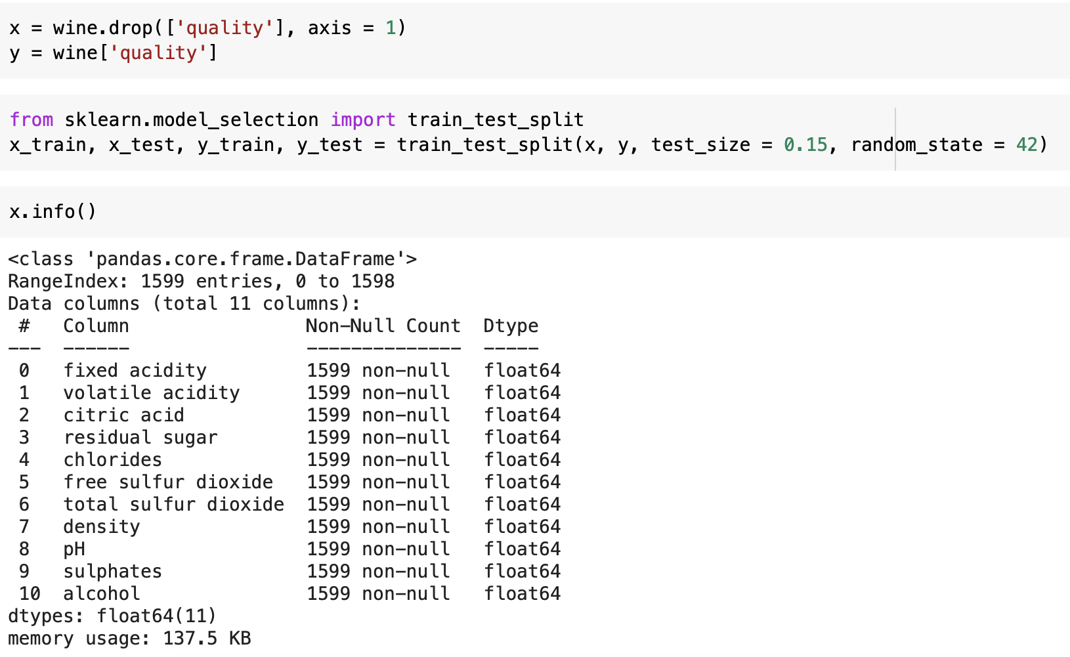
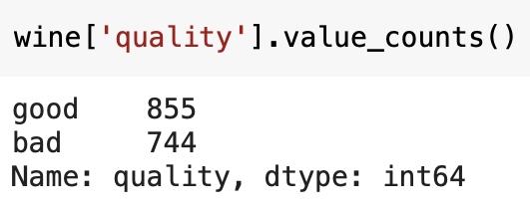
Training, Testing, and Splitting the Dataset
Does not need to be stratified since data is evenly distributed
Best results were with 85 / 15 training and test sizes
Only ‘x’ is scaled since it is a classification problem

Slide 4
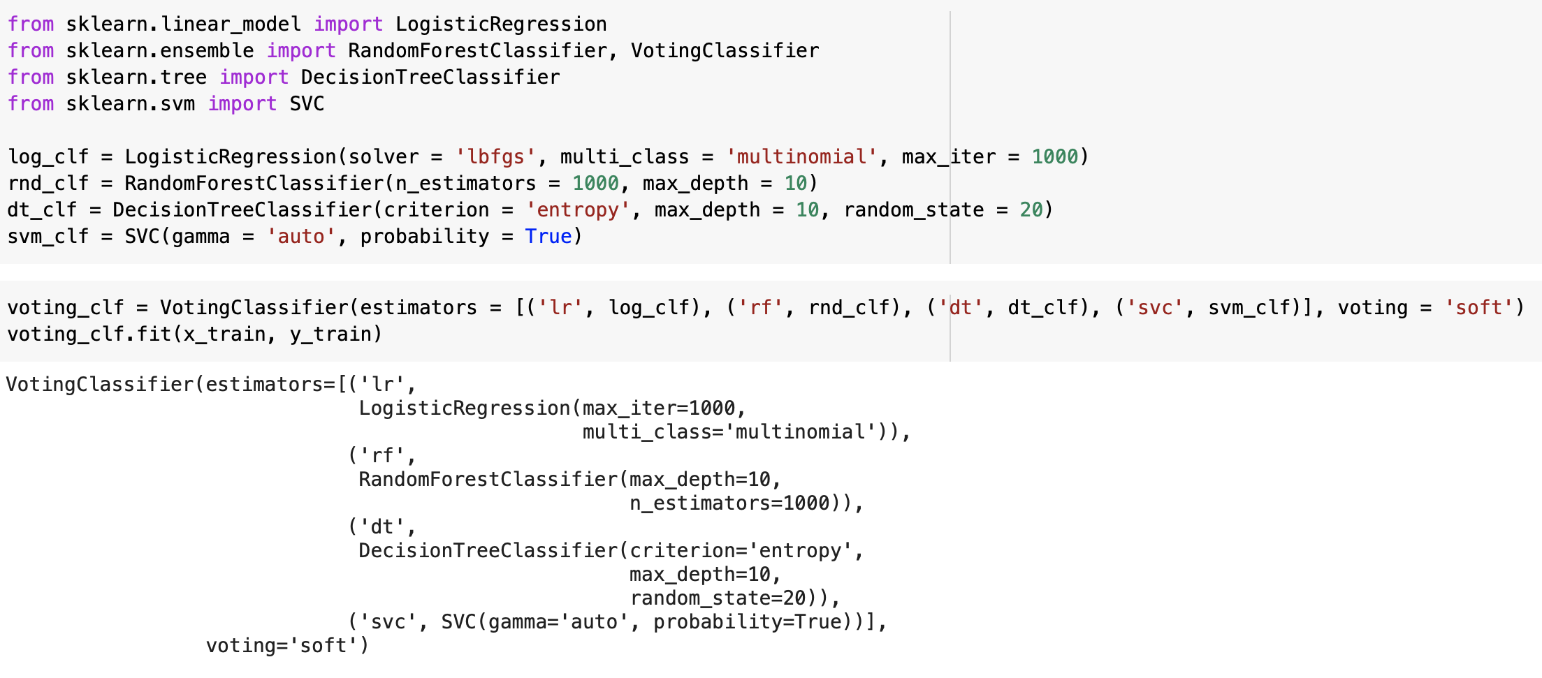
Wine Dataset
Parameters gave the best results, although they did not impact the accuracy score a lot
Other parameters only gave a score that was around 1-2% less than the actual score
Soft voting gave best results over hard voting

Slide 5
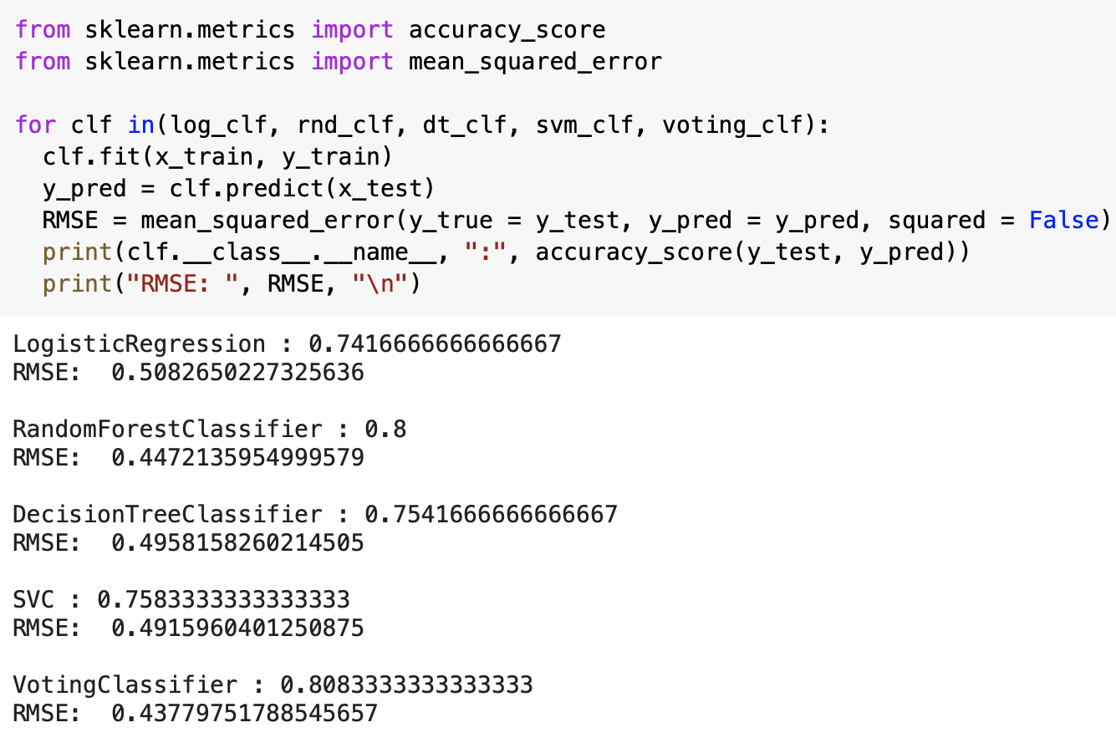
results
Best Model: Random Forest with 80%
Worst Model: Logistic Regression with 74%
Soft Voting Classifier gives each classifier a weight and takes the average, finding the best model based on the accuracy score
Root Mean Squared Error is much lower with 0.43

Slide 6
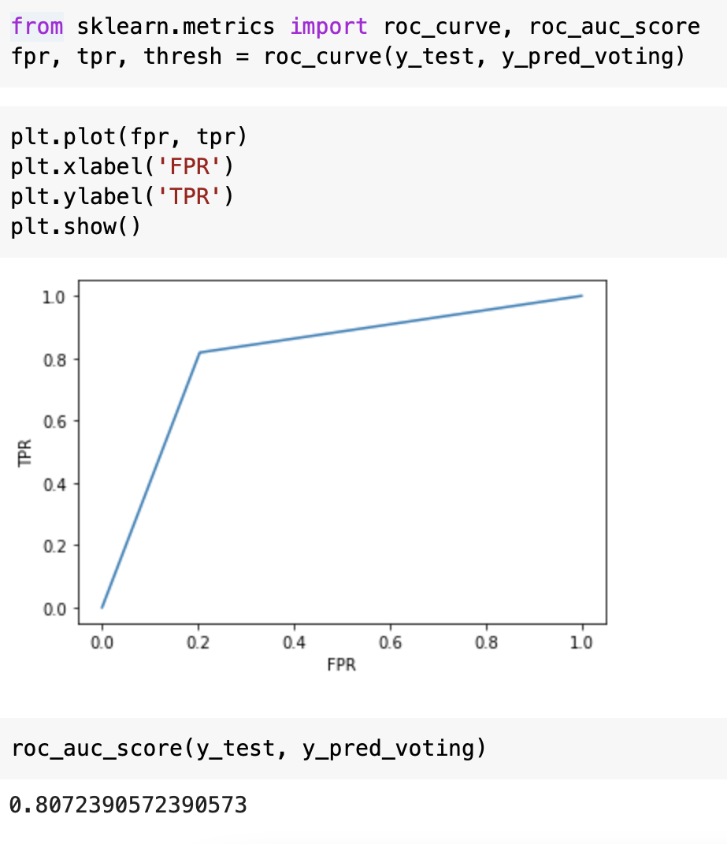
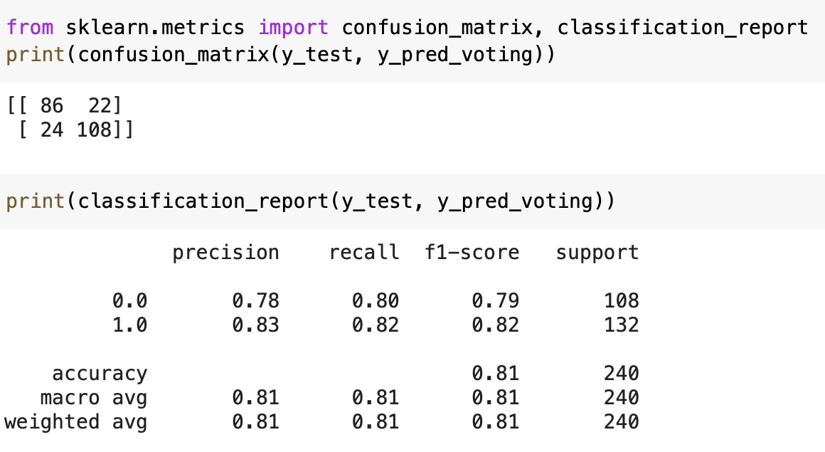
Wine Dataset
Shows that the model is decent, but could be better
ROC Curve shows model was trained since it falls between 0.5 and 1 and is closer to 1
Score states model is 80% accurate, which matches the RMSE accuracy score from before

