Slide 1
HR Dataset
By: Morgan Hardin

Slide 2
Background
Goal: Predict if an employee will leave a company or not
Hypothesis: Satisfaction, Hours Worked, and Salary have the most impact on an employee leaving
HR dataset helps companies see their turnover rate and what leads to an employee leaving their company
Turnover Rate: percentage of employees that leave in a specific time period
HR department keeps track of this information and analyzes the data to determine what plays into an employee leaving to try and prevent them from leaving before it is too late
Dataset was collected to analyze what variables play into an employee leaving to help a company understand why they left
Helps the company understand what areas they need to improve to help an employee stay
Helps the employee understand more about the company and where they stand
By predicting if an employee will leave, it can help a company lower their turnover rate.

Slide 3
Introduction
1 file with 10 columns and 14,999 rows
Found on Kaggle: https://www.kaggle.com/datasets/jixiangruyi/predict-employee-left
No null entries
8 numerical columns
2 categorical columns
2 Float data types
Decimal between 0 and 1 to represent percentage
6 Integer data types
2 Object data types
Independent variables were:
‘satisfaction_level’, ‘last_evaluation’, ‘number_project’, ‘average_monthly_hours’, ‘time_spend_company’, ‘work_accident’, ‘promotion_last_5years’, ‘Department’, and ‘salary’
Dependent variable:
‘left’ --> 0 means Stayed and 1 means Left

Slide 4
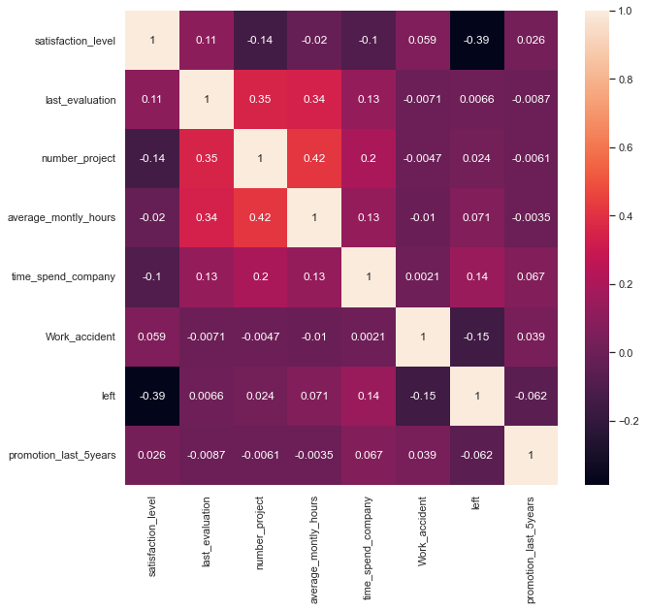
Correlation Matrix
‘satisfaction_level’, ‘Work_accident’, and ‘promotion_last_5years’ have negative correlation with an employee leaving
Different than original hypothesis that salary would negatively impact if they left
Number of projects and hours worked also have positive correlation
All other categories were too close to 0 to show an impact

Slide 5
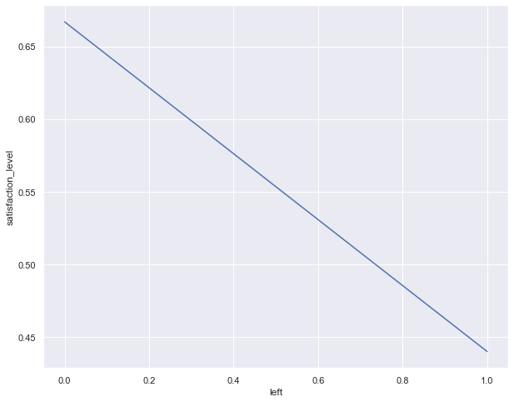
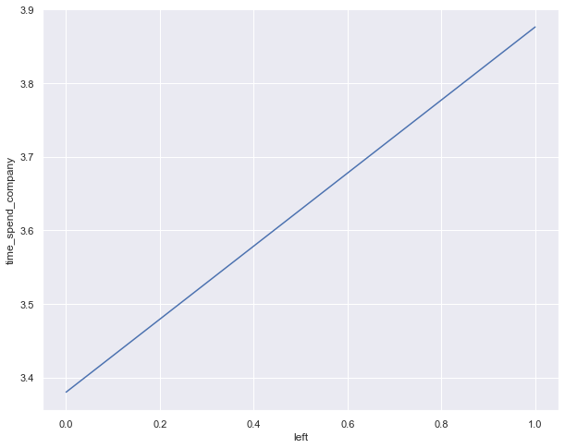
Line Plot of Satisfaction and Time Spent vs Left
Higher the satisfaction level, the less likely an employee will leave
More time spent at a company, the less likely an employee will leave

Slide 6
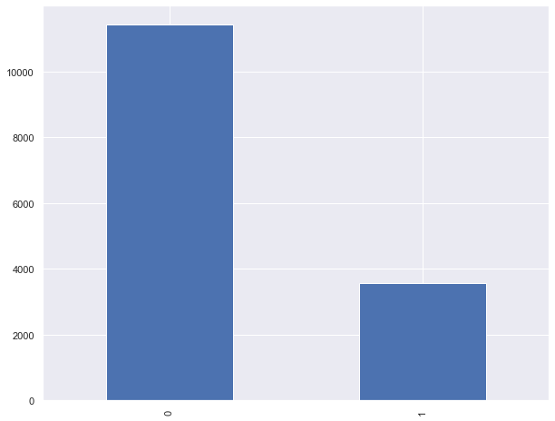
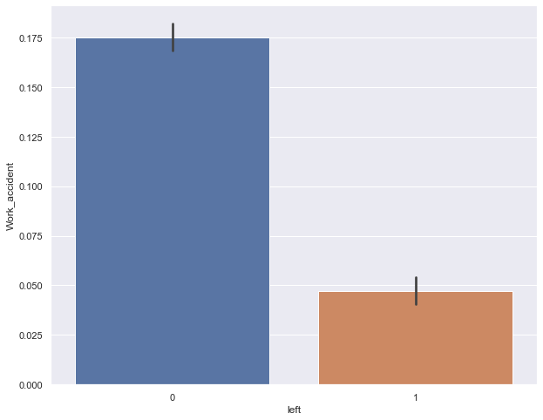
Bar Plot of Left Frequency and Left vs Work Accident
More people staying at a company than leaving
Contradicts with Correlation Matrix since more employees with Work accidents are staying instead of leaving

Slide 7
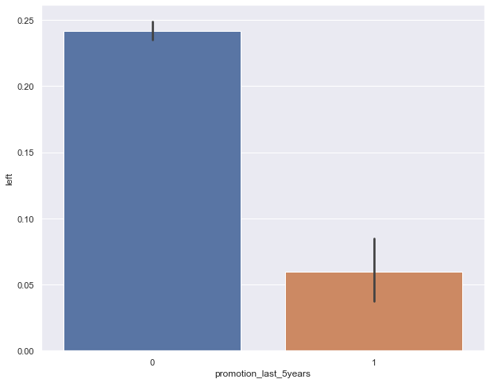
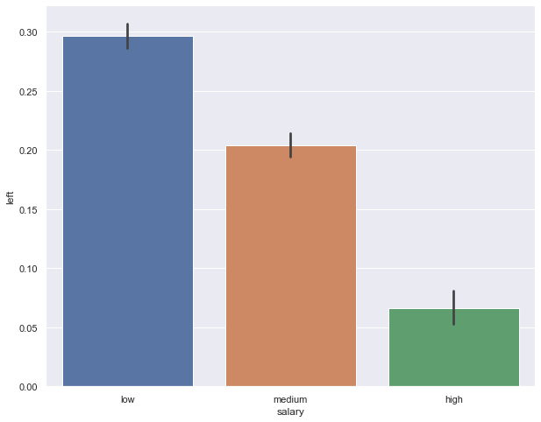
Bar Plot of Promotion in 5 Years and Salary vs Left
Employees without a promotion in last 5 years are more likely to leave
Shows salary does have an impact on leaving since employees with a low salary are likely to leave the company

Slide 8
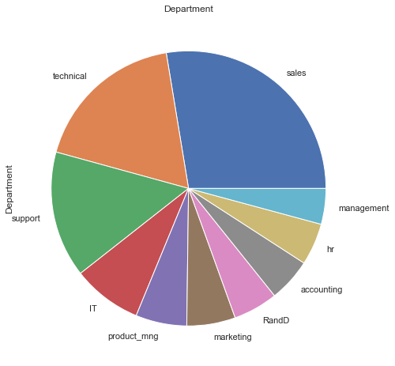
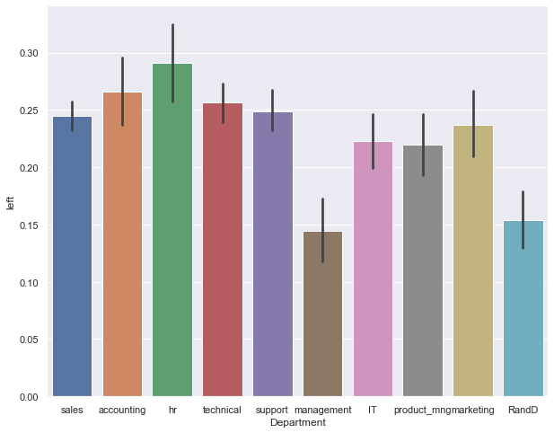
Plots of Department and Department vs Left
Biggest departments are sales, technical, and support
Highest turnover rate is in HR, Accounting, and Technical departments

Slide 9
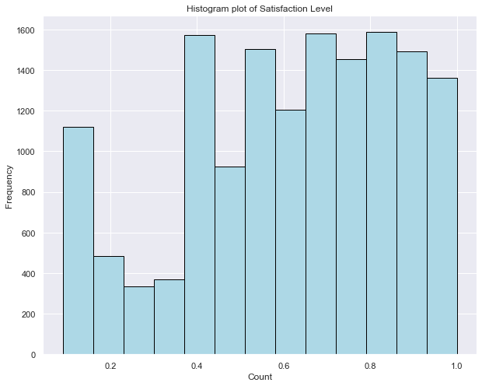
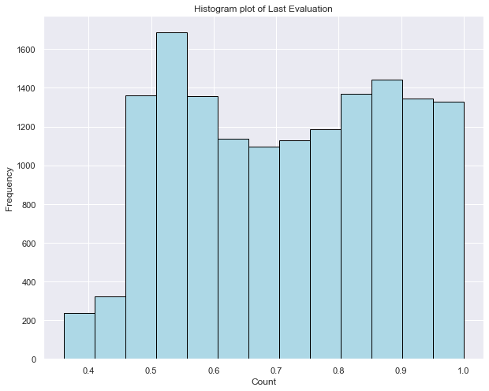
Plots of Satisfaction Level and Last Evaluation
Left skewed where most employees have good satisfaction levels
Also left skewed where last evaluations were mostly on the high end

Slide 10
Results of Exploration
Correlation matrix was correct about satisfaction levels and promotion in the last 5 years impacted if an employee left
Satisfaction levels also had a positive correlation with last evaluation showing that this correlates with an employee leaving
Found that the longer an employee is at a company, the more likely they will stay
Possibly due to higher salary
Correlation matrix was not accurate about work accidents making an employee leave a company
Possibly due to workers compensation
Employees without a promotion in the last 5 years or who have a low salary are likely to leave
HR, Accounting, and Technical departments have the highest turnover rate
Possibly due to low salary, high work hours, and stress
Most columns in the dataset had a negative correlation with an employee leaving a company

Slide 11
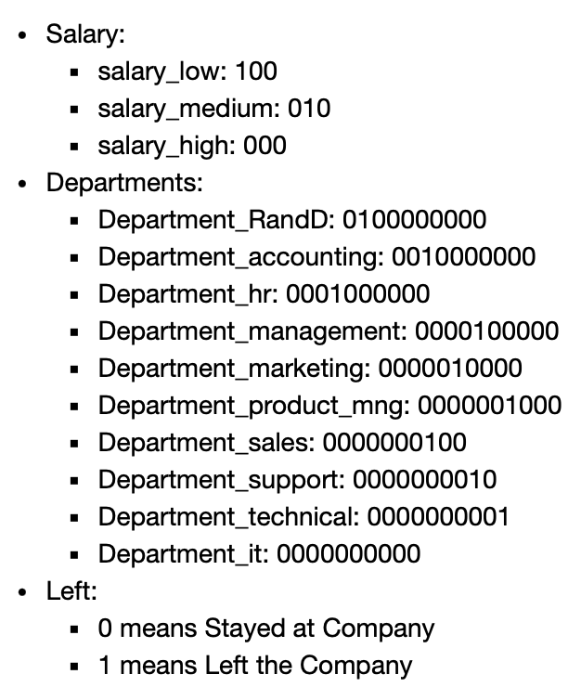
Logistic Regression
Split into x and y variables with x being independent and y being dependent (‘left’ column)
Used get dummies to handle the categorical data
Used 3 different split sizes and 2 random states:
85/15 split with random state of 42
85/15 split with random state of 20
80/20 split with random state of 42
80/20 split with random state of 20
70/30 split with random state of 42
70/30 split with random state of 20

Slide 12
Accuracy Scores, R2, MSE, and RMSE
Accuracy scores for experiments with different splits and random states:
85/15 split with random state of 42: 78%
85/15 split with random state of 20: 80%
80/20 split with random state of 42: 78%
80/20 split with random state of 20: 79%
70/30 split with random state of 42: 78%
70/30 split with random state of 20: 79%
R2 Score: -0.1279503105590063
Model is not a good fit for the dataset since it’s negative
Possibly from the line of best fit being skewed from there being more 0’s than 1’s in the dataset
MSE: 0.20177777777777778
Low score which means model is fit well and accuracy will be high
RMSE: 0.4491968140779471
Low score which means model is fit well and makes accurate predictions

Slide 13
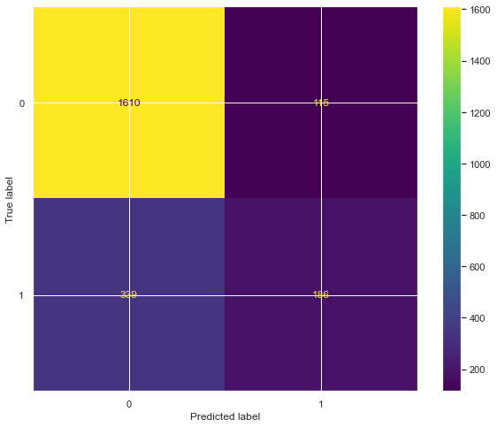
Confusion Matrix
Predicted 1,610 true negatives, 339 false negatives, 115 false positives, and 186 true positives
Did a better job of predicting 0’s than 1’s meaning the model did a better job of predicting if an employee would stay than if an employee would leave
Due to the skewed distribution of 0’s and 1’s in the dataset

Slide 14
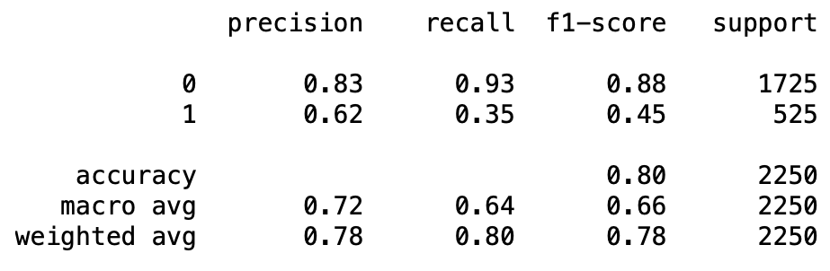
Classification Report
About 3 times as many 0’s than 1’s
Model did better at predicting 0’s than 1’s
Could have higher accuracy score to raise the average if there was a more even distribution

Slide 15
Conclusion
Employee’s satisfaction level, if they received a promotion, salary, and time spent at the company impacted if they left the company the most
All the independent variables played a role in determining if an employee would stay or leave
Most employee’s who left the company had only been there between 2 and 5 years, so they would likely not have had a promotion, and their salary and satisfaction levels would be low
Model was skewed in distribution of 0’s and 1’s
Better at predicting if an employee would stay
Good accuracy of 80%
Could improve with a better distribution of 1’s
Decent dataset to work with but might work better under a different model
Overall, a decent accuracy score with good MSE and RMSE values

