Slide 1
Social Media Assignment
By: Kadin and Morgan

Slide 2
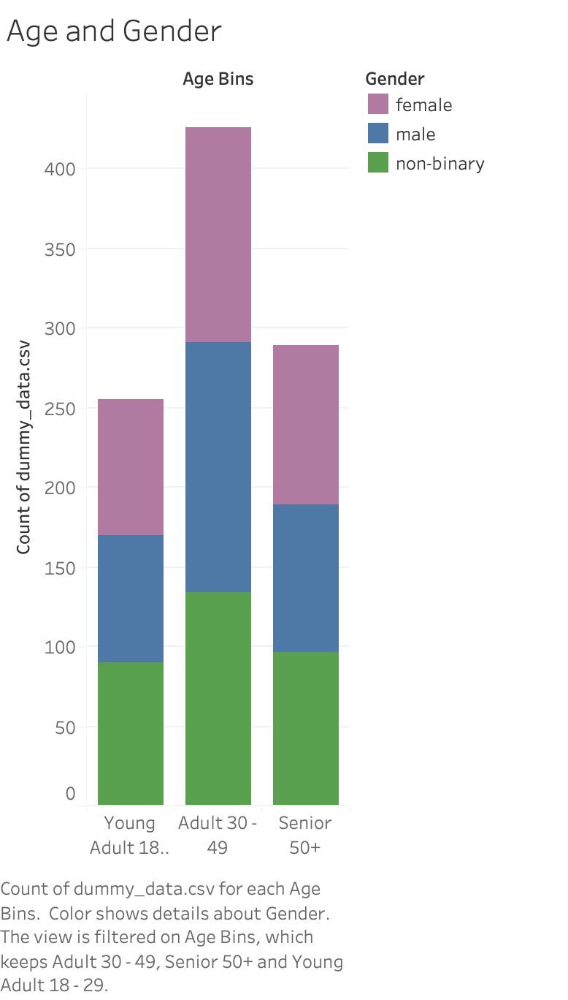
This shows the ages between 18 and 50+ who are on social media. It groups them between Young Adults being between 18 and 29, Adults being between 30 and 49, and Seniors being 50 and over.
This histogram shows that the ages 30 to 49 have the most presence on social media.
It also shows that it is nearly an even split between gender on social media between every age group.

Slide 3
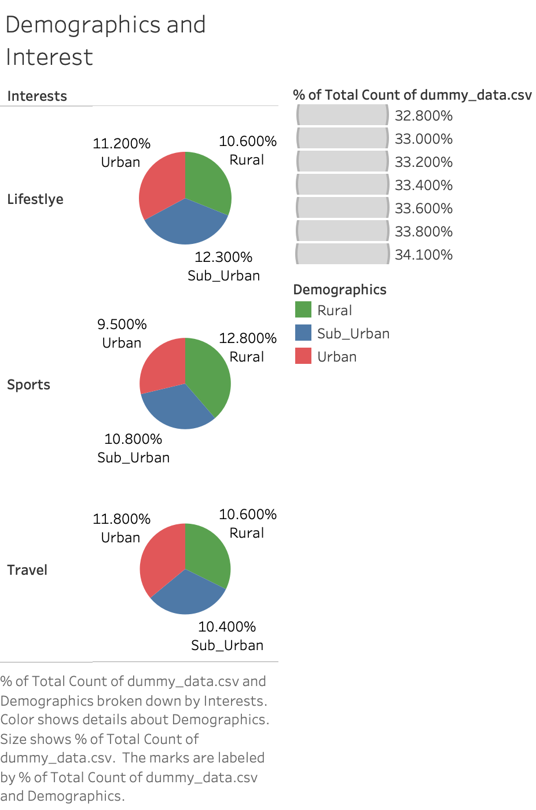
This pie chart shows the correlation between Demographics and Interests between those on social media. There are three different demographics: Urban, Rural, and Suburban. The interest are nearly evenly distributed across the board with all demographics and interests ranging between 10 and 12 percent.

Slide 4
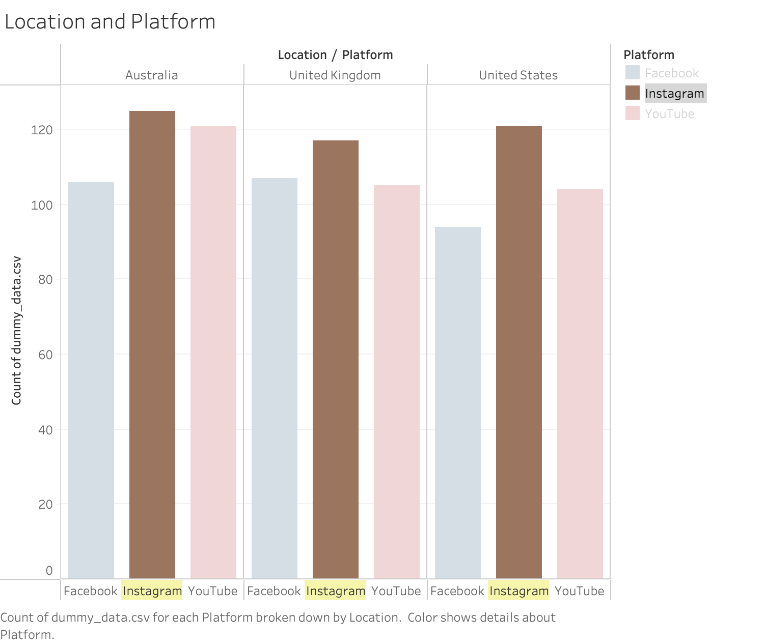
This chart shows the location based on the platform. This shows that Instagram is used more than other social media in Australia, the United Kingdom, and the United States. After that, YouTube is for the most part used more than Facebook, but it is very close.

Slide 5
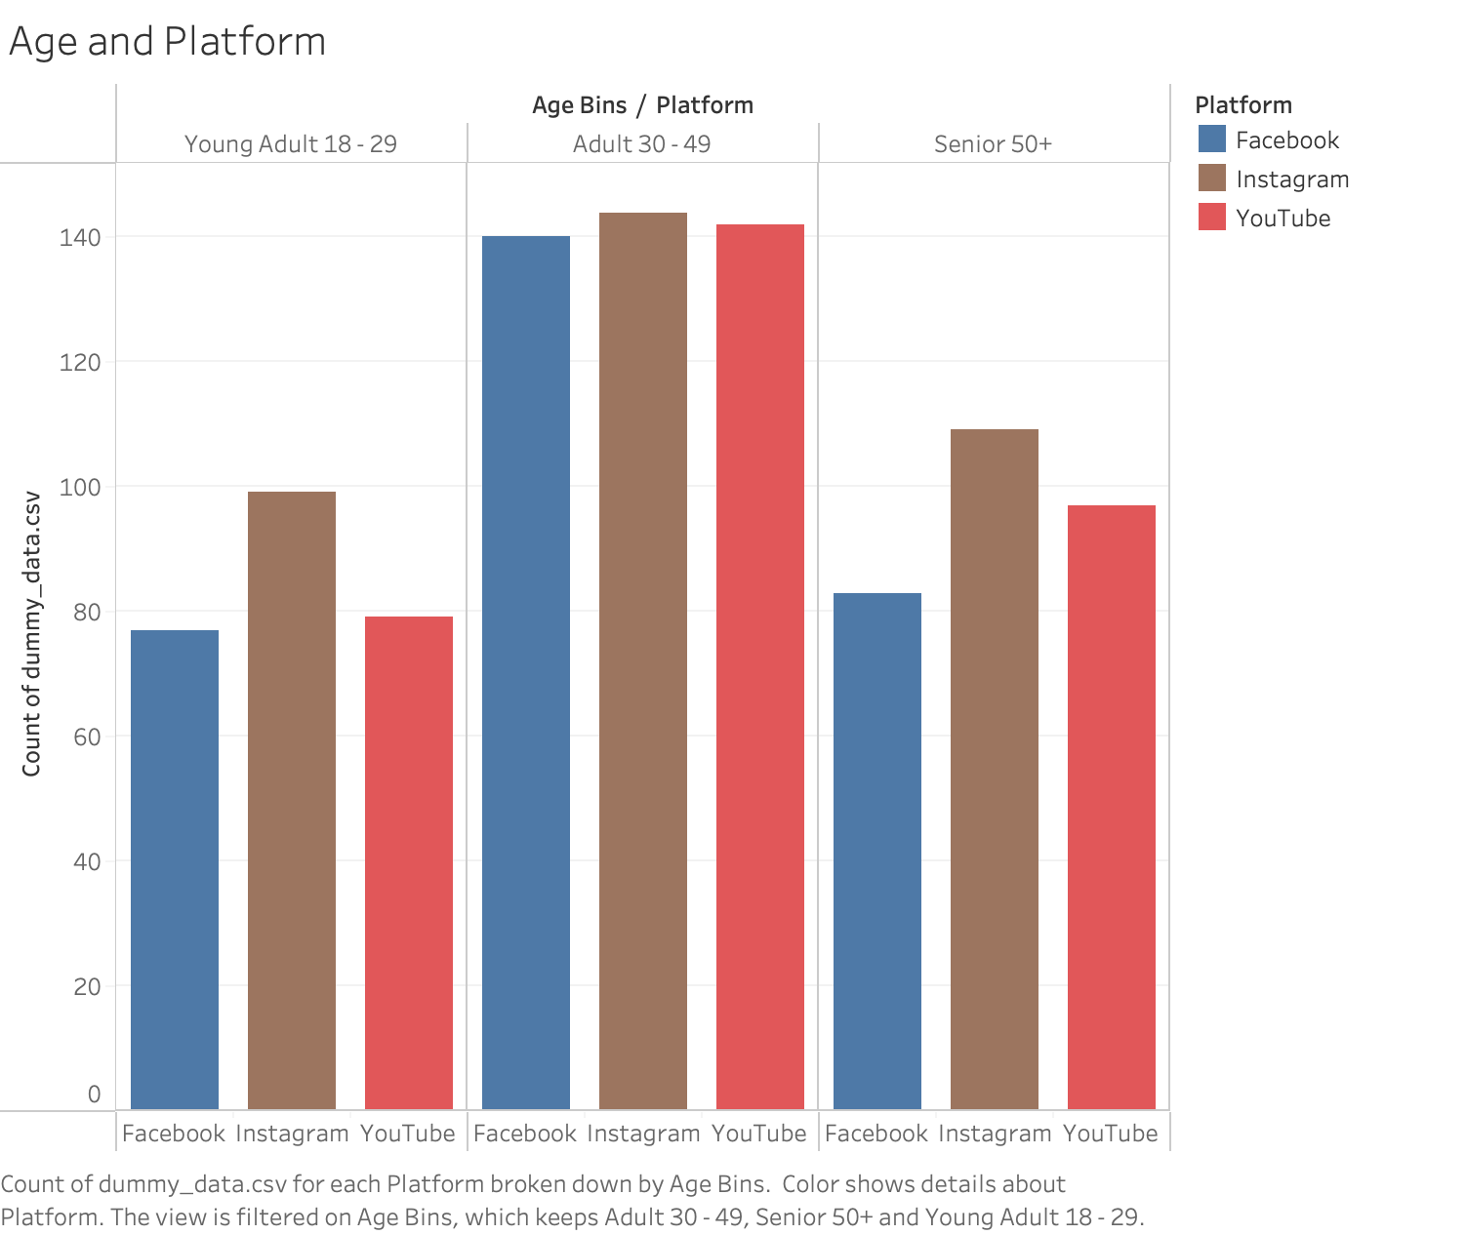
This shows Age and Platforms. We calculated bins based on a certain range for Young Adults, Adults, and Seniors. This shows that Adults use social media more than the other age ranges. They also use social media evenly, while the other ranges use Instagram more.

Slide 6
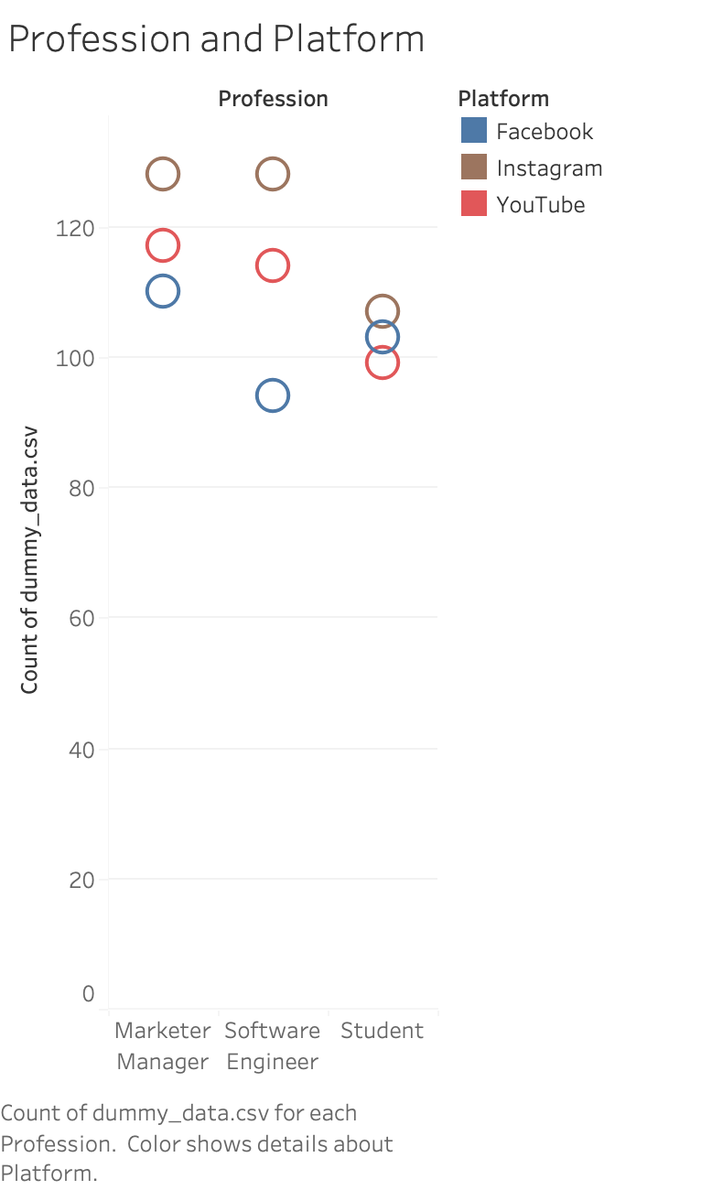
This chart shows profession vs platform. It shows that Instagram is used more by every profession while YouTube is the next most used for Marketer Managers and Software Engineers. Students use all three forms of social media almost evenly.

Slide 7
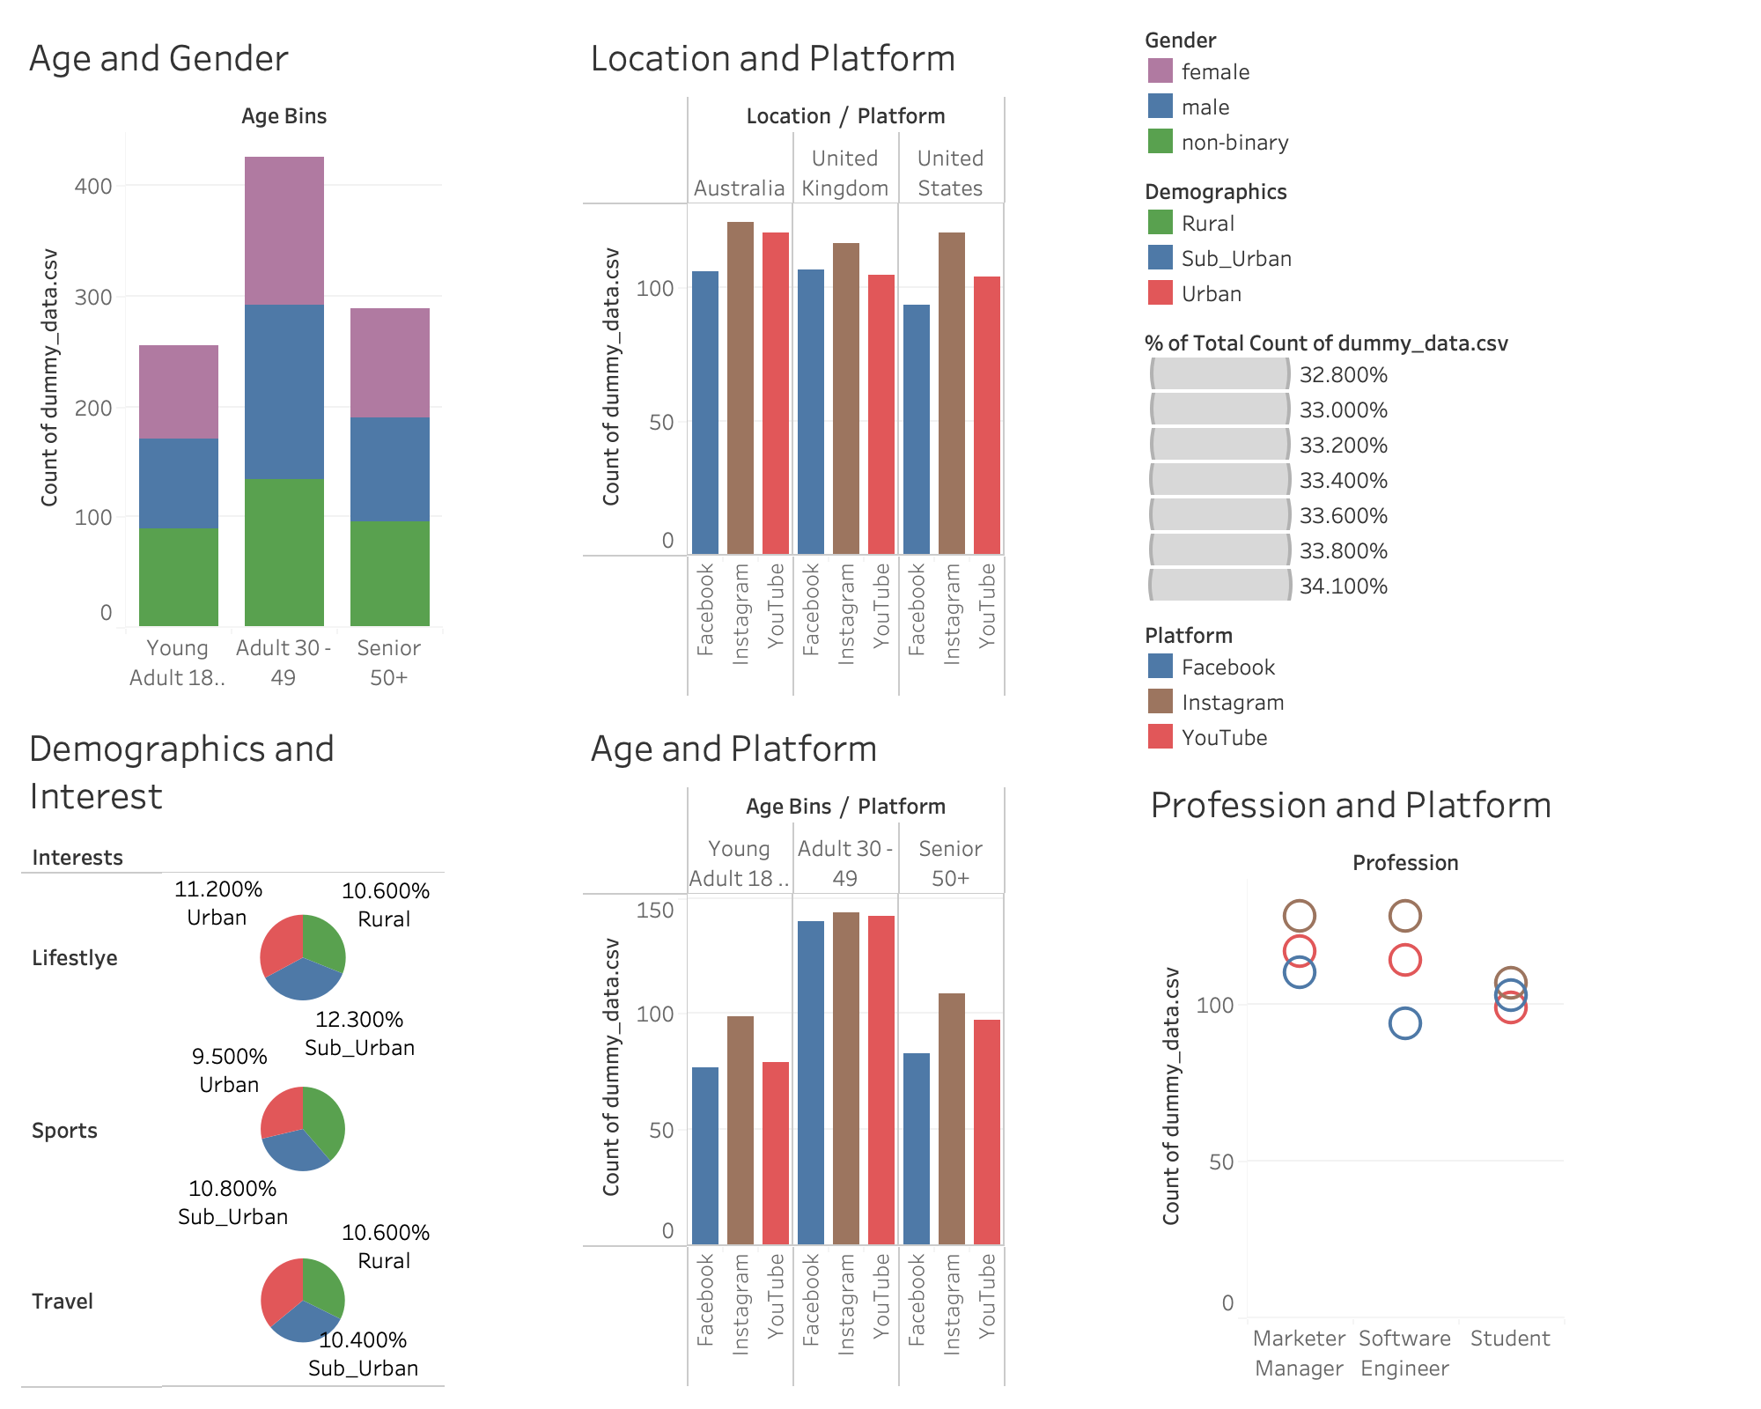
In conclusion, Instagram is the most used among every demographic, profession, and age range, no matter where they are from. The Adult age range from 30 to 49 used social media the most which was extremely surprising. Facebook was the least used among nearly all age ranges, gender, and professions which was not surprising.

