Slide 1
SmartReserve
Tyler Cambron and Morgan Hardin
Notes:
Our application is SmartReserve.

Slide 2



For High-End restaurants
Who want an easy-to-use application to schedule and cancel reservations for a specific date and time
Ability to track available tables and reservations along with the number of people in the restaurant
Calendar view that shows the day and time of open and filled reservations
Notes:
SmartReserve is an easy-to-use application for high-end restaurants. It allows users to schedule, cancel, and edit reservations for a specific date and time and number of people. It also allows the ability to track available tables and reservations, along with the occupancy in the restaurant that changes as customers get seated. SmartReserve has a calendar view for employees to easily observe reservations that are open and filled for certain days and times.

Slide 3
Product Vision Statement
FOR restaurant's employees and their customers WHO need an easy to use application that schedules and tracks reservations based on the date and time. THE SmartReserve is a restaurant reservation application THAT can schedule and cancel reservations easily, track tables to see what is reserved and what is available, and offers two different view modes based on employee or customer access. UNLIKE OpenTable, resOS, and EatApp, SmartReserve is a free and easy to use for all restaurants who want to manage their tables and reservations. OUR PRODUCT is the smart choice for restaurant reservations. Be smart and use SmartReserve.
Notes:
Our product vision statement is: **READ Product Vision Statement**

Slide 4
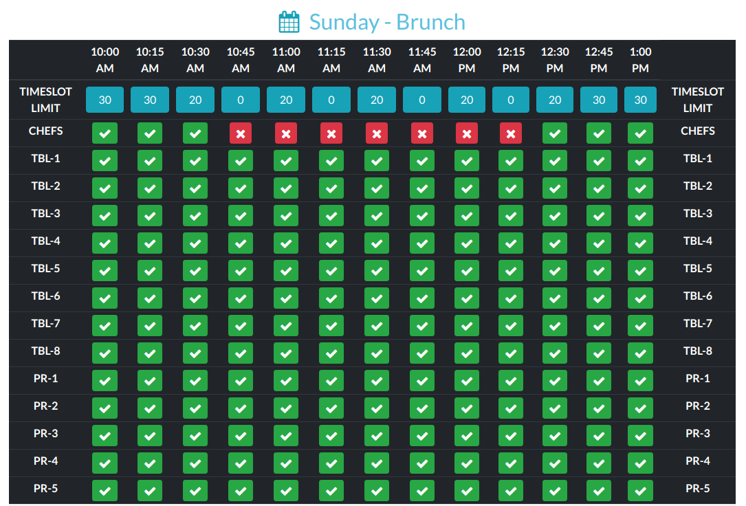
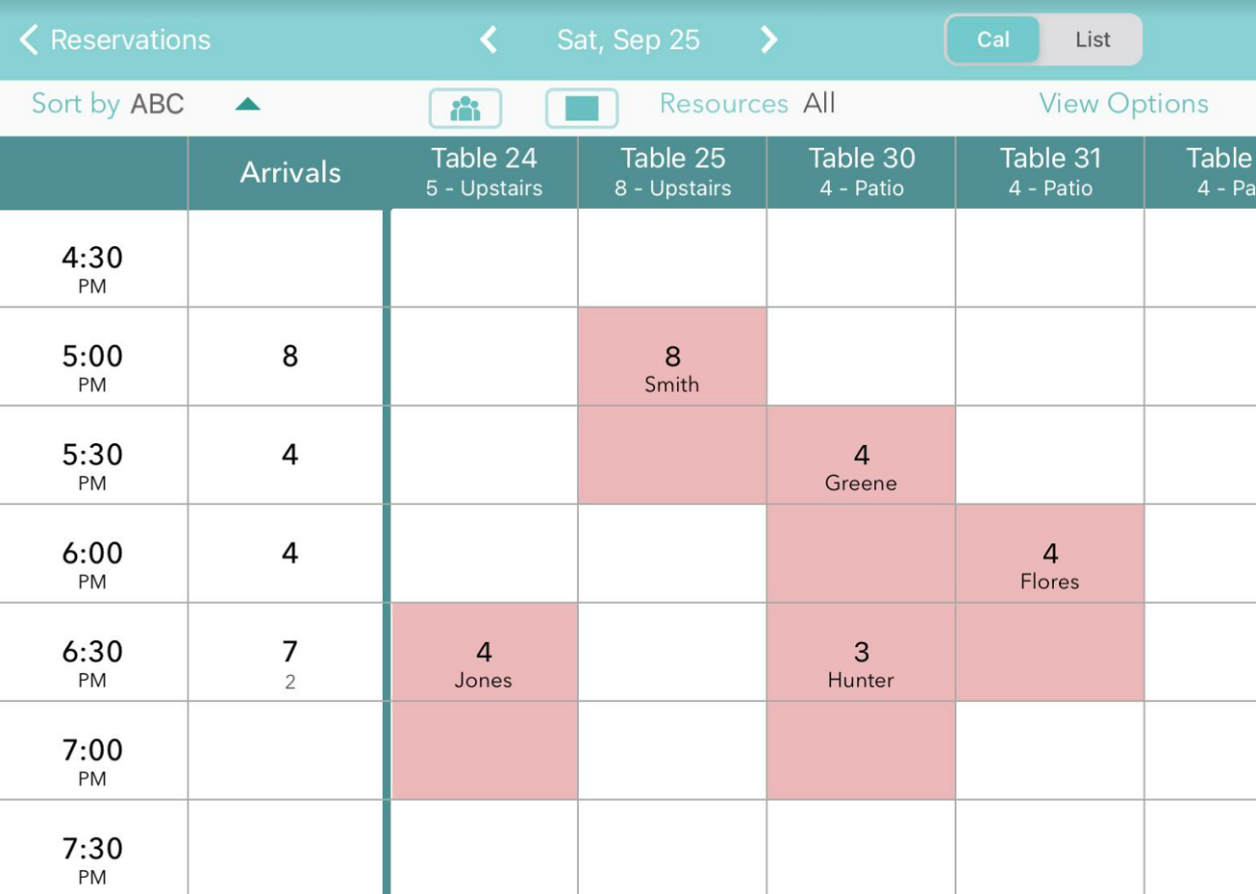
Why Customers Should Buy SmartReserve
CLOSE THE GAP
Makes consumer lives easier and is more cost-efficient than leading competitors
TARGET AUDIENCE
High-end restaurants as well as their customers
EASY TO USE
Simple design that allows customers to schedule, cancel, and track reservations within a restaurant
Notes:
Customers should buy our product because it makes their lives easier and is free, unlike our competition. It is for high-end restaurants along with their customers to track reservations for certain days, times, and parties. The images on the right show a similar user interface to SmartReserve. It will have the number of tables, either marked filled or empty, the date and times, and reservations booked for a specific number of people. Our interface is simple to learn, use, and view for all customers in need of a reservation application.

Slide 5
SmartReserve Modes
Offers 2 Modes
Employee Mode
More access with the ability to see up-to-date table seating, all reservations for any day or time through the calendar, and the ability to keep track of what tables are available
Customer Mode
Custom view with the ability to see reservations for a specific day and time with the ability to edit future reservations
Both Modes
Ability to schedule and cancel reservations for any date or time
Notes:
SmartReserve offers two services modes: employee and customer. The employee mode requires authorized access but allows the employees in the restaurant to see table seating, occupancy, reservations, the calendar, and specific date and time availabilities. The customer mode is for any customer to use and only offers the ability to schedule, cancel, and edit reservations for a specific number of people for a party.

Slide 6
Our competition
Convenient
SmartReserve
EatApp
Affordable
Expensive
OpenTable
Yelp Guest Manager
resOS
Resy
Inconvenient
Notes:
There is a lot of competition in the restaurant reservation field. Many of these applications come at a high price, either a high dollar fee each month or a difficult interface that is not easy-to-use. The graph above shows our competitors plotted based on their convenience and cost. Out of all the leading competitors in the field, SmartReserve is the most cost-efficient and convenient option for customers.

