Slide 1

XGBoost
Morgan Hardin
Grant Pennington

Slide 2

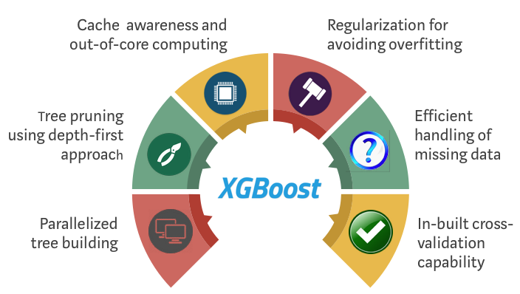
XGBoost
XGBoost stands for Extreme Gradient Boosting
It uses Gradient Boosted decision trees
Decision trees are created in sequential form
Weights are assigned to all the independent variables which are then fed into the decision tree which predicts results

Slide 3
Definition of XGBoost
XGBoost stands for Extreme Gradient Boosting and is a mix of multiple types of techniques to find the highest accuracy score
There are a few topics included in understanding XGBoost
Decision Tree
Bagging
Random Forest
Boosting
Gradient Boosting
Notes:
Mostly Decision Tree and Random Forest are used, but the other
These are notes for later haha… fit_transform(X_test, y_test)
What is the probability of that? I don’t know only chegg gods knows
Linear Algebra

Slide 4

Applications of XGBoost
Can be used for both classification and regression
Classification to classify data into groups:
If an email is spam or not
If a person’s credit risk is high or low
Regression to predict numerical data:
Housing prices
Salaries

Slide 5
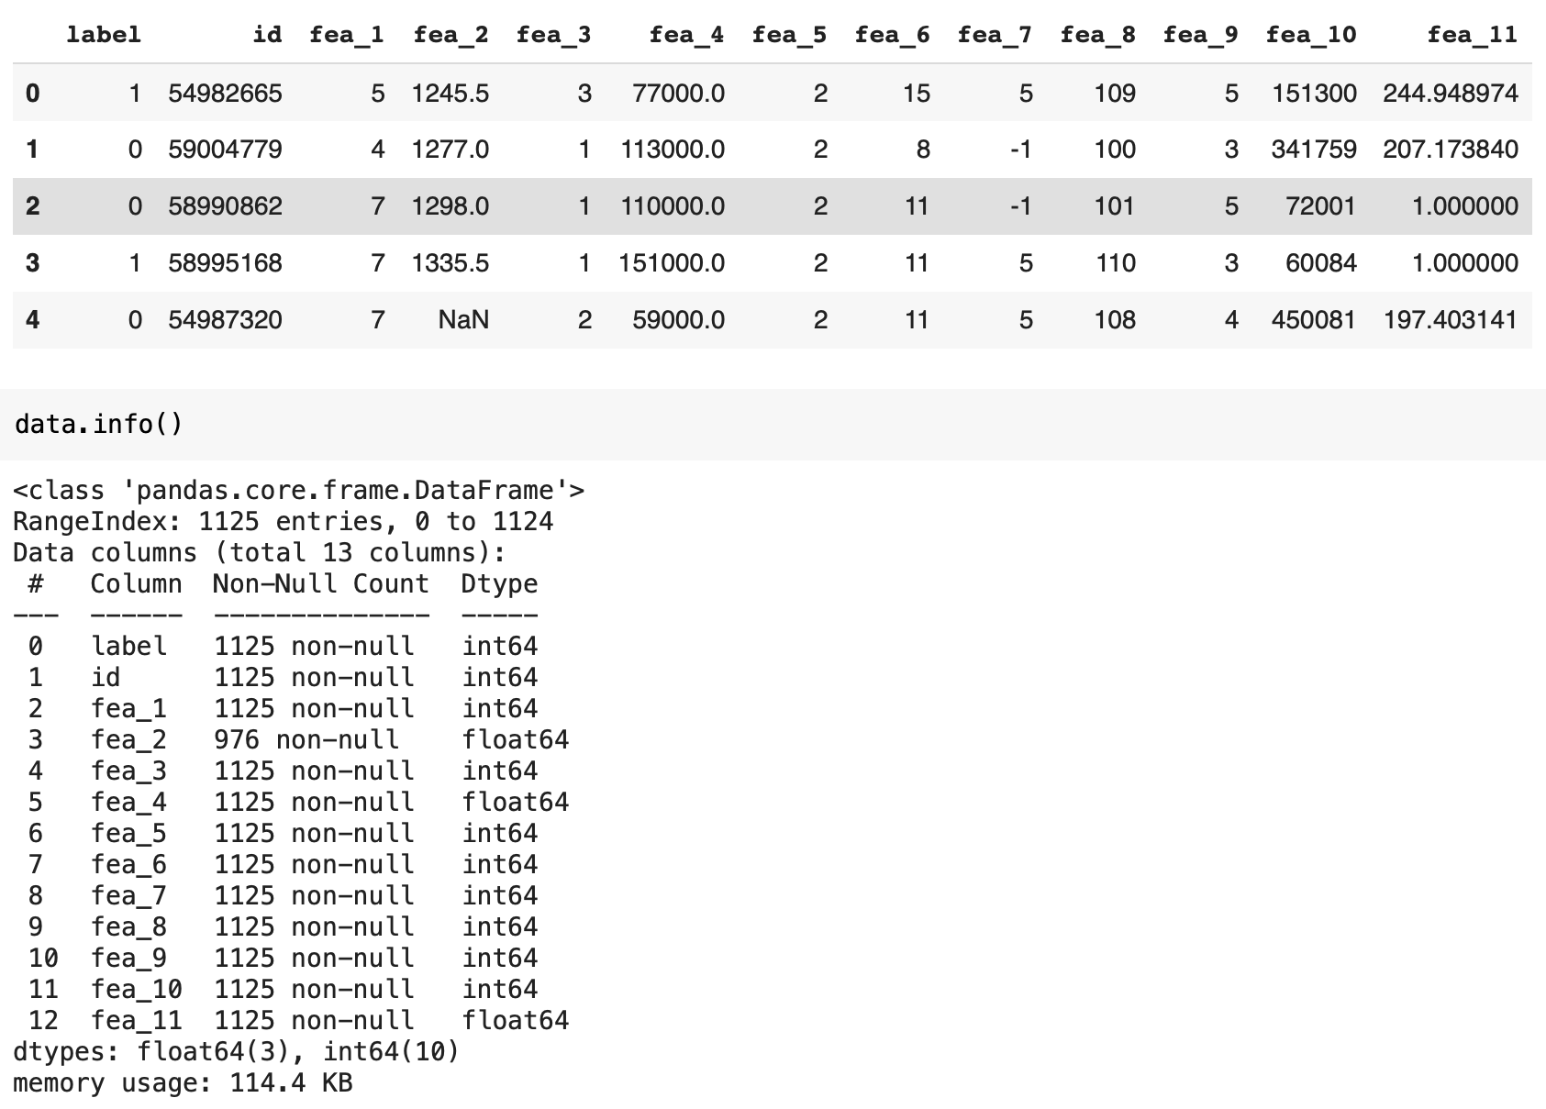
Example using XGBoost Classifier
We used a customer data set from Kaggle.com
We did the preprocessing to impute missing values for ‘fea_2’
Target column is label
If the outcome is 1, they have a high credit risk
If the outcome is 0, they have a low credit risk
Notes:
Nobody knows >:((((

Slide 6
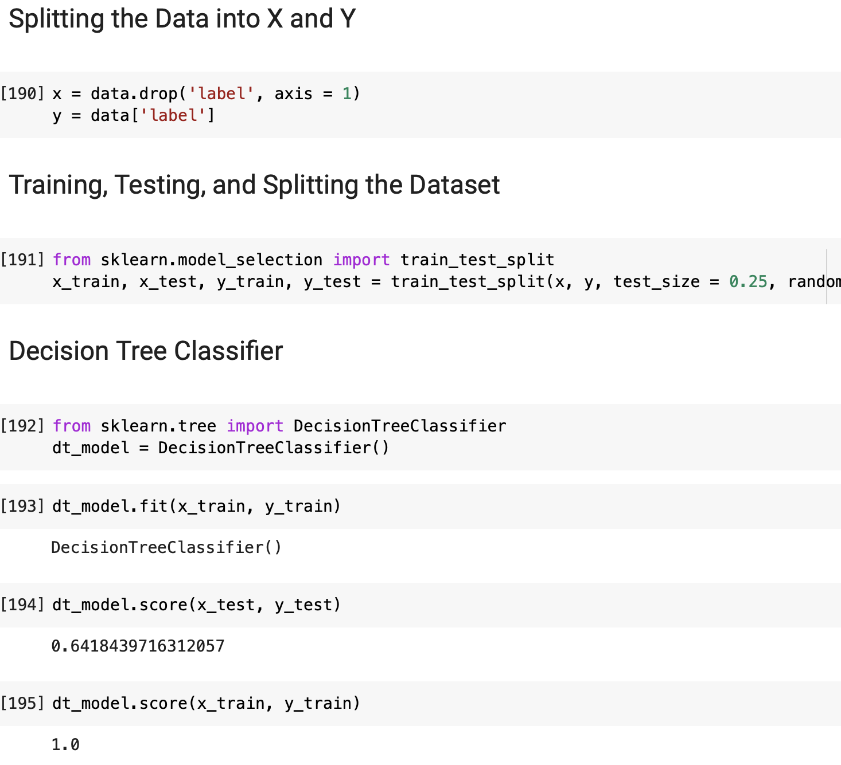
Example using XGBoost Classifier
Used drop method to split data into independent and dependent variables based on outcome
Found best split is 75 / 25
Used Decision Tree Classifier as a base to determine how well XGBoost performed
Found that Decision Tree Classifier is overfitted with a testing accuracy score of 64% and a training accuracy score of 100%

Slide 7
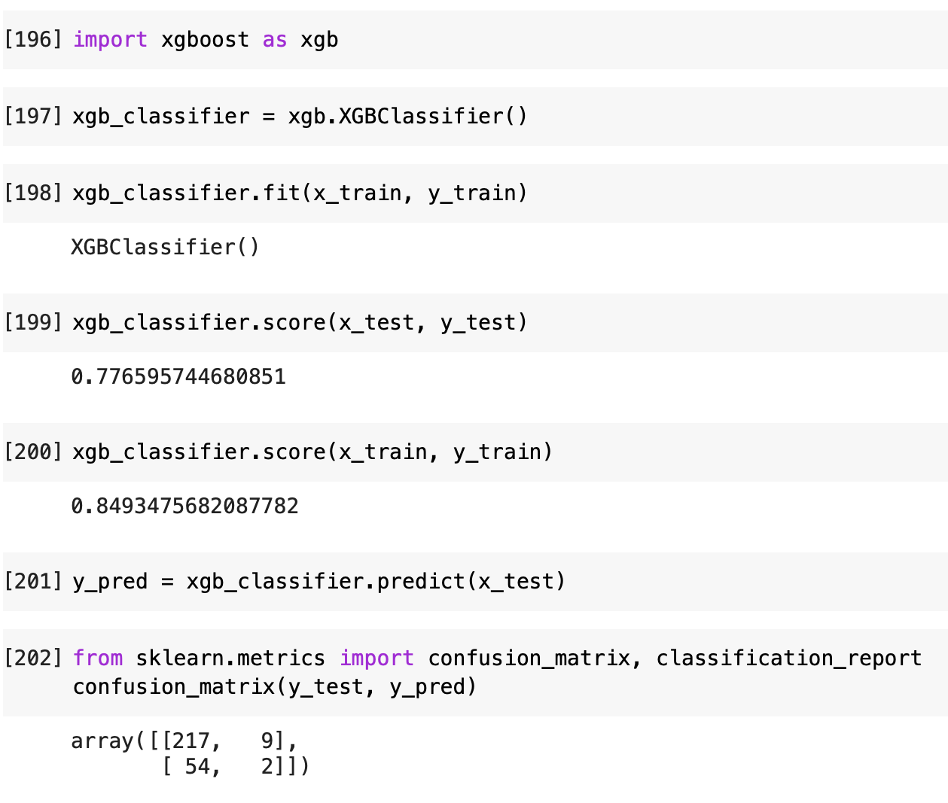
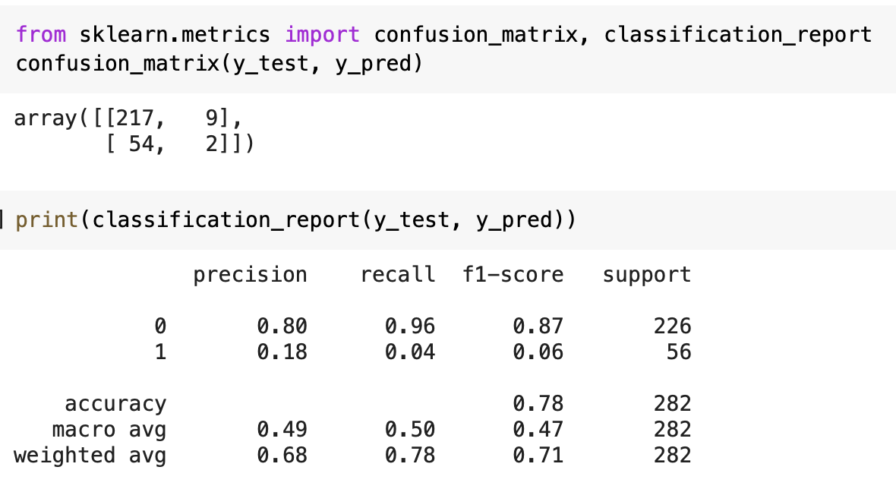
Example using XGBoost Classifier
Import XGBoost–not from sklearn–has its own library
Found that it was not as overfitted and the test scores were better
Test Score: 78%
Training Score: 85%
Better results than Decision Tree since it has a more accurate score, and it is not as overfitted
Confusion matrix and classification report show that this model does a better job of predicting 0, or low credit risk, than 1, or high credit risk
The dataset is not great since the dependent variable has an uneven distribution between the 0’s and 1’s

