Slide 1
How To Hack The Government
Just Kidding. Seriously

Slide 2
I’m a badass

Slide 3
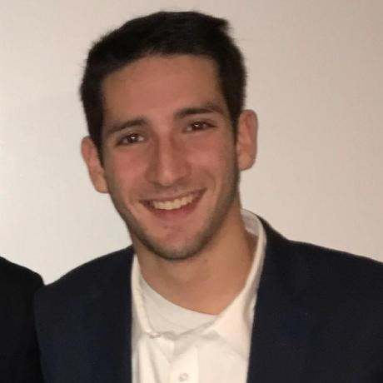
A little about me…..
Current Undergraduate student at Michigan State University
Studying Computer Science with a cognate in Astrophysics.
Areas of interest include:
Cyber Security
Artificial Intelligence
Machine Learning
Astrophysics
Simulation Technologies

Slide 4
What is “Hacking”
Many definitions…..
Hackathons
CTFs
In general:
A computer hacker is any skilled computer expert that uses their technical knowledge to overcome a problem
“Hacker mentality”: Make things do stuff that its not designed or intended to do

Slide 5
Ethics of Hacking and Disclaimer
Disclaimer:
All the information provided today is for educational purposes only. Sp4rtans and Spartan Hackers are in no way responsible for any misuse of the information. “Sp4rtans” and “Spartan Hackers” are clubs related to Computer Security and not a site that promotes hacking / cracking / software piracy.
This discord is totally meant for providing information on “Computer Security”, “Computer Programming” and other related topics and is no way related towards the terms “CRACKING” or “HACKING” (Unethical).
All the information provided today is for developing Hacker Defense attitude to help prevent the hack attacks discussed. Sp4rtans and Spartan Hackers insists that this information shall not be used for causing any kind of damage directly or indirectly. However you may try these codes on your own computer at your own risk.

Slide 6
What is CTF
CTFs are events that are usually hosted at information security conferences (E.g DEFCON, BSides). These events consist of a series of challenges that vary in their degree of difficulty, and that require participants to exercise different skillsets to solve. Once an individual challenge is solved, a “flag” is given to the player and they submit this flag to the CTF server to earn points. Players can be lone wolves who attempt the various challenges by themselves, or they can work with others to attempt to score the highest number of points as a team.
CTF events are usually timed, and the points are totaled once the time has expired. The winning player / team will be the one that solved the most challenges and thus secured the highest score.

Slide 7
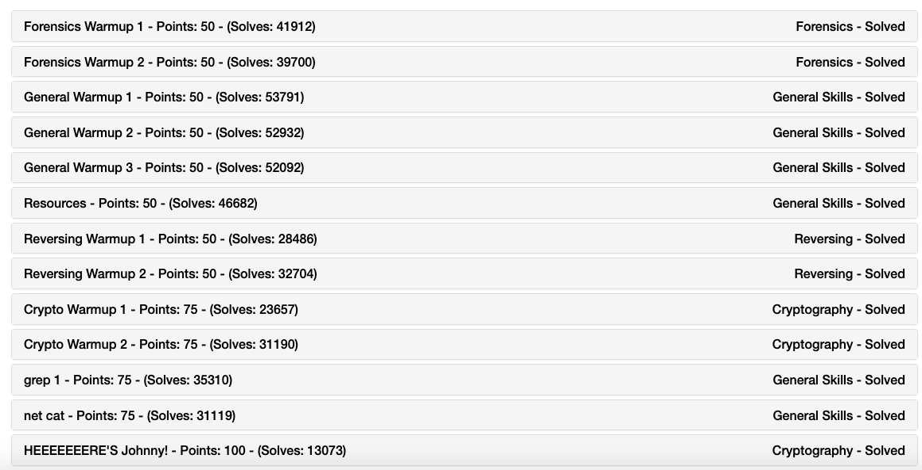
CTF Game Example
PicoCTF - CTF aimed at beginners and intermediate players. www.picoctf.org

Slide 8
What is Binary Exploitation
Binary exploitation is the process of subverting a compiled application such that it violates some trust boundary in a way that is advantageous to you, the attacker. Today, we are going to focus on memory corruption

Slide 9
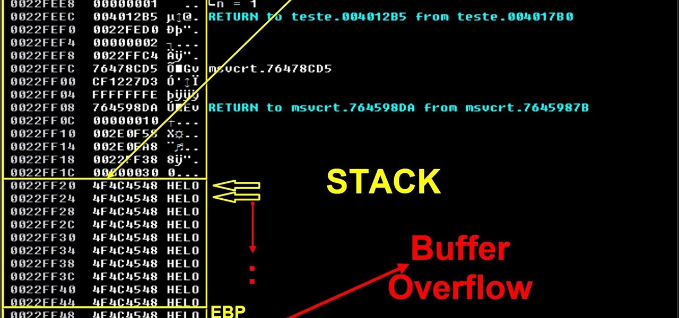
Theoreticals of how buffer overflow works
In information security and programming, a buffer overflow, or buffer overrun, is an anomaly where a program, while writing data to a buffer, overruns the buffer's boundary and overwrites adjacent memory locations
Overwrite memory locations and instructions crucial to regular operation of the program

Slide 10
Cool. I’ll draw some pictures
How do we use this…..
Code injection at that spot in memory. AKA run my malicious programs on their computer while their computer still thinks their own program is running
Defense: Use “defensive programming”. Methods designed to prevent buffer overflow. Not 100% preventable though, issue in computing itself (fgets instead of gets, strncmp instead of strcmp)

Slide 11
Demo
Hopefully it actually works live
Materials Available on github.com

Slide 12
YoU caNt sEe my FilEs
Windows computer has an NTFS file system installed on a hard drive with its own rules and security procedures
Linux booted flash drive with its EXT4 file system doesn’t recognize those Windows NTFS file system rules. Files are raw and viewable. Even if there is a password on the Windows computer
Defense: Encrypt hard drive when computer turns off (Software to do this: GRUB hard drive encryption. LVM on LUKS)

Slide 13
Shameless plug about Sp4rtans CTF
If you are interested in learning more or just getting involved in the Computer Security community here at MSU. Open to all skill levels we have a Discord server where you can connect with other like-minded hacker individuals, ask questions, and compete in our CTF games. We are still a fairly new organization and are currently in the search for Eboard members (Applications will be sent over discord soon)
Discord: https://discord.gg/ePrpDBb

Slide 14
Questions
Concerns
Comments

