Slide 1
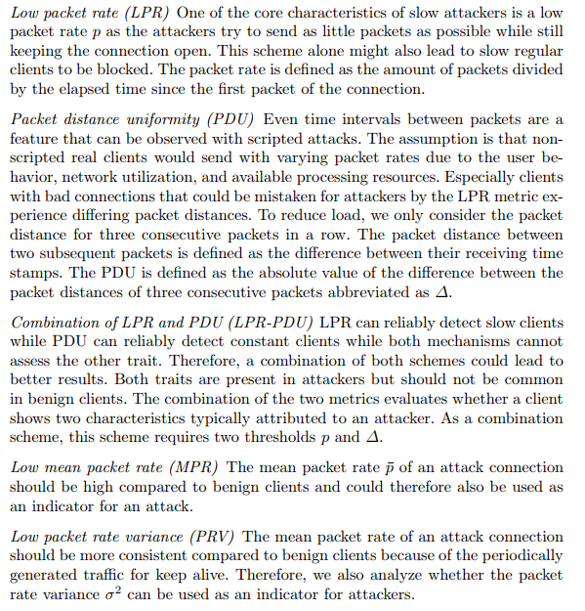

Slide 2
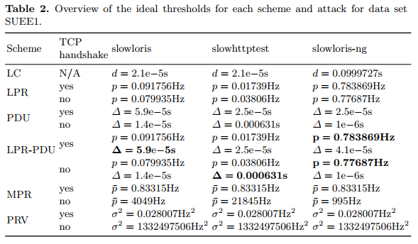
Specific thresholds for their data set

Slide 3
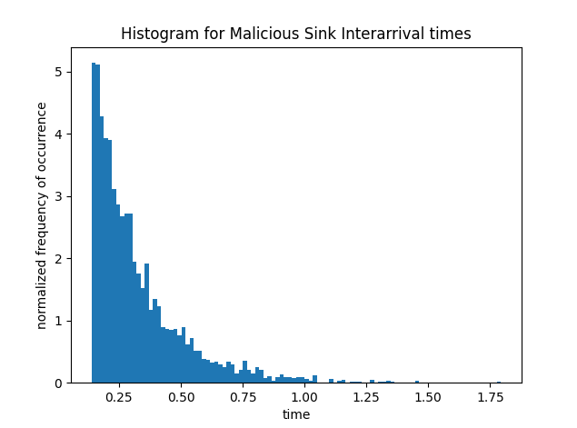
I can generate a dataset but

Slide 4
How it works
Sends normal or malicious traffic based on a table of whether a bus is being attacked or not
Generator
Sink
Generator
Sink
Generator
Sink
Generator
Sink
Generator
Sink
Packets

Slide 5
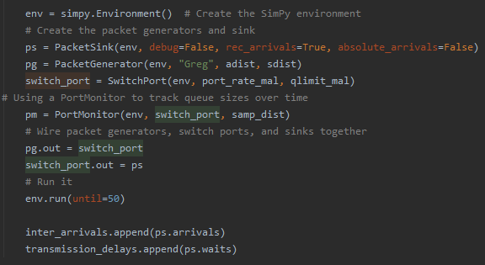
Problem
Problem comes from packet/sink generation.
We can control the rate at which we transmit but this does not control the interarrival time.
Trying to find way to control IAT.

