Slide 1
Before
Random generation
Choose 5 random nodes
1 - 118

Slide 2
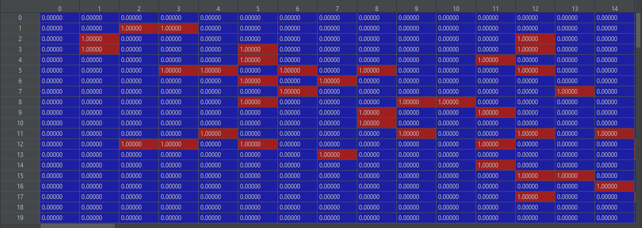
Adjacency

Slide 3
Choose a node to attack at random ->

Slide 4
Identify adjacent nodes

Slide 5
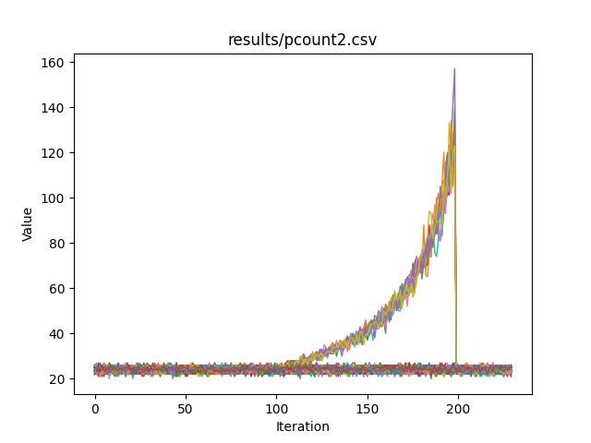
Attack node and adjacent at once

