Slide 1

Detection uses blockchain for distributed ddos detection
Mitigation is simple:
Detect DDoS attack coming into switch using their detection method
Packet arrives at switch, if flow rule already exists it will move it as required by flow
If it doesn’t exist, check to see if controller thinks it’s a ddos attack
If the controller thinks it is a ddos, throw away packet and blacklist host
https://www.researchgate.net/profile/Zohaib-Khan-12/publication/331790536_Detection_and_Prevention_of_DDoS_attacks_on_Software_Defined_Networks_Controllers_for_Smart_Grid/links/5c8cbafea6fdcc381756dde3/Detection-and-Prevention-of-DDoS-attacks-on-Software-Defined-Networks-Controllers-for-Smart-Grid.pdf

Slide 2
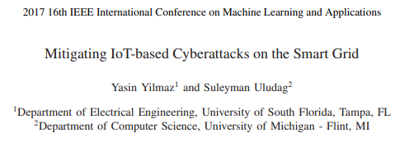
Not SDN-based
Mitigation is done in three steps:
Detection
Control gathers data and detects anomalies
Isolation
Identify the attackers, and isolate the attacked node and attackers
Localization
Detailed investigation to localize the attack places by comparing data with normal data
Data from attacked places is ignored until attack is done

Slide 3
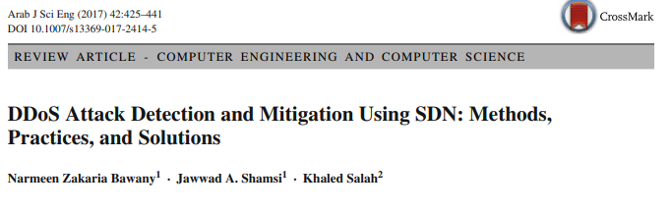
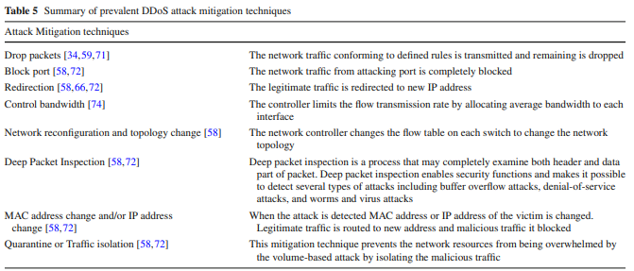

Slide 4
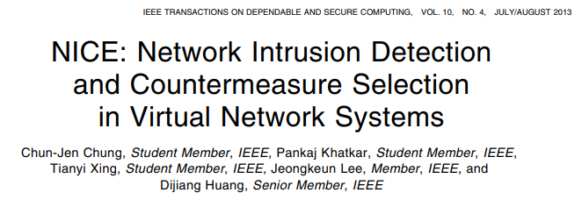
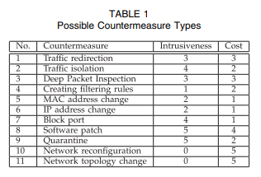
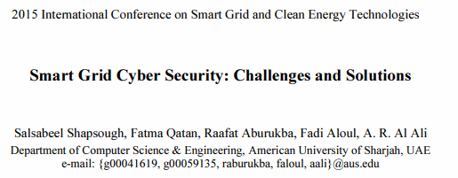
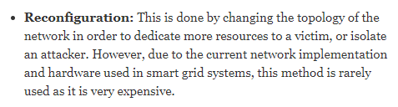
Not specific to smart grid
Actually determines strategy to use in response to attack
Cost analysis of what countermeasure to use
Includes countermeasures of network reconfiguration/topology change
Graph based reconstruction around target
However:

Slide 5
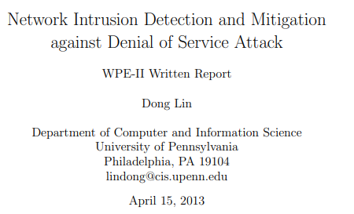
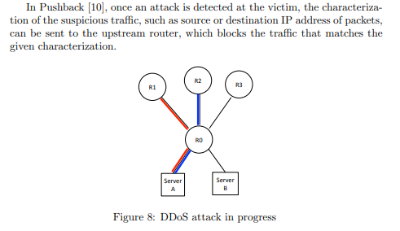
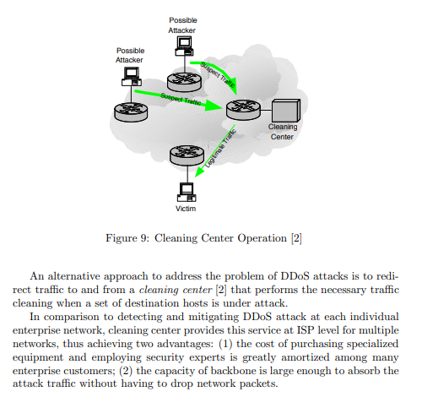
Describes types of mitigations for DDoS:
Pushback
Cleaning center

Slide 6
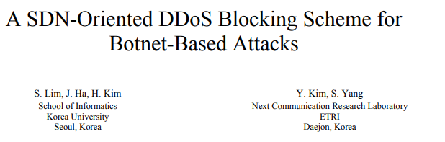
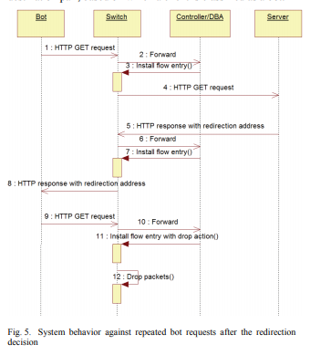
Not Smart-grid specific
Detection assumes botnet attacks with no ip masking
Mitigation uses standard OpenFlow API, no external software
Detect a DDoS incoming
Controller will install a flow entry into switch to forward packets to a ‘fake’ entry
Fake entry then drops the packets
Botnet still thinks server is receiving packets, tricks attackers
https://ieeexplore.ieee.org/document/6876752

