Slide 1
Ramp Ddos Attacks
Morgan

Slide 2
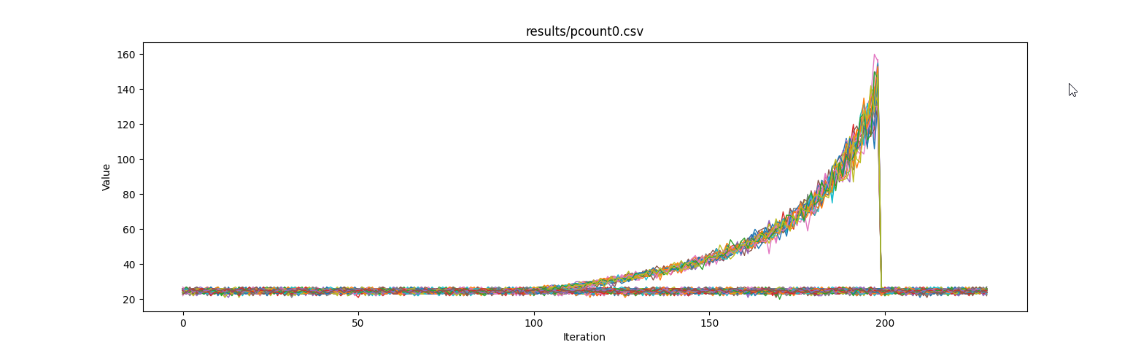
Ramping

Slide 3
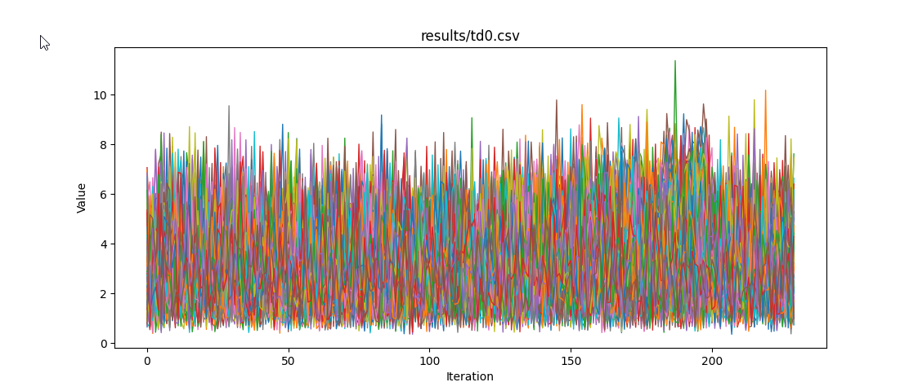
Transmission delays

Slide 4
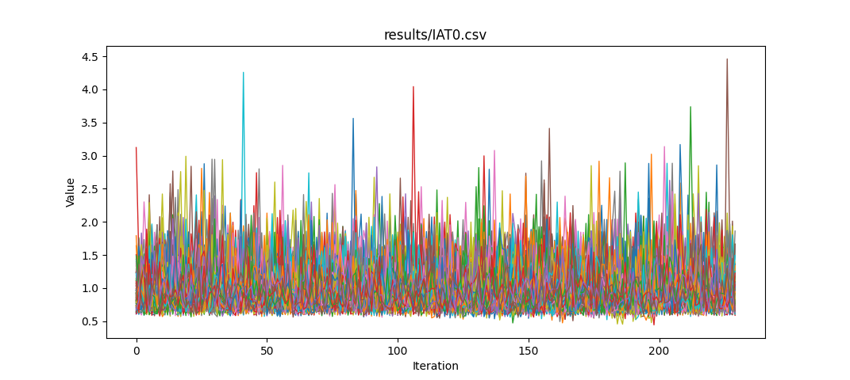
Interarrival times

Slide 5
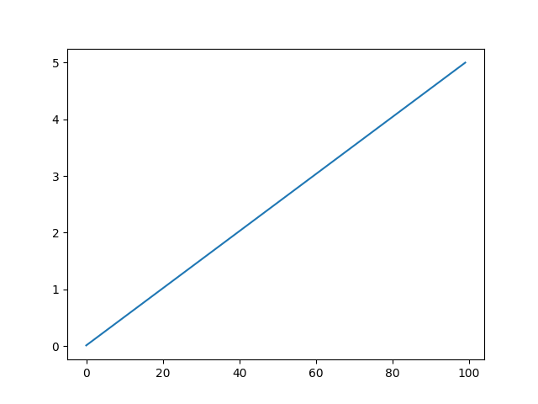
Trying to get a linear ramp still
Current ramping was supposed to be linear, was based off of linear functions, ended up exponential
Perhaps a lower linear ramping will give more linear values

