Slide 1
Slow DDoS

Slide 2
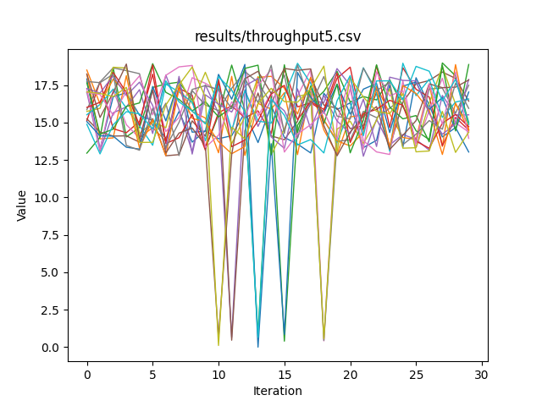
Throughput
Might need to scale back the massive fall in throughput, as slow ddos would have less impact.

Slide 3
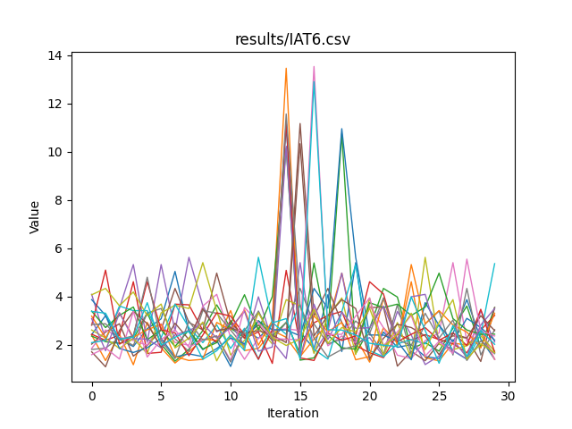
Interarrival times
Increased interarrival times.
Working on increasing how long the nodes are attacked so we see less spikes

Slide 4
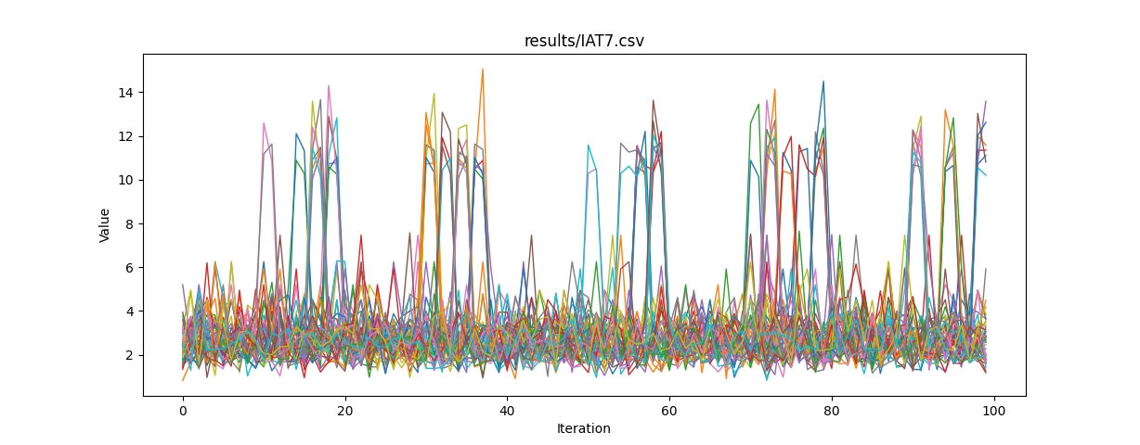
Increased length of attacks Interarrival time

Slide 5
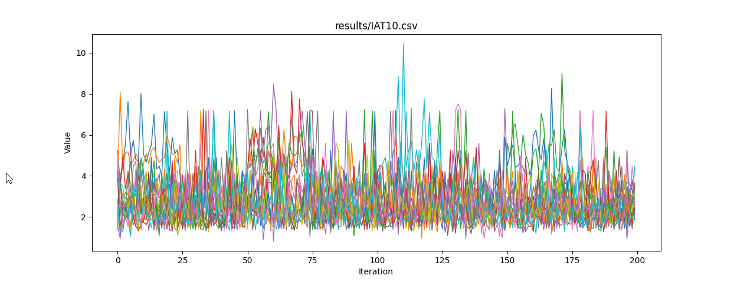
Increased length Getting better

Slide 6
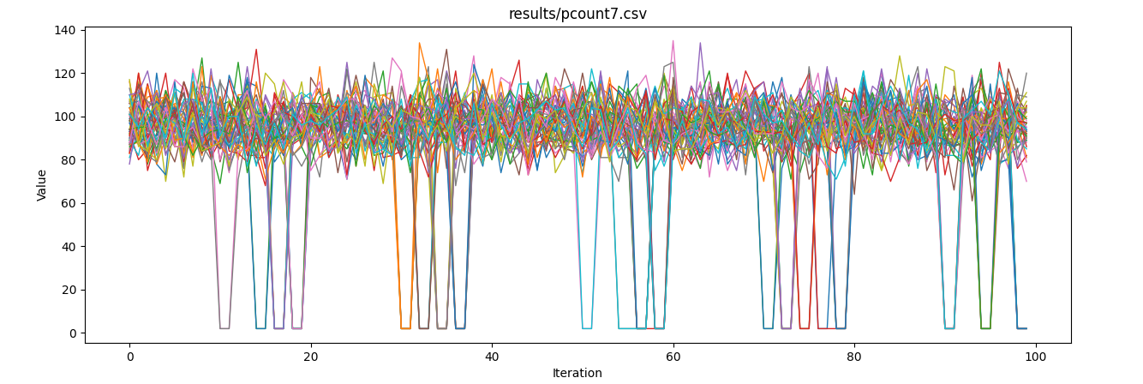
Packet Counts Significantly decreased

Slide 7
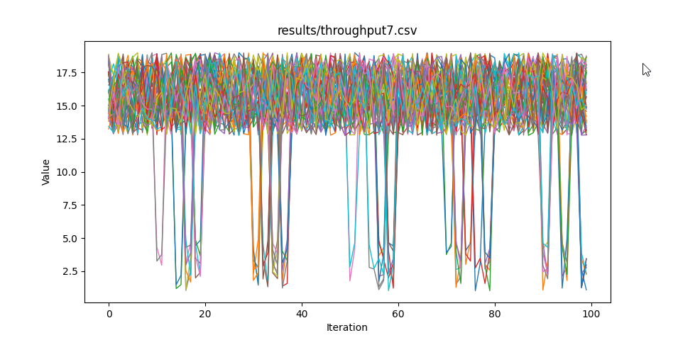
Adjusted Throughput

