Slide 1
JAVAFx
David rutsch and morgan mccollum

Slide 2
Javafx
… a cross platform GUI toolkit for Java
Based off of JavaFX Script, previous called F3 for “Form Follows Function”
Available on the leading desktop operating systems (Windows, Linux, and Mac OS X)
JavaFX Mobile is capable of running on multiple mobile operating systems
including iOS, Android, Windows Mobile, and Raspberry Pi
Solves one of the biggest issues found in other UI toolkits: threading
Other UI toolkits use a single event dispatcher thread
JavaFX uses 3 threads for event dispatching, drawing, and media
Uses a scene graph to code more "what do you want to do" rather than "how do you want to do it“
Has modern HTML5 compliant web rendering engine built right in
Full 3D support out of the box with pipelines for DirectX/OpenGL - in a totally cross-platform way
Successor to Swing
https://blogs.oracle.com/jfxprg/entry/netbeans_support_for_javafx_for

Slide 3
Javafx
Is JavaFX replacing Swing as the new client UI library for Java SE?
“Yes. However, Swing will remain part of the Java SE specification for the foreseeable future, and therefore included in the JRE. While we recommend developers to leverage JavaFX APIs as much as possible when building new applications, it is possible to extend a Swing application with JavaFX, allowing for a smoother transition.”
http://www.oracle.com/technetwork/java/javafx/overview/faq-1446554.html#6

Slide 4
Advantages / Disadvantages of Swing
Stable
Well supported across Java platforms
Lots of example code to learn from
Larger amount of third party components and libraries
Backward compatible
No longer supported
No new features
Clunky API

Slide 5
ENHANCEMENTS
HTML Content
with web view and full browsing functionality
Animations and Multitouch
schedules animation frames explicitly, rather than having an independent, choppy timer for each one
CSS and Photoshop Support
applies a style to every matching component with a single directive
applies multiple CSS stylesheets at once (similar to Swing's MultiLookAndFeel)
Scene Builder
controls (buttons, labels, check boxes) and graphics primitives (lines, polygons, text) coexist in a single tree
each node can have transforms (scaling, rotation) applied to it that affect all descendants
FXML
a single, standard format that all GUI design tools are expected to understand
able to switch to a different one without having to reconstruct GUI from scratch
http://www.oracle.com/technetwork/articles/java/casa-1919152.html

Slide 6
Tutorial Overview
Required software to use JavaFX
IDE: NetBeans, Eclipse, or IntelliJ
JavaFX Scene Builder
Completed version of FXML layout
JavaFX Scene Builder Interface
CSS Style Sheets

Slide 7
A JavaFX program is made up of:
FXML file (based on XML markup language)
CSS style sheet
Controller class using Java

Slide 8
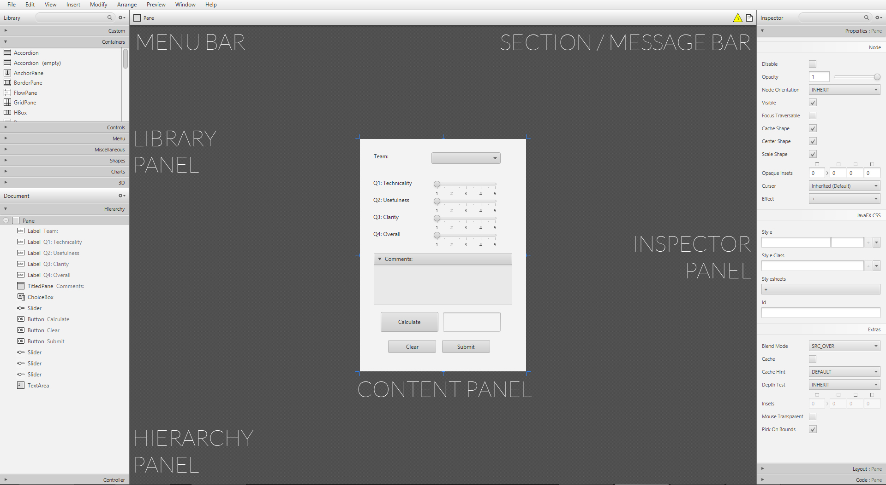
Javafx scene builder
http://www.oracle.com/technetwork/java/javase/downloads/javafxscenebuilder-info-2157684.html

Slide 9
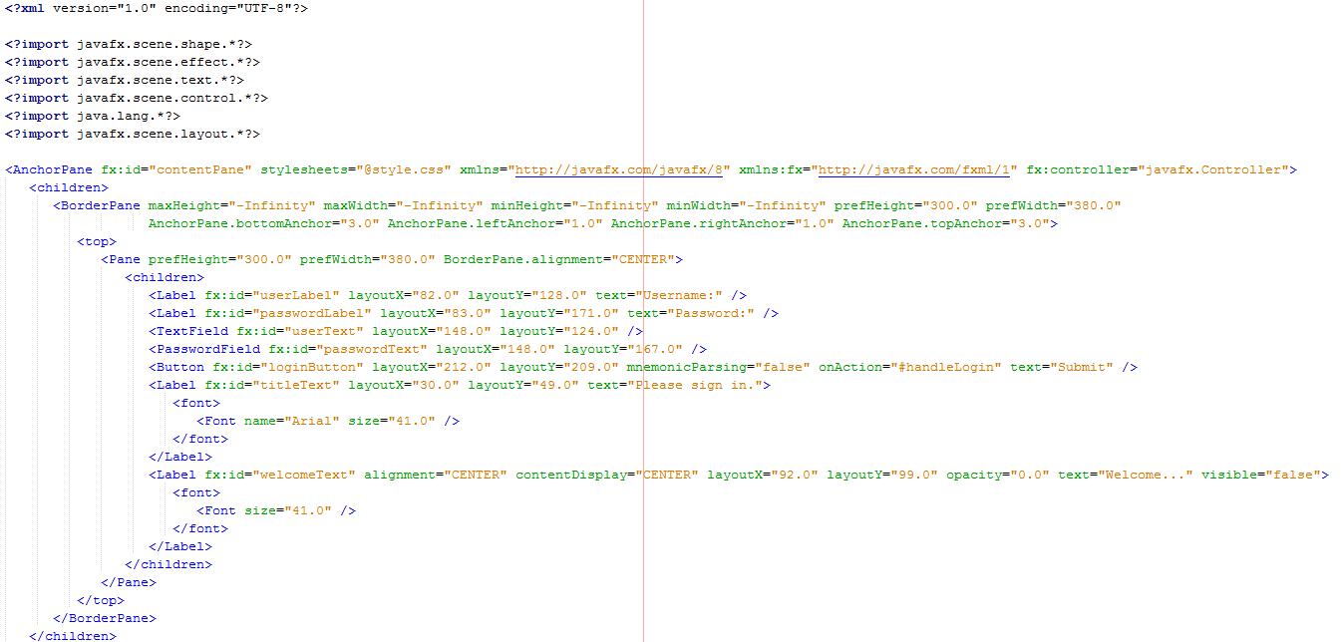
FXML
… XML based declarative markup language used to create user interfaces for JavaFX
XML based language used to create user interfaces for JavaFX

Slide 10
controller
… implements “event handlers” to allow the UI elements to carry out code
JavaFX’s scene builder can be used to get a skeleton of the Controller class, but before doing so we need to look at three things:
fx:id
“On Action” property
Controller property

Slide 11
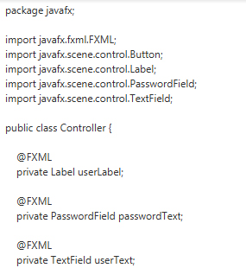
Sample Skeleton code

Slide 12
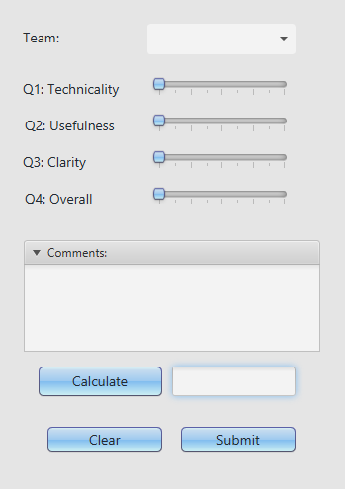
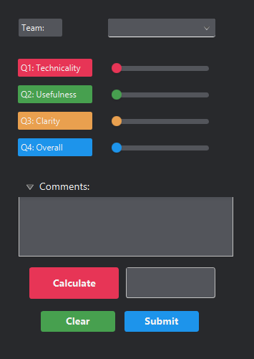
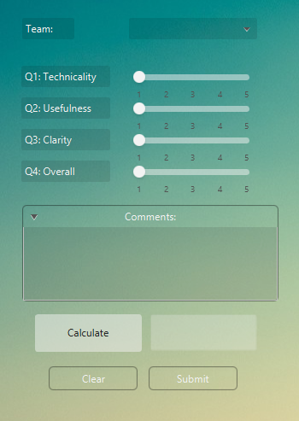
CSS Style sheetS
http://docs.oracle.com/javafx/2/api/javafx/scene/doc-files/cssref.html

Slide 13
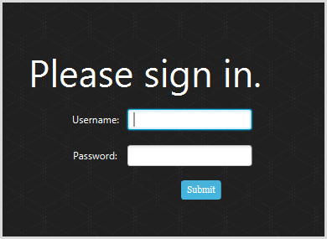
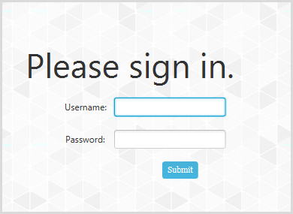
CSS Style sheetS

