Slide 1


Vektrum
Vektrum
Procore keeps the project record. Vektrum adds enforceable release governance before construction funds are disbursed.

Slide 2

Procore shows what happened on the project. Vektrum enforces what must be true before the money is released.
+ Construction lenders & private-credit funds administering draws on projects their contractors run in Procore
+ Enforcement, not tracking. All 10 release conditions must pass before authorization — no one can bypass the gate.
+ Owners & developers running fund control on Procore-managed projects
+ Proof by default. An append-only, hash-chained, tamper-evident audit trail.
+ Title, escrow & fund-control partners executing disbursements who need verifiable authorization evidence
+ No rip-and-replace. Non-custodial and rail-neutral — keep Procore and your payment process.

Slide 3
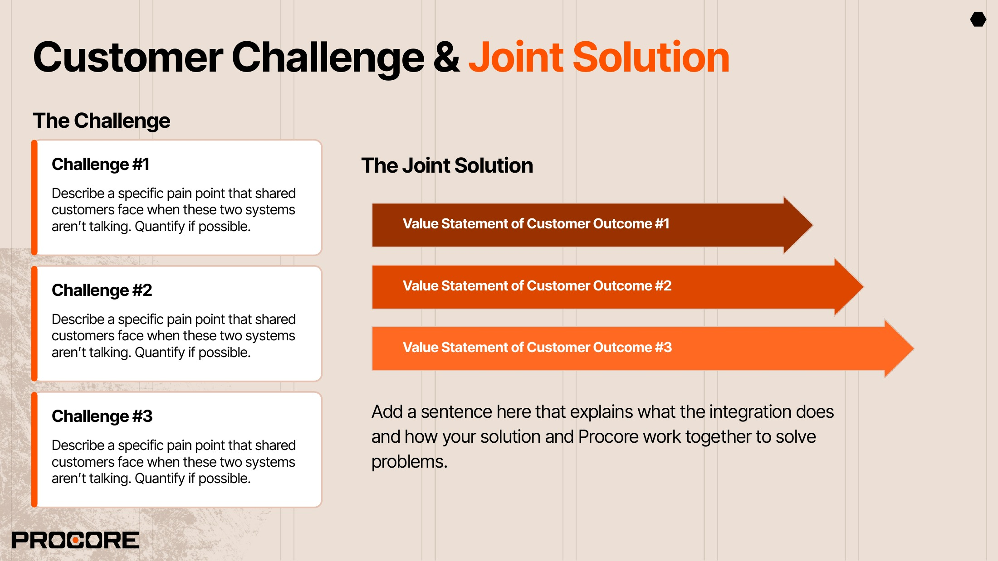
Draw decisions live outside the record Release decisions for the capital funding a project too often run on emailed PDFs and manual sign-off.
Project evidence meets enforced release conditions.
Approval is not enforcement Nothing structurally stops a release when a lien waiver is missing or a change order is still open.
Blocked draws show exactly what’s missing.
Every release carries provable authorization.
Proof is scattered, disputes over-freeze Evidence of who authorized what is spread across inboxes — and one dispute can stall a project’s funding.
Vektrum evaluates draw evidence against a deterministic release gate, records the funder’s authorization, and keeps tamper-evident proof — alongside Procore as the project and cost system of record. The simulated joint workflow demonstrates how Procore-originated records would feed that review.

Slide 4
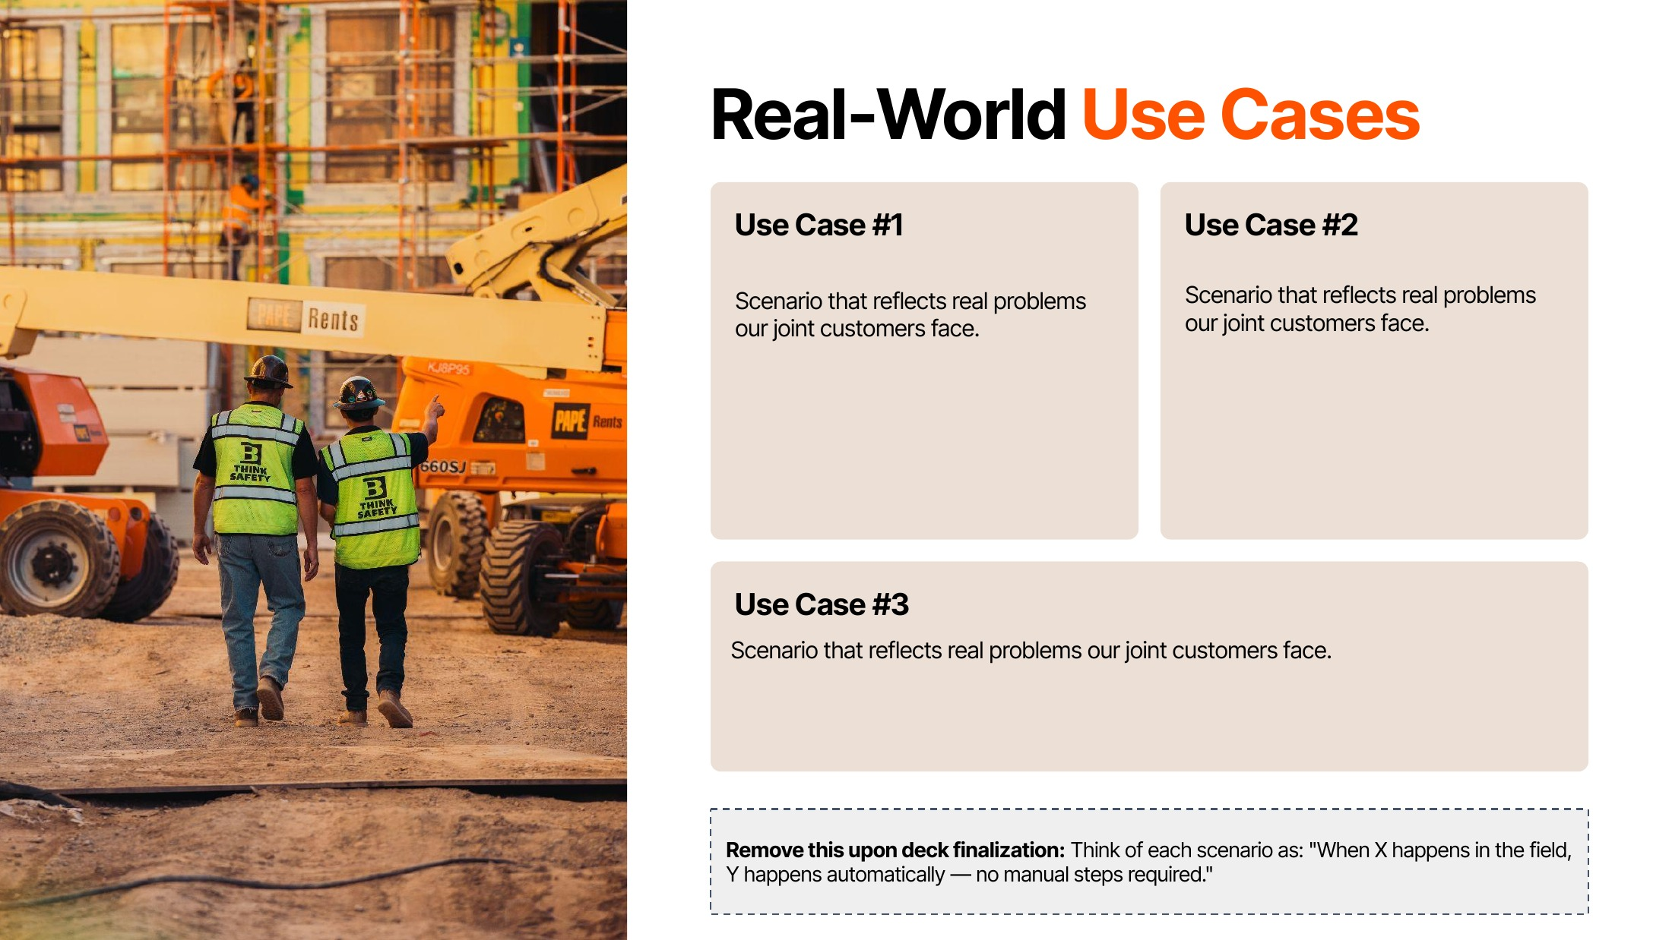
Change-order-aware draw readiness When an open change order touches a draw’s milestone, the release gate blocks that authorization until it is resolved. In the simulated workflow, resolving it at source clears the block.
Lien-waiver completeness before release When the required conditional lien waiver is not yet approved, the gate blocks the draw; once the approved waiver is on file, the gate can pass and the funder can authorize.
Milestone isolation with execution proof When one milestone is disputed, only that release unit is blocked — unrelated milestones keep moving. The executing partner’s confirmation is recorded against the signed authorization.
Release-gate enforcement is live in Vektrum today. The Procore-connected workflow is shown as a simulated concept; production integration is planned.

Slide 5
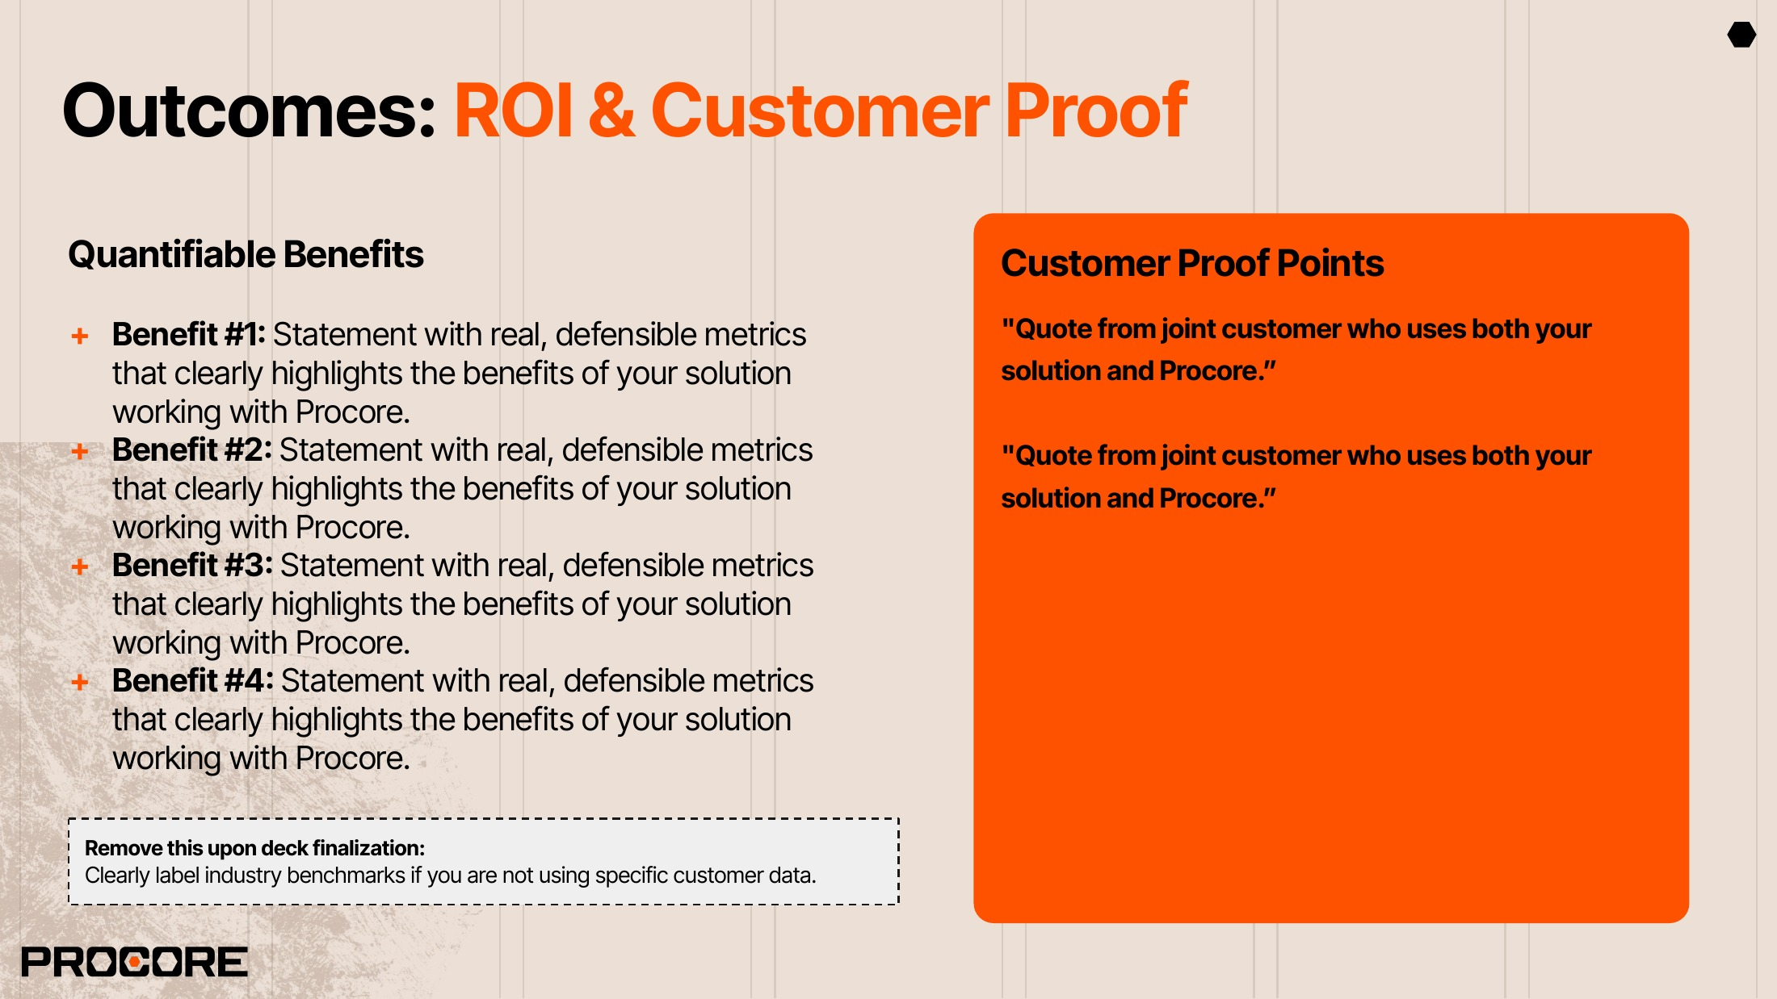
+ 10 required conditions, zero exceptions: every release authorization passes the full deterministic gate. (Internal product metric)
ILLUSTRATIVE — SIMULATED WORKFLOW, FICTIONAL DATA A $2.18M draw on a $42.8M project is blocked on an open change order and an unapproved lien waiver, then authorized after both resolve — with the full audit timeline recorded.
+ Blocked before, not disputed after: missing waivers and open change orders stop the affected draw before funds are authorized.
+ Audit-ready by default: exportable, hash-chained, tamper-evident evidence for LP reporting, audits, and reviews.
ILLUSTRATIVE — PUBLISHED VEKTRUM SCENARIO, NOT CUSTOMER DATA A $15K dispute on a $9M project locks one milestone — the other milestones keep releasing.
+ Capital keeps moving under dispute: milestone-level isolation blocks one release unit, not the whole project.
No joint-customer metrics yet: the proof points at right are illustrative scenarios, clearly labeled. Joint pilot data would replace them.
Vektrum governs authorization; the selected rail executes. Stripe Connect is one supported execution rail.

Slide 6
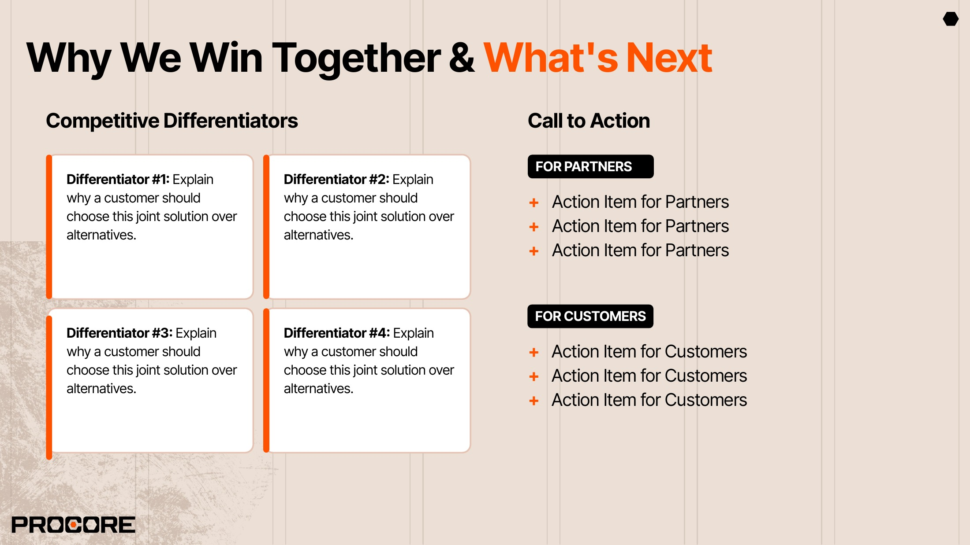
Purpose-built release governance: a deterministic 10-condition gate enforced in UI, API, and database — not a tracking checklist.
Complementary by design: non-custodial and rail-neutral — adds enforcement without touching Procore’s lane or the customer’s payment stack.
+ Validate the proposed integration workflow with Procore’s Technology Partner team
+ Review the sandbox connectivity in place (read-only Procore Developer Sandbox OAuth) and define supported read objects
+ Scope a joint design-partner pilot and pursue Marketplace readiness
Evidence-grade audit: append-only, hash-chained, tamper-evident records of every pass and block.
Disciplined AI: AI-assisted pre-review flags risk; the deterministic gate decides — AI never approves a release.
+ Walk through the simulated joint workflow at vektrum.io/demo-live/procore
+ Bring one upcoming lender-funded draw as a design-partner scenario
+ Contact operations@vektrum.io to set up a working session

Slide 7

+ Vektrum: vektrum.io
+ Simulated joint workflow: vektrum.io/demo-live/procore
+ Security overview: vektrum.io/security
+ Milestone-dispute isolation: vektrum.io/resources
+ Procore Marketplace (no Vektrum listing yet): marketplace.procore.com
+ operations@vektrum.io
Vektrum operations@vektrum.io · named alliances contact to be supplied

Slide 8
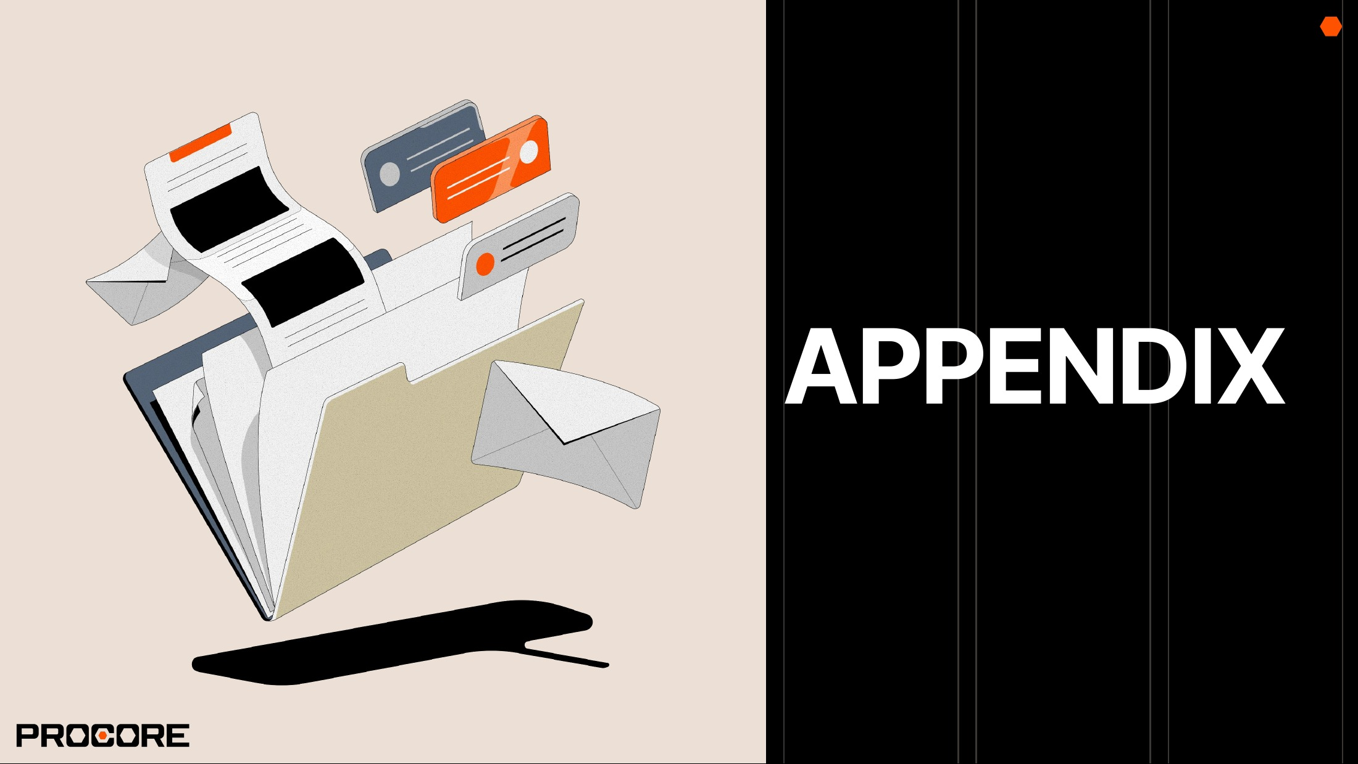

Slide 9
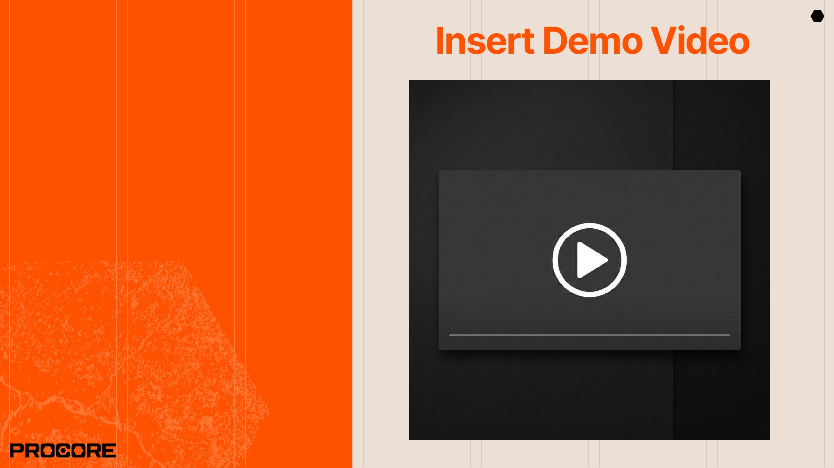
Demo: Simulated Joint Workflow
vektrum.io/demo-live/procore Simulated integration concept — fictional demo data only. No external system is connected and no funds are moved.

