Slide 1
Decision Trees
Note to other teachers and users of these slides. Andrew would be delighted if you found this source material useful in giving your own lectures. Feel free to use these slides verbatim, or to modify them to fit your own needs. PowerPoint originals are available. If you make use of a significant portion of these slides in your own lecture, please include this message, or the following link to the source repository of Andrew’s tutorials: http://www.cs.cmu.edu/~awm/tutorials . Comments and corrections gratefully received.
Andrew W. Moore
Associate Professor
School of Computer Science
Carnegie Mellon University
www.cs.cmu.edu/~awm
awm@cs.cmu.edu
412-268-7599
Copyright © 2001, Andrew W. Moore
July 30, 2001

Slide 2
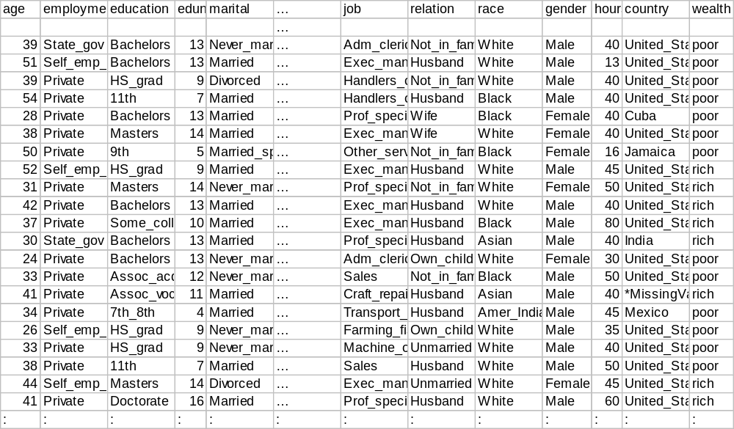
Here is a dataset
48,000 records, 16 attributes [Kohavi 1995]
Copyright © 2001, Andrew W. Moore

Slide 3
Classification
A Major Data Mining Operation
Give one attribute (e.g wealth), try to predict the value of new people’s wealths by means of some of the other available attributes.
Applies to categorical outputs
    Categorical attribute: an attribute which takes on two or more discrete values. Also known as a symbolic attribute.
    Real attribute: a column of real numbers
Copyright © 2001, Andrew W. Moore

Slide 4
Today’s lecture
Information Gain for measuring association between inputs and outputs
Learning a decision tree classifier from data
Copyright © 2001, Andrew W. Moore

Slide 5
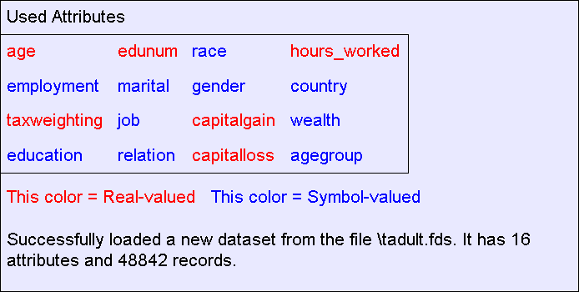
About this dataset
It is a tiny subset of the 1990 US Census.
It is publicly available online from the UCI Machine Learning Datasets repository
Copyright © 2001, Andrew W. Moore

Slide 6
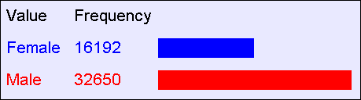
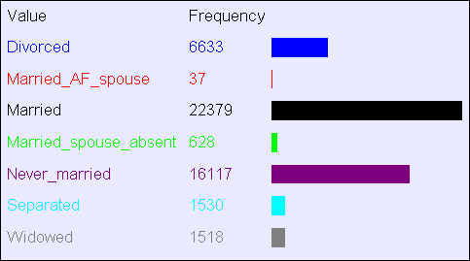
What can you do with a dataset?
Well, you can look at histograms…
Gender
Marital
Status
Copyright © 2001, Andrew W. Moore

Slide 7
Contingency Tables
A better name for a histogram:
A One-dimensional Contingency Table
Recipe for making a k-dimensional contingency table:
  Pick k attributes from your dataset. Call them a₁,a₂, … a_{k}.
  For every possible combination of values, a₁,=x₁, a₂,=x₂,… a_{k},=x_{k} ,record how frequently that combination occurs
  Fun fact: A database person would call this a “k-dimensional datacube”
Copyright © 2001, Andrew W. Moore

Slide 8
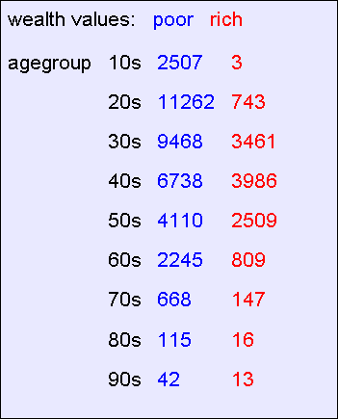
A 2-d Contingency Table
For each pair of values for attributes (agegroup,wealth) we can see how many records match.
Copyright © 2001, Andrew W. Moore

Slide 9
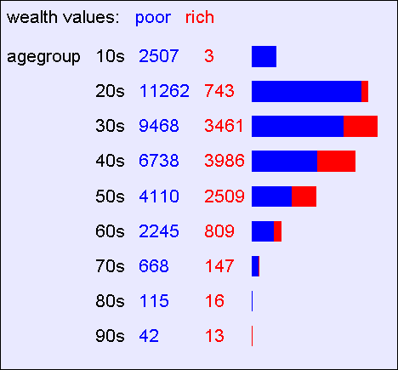
A 2-d Contingency Table
Easier to appreciate graphically
Copyright © 2001, Andrew W. Moore

Slide 10
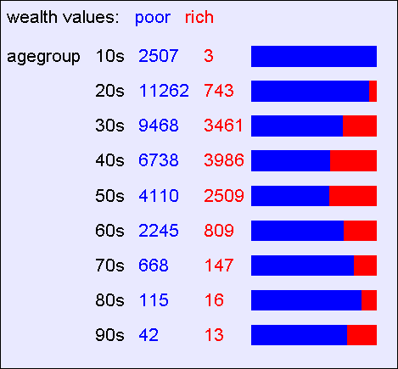
A 2-d Contingency Table
Easier to see “interesting” things if we stretch out the histogram bars
Copyright © 2001, Andrew W. Moore

Slide 11
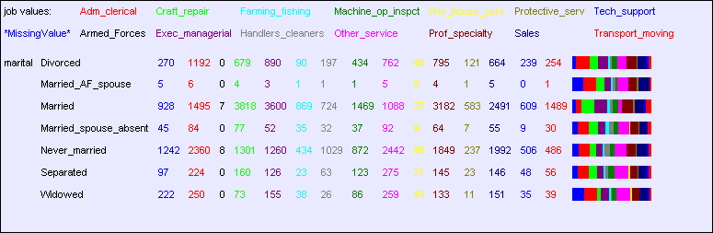
A bigger 2-d contingency table
Copyright © 2001, Andrew W. Moore

Slide 12
3-d contingency tables
These are harder to look at!
20s
30s
40s
50s
Poor
Rich
Male
Female
Copyright © 2001, Andrew W. Moore

Slide 13
On-Line Analytical Processing (OLAP)
Software packages and database add-ons to do this are known as OLAP tools
They usually include point and click navigation to view slices and aggregates of contingency tables
They usually include nice histogram visualization
Copyright © 2001, Andrew W. Moore

Slide 14
Time to stop and think
Why would people want to look at contingency tables?
Copyright © 2001, Andrew W. Moore

Slide 15
Let’s continue to think
With 16 attributes, how many 1-d contingency tables are there?
How many 2-d contingency tables?
How many 3-d tables?
With 100 attributes how many 3-d tables are there?
Copyright © 2001, Andrew W. Moore

Slide 16
Let’s continue to think
With 16 attributes, how many 1-d contingency tables are there? 16
How many 2-d contingency tables? 16-choose-2 = 16 * 15 / 2 = 120
How many 3-d tables? 560
With 100 attributes how many 3-d tables are there? 161,700
Copyright © 2001, Andrew W. Moore

Slide 17
Manually looking at contingency tables
Looking at one contingency table: can be as much fun as reading an interesting book
Looking at ten tables: as much fun as watching CNN
Looking at 100 tables: as much fun as watching an infomercial
Looking at 100,000 tables: as much fun as a three-week November vacation in Duluth with a dying weasel.
Copyright © 2001, Andrew W. Moore

Slide 18
Data Mining
Data Mining is all about automating the process of searching for patterns in the data.
Which patterns are interesting?
Which might be mere illusions?
And how can they be exploited?
Copyright © 2001, Andrew W. Moore

Slide 19
Data Mining
Data Mining is all about automating the process of searching for patterns in the data.
Which patterns are interesting?
    That’s what we’ll look at right now.
    And the answer will turn out to be the engine that drives decision tree learning.
Which might be mere illusions?
And how can they be exploited?
Copyright © 2001, Andrew W. Moore

Slide 20
Deciding whether a pattern is interesting
We will use information theory
A very large topic, originally used for compressing signals
But more recently used for data mining…
Copyright © 2001, Andrew W. Moore

Slide 21
Deciding whether a pattern is interesting
We will use information theory
A very large topic, originally used for compressing signals
But more recently used for data mining…
(The topic of Information Gain will now be discussed, but you will find it in a separate Andrew Handout)
Copyright © 2001, Andrew W. Moore

Slide 22
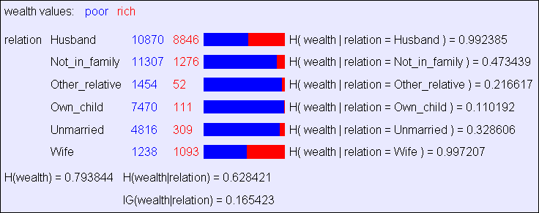
Searching for High Info Gains
Given something (e.g. wealth) you are trying to predict, it is easy to ask the computer to find which attribute has highest information gain for it.
Copyright © 2001, Andrew W. Moore

Slide 23
Learning Decision Trees
A Decision Tree is a tree-structured plan of a set of attributes to test in order to predict the output.
To decide which attribute should be tested first, simply find the one with the highest information gain.
Then recurse…
Copyright © 2001, Andrew W. Moore

Slide 24
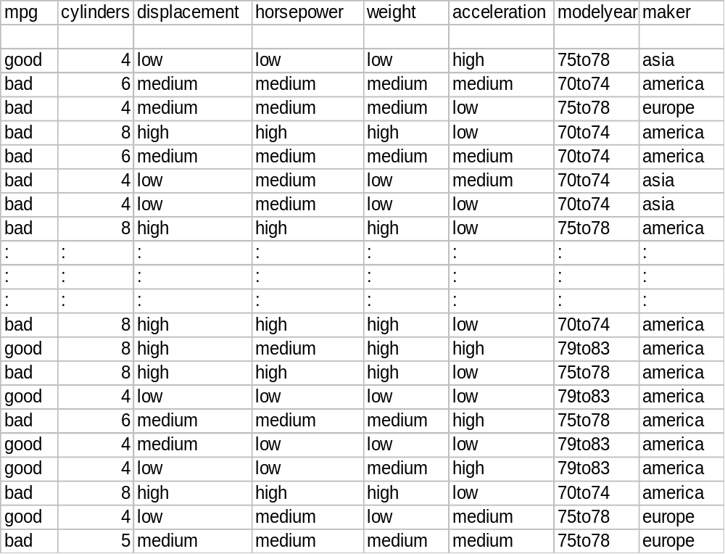
A small dataset: Miles Per Gallon
40 Records
From the UCI repository (thanks to Ross Quinlan)
Copyright © 2001, Andrew W. Moore

Slide 25
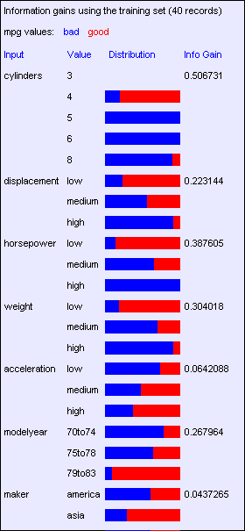
Look at all the information gains…
Suppose we want to predict MPG.
Copyright © 2001, Andrew W. Moore

Slide 26
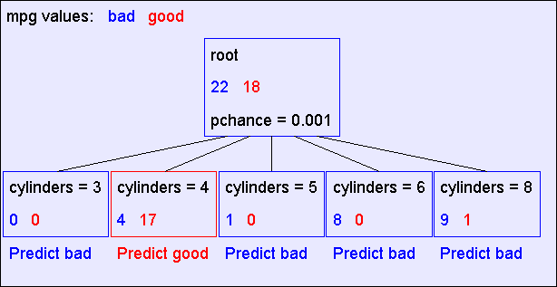
A Decision Stump
Copyright © 2001, Andrew W. Moore

Slide 27
Recursion Step
Records in which cylinders = 4
Records in which cylinders = 5
Take the
Original
Dataset..
And partition it according
to the value of the attribute we split on
Records in which cylinders = 6
Records in which cylinders = 8
Copyright © 2001, Andrew W. Moore

Slide 28
Recursion Step
Build tree from
These records..
Build tree from
These records..
Build tree from
These records..
Build tree from
These records..
Records in which cylinders = 8
Records in which cylinders = 6
Records in which cylinders = 4
Records in which cylinders = 5
Copyright © 2001, Andrew W. Moore

Slide 29
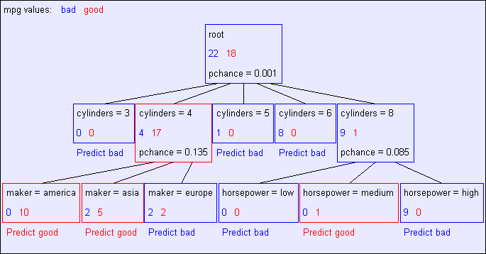
Second level of tree
Recursively build a tree from the seven records in which there are four cylinders and the maker was based in Asia
(Similar recursion in the other cases)
Copyright © 2001, Andrew W. Moore

Slide 30
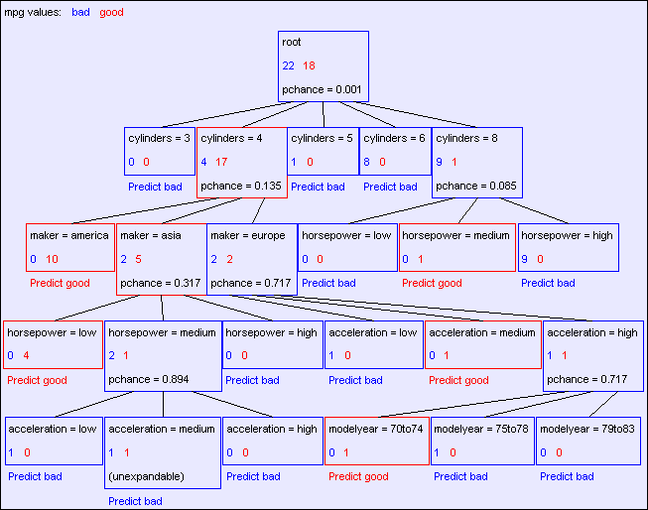
The final tree
Copyright © 2001, Andrew W. Moore

Slide 31
Base Case One
Don’t split a node if all matching records have the same output value
Copyright © 2001, Andrew W. Moore

Slide 32
Base Case Two
Don’t split a node if none of the attributes can create multiple non-empty children
Copyright © 2001, Andrew W. Moore

Slide 33
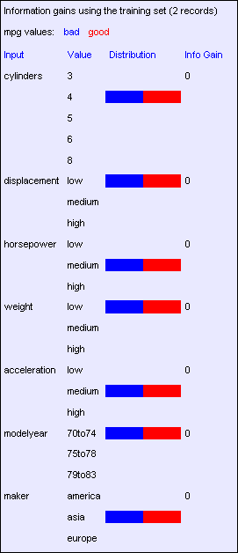
Base Case Two: No attributes can distinguish
Copyright © 2001, Andrew W. Moore

Slide 34
Base Cases
Base Case One: If all records in current data subset have the same output then don’t recurse
Base Case Two: If all records have exactly the same set of input attributes then don’t recurse
Copyright © 2001, Andrew W. Moore

Slide 35
Base Cases: An idea
Base Case One: If all records in current data subset have the same output then don’t recurse
Base Case Two: If all records have exactly the same set of input attributes then don’t recurse
Proposed Base Case 3:
If all attributes have zero information gain then don’t recurse
Is this a good idea?
Copyright © 2001, Andrew W. Moore

Slide 36
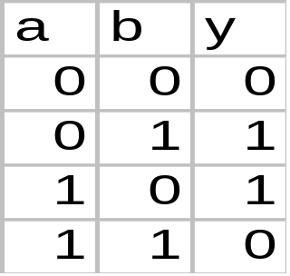
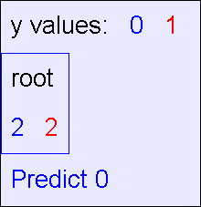
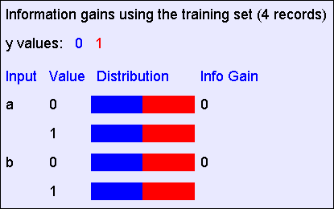
The problem with Base Case 3
y = a XOR b
The resulting decision tree:
The information gains:
Copyright © 2001, Andrew W. Moore

Slide 37
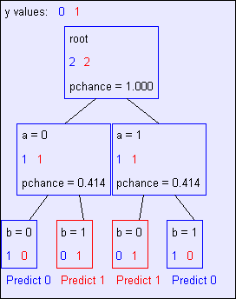
If we omit Base Case 3:
y = a XOR b
The resulting decision tree:
Copyright © 2001, Andrew W. Moore

Slide 38
Basic Decision Tree Building Summarized
BuildTree(DataSet,Output)
If all output values are the same in DataSet, return a leaf node that says “predict this unique output”
If all input values are the same, return a leaf node that says “predict the majority output”
Else find attribute X with highest Info Gain
Suppose X has n_{X} distinct values (i.e. X has arity n_{X}).
  Create and return a non-leaf node with n_{X} children.
  The i’th child should be built by calling
        BuildTree(DS_{i},Output)
    Where DS_{i} built consists of all those records in DataSet for which X = ith distinct value of X.
Copyright © 2001, Andrew W. Moore

Slide 39
Training Set Error
For each record, follow the decision tree to see what it would predict
  For what number of records does the decision tree’s prediction disagree with the true value in the database?
This quantity is called the training set error. The smaller the better.
Copyright © 2001, Andrew W. Moore

Slide 40
MPG Training error
Copyright © 2001, Andrew W. Moore

Slide 41

MPG Training error
Copyright © 2001, Andrew W. Moore

Slide 42
MPG Training error
Copyright © 2001, Andrew W. Moore

Slide 43
Stop and reflect: Why are we doing this learning anyway?
It is not usually in order to predict the training data’s output on data we have already seen.
Copyright © 2001, Andrew W. Moore

Slide 44
Stop and reflect: Why are we doing this learning anyway?
It is not usually in order to predict the training data’s output on data we have already seen.
It is more commonly in order to predict the output value for future data we have not yet seen.
Copyright © 2001, Andrew W. Moore

Slide 45
Stop and reflect: Why are we doing this learning anyway?
It is not usually in order to predict the training data’s output on data we have already seen.
It is more commonly in order to predict the output value for future data we have not yet seen.
      Warning: A common data mining misperception is that the above two bullets are the only possible reasons for learning. There are at least a dozen others.
Copyright © 2001, Andrew W. Moore

Slide 46
Test Set Error
Suppose we are forward thinking.
We hide some data away when we learn the decision tree.
But once learned, we see how well the tree predicts that data.
This is a good simulation of what happens when we try to predict future data.
And it is called Test Set Error.
Copyright © 2001, Andrew W. Moore

Slide 47
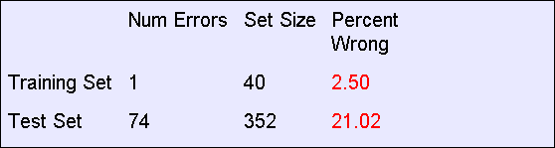
MPG Test set error
Copyright © 2001, Andrew W. Moore

Slide 48
MPG Test set error
The test set error is much worse than the training set error…
…why?
Copyright © 2001, Andrew W. Moore

Slide 49
An artificial example
We’ll create a training dataset
Output y = copy of e,
Except a random 25% of the records have y set to the opposite of e
Five inputs, all bits, are generated in all 32 possible combinations
a | b | c | d | e | y
0 | 0 | 0 | 0 | 0 | 0
0 | 0 | 0 | 0 | 1 | 0
0 | 0 | 0 | 1 | 0 | 0
0 | 0 | 0 | 1 | 1 | 1
0 | 0 | 1 | 0 | 0 | 1
: | : | : | : | : | :
1 | 1 | 1 | 1 | 1 | 1
32 records
Copyright © 2001, Andrew W. Moore

Slide 50
In our artificial example
Suppose someone generates a test set according to the same method.
The test set is identical, except that some of the y’s will be different.
Some y’s that were corrupted in the training set will be uncorrupted in the testing set.
Some y’s that were uncorrupted in the training set will be corrupted in the test set.
Copyright © 2001, Andrew W. Moore

Slide 51
Building a tree with the artificial training set
Suppose we build a full tree (we always split until base case 2)
Root
e=0
e=1
a=0
a=1
a=0
a=1
25% of these leaf node labels will be corrupted
Copyright © 2001, Andrew W. Moore

Slide 52
Training set error for our artificial tree
All the leaf nodes contain exactly one record and so…
We would have a training set error of zero
Copyright © 2001, Andrew W. Moore

Slide 53
Testing the tree with the test set
 | 1/4 of the tree nodes are corrupted | 3/4 are fine
1/4 of the test set records are corrupted | 1/16 of the test set will be correctly predicted for the wrong reasons | 3/16 of the test set will be wrongly predicted because the test record is corrupted
3/4 are fine | 3/16 of the test predictions will be wrong because the tree node is corrupted | 9/16 of the test predictions will be fine
In total, we expect to be wrong on 3/8 of the test set predictions
Copyright © 2001, Andrew W. Moore

Slide 54
What’s this example shown us?
This explains the discrepancy between training and test set error
But more importantly… …it indicates there’s something we should do about it if we want to predict well on future data.
Copyright © 2001, Andrew W. Moore

Slide 55
Suppose we had less data
Let’s not look at the irrelevant bits
Output y = copy of e, except a random 25% of the records have y set to the opposite of e
These bits are hidden
a | b | c | d | e | y
0 | 0 | 0 | 0 | 0 | 0
0 | 0 | 0 | 0 | 1 | 0
0 | 0 | 0 | 1 | 0 | 0
0 | 0 | 0 | 1 | 1 | 1
0 | 0 | 1 | 0 | 0 | 1
: | : | : | : | : | :
1 | 1 | 1 | 1 | 1 | 1
32 records
What decision tree would we learn now?
Copyright © 2001, Andrew W. Moore

Slide 56
Without access to the irrelevant bits…
Root
e=0
e=1
These nodes will be unexpandable
Copyright © 2001, Andrew W. Moore

Slide 57
Without access to the irrelevant bits…
Root
e=0
e=1
These nodes will be unexpandable
In about 12 of the 16 records in this node the output will be 0
So this will almost certainly predict 0
In about 12 of the 16 records in this node the output will be 1
So this will almost certainly predict 1
Copyright © 2001, Andrew W. Moore

Slide 58
Without access to the irrelevant bits…
 | almost certainly none of the tree nodes are corrupted | almost certainly all are fine
1/4 of the test set records are corrupted | n/a | 1/4 of the test set will be wrongly predicted because the test record is corrupted
3/4 are fine | n/a | 3/4 of the test predictions will be fine
Root
e=0
e=1
In total, we expect to be wrong on only 1/4 of the test set predictions
Copyright © 2001, Andrew W. Moore

Slide 59
Overfitting
Definition: If your machine learning algorithm fits noise (i.e. pays attention to parts of the data that are irrelevant) it is overfitting.
Fact (theoretical and empirical): If your machine learning algorithm is overfitting then it may perform less well on test set data.
Copyright © 2001, Andrew W. Moore

Slide 60
Avoiding overfitting
Usually we do not know in advance which are the irrelevant variables
…and it may depend on the context
    For example, if y = a AND b then b is an irrelevant variable only in the portion of the tree in which a=0
        But we can use simple statistics to warn us that we might be overfitting.
Copyright © 2001, Andrew W. Moore

Slide 61
Consider this split
Copyright © 2001, Andrew W. Moore

Slide 62
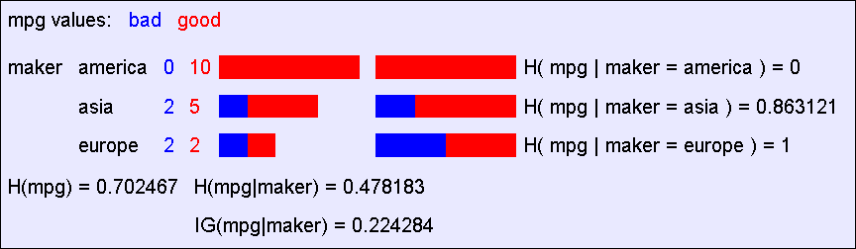
A chi-squared test
Suppose that mpg was completely uncorrelated with maker.
What is the chance we’d have seen data of at least this apparent level of association anyway?
Copyright © 2001, Andrew W. Moore

Slide 63
A chi-squared test
Suppose that mpg was completely uncorrelated with maker.
What is the chance we’d have seen data of at least this apparent level of association anyway?
By using a particular kind of chi-squared test, the answer is 13.5%.
Copyright © 2001, Andrew W. Moore

Slide 64
Chi-squared test
(dennis shasha addition)
In our case, the values expected are that a given car has a 17/21 chance of having good mpg.
So, we’d expect america to produce fraction 17/21 good cars vs 4/21 bad cars.
Chi-squared is sum of (observed – expected)^2 / expected. In our case
((10 – (17/21)*10)^2)/((17/21)*10) +
((5 – (17/21) * 7)^2)/((17/21) * 7) +
((2 – (17/21)*4)^2)/((17/21) * 4)
Copyright © 2001, Andrew W. Moore

Slide 65
Chi-squared test
(dennis shasha addition)
How likely we can get a number this high or more can be looked up in a table or by doing resampling (my preference).
Copyright © 2001, Andrew W. Moore

Slide 66
Resampling Applied Here
(dennis shasha addition)
Suppose there are 21 cars, 17 of which have the “good” property and 4 have the “bad” property.
Choose 1000 sets of 21 from these cars but with replacement.
Recompute the chi-squared statistic. Prob that this chi-squared would have happened by chance is fraction of 1000 where chi-squared value is greater than the one calculated.
Copyright © 2001, Andrew W. Moore

Slide 67
Using Chi-squared to avoid overfitting
Build the full decision tree as before.
But when you can grow it no more, start to prune:
  Beginning at the bottom of the tree, delete splits in which p_{chance} > MaxPchance.
  Continue working you way up until there are no more prunable nodes.
MaxPchance is a magic parameter you must specify to the decision tree, indicating your willingness to risk fitting noise.
Copyright © 2001, Andrew W. Moore

Slide 68
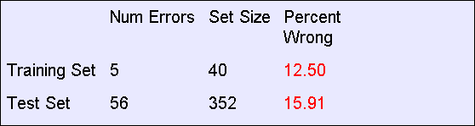
Pruning example
With MaxPchance = 0.1, you will see the following MPG decision tree:
Note the improved test set accuracy compared with the unpruned tree
Copyright © 2001, Andrew W. Moore

Slide 69
MaxPchance
Good news: The decision tree can automatically adjust its pruning decisions according to the amount of apparent noise and data.
Bad news: The user must come up with a good value of MaxPchance. (Note, Andrew usually uses 0.05, which is his favorite value for any magic parameter).
Good news: But with extra work, the best MaxPchance value can be estimated automatically by a technique called cross-validation.
Copyright © 2001, Andrew W. Moore

Slide 70
MaxPchance
Technical note (dealt with in other lectures): MaxPchance is a regularization parameter.
Expected Test set Error
Decreasing
Increasing
MaxPchance
High Bias
High Variance
Copyright © 2001, Andrew W. Moore

Slide 71
The simplest tree
Note that this pruning is heuristically trying to find
The simplest tree structure for which all within-leaf-node disagreements can be explained by chance
This is not the same as saying “the simplest classification scheme for which…”
Decision trees are biased to prefer classifiers that can be expressed as trees.
Copyright © 2001, Andrew W. Moore

Slide 72
Expressiveness of Decision Trees
Assume all inputs are Boolean and all outputs are Boolean.
What is the class of Boolean functions that are possible to represent by decision trees?
Answer: All Boolean functions.
Simple proof:
Take any Boolean function
Convert it into a truth table
Construct a decision tree in which each row of the truth table corresponds to one path through the decision tree.
Copyright © 2001, Andrew W. Moore

Slide 73
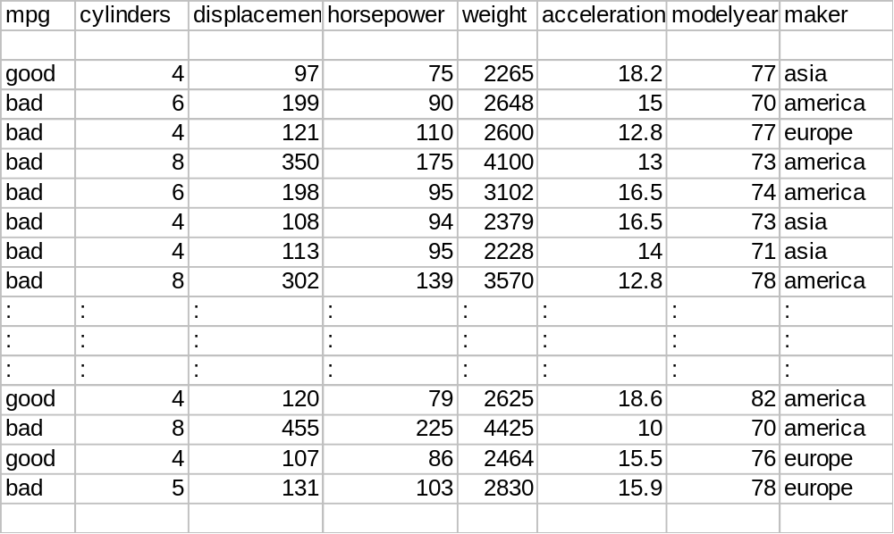
Real-Valued inputs
What should we do if some of the inputs are real-valued?
Idea One: Branch on each possible real value
Copyright © 2001, Andrew W. Moore

Slide 74
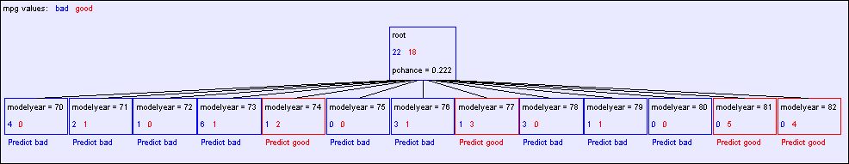
“One branch for each numeric value” idea:
Hopeless: with such high branching factor will shatter the dataset and over fit
Note pchance is 0.222 in the above…if MaxPchance was 0.05 that would end up pruning away to a single root node.
Copyright © 2001, Andrew W. Moore

Slide 75
A better idea: thresholded splits
Suppose X is real valued.
Define IG(Y|X:t) as H(Y) - H(Y|X:t)
Define H(Y|X:t) =
H(Y|X < t) P(X < t) + H(Y|X >= t) P(X >= t)
    IG(Y|X:t) is the information gain for predicting Y if all you know is whether X is greater than or less than t
Then define IG*(Y|X) = max_{t} IG(Y|X:t)
For each real-valued attribute, use IG*(Y|X) for assessing its suitability as a split
Copyright © 2001, Andrew W. Moore

Slide 76
Computational Issues
You can compute IG*(Y|X) in time
R log R + 2 R n_{y}
Where
      R is the number of records in the node under consideration
      n_{y} is the arity (number of distinct values of) Y
      How?
      Sort records according to increasing values of X. Then create a 2xn_{y} contingency table corresponding to computation of IG(Y|X:x_{min}). Then iterate through the records, testing for each threshold between adjacent values of X, incrementally updating the contingency table as you go. For a minor additional speedup, only test between values of Y that differ.
Copyright © 2001, Andrew W. Moore

Slide 77
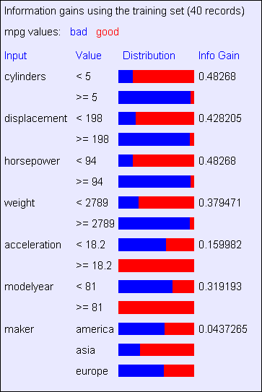
Example with MPG
Copyright © 2001, Andrew W. Moore

Slide 78
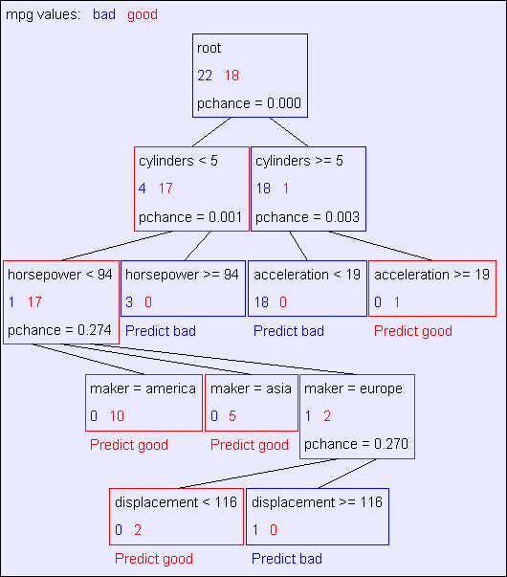
Unpruned tree using reals
Copyright © 2001, Andrew W. Moore

Slide 79
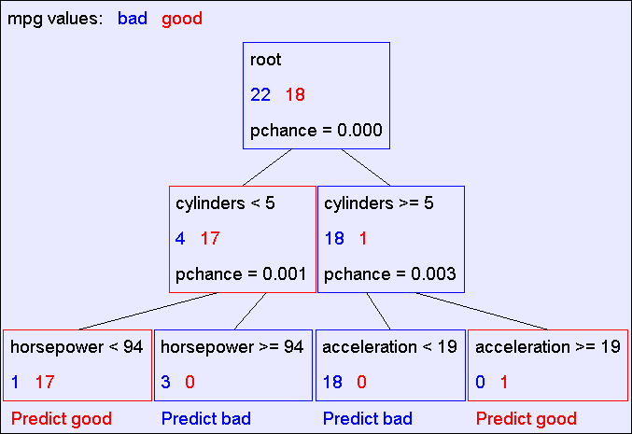
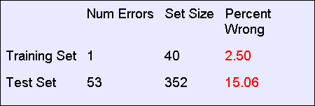
Pruned tree using reals
Copyright © 2001, Andrew W. Moore

Slide 80
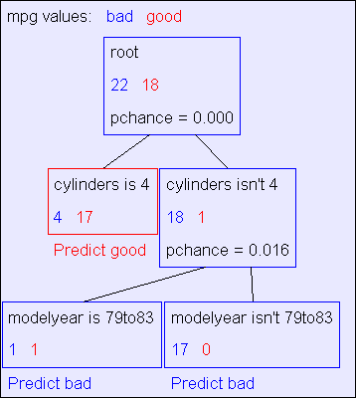
Binary categorical splits
One of Andrew’s favorite tricks
Allow splits of the following form
Example:
Root
Attribute equals value
Attribute doesn’t equal value
Copyright © 2001, Andrew W. Moore

Slide 81
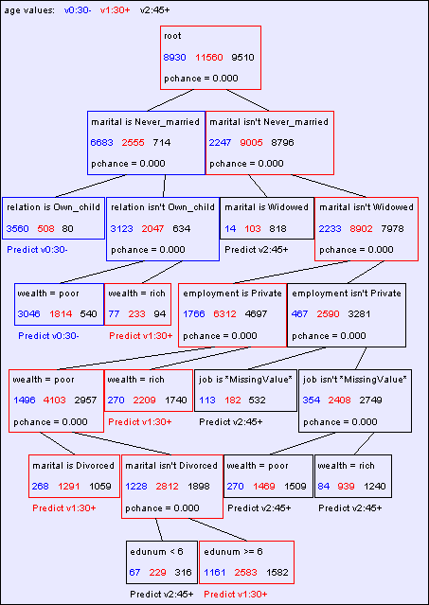
Predicting age from census
Copyright © 2001, Andrew W. Moore

Slide 82
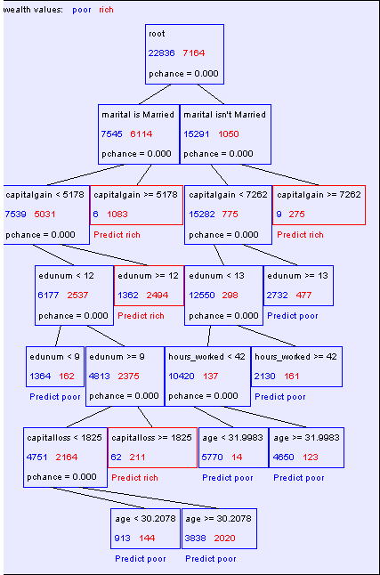
Predicting wealth from census
Copyright © 2001, Andrew W. Moore

Slide 83
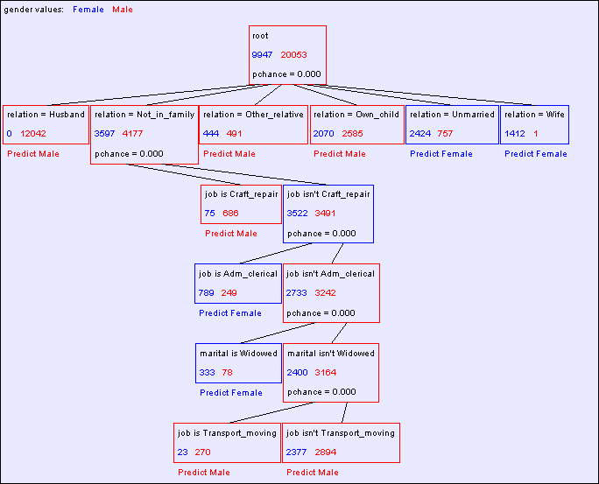
Predicting gender from census
Copyright © 2001, Andrew W. Moore

Slide 84
Conclusions
Decision trees are the single most popular data mining tool
  Easy to understand
  Easy to implement
  Easy to use
  Computationally cheap
It’s possible to get in trouble with overfitting
They do classification: predict a categorical output from categorical and/or real inputs
Copyright © 2001, Andrew W. Moore

Slide 85
What you should know
What’s a contingency table?
What’s information gain, and why we use it
The recursive algorithm for building an unpruned decision tree
What are training and test set errors
Why test set errors can be bigger than training set
Why pruning can reduce test set error
How to exploit real-valued inputs
Copyright © 2001, Andrew W. Moore

Slide 86
What we haven’t discussed
It’s easy to have real-valued outputs too---these are called Regression Trees*
Bayesian Decision Trees can take a different approach to preventing overfitting
Computational complexity (straightforward and cheap) *
Alternatives to Information Gain for splitting nodes
How to choose MaxPchance automatically *
The details of Chi-Squared testing *
Boosting---a simple way to improve accuracy *
  * = discussed in other Andrew lectures
Copyright © 2001, Andrew W. Moore

Slide 87
For more information
Two nice books
      L. Breiman, J. H. Friedman, R. A. Olshen, and C. J. Stone. Classification and Regression Trees. Wadsworth, Belmont, CA, 1984.
      C4.5 : Programs for Machine Learning (Morgan Kaufmann Series in Machine Learning) by J. Ross Quinlan
Dozens of nice papers, including
      Learning Classification Trees, Wray Buntine, Statistics and Computation (1992), Vol 2, pages 63-73
      Kearns and Mansour, On the Boosting Ability of Top-Down Decision Tree Learning Algorithms, STOC: ACM Symposium on Theory of Computing, 1996“
Dozens of software implementations available on the web for free and commercially for prices ranging between $50 - $300,000
Copyright © 2001, Andrew W. Moore

Slide 88
Discussion
Instead of using information gain, why not choose the splitting attribute to be the one with the highest prediction accuracy?
Instead of greedily, heuristically, building the tree, why not do a combinatorial search for the optimal tree?
If you build a decision tree to predict wealth, and marital status, age and gender are chosen as attributes near the top of the tree, is it reasonable to conclude that those three inputs are the major causes of wealth?
..would it be reasonable to assume that attributes not mentioned in the tree are not causes of wealth?
..would it be reasonable to assume that attributes not mentioned in the tree are not correlated with wealth?
Copyright © 2001, Andrew W. Moore

