Slide 1
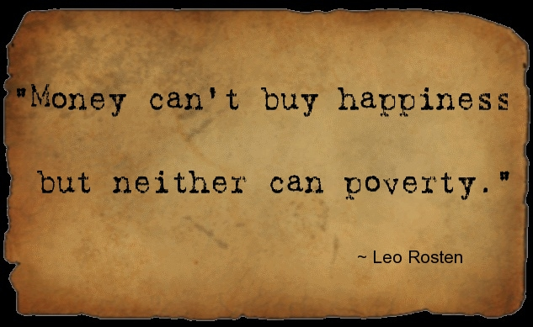
Introductory

Slide 2
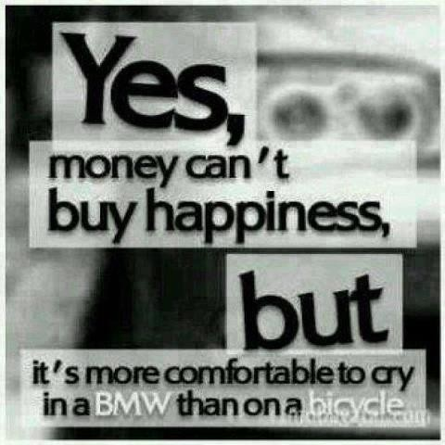

Slide 3
What do you think?
What is the good life?
What is the part money plays in it?

Slide 4
Further questions
Is there an ethical component in the actions of money-making and money-spending?
Luck, work, inheritance: do they change our approach to money?
Is the good life for all?
Is the class system based on money?
Are people judged according to their money value?
In which relation is money to feelings/passions such as love, hate, ambition, greed, self-preservation or self-enhancement?

Slide 5
Ibn Sīnā (980 –1037)
Good life/ sa’ada
Good/khair:
“is that which everything desires, and what everything desires is either existence, or the perfection of existence as such” (Metaphysics)

Slide 6
The Greek good life
Eudaimonia:
Eu = good
Daimon= spirit
Happiness
Welfare
Good life

Slide 7
Aristotle, Nicomachean Ethics (350 BC)
Good life/ happiness/welfare
set in relation to VIRTUE
Components:
= practical or philosophical wisdom
= pleasure
Dynamic: a way of being in action appropriate
to the human soul:
“Virtuous activities in accordance with reason”

Slide 8
Happiness/virtue
Virtue/ moral excellence
Concern: pleasures and pains
“it is on account of the pleasure that we do bad things, and on account of the pain that we abstain from noble ones. “
Expression: actions and passions
“Virtue, then, is a state of character concerned with choice, lying in a mean”

Slide 9
Means: Feelings/Actions
PLEASURES/PAINS
MEAN: temperance
EXCESS: self-indulgence
FEAR/CONFIDENCE
MEAN: courage
EXCESS: Rashness, Cowardice

Slide 10
Money- making: An intermediate good in order to achieve higher goals
“The life of money-making is one undertaken under compulsion since wealth is not the good we are seeking and is merely useful for the sake of something else. “
Virtue is to know how to use money
Liberality, magnificence, magnanimity (greatness of the soul)

Slide 11
Money and Actions
GIVING AND TAKING
mean: liberality/magnificence,
excess : prodigality and meanness
tastelessness, vulgarity
deficiency, stinginess

Slide 12
Self and social recognition
SERIOUSNESS: to know HOW live well and beautifully (good at work/good at thinking)
HONOR/DISHONOR
Mean: proper pride
Excess: empty vanity/undue humility
HONESTY ABOUT ONESELF, SENSE OF JUSTICE AND FAIRNESS

Slide 13
Who is excluded in Aristotle’s good life?
Women, slaves, lower classes (they cannot choose their own actions)
Animals (lacking reason)
Children
Chronically ill
Even the gods since they acknowledge no limits
Generally those whose freedom of action is impaired.

Slide 14
More on money: Georg Simmel, The Philosophy of Money (1900)
The more money becomes the sole centre of interest, the more one discovers that honour and conviction, talent and virtue, beauty and salvation of the soul are exchanged against money and so the more a mocking and frivolous attitude will develop in relation to these higher values that are for sale for the same kind of value as groceries, and that also command a ‘market price’.

Slide 15
Money is the purest form of the tool…it is
an institution through which the individual concentrates his activity and possessions in order to attain goals that he could not attain directly.
Money is totally indifferent to the objects because it is separated from them by the fact of exchange

Slide 16
The wealthy man enjoys advantages beyond the enjoyment of what he can buy with his money
Wealth, indeed, is often regarded as a kind of moral merit, as is indicated by the term ‘respectability’ and by popular references to the well-to-do as ‘upright citizens’ or ‘the better-class public’. The same phenomenon is shown from the other side by the fact that the poor are treated as if they were guilty, that beggars are angrily driven away, and that even good-natured people consider themselves naturally superior to the poor.

Slide 17
Agree or disagree?
The inner polarity of the essence of money lies in its being the absolute means and thereby becoming psychologically the absolute purpose for most people, which makes it, in a strange way, a symbol in which major regulators of practical life are frozen.

Slide 18
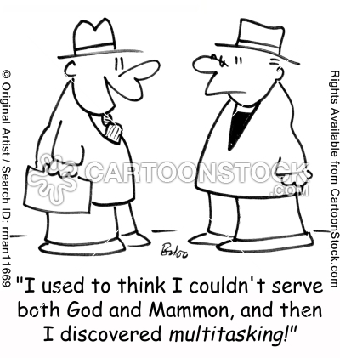

Slide 19
Money is human happiness in the abstract: he, then, who is no longer capable of enjoying human happiness in the concrete devotes his heart entirely to money.
Arthur Schopenhauer

Slide 20
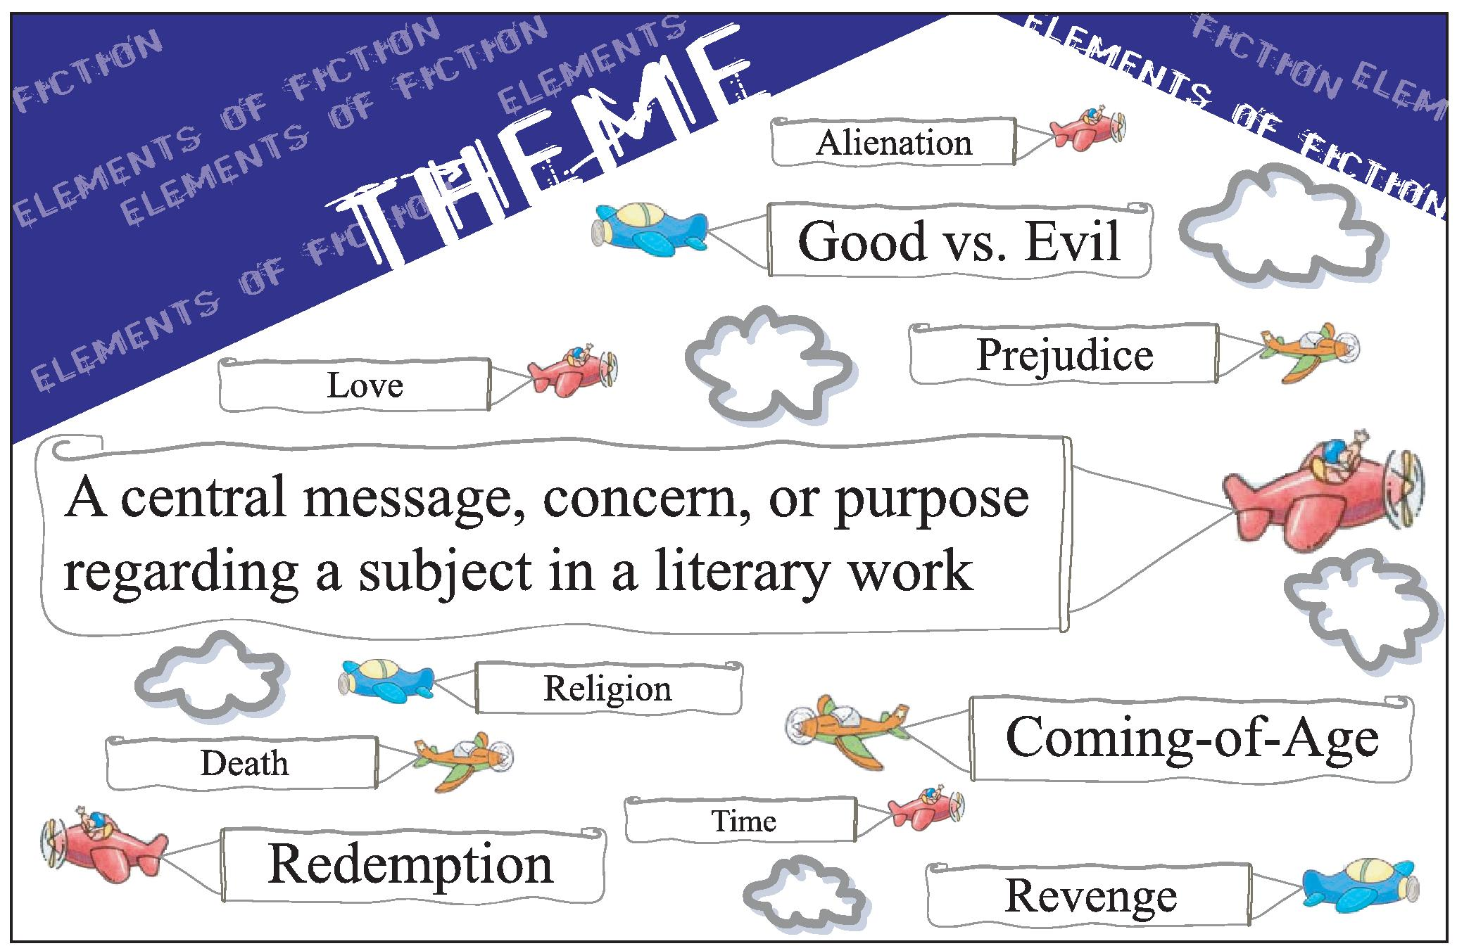
A theme

Slide 21
A-Merchant of Venice/ B- Great Gatsby
Common Themes:
Wealth
Love
Marriage
Friendship
Theme variants:
Text A: race, justice
Text B: class, compassion, the past

Slide 22
Thematic concept: what readers "think the work is about"
thematic statement: what the work says about the subject

Slide 23
Peter Brooks, Reading for the Plot
Plotting theme:
Narration’s direction and intention in existence

