Slide 1
Global Banking
Introduction

Slide 2

Roy Smith (middle)
Notes:
Read his funny story in Paper Fortunes

Slide 3
What is GDP?
It is the most commonly used measure of the size of an economy. It is defined as the market value of all final goods and services produced within a country in a given period of time
The Components of GDP
GDP (Y ) is the sum of the following:
  Consumption (C)
   Investment (I)
   Government Purchases (G)
   Net Exports (NX, exports minus imports)
Y = C + I + G + NX

Slide 4
U.S. GDP and Its Components (1998)
Government Purchases
18%
Investment
16%
Net Exports
-2 %
Consumption
68 %
Ultimately, all is for consumption. But before you consume, you have to produce, and that’s where finance plays a role

Slide 5
Two types of “body cells” in real economy: households and firms
Revenue
Market for
Goods
and Services
Spending
Goods & Services sold
Goods & Services bought
Firms
Households
Inputs for production
Labor, land, and capital
Market for
Factors
of Production
Wages, rent, and interest
Income
Where do banks fit in?
Notes:
7

Slide 6
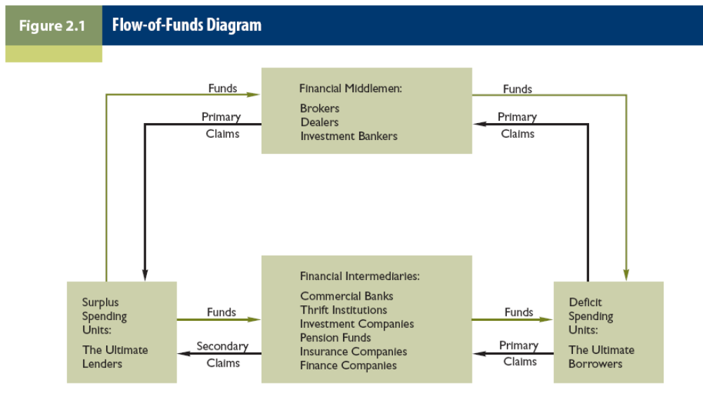
Flow of Funds in Virtual Economy
(Capital Markets)

Slide 7
To summarize …
Modern economy created by industrial revolution exhibits two separations:
  Separation of production and consumption by economic agents
  Separation of production and consumption over time
Financial industry’s role is to facilitate the connections of the two through voluntary exchanges
  In addition, creating a market for exchanging risks and rewards

Slide 8
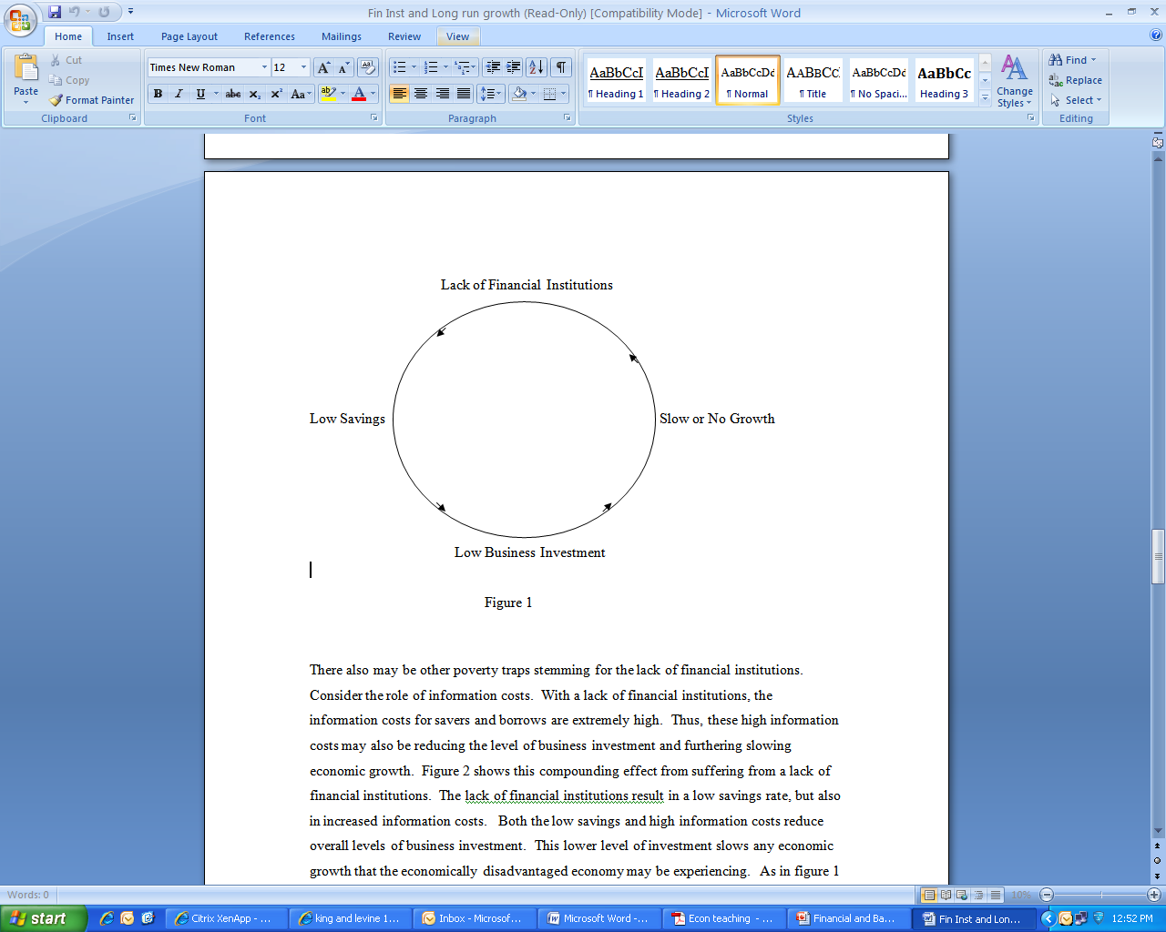
Financial Sector and Economic Growth
Development of a healthy financial sector promotes economic growth
  Information processing, risk diversification (to help investor holding specialized company stocks or projects), and liquidity provision (to prevent premature withdraw of investors) are fundamental functions
  Efficient resource allocation means lower transactions costs and higher portion of savings are funneled into investment with high returns
  Wasteful investment, measured by non-performing loans, hinders economic growth
Credit growth promotes economic growth, but only to a certain degree
  Excessive credit almost always increases the risk of volatility and reduced investment efficiency
Low-growth trap without financial system:

Slide 9
Which serves economy better: banks or capital markets?
There is a sharp contrast between Europe and US financial system in terms of whether financial services are provided by banks or capital markets
East Asian countries experienced a less dependence on banks as their capital markets develop
Academic research suggest that both “business models” can work to promote growth, what is important is not bank or capital market financing per se, but how the legal, regulatory framework that underpin the financial institutions function
Empirically, bank’s share of financial sector rises as economy emerge, reaches peak, and then tends to decline

Slide 10
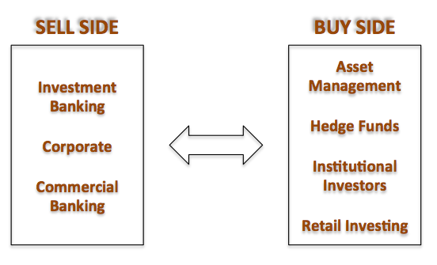
Buy side and sell side

Slide 11


Slide 12
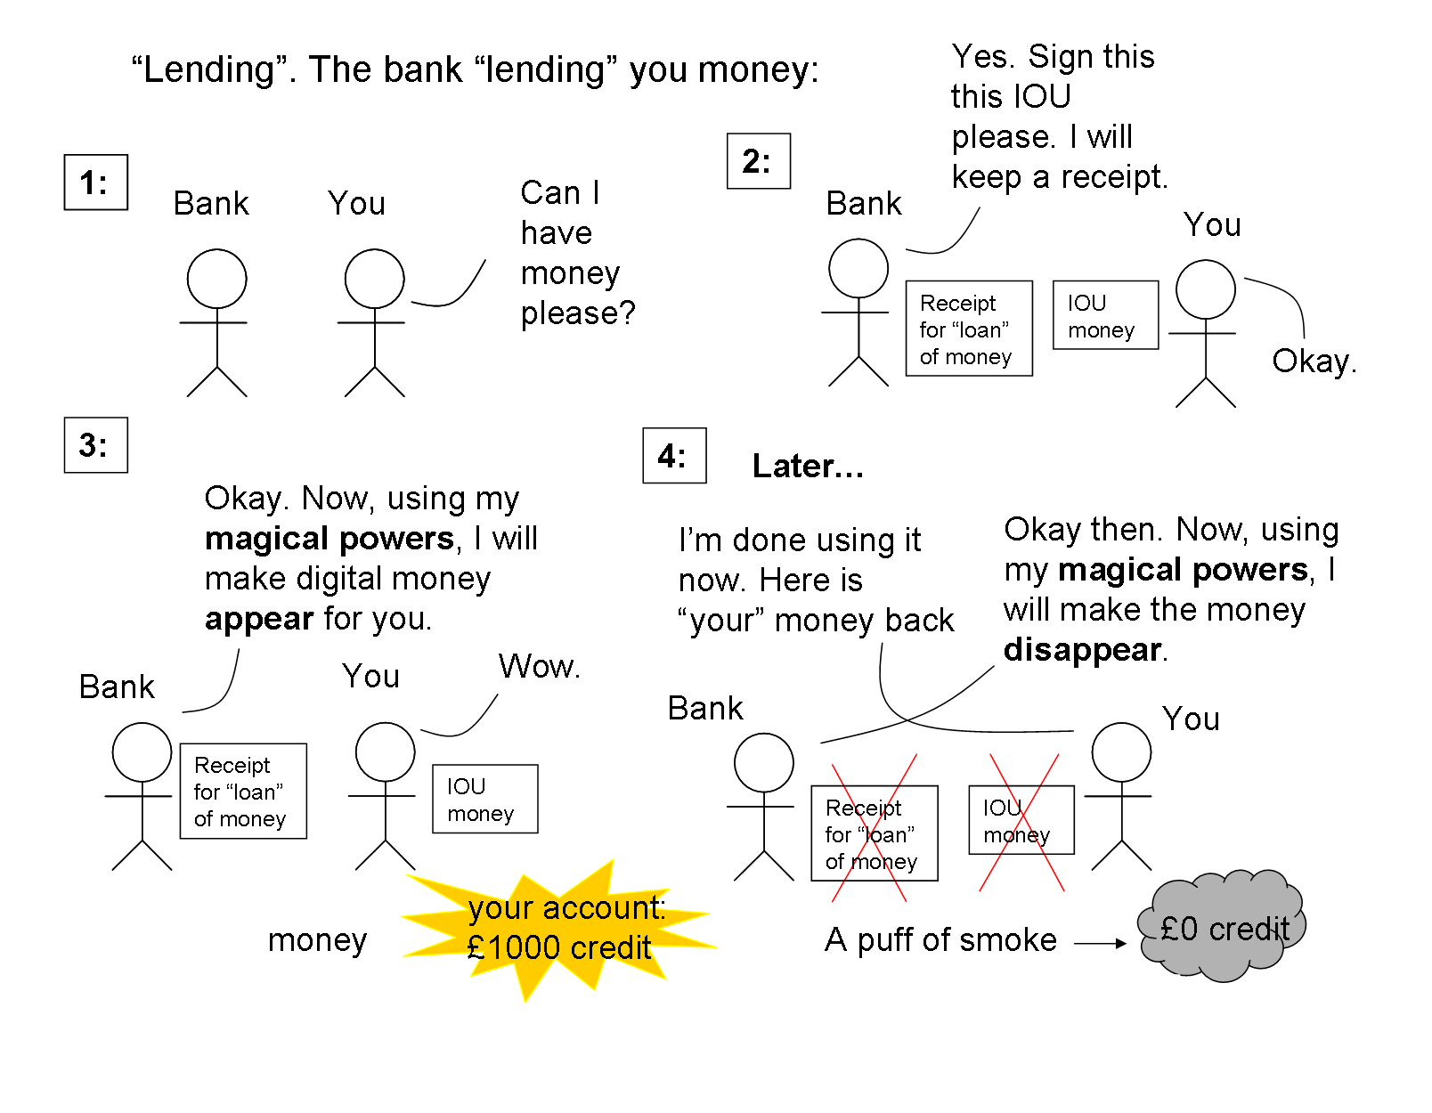
How do banks lend money?

Slide 13
The modern financial system rests on, and only on, one thing:
TRUST

Slide 14
The modern banking system
Central banks
Commercial banks
Investment banks
Banking regulators

Slide 15
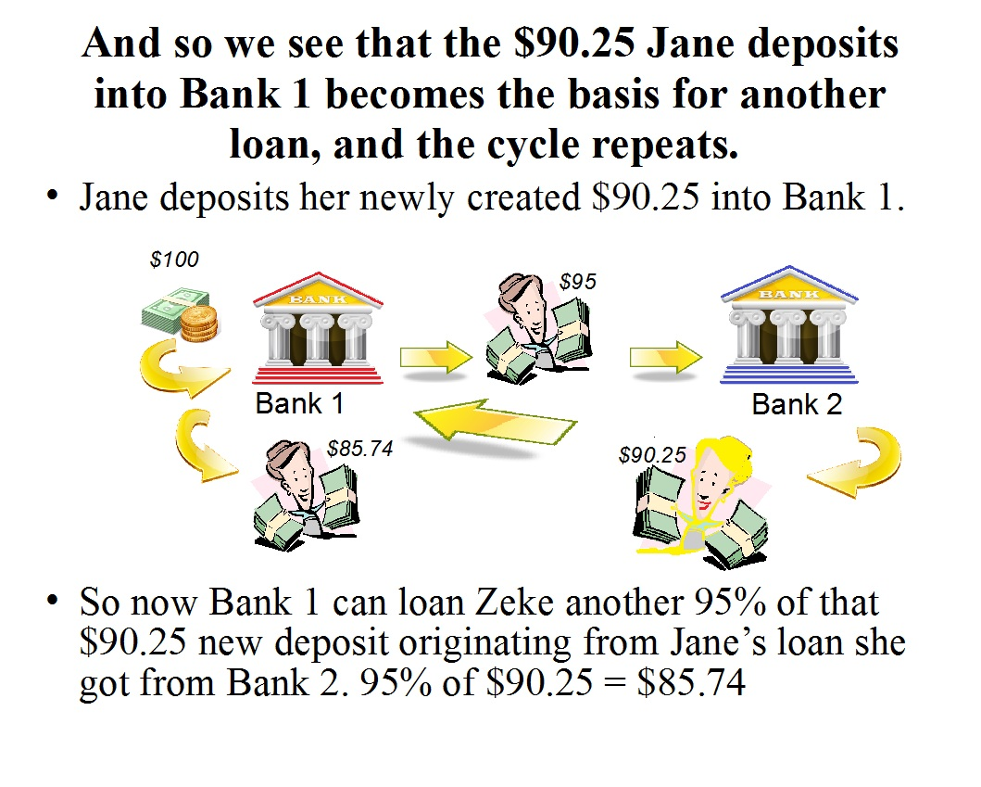

Slide 16
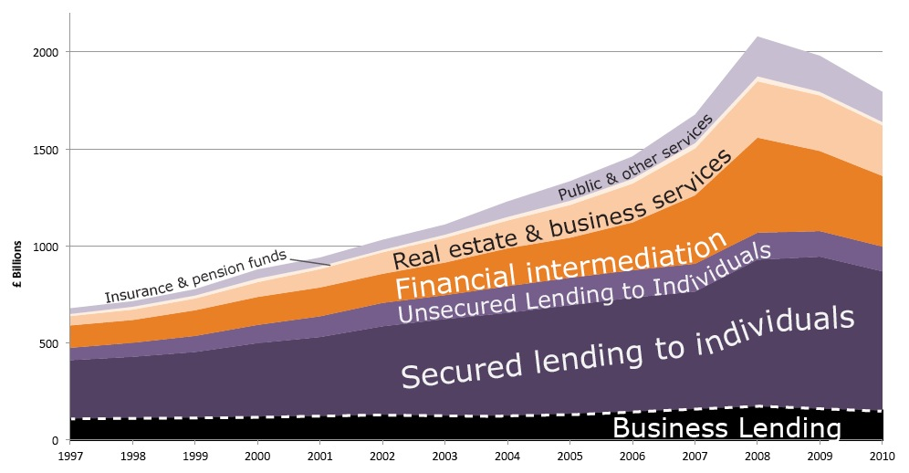
What do banks do?

Slide 17
Banks must follow regulations, but bankers will always be:
CREATIVE
Notes:
High pay attracts lots of smart, creative people, but also people who likes to make money!

Slide 18
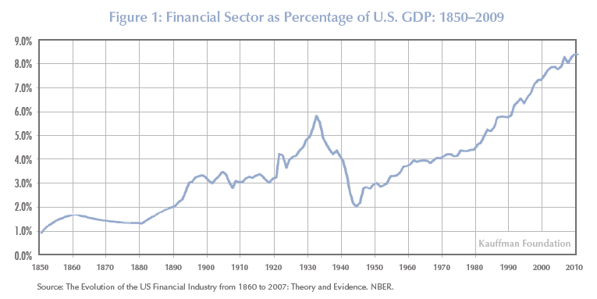

Slide 19
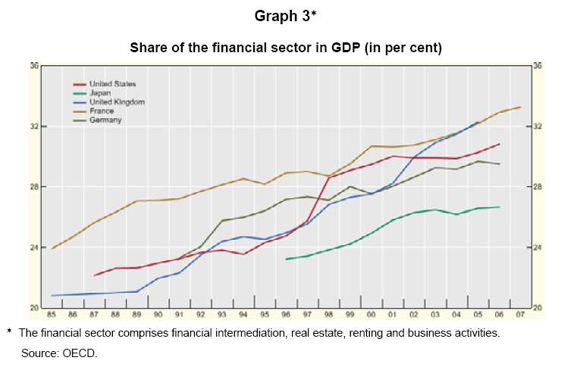

Slide 20
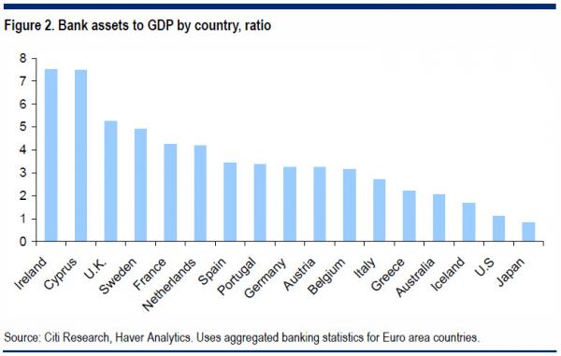
Published May 1, 2013

Slide 21
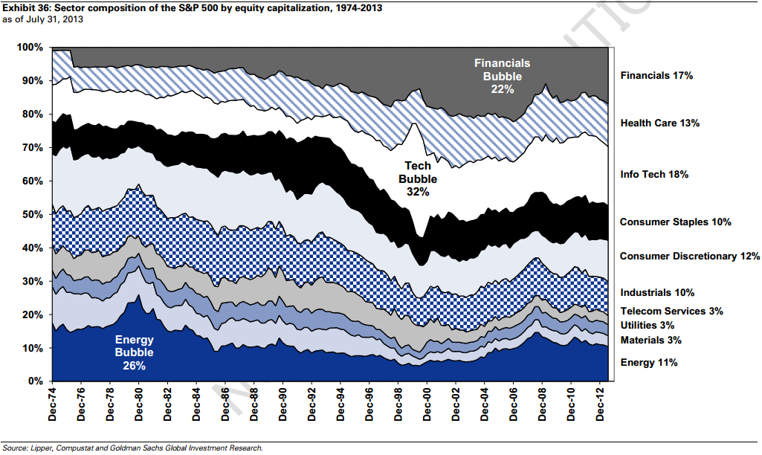

Slide 22
