Slide 1

Global Economy
Chapter 16
The Monetary System

Slide 2
Key Topics for Today
• What is money?
Central Banks
Commercial banks and the money supply
Bank Runs

Slide 3
What is money?
Set of assets in an economy that people regularly use to buy goods and services from other people.
Medium of exchange
An asset is said to be more or less liquid depending on how easily it is turned into the medium of exchange.
Money is very liquid

Slide 4
What is money?
Three traditional functions of money
medium of exchange
no money ⇒ barter
double coincidence of wants
unit of account
informationally efficient -- only need to know prices in terms of money.
store of value.

Slide 5
What is money?
Common to find these functions bundled together, but sometimes money loses latter two.
T-bills dominate dollars as a store of value
High inflation countries often price goods in dollars
Medium of exchange is primary function of money

Slide 6
What is money?
Ideal characteristics of money
• divisible
• uniform (or of recognizable quality)
• durable
• portable

Slide 7
What is money?
Types of money
Commodity money
Money that represents a claim on gold or silver
Fiat money
Money that has value only because it is an accepted means of payment
Mass hallucination?

Slide 8
What is money?
The money stock is difficult to measure since there are many assets that have varying degrees of liquidity or “moneyness”
Currency
Monetary base = currency + bank reserves
M1 = currency + demand deposits
M2 = M1 + savings and time deposits
Financial innovation makes more and more assets liquid

Slide 9
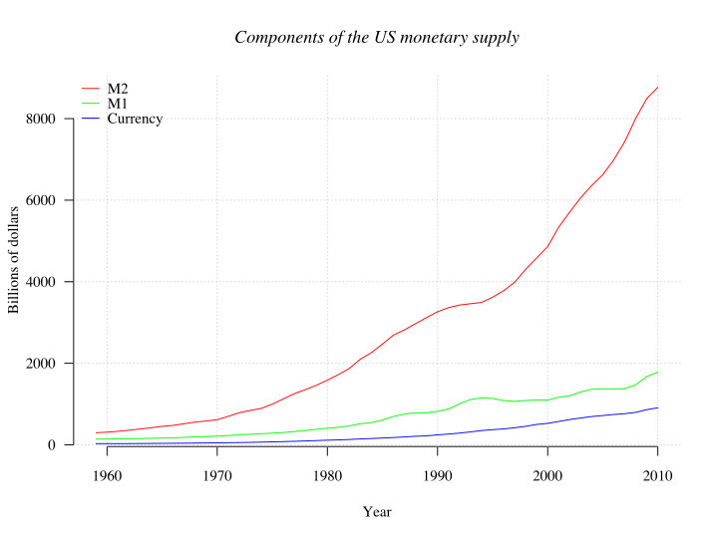

Slide 10
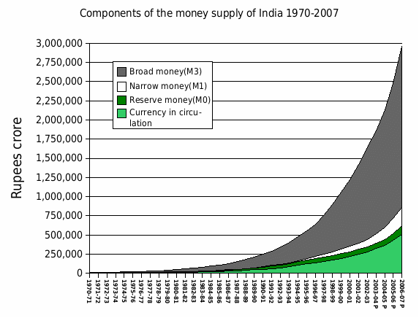

Slide 11
What is money?
Credit cards are not money
Short term loan – credit
Payment occurs when medium of exchange changes hands

Slide 12
What is money?
Review: Lots of terms/concepts
Liquidity
Medium of exchange/unit of account/store of value
“Double coincidence of wants”
Fiat and commodity money
Monetary base
Reserves

Slide 13
Central Banks
Most countries have a financial institution with responsibility over the money supply
Federal Reserve, Bank of England, European Central Bank, Hong Kong Monetary Authority

Slide 14
Central Banks
Control the amount of money in circulation through “purchases” of assets.
The Federal Reserve injects dollars into the economy by purchasing government bonds
Fed buys a bond → pays with money → more money & fewer bonds in the economy
Remove dollars by selling bonds
“Open market operations”

Slide 15
Central Banks
Control the amount of money in circulation through “purchases” of assets.
The Hong Kong Monetary Authority buys and sells US dollars for Hong Kong dollars
The European Central Bank borrows bonds in exchange for Euro (repurchase agreements)

Slide 16
Central Banks
Central Banks differ in the freedom that they are granted to undertake such transactions
Federal Reserve as complete discretion to make trades (subject to Congressional oversight)
Hong Kong Monetary Authority buys one US dollar at 7.75 Hong Kong dollar and sells US dollar at 7.85 Hong Kong dollar
Rules vs Discretion

Slide 17
Money Supply
Monetary base = currency + bank reserves.
Central Bank controls the monetary base through open market operations.
M1 depends on private decisions
Consumers’ preferences over cash and deposits.
Banks’ preferences over reserves.

Slide 18
Banks, Reserves, and the Money Supply
Reserves = deposits that banks receive but don’t loan out.
Reserve ratio = the fraction of deposits a bank holds as reserves.

Slide 19
100% Reserve Banking
Central Bank buys a bond worth 1,000. The payment for the bond is deposited with Bank One.
Banks have no control over the money supply
Banks are basically safe deposit boxes
BANK ONE
ASSETS |  | LIABILITIES
Reserves | 1,000 | Deposits | 1,000
 | 1,000 |  | 1,000

Slide 20
Fractional Reserve Banking: Only 10% reserves
Bank One decides NOT to hold 100% reserves. Instead, they
keep 10% of deposits as reserves
lend out 90% of deposits to Carmen
Carmen uses the money to buy a car from Tom
BANK ONE
ASSETS |  | LIABILITIES
Reserves | 100 | Deposits | 1,000
Loans | 900
 | 1,000 |  | 1,000

Slide 21
Fractional Reserve Banking: Only 10% reserves
Bank Two receives a check for 900 from Tom and:
keeps 10% as reserves
lends out the remaining 90% to Oleg
Oleg uses the money to buy a computer for his business from Peter
BANK TWO
ASSETS |  | LIABILITIES
Reserves | 90 | Deposits | 900
Loans | 810
 | 900 |  | 900

Slide 22
Fractional Reserve Banking: Only 10% reserves
Bank Three receives a check for 810 from Peter and:
keeps 10% as reserves
lends out the remaining 90% to Nneka
BANK THREE
ASSETS |  | LIABILITIES
Reserves | 81 | Deposits | 810
Loans | 729
 | 810 |  | 810

Slide 23
Money Supply
Money supply > quantity of reserves
Sense in which banking system creates money
Money multiplier = 1
Reserve Ratio
Initial Deposit at Bank One | 1,000
New deposit at Bank Two | 900 | = 1000 x (1-0.1)
New deposit at Bank Three | 810 | = 900 x (1-0.1)
New deposit at Bank Four | 729 | = 810 x (1-0.1)
Total money supply | 10,000 | = 1000 x 1______ Reserve ratio

Slide 24

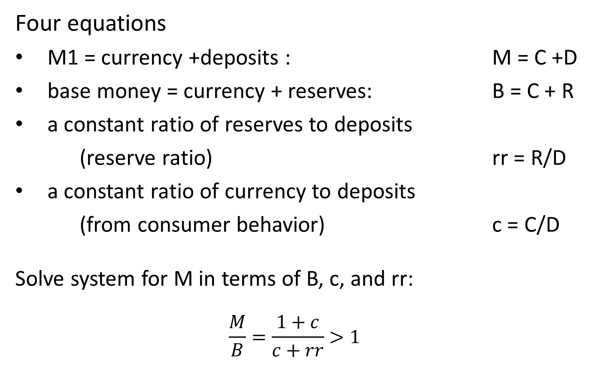
Money multiplier in general
Four equations
M1 = currency +deposits : M = C +D
base money = currency + reserves: B = C + R
a constant ratio of reserves to deposits
(reserve ratio) rr = R/D
a constant ratio of currency to deposits
(from consumer behavior) c = C/D
Solve system for M in terms of B, c, and rr:
$$\frac{M}{B}=\frac{1+c}{c+rr}>1$$

Slide 25
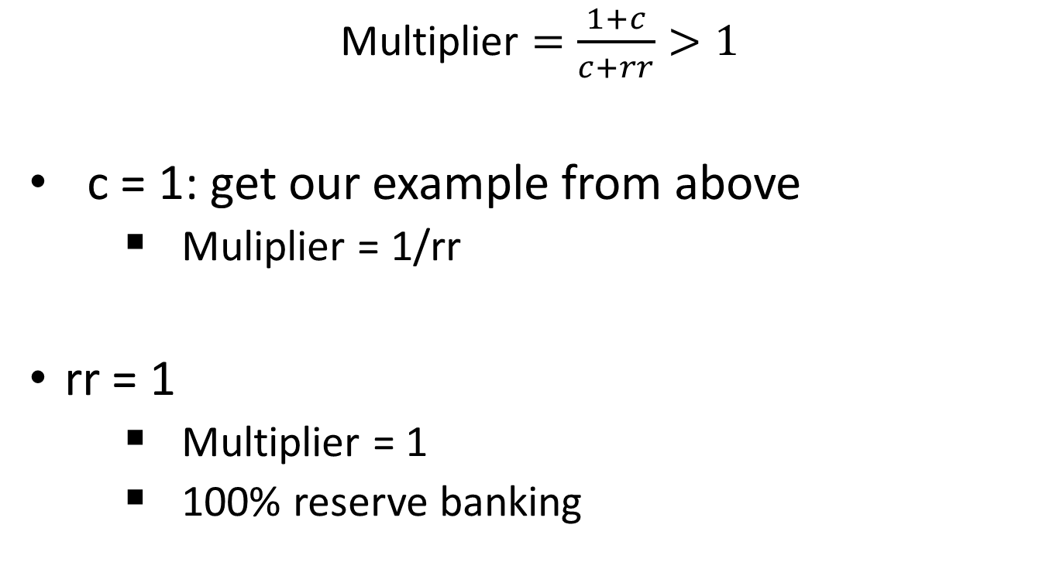
Money multiplier special cases
Multiplier $=\frac{1+c}{c+rr}>1$
c = 1: get our example from above
Muliplier = 1/rr
rr = 1
Multiplier = 1
100% reserve banking

Slide 26
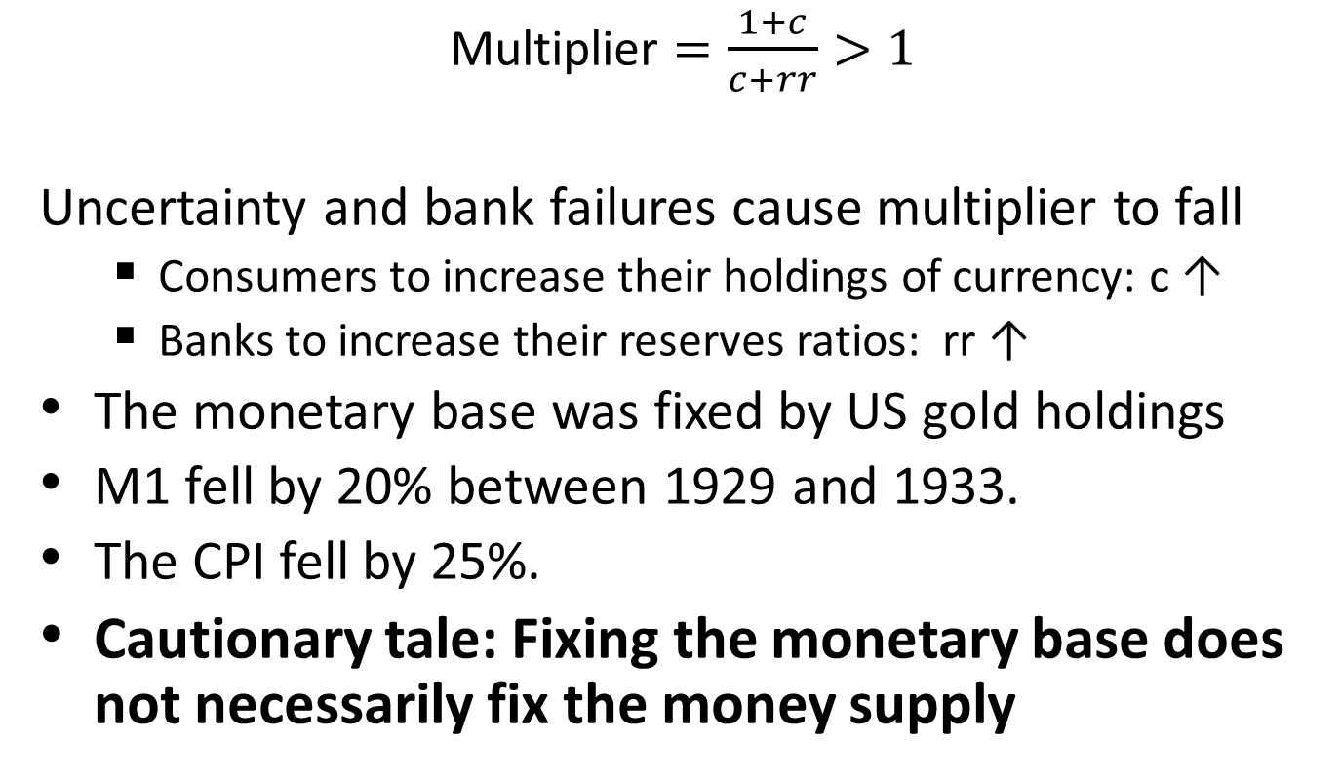
The multiplier during the Great Depression
Multiplier $=\frac{1+c}{c+rr}>1$
Uncertainty and bank failures cause multiplier to fall
Consumers to increase their holdings of currency: c ↑
Banks to increase their reserves ratios: rr ↑
The monetary base was fixed by US gold holdings
M1 fell by 20% between 1929 and 1933.
The CPI fell by 25%.
Cautionary tale: Fixing the monetary base does not necessarily fix the money supply

Slide 27
Tools of Central Banks
Open market operations
Reserve requirements
Direct lending
Discount window
Interest on reserves
Regulation of the banking system

Slide 28
Bank Runs
Bank Balance Sheet
Leverage = Assets/Net worth (here = 20)
Bank A
ASSETS |  | LIABILITIES
Reserves | 100 | Deposits | 800
Loans | 700 | Debt | 150
Government Securities | 200 | Net Worth | 50
 | 1,000 |  | 1,000

Slide 29
Bank runs
Leverage amplifies effect of asset gains and losses on net worth -- means of taking on more risk

Slide 30
Bank Runs
Consider our bank from the previous slide
Suppose that loans perform unexpectedly well – value rise by 100
Assets rise by 100 or 10%
Net worth rises by 100 or 200% (recall leverage ratio was 20)
Bank A
ASSETS |  | LIABILITIES
Reserves | 100 | Deposits | 800
Loans | 700+100 | Debt | 150
Government Securities | 200 | Net Worth | 50+100
 | 1,100 |  | 1,100

Slide 31
Bank Runs
Problem: Also works in reverse
Suppose that loans perform unexpectedly poorly – value fall by 100
Loan falls from 700 to 600
Net worth becomes negative -- insolvent
Bank A
ASSETS |  | LIABILITIES
Reserves | 100 | Deposits | 800
Loans | 700-100 | Debt | 150
Government Securities | 200 | Net Worth | -50
 | 900 |  | 900

Slide 32
Bank Runs
Insolvency
Negative net worth
Not enough assets to pay all depositors and creditors
Illiquidity
Banks often lend long term and borrow short term
Deposits are short term liabilities – can be claimed at any time.
Under fractional reserve banking system never enough liquid assets (mainly reserves) to satisfy all creditors should all creditors demand their money at once.

Slide 33
Bank Runs
Problem 1: Often very difficult to tell if a bank is insolvent or illiquid.
Governments may want to aid illiquid banks.
Costly to aid insolvent banks – throwing good money after bad.

Slide 34
Bank Runs
Problem 2: Self fulfilling crises
Suppose for some reason depositors come to believe a bank is insolvent.
All rush to get their money out first
Since bank is in fact illiquid, not all will get their money

Slide 35
Bank Runs
Example:
President of Knickerbocker Trust was associated with a failed attempt to corner the copper market.
Led to questions regarding soundness of the Trust and a run on the bank, a run that triggered the panic of 1907.
Years later when the assets of the bank were all counted, all depositors got their money back.
The trust was illiquid not insolvent.

Slide 36
Bank Runs
After the bank runs of 1933 the US instituted deposit insurance.
Deposits up to $250,000 are insured
Removes incentive to remove money at hint of bank failure
Bank runs are now rare – no bank runs in US during recent financial crisis.

Slide 37
Bank Runs
Deposit insurance only protects depositors, not other creditors such as bond holders.
Banks increasingly funded by short term debt.
Lehman failure was like a bank run.
Short term debt holders tried to get their money out ahead of others.

Slide 38
Bank Runs
Problem 3: Banks have incentives to take excessive risk.
A levered financial institution, can make money if its investments pan out
With limited liability its losses are capped by its net worth.
Form of moral hazard -- externality
Lehman targeted a 5% failure rate.
Note: depositors do not care since they are insured, bond holders may charge higher interest rates, except…..

Slide 39
Bank Runs
Problem 4: To big to fail
Many financial institutions are so central to the workings of the economy, that their failure would be predicted to cause much pain and suffering.
The government has an incentive to bail these institutions out.
This is like giving insurance to the bond holders, even though they did not pay for it.

Slide 40
Bank Runs
In response to recent financial crisis:
Attempts to increase capital requirements
Limits on leverage
Attempts to reign in Fed’s ability to bail out failed financial institutions
Dodd-Frank

