Slide 1
Context Engineering Techniques for AI Agents
Morgan Willis
AWS

Slide 2
4K → 32K → 128K → 1M → 2M tokens
Just add more tokens, that’ll fix it
Notes:
As context windows grow in size, when agents don’t do what you want the initial instinct might be to include more context, examples, constraints. Just prompt the agent harder, that should fix it, right? Wrong. Why doesn’t this work?

Slide 3
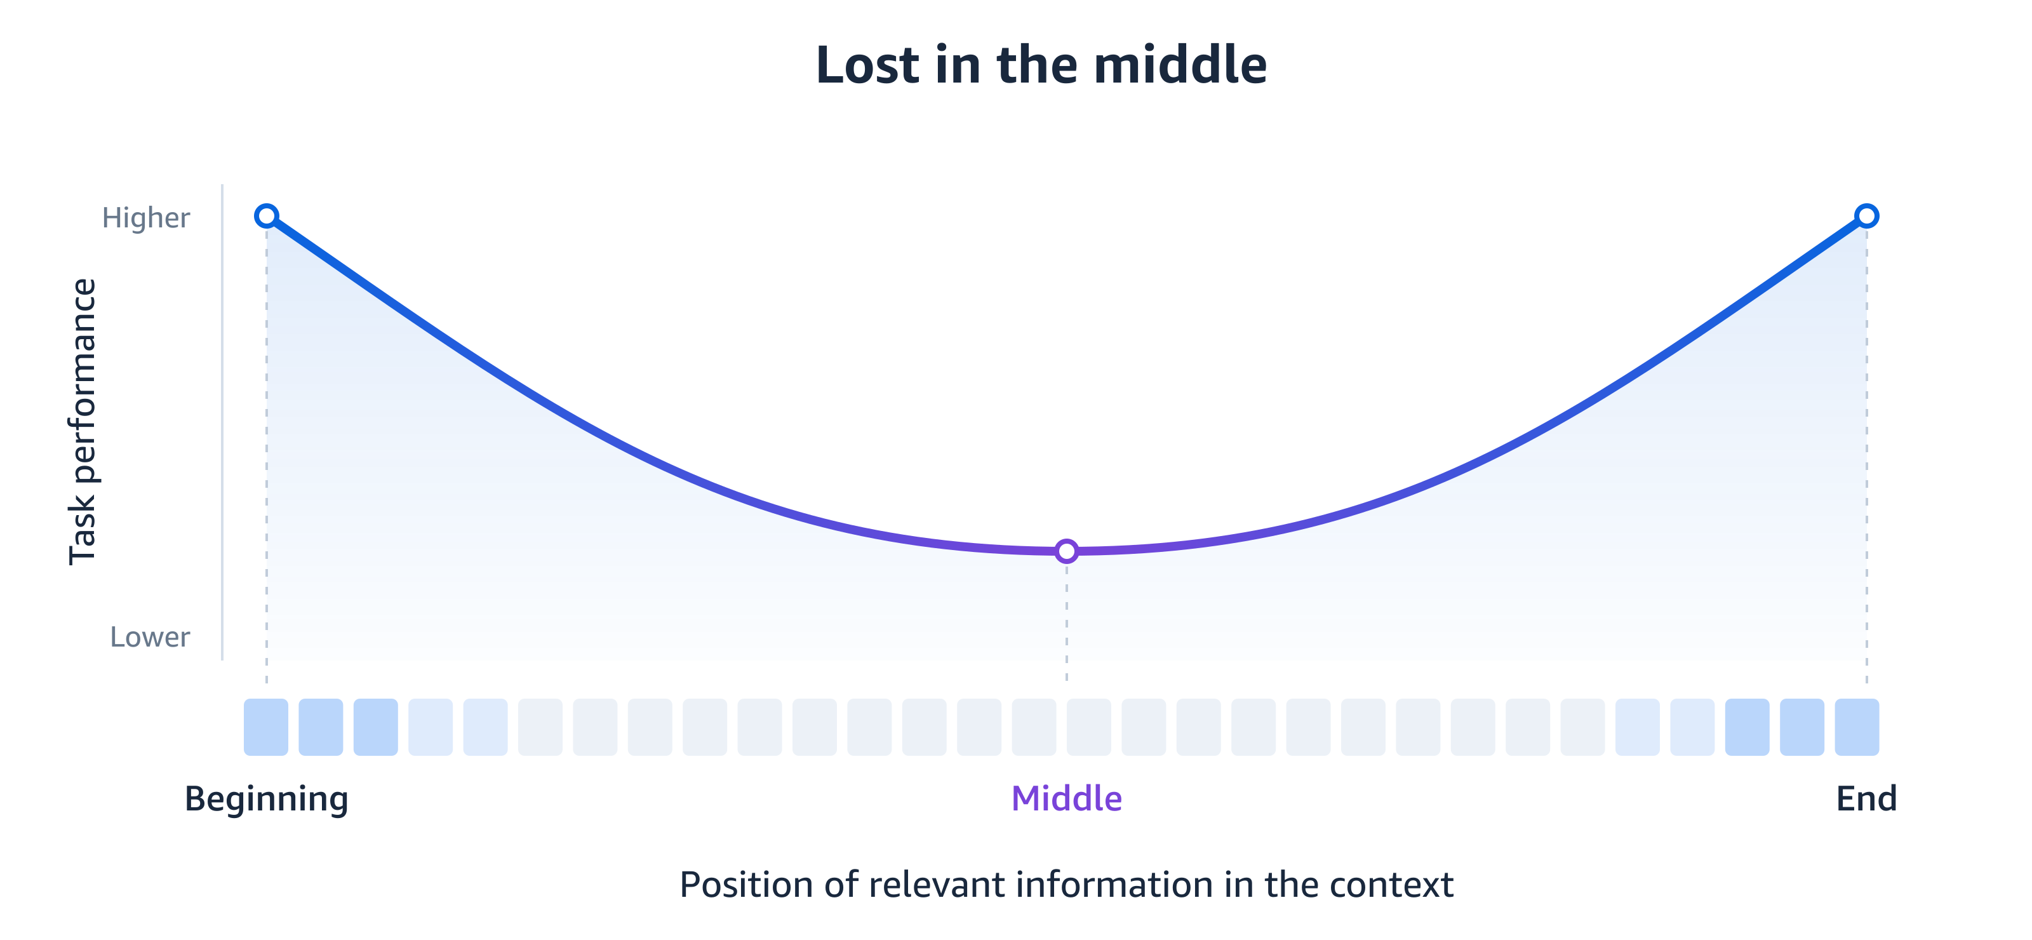
Why It Doesn't Work
Notes:
And theres the cost of it all, you may get some performance as models get better but there is something called the lost in the middle effect. You don’t get the full context window, agents have degraded performance over certain thresholds so you aren’t getting the benefit of the full context window and you are paying for the tokens anyways. You need to find the balance that gives you the highest performance at the best cost.

Slide 4
Context Engineering
Giving the model the information it needs when it needs it.
Curating the context window for optimal outcomes and token consumption.

Slide 5
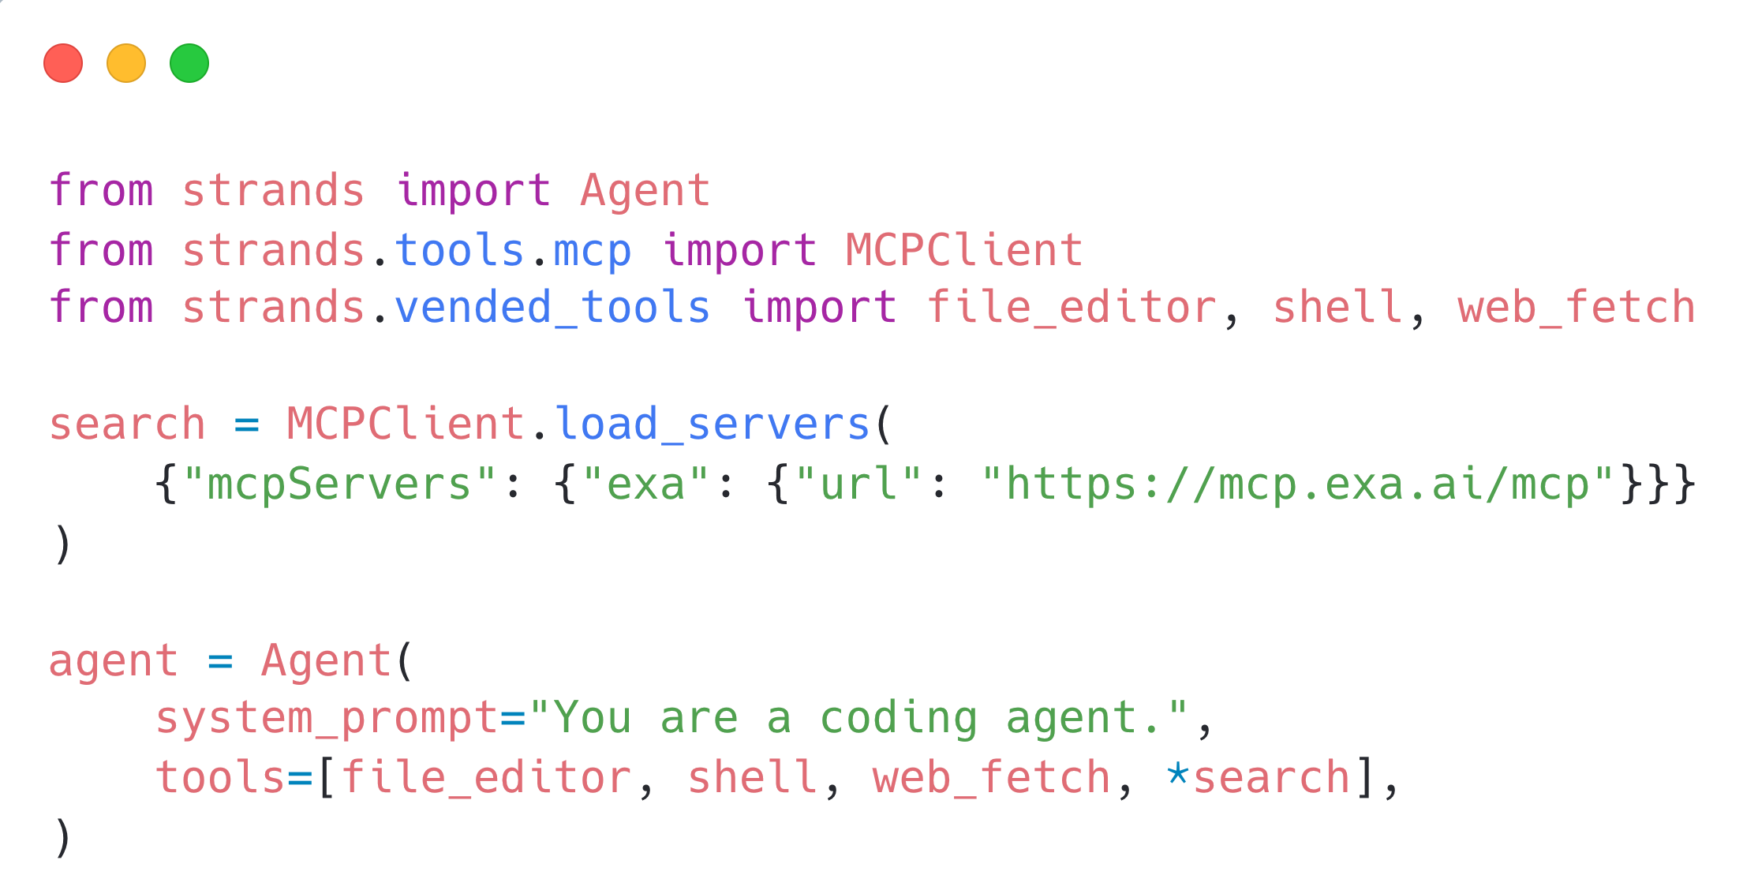
Notes:
We will use the Strands Agents SDK for individual context-engineering patterns, then Strands Harness to assemble the defaults. This starting agent uses file_editor, shell, and web_fetch from strands.vended_tools. Exa supplies web search through its hosted MCP server. MCPClient.load_servers returns clients; *search includes those clients in the agent tools, with lifecycle managed by Strands. Exa does not require an API key to get started with this hosted endpoint.
Install the web-fetch extra: pip install "strands-agents[web-fetch]"
web_fetch reads a known URL; Exa discovers pages through search. The default web_fetch mode uses an analyst agent to answer a targeted prompt about the page.
A base Agent maintains conversation history and has default conversation management. We have not yet configured the automatic offloading and summarization strategy, persistent sessions, long-term memory, or skills shown later.
Sources: https://strandsagents.com/docs/user-guide/sdk/tools/vended-tools/
https://strandsagents.com/docs/user-guide/sdk/tools/mcp-tools/
https://exa.ai/docs/reference/exa-mcp

Slide 6
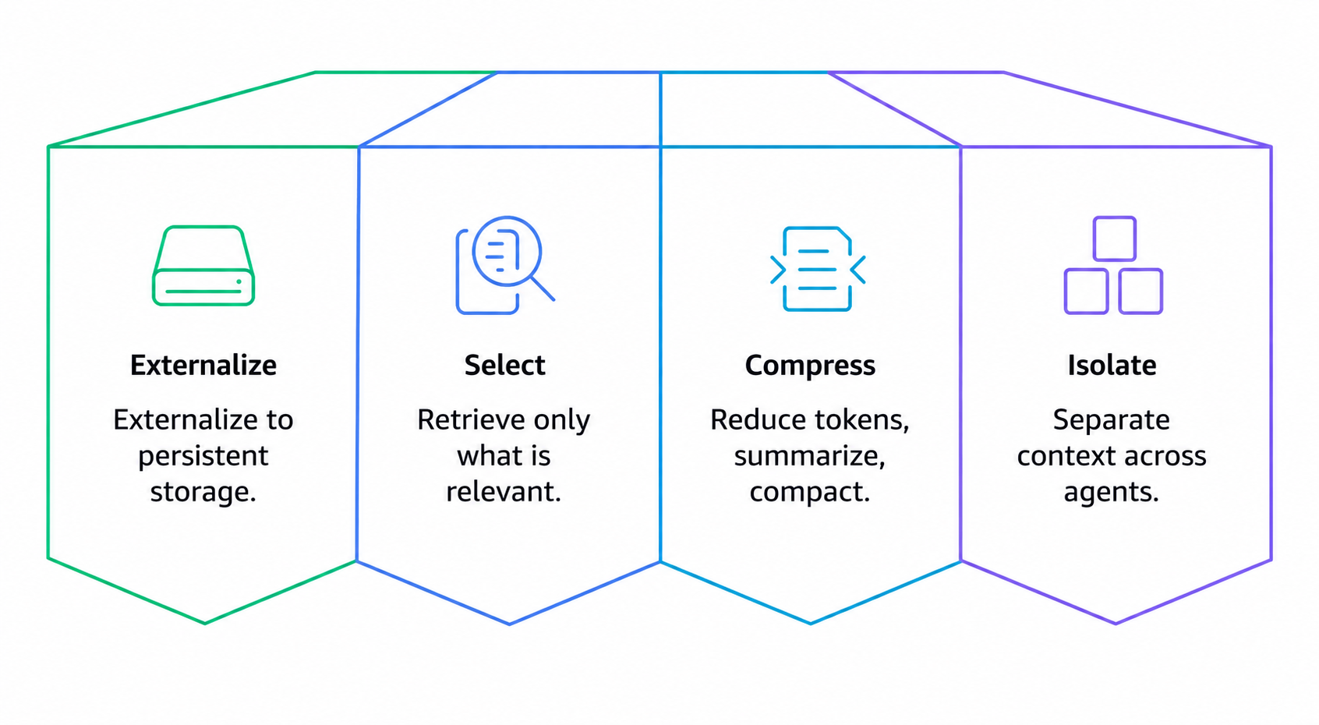
Context Engineering Strategies
Notes:
Will show examples for each of these then at the end show you a one line default that gives you a reasonable default ouf the box

Slide 7
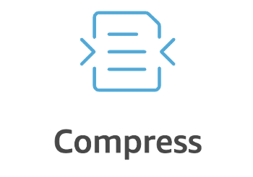
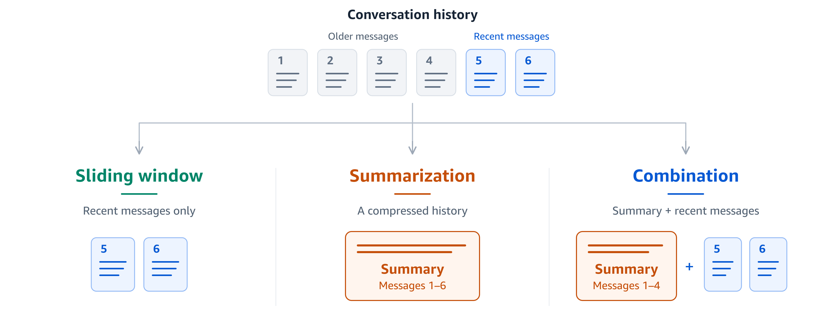
The Starting Point:
Conversation Management
Notes:
Add a built-in conversation manager with an eviction policy
Sliding Window
Summarization
Combination
Forgets too fast and remembers for too long
Summarization compacts relevant and important details
Sliding window is too absolute

Slide 8
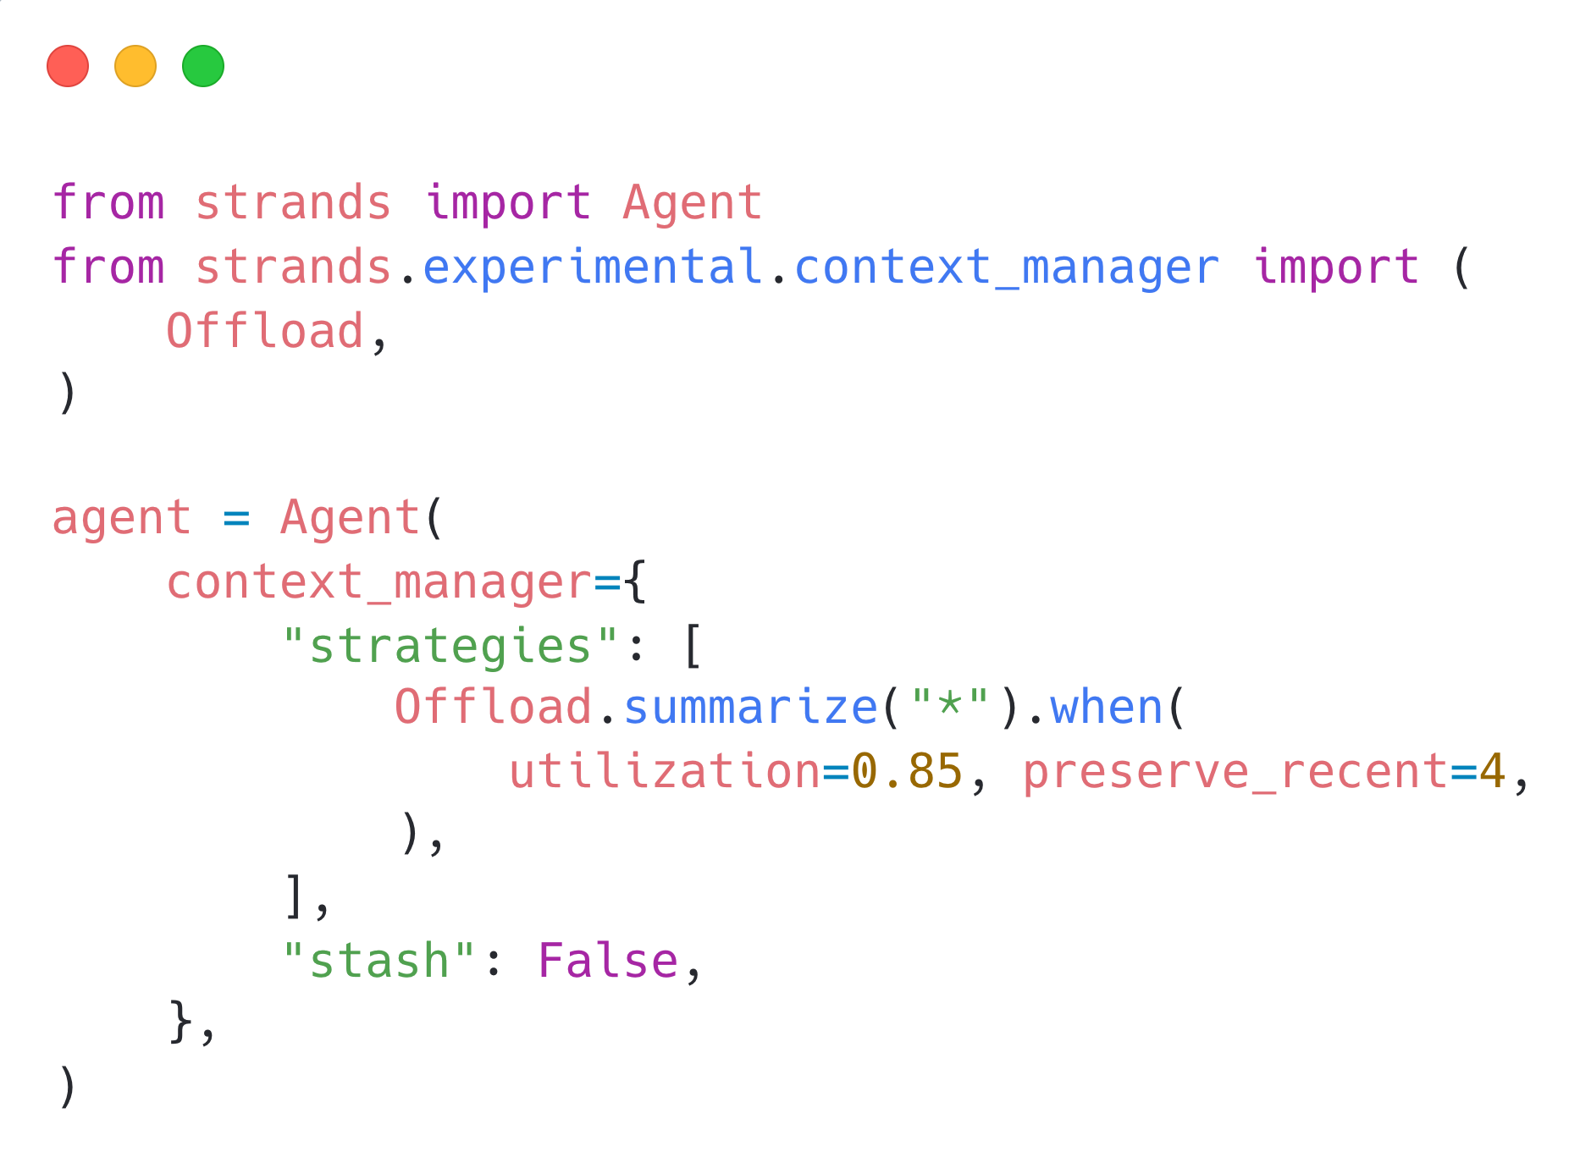
Notes:
This example uses the experimental strategy API. At 85% estimated context utilization, summarize older messages and preserve the four most recent matching messages. Stash is disabled here to show compression by itself; later we add durable storage and retrieval. You can provide a separate summarization model and a system_prompt through Offload.summarize options to preserve workload-specific details.
Source: https://strandsagents.com/docs/user-guide/sdk/context-management/custom-strategies/

Slide 9
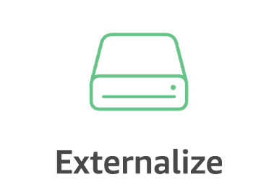

Tiered Memory
Short-term memory
Long-term memory
Relational memory
Recent conversation history
Last k-turns always returned
Sliding window + summarization
Extracted from conversation history
Clean facts > raw conversation
Scored retrieval
Entity graph
Traversal based
How things connect
Notes:
These are useful memory patterns, not three capabilities that every agent gets automatically. Short-term memory manages the active conversation. Long-term memory extracts and retrieves useful facts across tasks. Relational memory adds entities and relationships when the application needs them. The next example connects a standard Strands Agent to AgentCore long-term memory through MemoryManager and AgentCoreMemoryStore; it does not configure a graph backend.

Slide 10
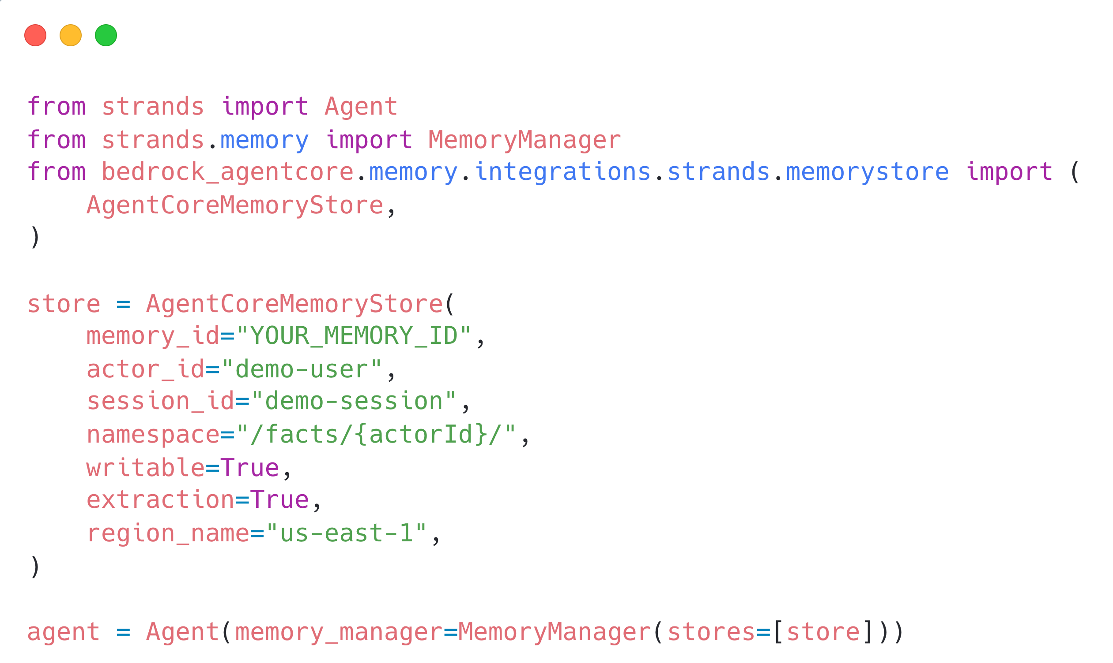
Notes:
This connects a standard Strands Agent to AgentCore long-term memory through MemoryManager. writable=True permits sending conversation messages, and extraction=True enables dispatch to AgentCore for server-side extraction. MemoryManager provides recall and context injection.
Setup: install strands-agents and bedrock-agentcore. Replace YOUR_MEMORY_ID with an existing AgentCore Memory resource in us-east-1. Configure its semantic memory strategy to write to /facts/{actorId}/, or change the namespace in this example to match the strategy already configured. The store does not provision the resource or its strategies.
This store recalls the facts namespace. Preferences or summaries in other namespaces require additional read stores or an appropriate subtree query, with only one writer for a shared conversation stream. AgentCore extraction is eventually consistent: newly written knowledge may not be immediately searchable. This is long-term knowledge retrieval, not restoration of the full conversation session.
Python source and usage: https://github.com/aws/bedrock-agentcore-sdk-python/blob/main/src/bedrock_agentcore/memory/integrations/strands/memorystore/README.md
Strands memory management: https://strandsagents.com/docs/user-guide/sdk/memory/managing-memory/

Slide 11
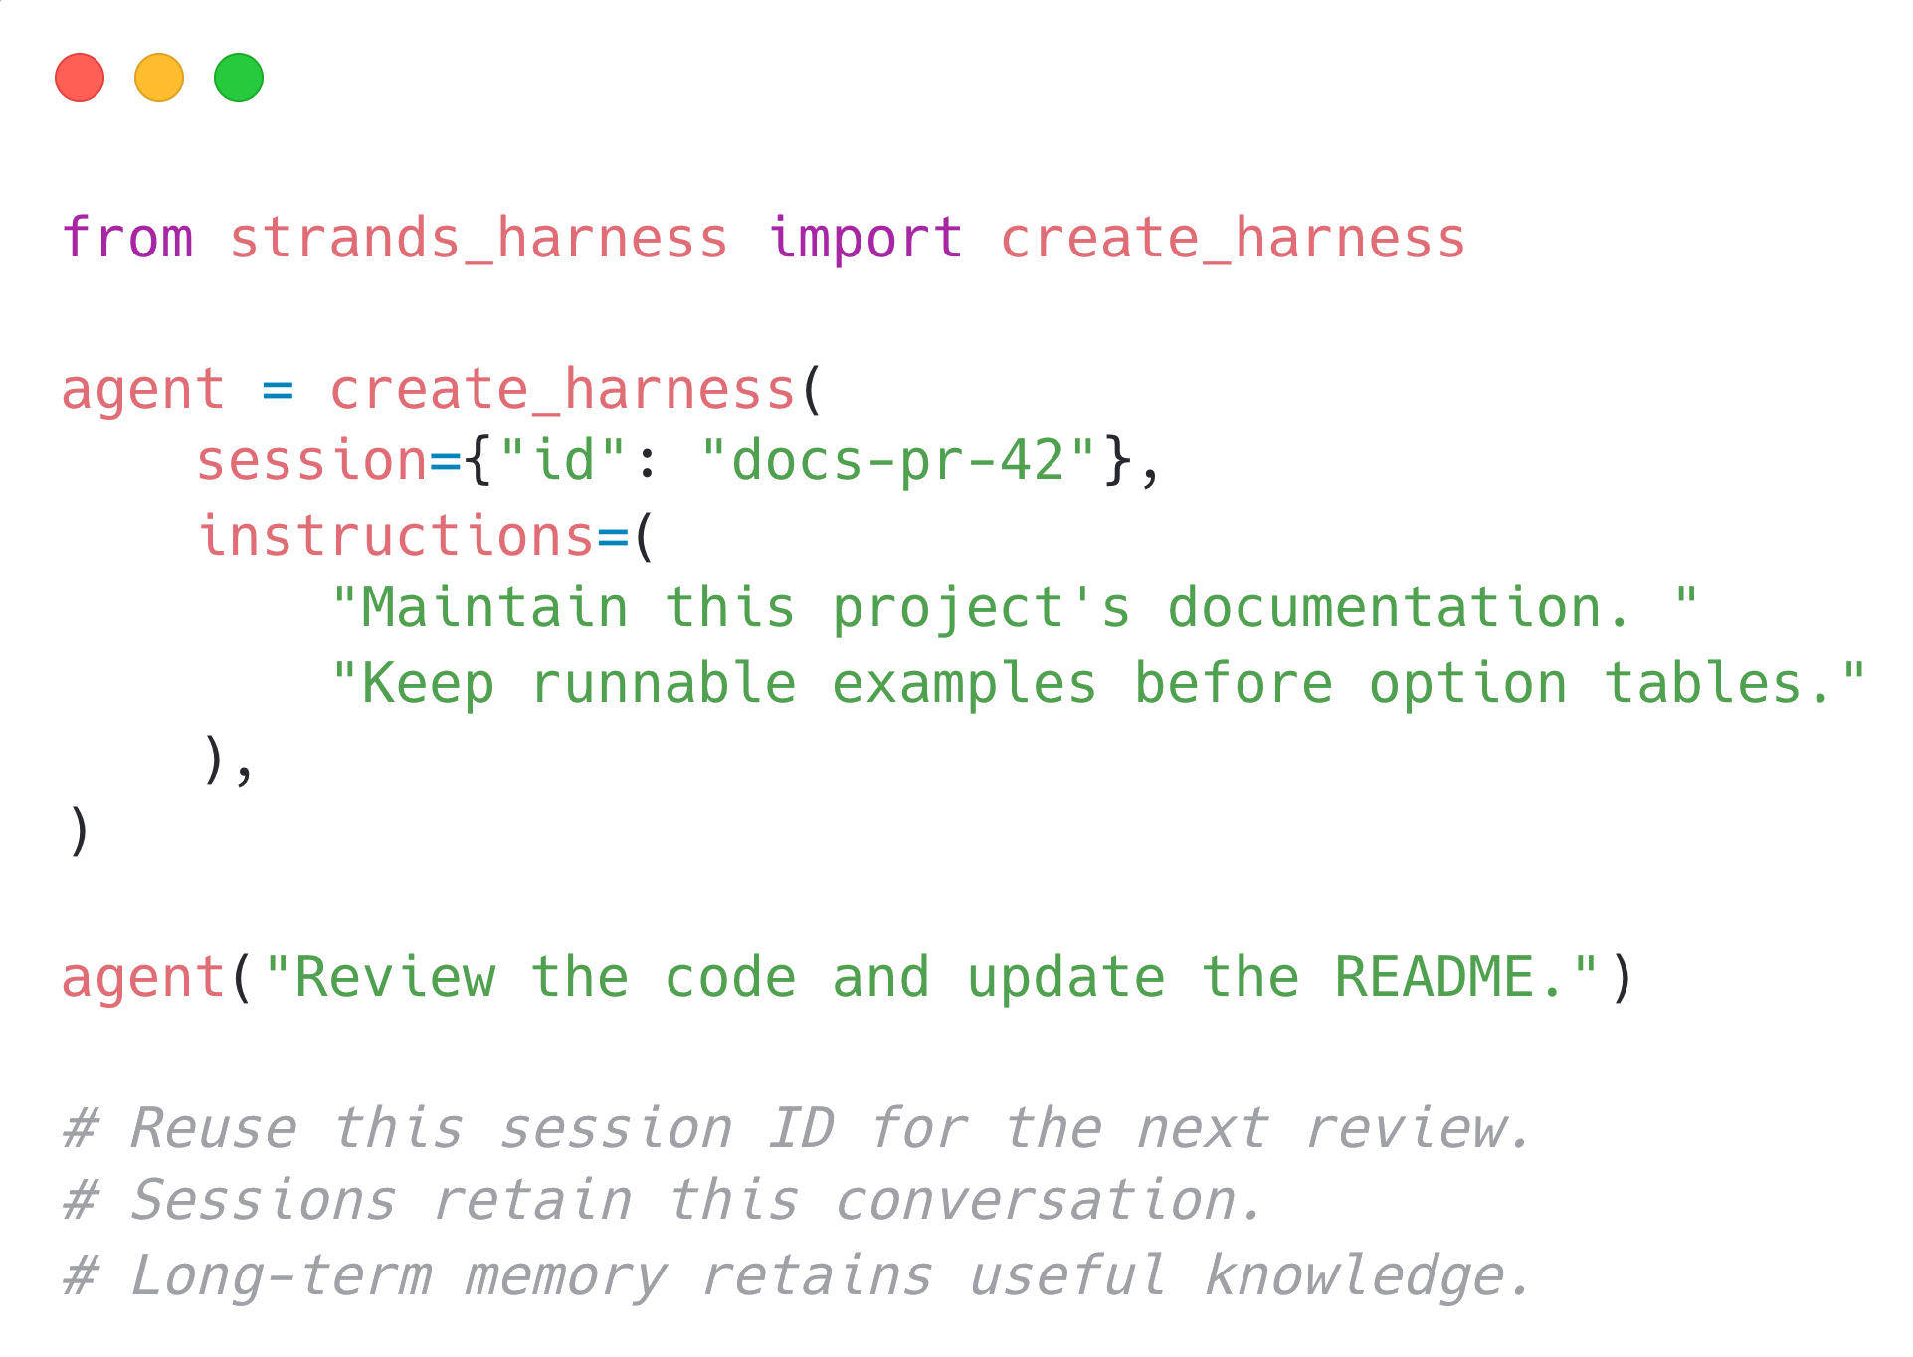
Notes:
Harness combines conversation management, sessions, and long-term memory. Reusing a session ID resumes this conversation when the saved session files are available. Long-term memory separately extracts useful knowledge for later tasks. This example uses the default local stores. A CI workflow must save and restore these files across runners.
Sources: https://strandsagents.com/docs/user-guide/harness/quickstart/
https://builder.aws.com/content/3JgWF0T6PorfoRq7EdgkwO3F96P/stop-starting-from-scratch-build-agents-with-strands-harness

Slide 12
Tool-Driven Context Injection
Agents need more than just conversation history
Give the agent tools to pull data from knowledge bases (RAG), file systems, MCP servers, and APIs on demand
Skills use progressive disclosure
The agent decides what to retrieve and when
Notes:
Agents use tools and hooks to bring in data into context. You can bring data in using RAG, leave it to the agent to search for the best fit. Or you can use hooks for deterministic injection of data if your agent always needs some sort of context for its use case.

Slide 13
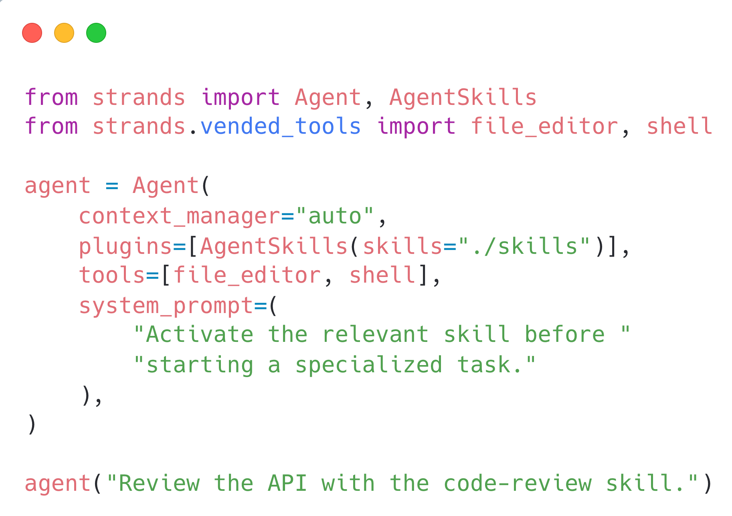
Notes:
Skills select specialized instructions only when needed. AgentSkills exposes available skills, and the agent activates the relevant skill before doing the task. The file_editor and shell tools come from strands.vended_tools. context_manager="auto" manages the conversation separately.
Source: https://builder.aws.com/content/3J36U47bvNh8qnt6KgNPUVP08q1/quit-tokenmaxxing-4-tips-for-context-engineering-with-code-samples

Slide 14
Offload Large Tool Results
Tool results can be verbose and eat up your context window
Most of it is not relevant to every single turn of the agent loop
Configure offloading to keep a preview and stash the original
Let the agent retrieve the full result when it needs more detail
Notes:
Tools like http requests, reading data from database, retrieving log files, Api results can be very verbose. Use tool result offloading to externalize that data and only bring it in when needed

Slide 15
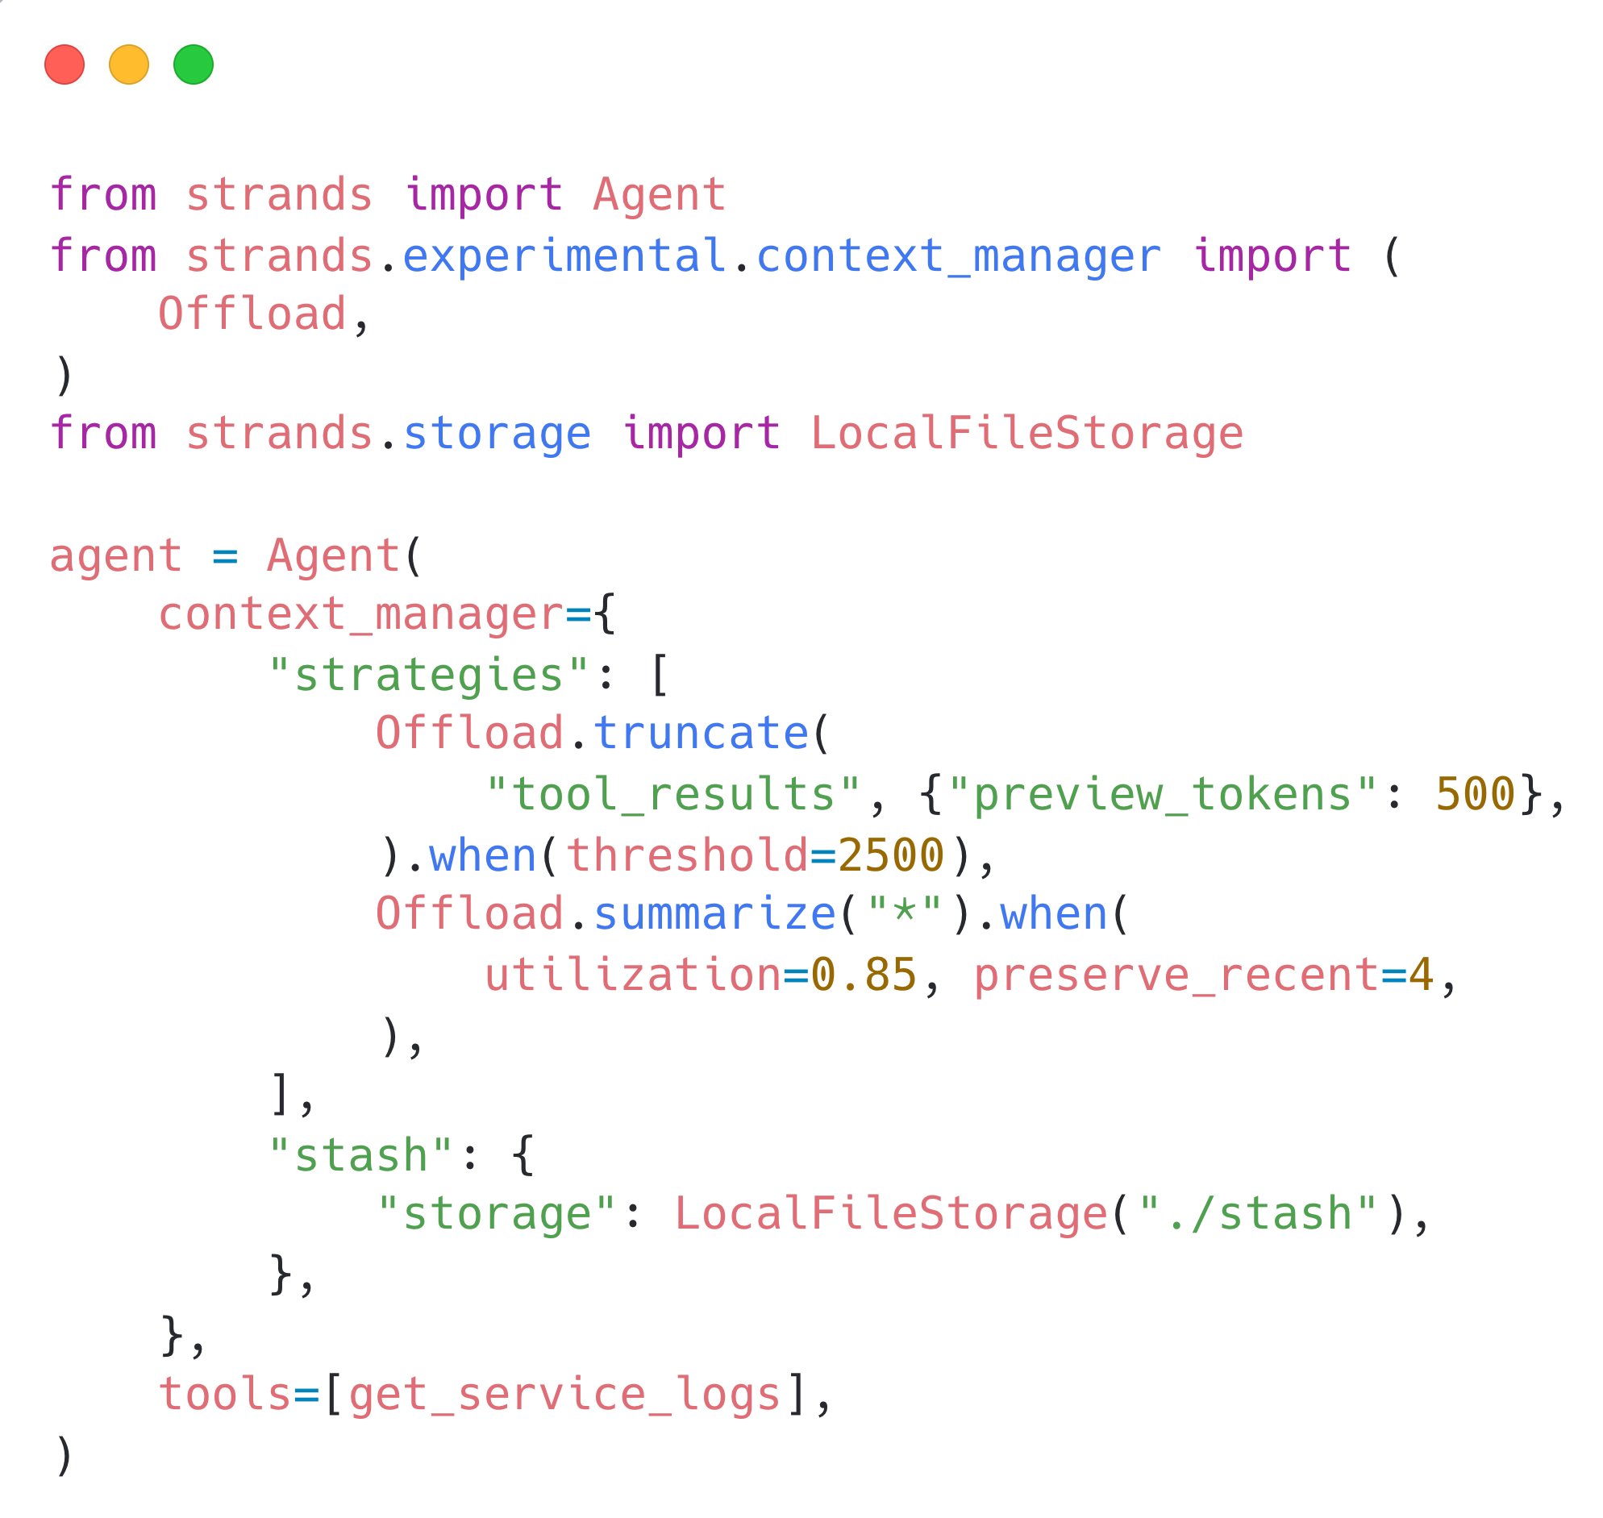
Notes:
Offload truncates tool-result blocks larger than 2,500 tokens to a 500-token preview, then summarizes at 85% utilization while preserving four recent messages. Original content is stashed in LocalFileStorage and can be retrieved with the SDK-provided retrieve_context tool. get_service_logs is the application tool from the blog example; its definition is omitted here. These strategies are currently experimental.
Source: https://strandsagents.com/docs/user-guide/sdk/context-management/custom-strategies/

Slide 16
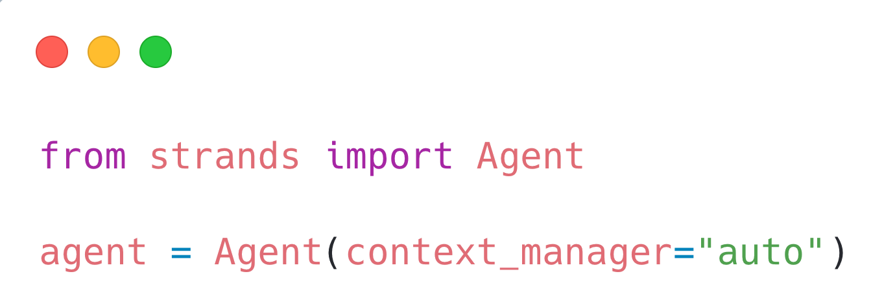
Context management in one line
Offload large tool results with on-demand retrieval
Summarize older messages as context fills
Notes:
The custom offloading and summarization strategies from the previous slide are available as a built-in default: Agent(context_manager=“auto”).
Automatic mode offloads tool results above 1,500 tokens, keeps a 750-token preview, and registers a retrieval tool for the full content. At 85% context utilization, it summarizes older messages while preserving the four most recent messages. These defaults differ from the custom thresholds on slide 15.
This configures context management for a standard Strands Agent. It does not automatically add long-term memory, skills, or subagents. The following examples use the same parameter on each agent. The Context Manager strategy API remains experimental.
Source: https://strandsagents.com/docs/user-guide/sdk/context-management/built-in-modes/

Slide 17
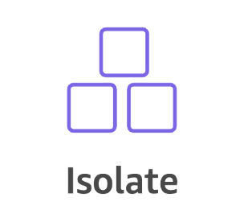
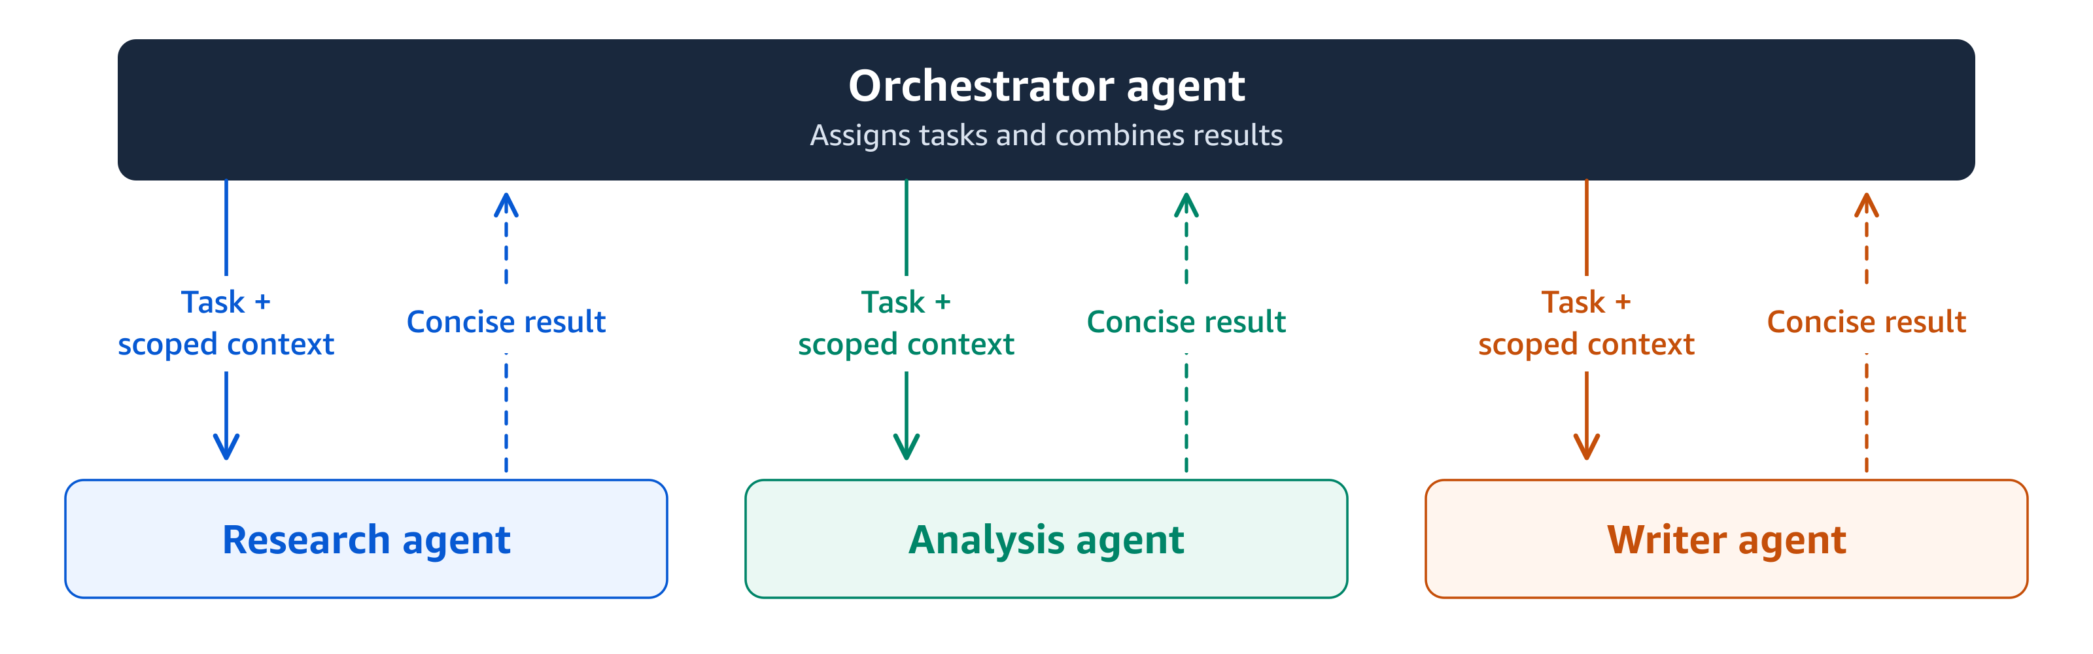
Context-Isolated Subagents
Notes:
Use multi-agent systems or agent as tool to isolate messy or noisy context into subagents to boost reliability and performance across the system. Be aware though that this can drive up token costs. There is a tradeoff to be made.

Slide 18
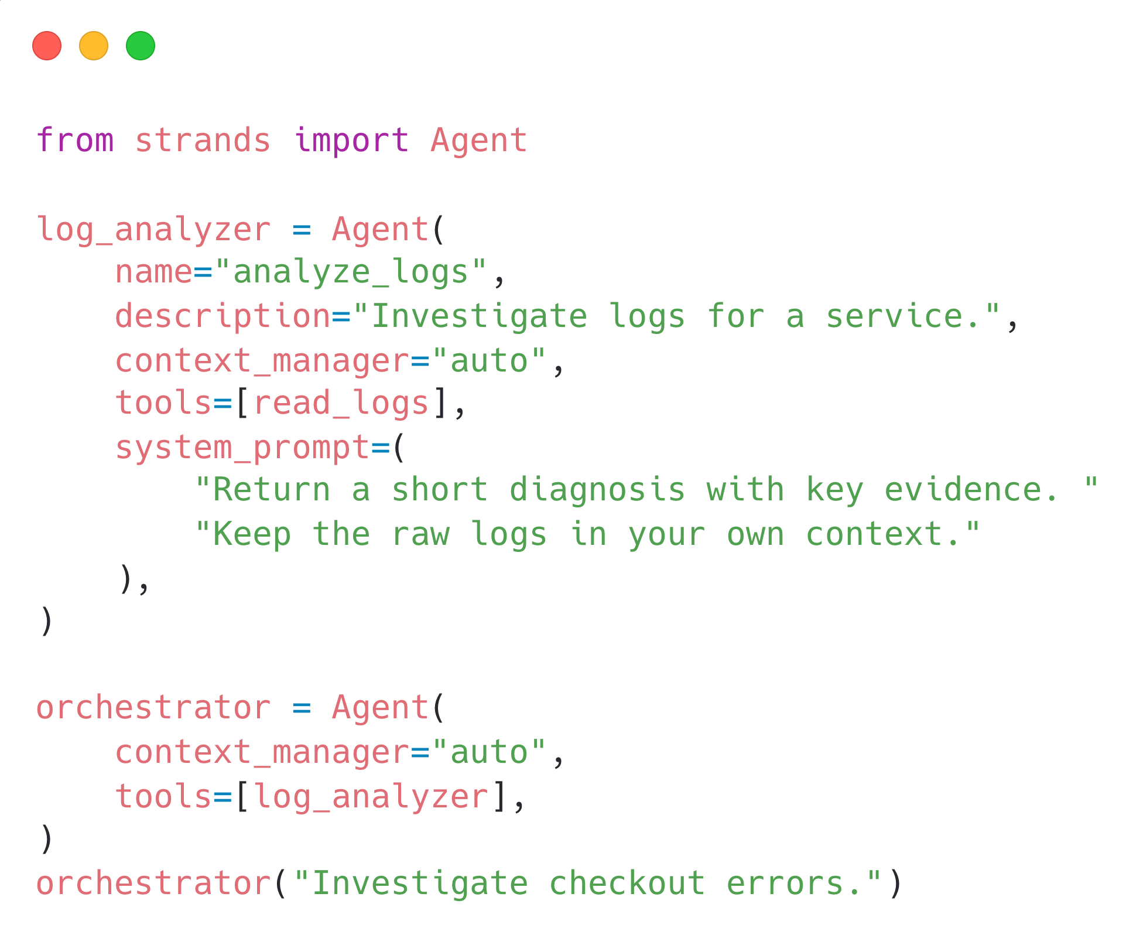
Notes:
Name and describe each subagent so the orchestrator can call it as a tool. The log analyzer keeps its own conversation and raw tool results, then returns a concise diagnosis to the parent. read_logs is an application-defined tool; its definition is omitted on this slide. Each agent opts into automatic context management.
Source: https://builder.aws.com/content/3J36U47bvNh8qnt6KgNPUVP08q1/quit-tokenmaxxing-4-tips-for-context-engineering-with-code-samples

Slide 19
One-line default for context engineering
Context offloading
Summarization with proactive compression
Real-code investigation benchmark: 55% lower cost; accuracy 68% → 98%
Notes:
Automatic mode offloads tool results above 1,500 tokens to a 750-token preview and summarizes at 85% utilization, preserving four recent messages. The defaults differ from the custom thresholds on slide 15. This parameter configures SDK context management; Strands Harness adds the broader agent setup. Agentic mode gives the model tools to summarize, truncate, and pin context, with automatic safety nets.
The reported 55% cost reduction and accuracy increase from 68% to 98% apply to the Strands real-code investigation benchmark, not every workload or a general Harness comparison.
Sources: https://strandsagents.com/docs/user-guide/sdk/context-management/built-in-modes/
https://strandsagents.com/blog/reduced-cost-better-isolation-more-resilience/

Slide 20
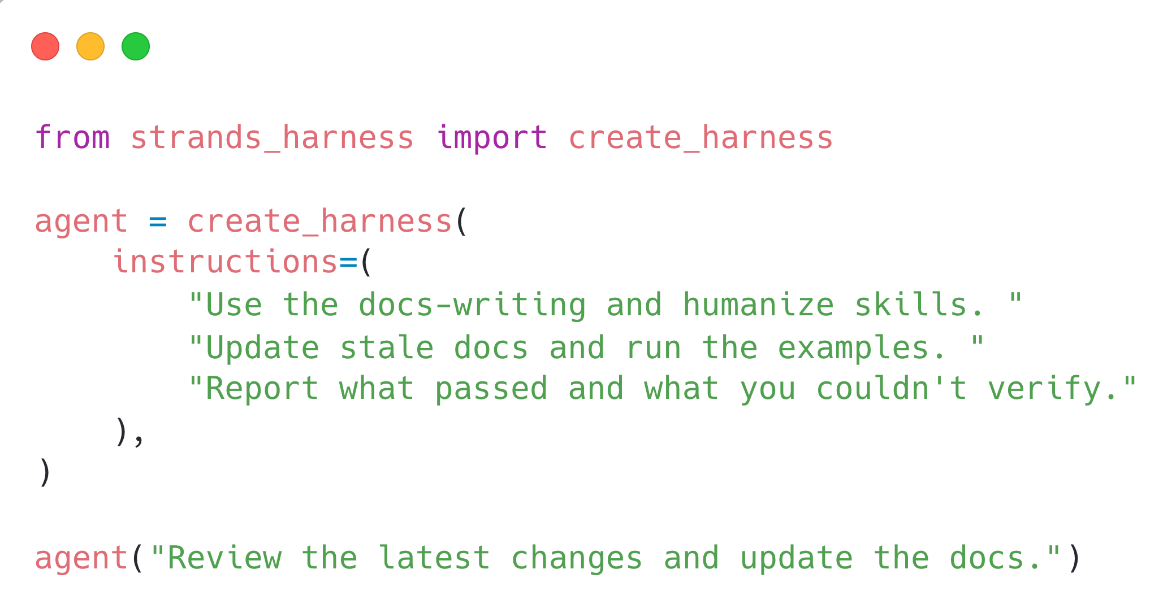
Strands harness
Context management and vended tools
Skills and isolated subagents
Sessions and long-term memory
Notes:
Strands Harness assembles context management, vended tools, skills, subagents, sessions, and long-term memory into a configured agent. create_harness returns a standard Strands Agent that you can extend. Put the docs-writing and humanize skill folders under .agent/skills for this example. The surrounding CI workflow checks out changes, restores persisted files, runs the agent, and handles pull-request creation; those workflow steps are separate from the harness call. This Python pattern adapts the TypeScript documentation-agent story in the Harness blog.
Sources: https://strandsagents.com/docs/user-guide/harness/quickstart/
https://builder.aws.com/content/3JgWF0T6PorfoRq7EdgkwO3F96P/stop-starting-from-scratch-build-agents-with-strands-harness

Slide 21
Try it Yourself
Thank you!
Examples using Strands
Notes:
Code and references:
https://builder.aws.com/content/3J36U47bvNh8qnt6KgNPUVP08q1/quit-tokenmaxxing-4-tips-for-context-engineering-with-code-samples
https://builder.aws.com/content/3JgWF0T6PorfoRq7EdgkwO3F96P/stop-starting-from-scratch-build-agents-with-strands-harness
https://strandsagents.com/docs/user-guide/sdk/context-management/
https://strandsagents.com/docs/user-guide/harness/quickstart/

